Slide 1
Melbourne High School
Choice Programs
Keith Barton – Assistant Principal
Kelly Persing – Guidance Counselor

Slide 2
What are choice programs?
Each high school has programs you can apply to. You ONLY need to complete the application process if you live OUTSIDE the zoned area of that school.
Choice Programs are different from Choice Schools
Choice Schools – only way to attend that school is through an application process
Choice Programs – you apply to a particular program within a school and must complete that program while you attend. This is referred to as Education Program Opportunity (EPO).
Chosen program cannot be offered at your home school
Only programs available to you will show
Your program commitment is priority over other elective/class choices
Quick Vocabulary Lesson
CTE = Career and Technical Education
Students are required to take a sequence of 3 CTE classes (complete a program) or 3 honors classes to earn a diploma

Slide 3
Application Process
EPO application window opens January 10th and goes through February 28th
Apply through district website - Open Enrollment - Parental Choice / Open Enrollment-Parental Choice Home (brevardschools.org)
Departments & Programs > Open Enrollment – Parental Choice
All applicants enter a lottery operated by the district office, not at the school level
You will be asked to upload two proofs of residency in the application process. If you commit to our school you will be asked to provide those proofs of residency again in the spring during our normal school registration.
Pay close attention to grade level and enter as it is asked
You will receive a course selection form after committing to your program.
Must renew every year
Your program commitment is priority over other elective/class choices

Slide 4
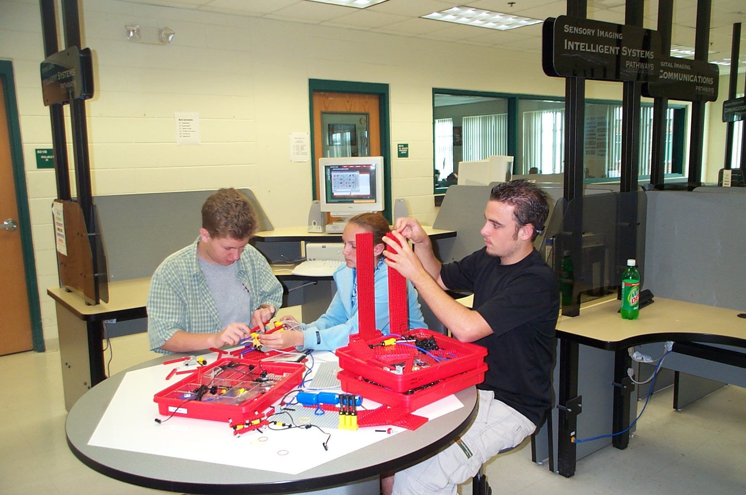
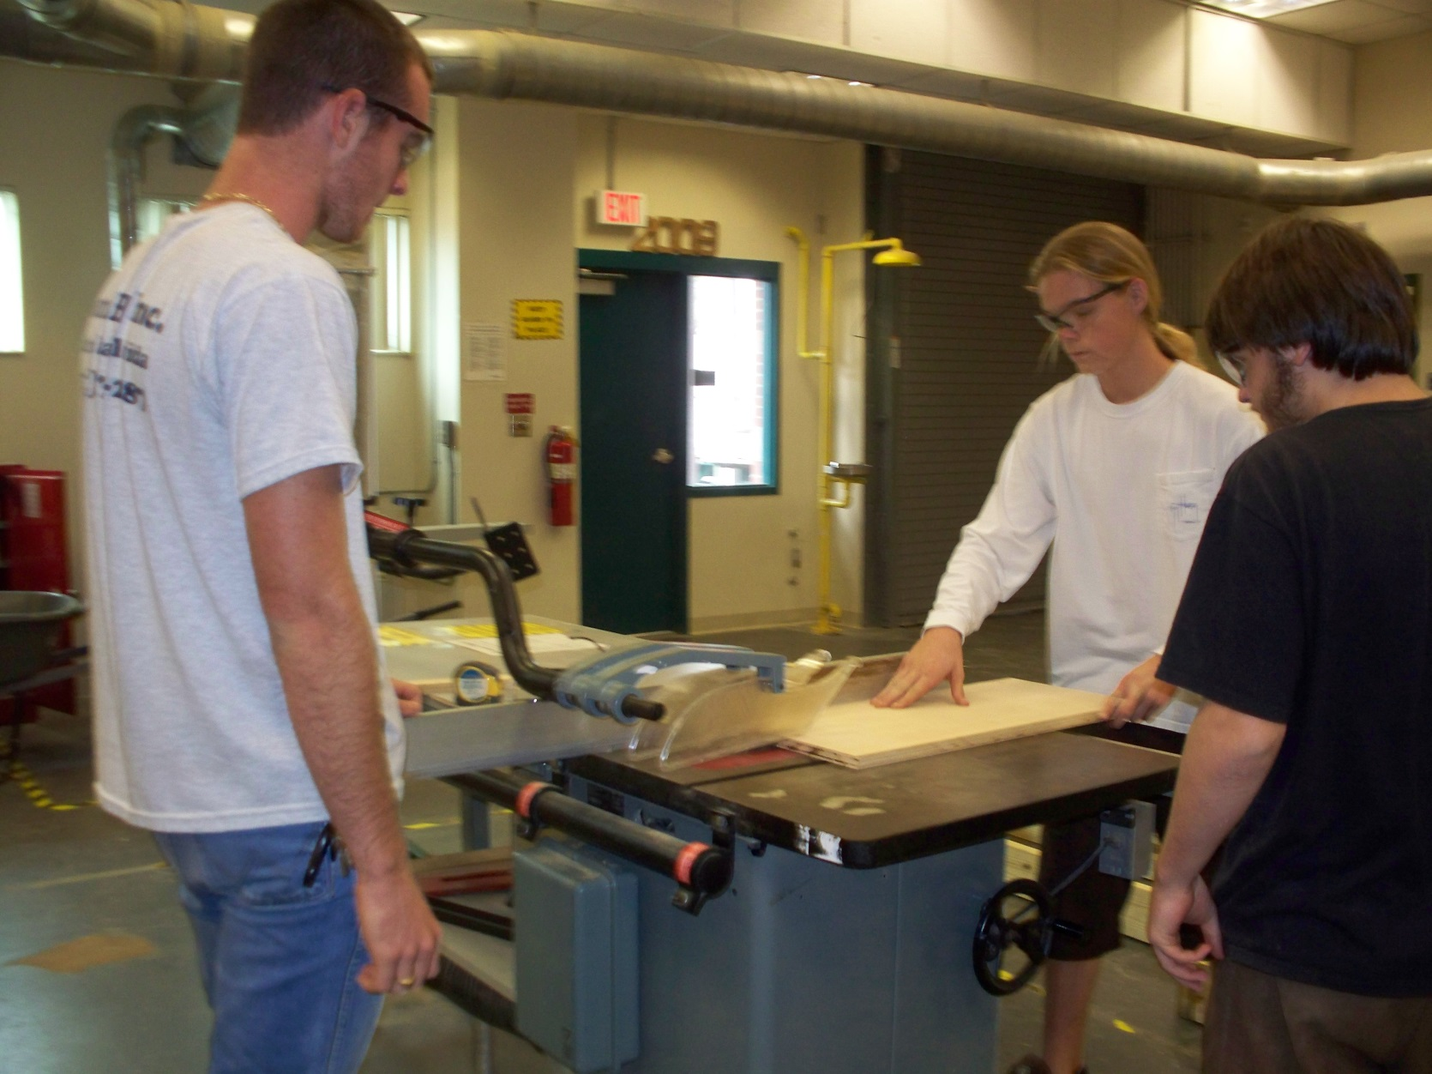
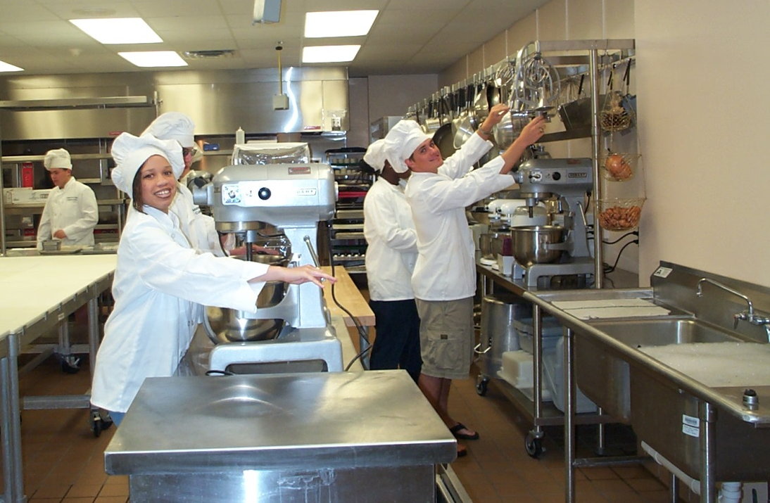
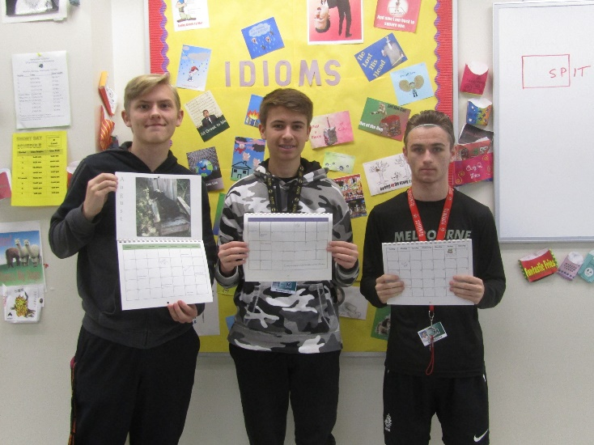
Programs at MHS
Applied Cyber Security
Certification: Microsoft Office Suite
Applied Engineering Technology
Certification: Solid Works
Building Construction
Certification: Home Builders Institute
Culinary Arts
Certification: ServSafe
Digital Design
Certification: Illustrator, Photoshop, InDesign
First class is Digital Information Technology

Slide 5
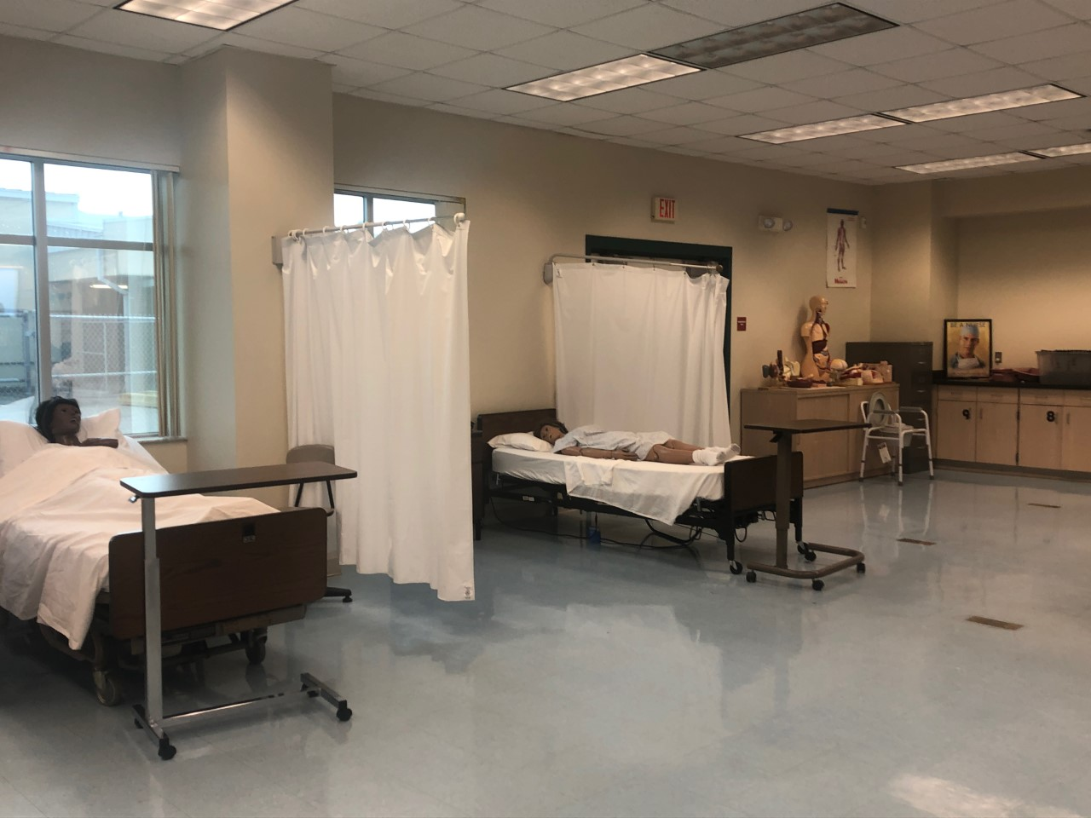
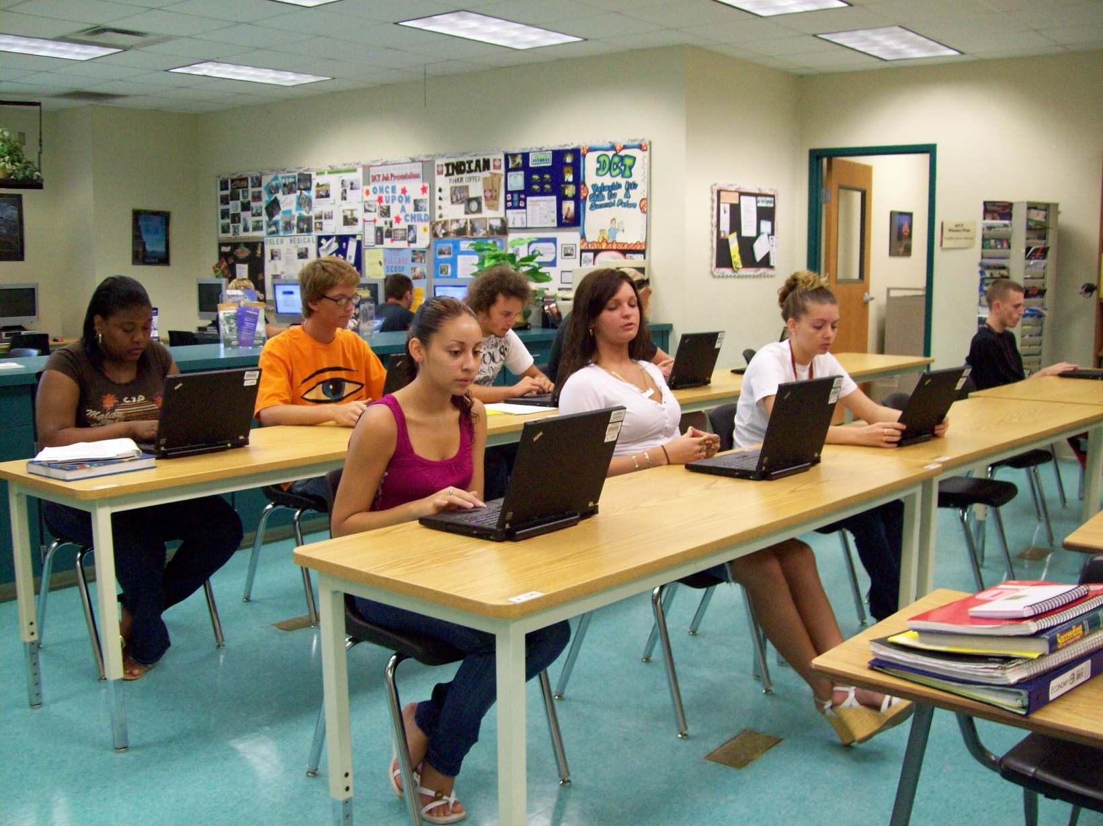
Programs Continued
Emergency Medical Responder (EMR)
International Business
Certification: Microsoft Office Suite
Patient Care/Nursing Assisting
State of Florida Certified Nursing Assistant License (CNA)
Limited Program
IB Diploma (slightly different, more info next)

Slide 6
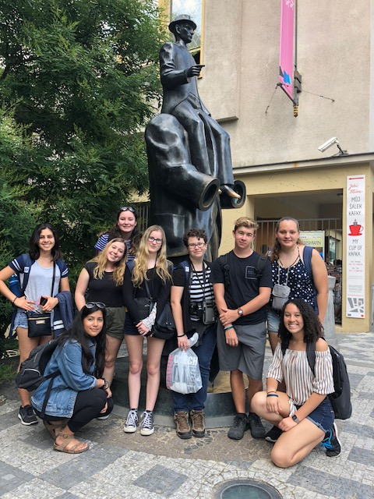
Students apply through District Application
(All students whether zoned or not zoned for MHS)
Applications open January 10th and close February 28th
The Diploma Program provides students:
An in-depth curriculum for academic preparation necessary for college
A program where students flourish physically, intellectually, emotionally and ethically
Study of English and a second language
Exploration for the nature of knowledge through the two-year course: Theory of Knowledge

Slide 7
Students apply through District Application
(All students whether zoned or not zoned for MHS)
Applications open January 10th and close February 28th
PreIB Diploma Program (9th and 10th grade):
Pre DP coursework + two electives each year
Must have completed Algebra I and Spanish I or French I
Graduation requirements are not the same as non-IB graduates
IB Diploma Program (11th and 12th grade):
Junior and senior students
Allows student choice in curriculum
Prepares students for college
IB Diploma = highest Bright Futures Award
May take AP and dual enrolled courses
College level courses (may earn college credit)
For any questions about the IB Diploma Program at Melbourne High School
IB and Diploma Program Coordinator
Jennifer Mason
Mason.Jennifer@brevardschools.org

Slide 8
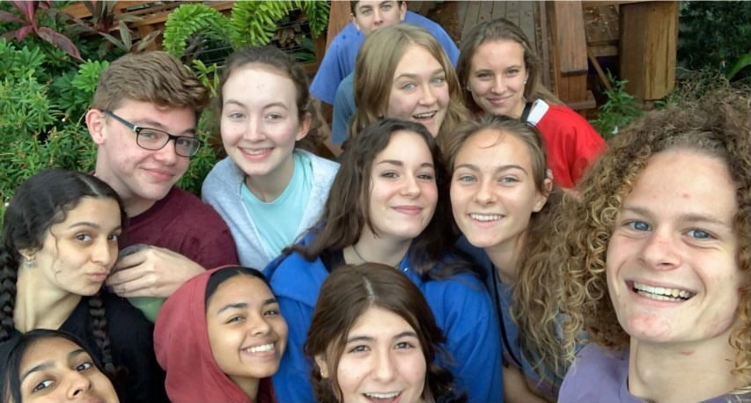
Students apply through School-based application
(once enrolled at MHS and have chosen a CTE pathway)
The Career Program provides students:
Earn industry certification through Career and Technical Education classes
Take 2 IB Diploma courses (earn college course credit)
Learn about personal and professional skills and how to use them for career or college
Benefit personally from a greater depth of post-graduation preparedness for the future
Make High School Meaningful
Individualize the high school experience through class choice, engaging in learning that interests the student, and meeting personal goals.

Slide 9
Students apply through School-based application
(once enrolled at MHS and have chosen a CTE pathway)
PreIB Career Program 9th and 10th grades
PreCP coursework = core + CTE + electives
No prerequisite courses
Must complete Florida State graduation requirements
IB Career Program 11th and 12th grades
Allows student choice in curriculum
Prepares students for college and career
Students earn career/industry certification
Take two DP courses, may take AP and dual enrolled courses
For any questions about the IB Diploma Program at Melbourne High School
IB and Diploma Program Coordinator IB Career Program Coordinator
Jennifer Mason Lesley Cosgrove
Mason.Jennifer@brevardschools.org Cosgrove.Lesley@brevardschools.org

Slide 10
High School Pointers
GPA matters!
Dual Enrollment, Sports, 2.0 required to graduate, clubs, etc.
Don’t dig a hole in your freshmen year, you will spend the rest of high school trying to get out
Get Involved!!
We have over 25 different clubs, many different sports, and several activities like drama, band, orchestra and chorus.
Opportunities for everyone!
https://tinyurl.com/melhi-homeroom
Course Selection
Will happen for all zoned students in the spring
Make sure you will be okay being in your 4th and 5th choice elective
Don’t pick based on what your friends are doing, pick something that interests YOU!

