Slide 1
Advanced Placement
Informational Presentation
Melbourne High School
Jim Meegan, AP Coordinator

Slide 2
Purpose of Tonight’s Meeting
Provide general information about our AP Program
Initiate a discussion about the options for courses of academic study for your child
Address general myths and specific questions
Discuss the course selection process, which begins in February

Slide 3
The Basics of AP
Advanced Placement Program® (AP®) courses are college-level courses offered in high school. AP courses reflect what is taught in top introductory college courses
At the end of course, students take AP Exams—standardized exams that measure how well students have mastered college-level course work.
Students who do well on AP Exams can earn credit and/or placement into advanced courses in college.

Slide 4
The Benefits of AP Courses
AP teachers are among the most prepared, dedicated, and inspiring teachers at their schools.
AP courses can be challenging, but it’s work that pays off.
AP students develop confidence, and learn the study habits and time management skills essential for success in college.

Slide 5
What are AP Courses Like?
Classes tend to be fast-paced and cover more material than typical high school honors classes.
AP teachers expect their students to think critically, analyze and synthesize facts and data, weigh competing perspectives, and write clearly and persuasively.
More time, inside and outside of the classroom, is required to complete lessons, assignments and homework.

Slide 6
AP Courses Offered by Our School:
Art History
Biology
Chemistry
Calculus AB
Calculus BC
Computer Science Principles
Computer Science A
English Lang & Comp
English Lang & Lit
European History
Human Geography
Microeconomics
Physics 1: Algebra-based
Physics C: Mechanics
Psychology
Statistics
Studio Art/ Drawing
U.S. Govt & Politics
U.S. History
World History

Slide 7
Brevard County AP Diploma
Our county recognizes AP students who rise above other students
Complete a minimum of six (6) full-year AP courses (or a combination of full-year courses and semester courses totaling six credits) and earn a score of 3 or higher on each of the exams for the courses selected
The courses must be chosen from at least three different subject areas of the six subject areas designated by the county

Slide 8
Why Take AP Exams?
“I took AP throughout high school because it was a challenging program.
When I reached college, I realized that I had accumulated a year’s worth of credits.
I graduated from Michigan’s undergraduate business school a full year early, saving $30,000 and a year’s time.”
—Nikki Baker, University of Michigan
More than 3,200 colleges and universities offer credit or advanced placement for qualifying AP Exam scores.
This includes more than 90 percent of four-year U.S. colleges and universities.

Slide 9
AP Credit Expands Students’ Options
College credit earned through AP Exams allows students to move into upper-level college courses sooner, pursue a double major, and gain time to study and travel abroad.
“As a freshman, I was able to skip general education requirements and head straight into the higher-level classes I wanted to take. Taking AP Exams literally saved me semesters of time.”
—Brent Wiese, University of Iowa

Slide 10
AP and College Admission
Colleges rank “Grades in college prep courses” and “Strength of curriculum” as the top two factors in the admission decision.*
85% of selective colleges and universities report that a student’s AP experience favorably impacts admission decisions.
“We look favorably on students who have taken AP courses. The presence of AP courses is a sign that a student has chosen to challenge him/herself.”
— Vanderbilt University Admission Officer

Slide 11
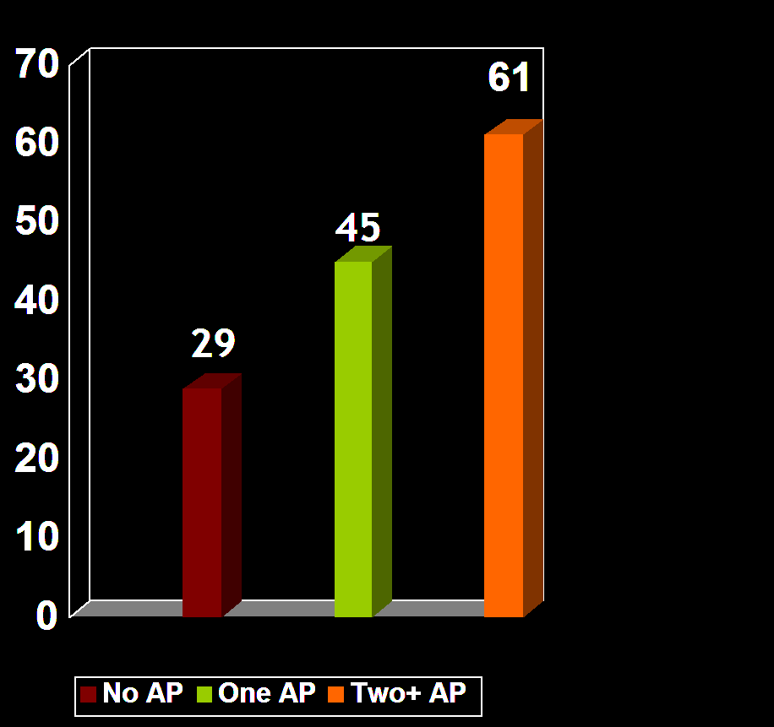
AP and College Success
Students who take AP courses and exams are much more likely than their peers to complete a bachelor’s degree in four years or less.
Source: Camara, Wayne (2003). College Persistence, Graduation, and Remediation. College Board Research Notes (RN-19). New York, NY: College Board.

Slide 12
For More Information
Contact the Melbourne High School Guidance office
Contact Jim Meegan, MHS AP Coordinator
Information about AP credit and placement policies at many colleges and universities is now available on the College Board’s Web site:
www.collegeboard.com/ap/creditpolicy

