Slide 1
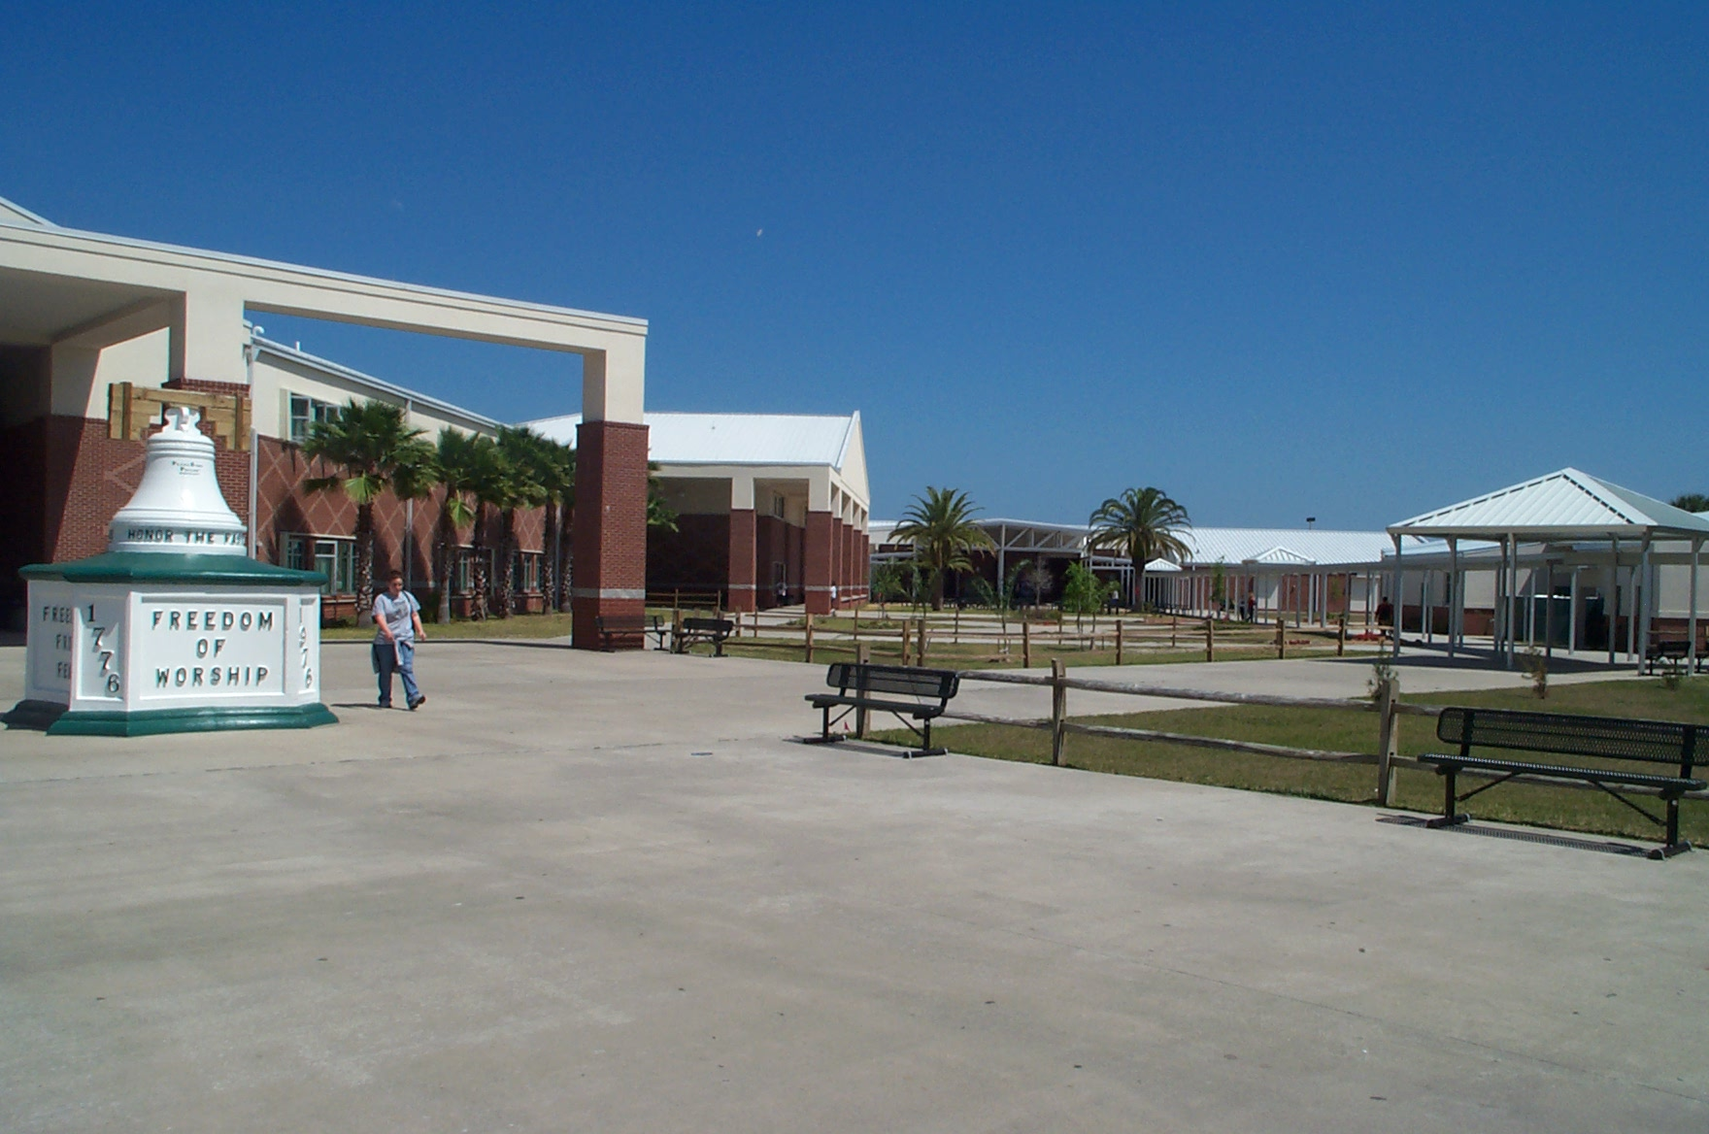
Welcome Sophomores
CLASS OF 2025

Slide 2
WHO IS MY COUNSELOR?
Last Name:
A - BR Ms. Canose
BS - GN Ms. Farrow
GO - MAN Ms. Weinstein
MAP – RI and ESOL Ms. Manhart
RO - Z Mr. Boos
College and Career Counseling Ms. Persing
IB Program Ms. Mason
How do I make an appointment?

Slide 3
GRADUATION Requirements for High School (4-years, 26 credits)
4 credits English
4 credits Math – must include Algebra I and Geometry
3 credits Science – sequence: Bio, Chem, Physics
3 credits Social Studies – World History, US History, US Gov and Econ
1 additional Science OR Social Studies Elective Credit
.5 credit Career Research & Decision Making (9th grade year)
1 credit Health Opportunities for Physical Education (HOPE)
1 credit performing fine art
8.5 credits electives
Total 26 credits*
* Earn cumulative GPA of at least a 2.0
* Rigorous Course requirement: 3 credits in rigorous courses (Honors, AP, or EFSC Dual Enrollment) OR 3 credits in one career technical education (CTE) program.
* Also, must successfully complete an online course

Slide 4
GRADUATION REQUIREMENTS FOR ALL
Students must demonstrate reading, math, and writing proficiency on the 10th grade test.
* Any student who scores a 1 or 2 on the FSA in reading/writing must take Intensive Language Arts Remediation.
All students must pass the Algebra 1 EOC (Level 3 or higher)
Other acceptable test options:
ACT average of reading/English score – 18
SAT evidenced based reading and writing – 480
SAT math section only – 420
ACT math section only – 16
PSAT math section only – 430
All information above is subject to change with new legislation

Slide 5
Performing/Fine Arts Credit
Art (2D or Ceramics)
Culinary Arts 2 and 3
Digital Information Technology
Digital Design
Engineering 1, 3
Music (Band, Orchestra, Chorus)
Theatre, Musical Theatre, or Technical Theatre
Note: 2 years of ROTC = 1 credit HOPE & 1 credit Performing/Fine Arts

Slide 6
Accelerated Programs (meets rigorous course requirement)
*Advanced Placement
AP World History
AP Computer Science Principles
AP Human Geography
AP Government
AP Biology
AP Chemistry
AP Physics
AP US History
AP Microeconomics
AP English Compo
AP English Lit
AP Calculus AB and BC
AP Statistics
Teacher Recommendation Required
See Mr. Meegan for details

Slide 7
Accelerated Programs (meets rigorous course requirement)
*Dual Enrollment
AA Degree Courses (3.0 GPA) & Test Scores
AS Degree Courses (2.5 GPA) & Test Scores
Vocational Courses (2.5 GPA) & Test Scores – very limited
Early College Program
Invited semester 2 9th grade based on 3.0 GPA
Get Bus to EFSC in 10th grade
Tracked specifically for AA degree
Part Time Dual Enrollment
Must meet qualifications – GPA, test scores, orientation
Want to get some college classes and experience
Transportation is not provided
Early Admissions – Senior Year
3.0 GPA by the end of junior year & test scores
Meet with counselor to plan early! (most HS graduation requirements must be completed prior to acceptance)
*See Ms. Persing for more information

Slide 8
Accelerated Programs (meets rigorous course requirement)
*IB Career Program
Must choose a career path (CTE)
Take as an elective each year for 3 years
2 IB courses & Personal/Professional Skills course
Take Junior & Senior year
1 IB course each year
*See Ms. Mason for more information

Slide 9
Career & Technical Education (CTE) Programs at Mel High (must complete 3 years in the same program)
Applied Engineering
Building Construction
Culinary Arts
Cyber Security
Digital Design
International Business
Emergency Medical Responder (HS Foundation, Anatomy & Physiology, EMR)
Patient Care Technology (dual enrollment, senior year only, application required)
AFJROTC

Slide 10
Online Course
Requirement is to complete a course
Any course through FLVS/BVS counts
You can take Career Research or Hope online during the summer if you haven’t taken it in school yet.
Make MHS your school on your FLVS account

Slide 11
PROMOTION STATUS
You must have 5 credits to be promoted to 10th grade.
Semester grade of “D” or better = .5 credit
Algebra 1, Geometry, US History, and Biology are considered yearlong courses. Credit earned is based on the final grade at the end of the year which includes the EOC as 30%. Final grade of “D” or better = 1 credit
11th – 11 credits, 2 English & 2 Math
12th – 18 credits, 3 English & 3 Math

Slide 12
How to Make-Up Failing Classes
(Grades of D/F only)
Retake possibilities:
Summer school (Failures only, if funded)
Adult Education night school (16 years old if available)
On-line courses through FLVS
Credit recovery (only available junior and senior year)
*See counselor for further details.

Slide 13
CAREER AND COLLEGE GOALS
Career interests affect educational needs.
Do some Career Research
Think about your Personal Interests
Where do you want to go after graduation?
University, Four Year College Program
Community College
2 + 2 Program
Career Programs
Direct Employment or Military Enlistment

Slide 14
FLORIDA BRIGHT FUTURES SHOWS YOU THE MONEY $$$$
Community service does not count for Bright Futures UNTIL a work plan is submitted and approved by Guidance.
Have to complete 8th grade before hours can count.
Florida Academic Scholar
3.5 weighted GPA
16 credits of college preparatory academic courses
Best composite score of 1340 SAT or 29 ACT
Combination of 100 hours community service or work hours
Florida Medallion Scholar
3.0 weighted GPA
16 credits of college preparatory academic classes
Best composite score of 1210 SAT or 25 ACT
75 hours community service or combination of 100 work/community service hours
**Must have two years of the same foreign language**

Slide 15
FLORIDA BRIGHT FUTURES SHOWS YOU THE MONEY $$$$
FLORIDA GOLD SEAL SCHOLAR
3.0 Weighted GPA
No Foreign Language requirement
Higher level math classes are not required
3.5 GPA in 3-year Voc/Tech Program
SAT, ACT or CPT qualifying test scores
30 hours community service

Slide 16
ACTION PLAN FOR 10TH GRADE
Get serious and organized about schoolwork!!
Work on maintaining a decent GPA (necessary for Bright Futures and dual enrollment.
Start working on a CTE program and/or honor courses to meet graduation requirements.
Get involved in clubs and extracurricular activities.
Choose high school courses carefully.
Prepare for the PSAT in the fall
Think:
Where do you want to be in three years?
How will you get there?

Slide 17
Course Requests
Course requests were collected from students in the spring after meeting with your guidance counselor
Math, English and Social Studies placements are based on current teacher recommendations
Any accelerated course must have teacher permission
Remember, these are requests not the students actual schedule, no courses are guaranteed

Slide 18
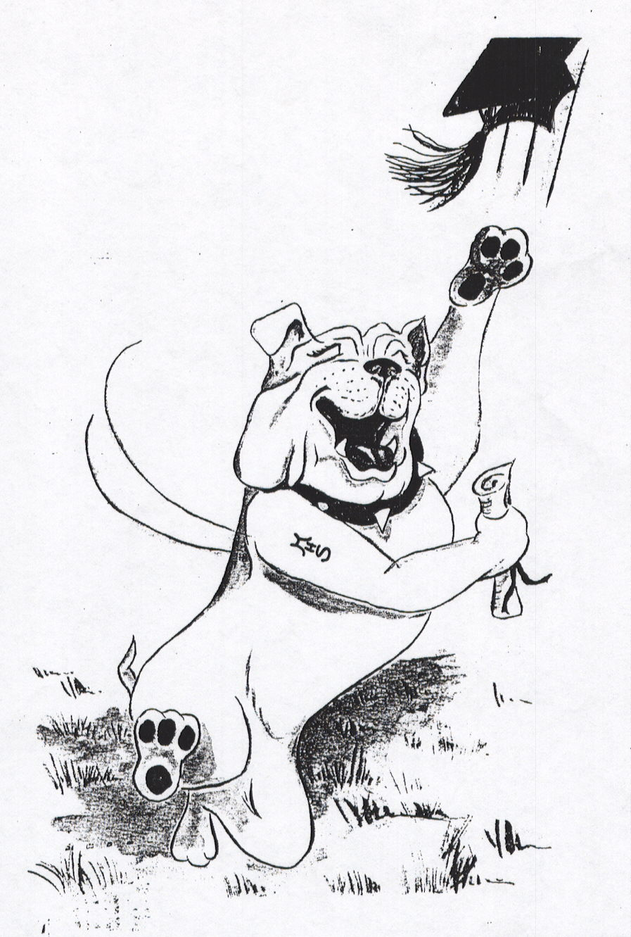
Ultimate Goal:
MEL
HIGH
Class of
2025!

Slide 19
WELCOME BACK BULLDOGS!!

Slide 20
MR. LINDE – 9TH GRADE

Slide 21
MS. PEREZ – 10TH GRADE

Slide 22
MS. KILMER – 11^{TH &} 12TH GRADE

Slide 23
MR. MEEGAN – FACILITIES

Slide 24
MS. WILLIAMS - CURRICULUM

Slide 25
Dr. KIRK - PRINCIPAL

Slide 26
MR. RAYMOND – ATHLETIC DIRECTOR

Slide 27
DRESS CODE – DO’S AND DON’TS
Do’s
Understand that you not only learn academics here, but also learn that there are different ways that you should act and dress according to where you are and what you wish to accomplish. There is a difference between very casual, semi-casual, and less casual ways of dressing and behavior.
Very Casual Semi -Casual Less Casual
Home /Beach School Job Interview/Work

Slide 28
DRESS CODE – DO’S AND DON’TS
Don’ts
Head
No hats indoors
No hoodies up
Upper Garments
Undergarments showing
Midriff showing
Tops (or dresses) that are strapless/backless/halter/transparent/tube
Low-cut necklines

Slide 29
DRESS CODE – DO’S AND DON’TS
Don’ts
Lower Garments
Lowriding
Immodest holes and/or rips
Shorts that do not completely cover the buttocks
See through/sheer leggings or yoga pants
Accessories/Clothing Design
Crude, vulgar, profane, violent, death-oriented, gang related, sexually suggestive, promoting alcohol, drugs or tobacco
Connected piercings, dog collars, wallet chains, large metal hair picks

Slide 30
Some don’ts

Slide 31
NEW WCD BOARD POLICY!!!
WE CANNOT RETURN THE DEVICE TO A STUDENT, IT HAS TO BE A PARENT!!

Slide 32
FILMING OTHERS ON CAMPUS
Two day OSS
30 day revocation of cell phone privileges on campus.
Posting Video/Audio on any Social Media
Three day OSS
Student not allowed to bring cell phone to school for rest of year.
Automatic suspension if you are caught with any cell phone for the reminder of the year.

Slide 33
Bad choices/ NOT Negotiable
Disrespect, Willful Disobedience, Bullying/Harassment – NEVER accepted here = severe consequences
Classroom Disruption – Really? Why? You are HERE to learn, grow, and graduate. Period. If this is not your goal, you will not be allowed to interfere with the learning of other students.
Fighting – NEVER accepted here = 3 Days Out – Minimum
Vaping/Cigarettes/Other smoking – No, not allowed. Civil Citation = Court/Fines/Community Service/1 Day Out - Minimum
CBD/THC – Will result in Expulsion Hearing/Could also result in Felony Charges
Skipping – Consequences not only disciplinary, but can result in FDA = Off Graduation Track!

Slide 34
DISCIPLINE OUTCOMES All referrals WILL RESULT IN A Student conference and parent/caregiver communication
Dean’s Detention
Detentions will be held after school
Detentions will be 60 minutes in length
Students will be expected to bring school work or a book to read
No cell phone usage is allowed
Failure to attend will result in an in-school suspension

Slide 35
DISCIPLINE OUTCOMES
In-School Suspension (ISS)
You will spend the day in the in-school suspension room, including lunch
You will have timed periods to work on assignments from your classes
You will do a reflective writing assignment
There is no talking, eating, sleeping or cell phone use
Failure to follow rules will result in an immediate removal and out-of-school suspension and upon your return to school you will be returning to ISS

Slide 36
DISCIPLINE OUTCOMES
Out-of-School Suspension
You will not be allowed on any school board property, which includes any after-school activities for the duration of the suspension
Receiving such suspension will result in your being on the No Go List which means you cannot attend Homecoming, Prom, Grad Bash, field trips, or any school functions
Athletes will be removed from their team when they receive their 2nd suspension within their season (practice to post-season)

Slide 37
ATTENDANCE
9 Days per semester
Doctor, religious, and court absences do not count against your 9 days per semester.
When absent, submit documentation to attendance office.
Parent notes/phone calls are NOT excused absences.
Absences are counted per period/ NOT by the day.
Over 9 absences will result in a failure due to absence grade.

Slide 38
TARDY TO CLASS OR SCHOOL Yes - if you are tardy to school, you are considered tardy to 1st period
If you are tardy to school, provide documentation to the attendance clerk
Your teacher will handle the discipline for the first two tardy incidents
Your third tardy will result in a discipline referral and a Dean’s detention
Continued tardy incidents will be viewed as willful disobedience
Your parking permit may be REVOKED for excessive tardiness

Slide 39
Speakout hotline
Why Call SpeakOut Hotline?
SpeakOut Hotline wants every student to know - telling isn't 'snitching'. Telling is when you need to keep yourself or someone you know safe from threats, harmful behaviors or dangerous situations.
To make a report, call 1-800-423-TIPS from anywhere, 24 hours a day, seven days a week. The call is free.
You may also make a web-tip by clicking here now.
Or text "SPEAKOUT" plus your tip information to CRIMES (274637).
You will always stay 100% anonymous! No one will ask for your name or number. There is no caller I.D., no I.P. tracking, and no call recording. We only want the information that you have to provide so that we can help.
Afraid to call SpeakOut Hotline? Think someone else will probably call? Stand up and stay anonymous!
We need your help to improve your school and community. By calling, you can help stop a fight, stop a bully from torturing your classmate, or stop a gang from recruiting a fellow teen. If you have information about the following topics, please call.

Slide 40
MINGA
Digital ID – You won’t need to carry your plastic ID card
School updates – Events/Clubs/Athletics
Teachers will be using this to send out messages to specific student groups
DOWNLOAD THE APP
SIGN IN WITH YOUR BPS SHARE ACCOUNT/GOOGLE

Slide 41
What do we expect from you?
You show up, every day, ready to learn and ready to work
You respect your teachers, your peers, the staff, and yourself
Own your behavior
You understand that your goal is to graduate and be ready for the next phase of your life

