Slide 1
Financial Aid Overview Melbourne High School October 12, 2021 Guidance Department
Notes:
Welcome to the financial aid overview presentation. This presentation is specifically for high school students graduating in the 2020-2021 academic year and then enrolling in a post secondary institution for the 2022-2023 academic year.
It is brought to you by the Office of Student Financial Assistance, a division of the Florida Department of Education.
Upon completion of this presentation you will gain a better understanding of the overall financial aid process for all post secondary institutions.
My name is Pedro Hernandez, Outreach Director, here at the Office of Student Financial Assistance. It is my pleasure to guide you through this process.

Slide 2
Agenda
Navigating Your Financial Future
What is financial aid?
Where do I find financial aid?
How and When do I apply?
Who can help me?
Notes:
The goal of this session is to understand of the entire financial aid process. This will be accomplished by reviewing the following four questions:
What is financial aid?
Where do I find financial aid?
How and when do I apply?
Who can help me?
After this brief yet comprehensive review, you will be able to better understand the entire financial aid process and make informed decisions pertaining to funding a postsecondary education.

Slide 3
What is Financial Aid?
Monies received from Four Sources: Federal, State, Institutional or Private
Monies are also categorized as:
Gift aid (Free $$$$ grants, scholarships)
Self-help (student loans and work study)
Need-based (grants, scholarships, work-study and loans)
Merit-based ($$ awarded on academics, athletics, artistic or special interest)
Can cover direct or indirect costs
Notes:
Let us begin by answering the first question: what is financial aid?
Financial aid is defined as monies received from the (4) major sources federal, state, institutional or private resources.
Federal aid includes funding such as the Pell Grant, Federal student loans, and federal work study.
State financial aid offers a variety of state-funded scholarships and grants that are administered by the FDOE/OSFA and subject to change each year during legislative session.
Institutional aid are monies offered directly from the postsecondary school.
Private resources include a variety of scholarships from various groups such as local employers, national organizations, and community groups.
It is important to research and apply for each of these resources.
Financial Aid May also viewed into the following different categories:
Gift aid – this is free money that DOES NOT require repayment as long as the student meets the parameters outlined for each grant or scholarship. Students should always consult with a financial aid administrator prior to making any schedule changes to determine what repercussions the schedule changes will have on their financial aid awards.
Self help – this can be as easy as taking part of your earnings as applying it toward your college expenses. Students should check with their employer (or potential employers) regarding any tuition assistance or reimbursement programs being offered. Student loans are also considered as a form of “self” help, but should only be used as a last resort.
Need-based – monies awarded based on the applicant’s Free Application for Federal Student Aid (FAFSA). Therefore, it is important to complete your FAFSA as soon as possible. While the Pell Grant is an entitlement program, other need-based monies are awarded on a first-come, first-serve basis.
Merit-based – merit-based monies are available through a variety of avenues that we will discuss throughout today’s presentation. For example, Bright Futures is a merit-based program.
College costs include tuition, fees, and books, along with other expenses such as: transportation, food, housing, clothing and computer costs. Cost of attendance can vary from institution to institution, so check your college’s website for additional information. Financial aid monies can be used toward all items included within the cost of attendance.

Slide 4
College Costs
COA=Cost of Attendance varies from:
Institution to institution
In State vs. out of state
On campus vs. off campus
Net Price Calculator
Requirement for every institution
Allows prospective students to enter information about themselves and find out what students like them paid to attend that college the previous year
Notes:
The cost of attendance (COA) varies from institution to institution. There are also variances between in-state and out of state schools and whether the student lives on campus or off campus. It is important to take this into consideration when researching at your options.
Cost of attendance traditionally includes both direct and indirect costs.
Direct Costs include tuition and fees.
Indirect costs include items such as books, food, transportation, housing, and computer.
A Great Resource to utilize: Net Price Calculator
Every school is now required to have a Net Price Calculator available.
You can use the Net Price Calculator to assist in analyzing your COA-Cost of Attendance at a specific school.

Slide 5
College Costs
Public 2-year college (tuition and fees, in-state) - $3,770
Public 4-year college (tuition and fees, in-state) - $10,560 (meal plan $4,000)
Public 4-year college (tuition and fees, out of state) - $27,020 (low end not including food)
Private 4-year college (tuition and fees) -
$37,650 (low end not including food)
Source: The College Board
Notes:
As we outlined on the previous slide, college costs include both direct and indirect costs.
Let us briefly review the average direct cost which is only tuition and fees per year at different types of institutions.
According to the College Board: The Average Yearly Tuition and Fees,
Nationally, In Florida Your specific school Direct Cost will be lower than the national average.
(read slide)

Slide 6
Free Application for Federal Student Aid (FAFSA)
Federal government is largest source of student aid; FAFSA distributed and processed by the U.S. Department of Education
Manual or electronic options
2022-23 FAFSA opened October 1
IRS Data Retrieval Tool opened October 1 and will allow students to import PRIOR PRIOR (2020) year tax data
Must be completed ANNUALLY (per academic year) to be evaluated for financial aid
www.fafsa.gov
Notes:
Where does one find financial aid? One essential step is completing the Free Application for Federal Student Aid (FAFSA).
While filing the FAFSA is not required, it is used by many institutions to determine need based financial aid provided by the school for FEDERAL/STATE/Institutional Programs!!
Please note that the first letter in the acronym FAFSA stands for FREE. Please make sure you are using the correct website: FAFSA.gov. or StudentAid.gov There are other websites that can assist you in completing the FAFSA for a fee. You do not need to pay someone to assist you in this process.
Three ways to submit the FAFSA:
On-line using your FSA ID to electronically sign the application –Highly Recommended
Submit information online and print signature page to be submitted by mail
Print out the entire PDF application from website and submit with signatures by mail
The 2022-232 application becomes available October 1. and not earlier!!
Applicants will use their 2019 tax information to complete the FAFSA. (Review your institution’s website to determine the priority deadline as deadlines vary from institution to institution. Also, please note that it is highly advisable to complete the application electronically and to utilize the IRS data retrieval tool.
It is recommended to file a FAFSA each year a student attends a postsecondary institution.

Slide 7
What type of form is FAFSA?
This is the form colleges use to determine a student’s eligibility for financial aid.
Financial aid comes in the form of grants, loans and work study.
FAFSA does not give you money but colleges use it to see what your ability is to pay for college and how much financial aid you would need if accepted to their school.

Slide 8
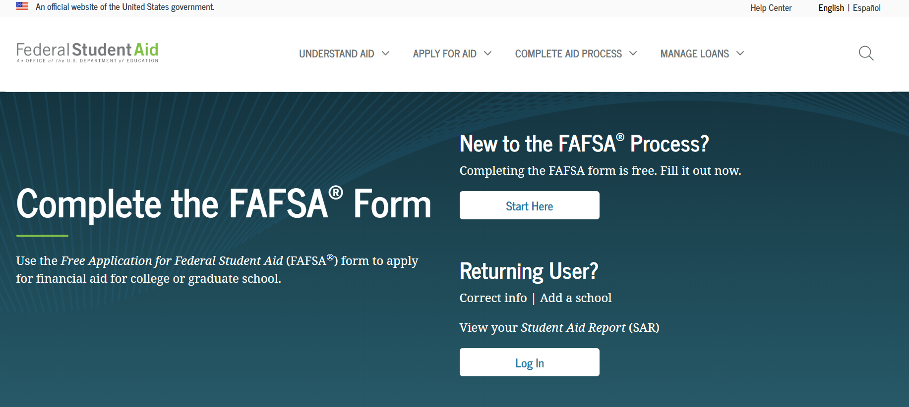
FAFSA.GOV
Help
Notes:
This is a screenshot of www.fafsa.gov. The reason that we show this screen shot is to ensure you are accessing the FREE website. If you feel that you need assistance in completing this application, there are built-in help resources available online. You can also reach out to a member of OSFA’s Outreach Services team, your high school counselor or a financial aid professional at your institution. We can all help you at no cost.

Slide 9
How do you get started?
Gather important data
Monitor priority deadlines
State and institutional deadlines vary
Confirm FAFSA dependency versus independency requirements
Dependent students are required to include parental information
Independent students are not required to include parental information
Search for school codes
Plan to sign and submit online using the Federal Student Aid (FSA) ID and FSA Password
Notes:
When completing the FAFSA, students will need to have their SSN, Alien Registration Numbers (if applicable), prior prior year tax returns or earning statements, untaxed income records, current bank statements, current business and investment records accessible.
Monitoring the various deadlines is an integral part of the financial aid process. For example, the state of Florida offers need-based programs that include a FAFSA priority deadline of May 15th. Institutions also have their own FAFSA priority deadline and you can check their website for the specifics.
The FAFSA may require parental information. Students will find out their dependency status by answering a few questions at the beginning of the application process.
If there are extenuating circumstances and students cannot provide parental information, they need to speak to a financial aid administrator regarding a Dependency Override. Dependency Overrides are for extenuating circumstances only, and are not applicable to parents who are unwilling to assist or living on their own!!
Students can search for school codes directly within the FAFSA application and can request up to 10 institutions to receive their information.
Students and parents will need to apply for their own FSA ID username and password. This FSA ID is used to sign the FASFA and utilize the IRS Data Retrieval Tool. Signing and submitting the FAFSA via this electronic format greatly expedites the process. Parents, if you have a FSA ID, either from your own FAFSA or in conjunction with another child, you will use that same FSA ID again. NOTE: a SEPARATE e-mail address is connected with each FSA ID. A parent’s e-mail address cannot be used with the student ID and vice versa.

Slide 10
Student Dependent or Independent?
Were you born before January 1, 1999?
As of today are you married?
At the beginning of the 2022-23 school year, will you be working on a master’s or doctorate program (such as an MA, MBA, MD, JD, PhD, EdD, or graduate certificate, etc.)?
Are you currently serving on active duty in the U.S. Armed Forces for purposes other than training?
Notes:
The US DOE identifies students dependency status based on the following questions:
If the student can answer Yes to any of the following questions, you are considered an independent student on the 2022-23 Free Application for Federal Student Aid (FAFSA), and you generally will not need to provide your parents’ information.
However, if answer No to all of the following questions, you are considered a dependent student and generally your parents must provide parental information on your FAFSA.
Read Slide

Slide 11
Student Dependent or Independent?
At any time since you turned age 13, were both your parents deceased, were you in foster care or were you a dependent or ward of the court?
Notes:
Read slide.
Add:
If you are not sure if you were in foster care, check with your state child welfare agency.

Slide 12
Student Dependent or Independent?
As determined by a court in your state of legal residence, are you or were you an emancipated minor?
Does someone other than your parent or stepparent have legal guardianship of you, as determined by a court in your state of legal residence?
At any time on or after July 1, 2021, did your high school or school district homeless liaison determine that you were an unaccompanied youth who was homeless or were self-supporting and at risk of being homeless?
Notes:
Read first two bullet points and then add:
The next few questions pertain to applicants who are designated as being:
Homeless
An unaccompanied youth
Self-supporting
At risk of being homeless
All designations are to be documented by one of the following:
Director of an emergency shelter
Director of a transitional housing program
High school homeless liaison

Slide 13
Who is a Parent?
A legal parent includes a biological or adoptive parent, or a person that the state has determined to be your parent (for example, when a state allows another person’s name to be listed as a parent on a birth certificate).
Grandparents, foster parents, legal guardians, older brothers or sisters, widowed stepparents, and aunts and uncles are not considered parents unless they have legally adopted you.
Notes:
Read slide
Parents’ Marital Status – often there is confusion regarding the marital status of parents and how to report a parent on the FAFSA.
If the parents’ marital status is:
Never Married: include the parent that you lived with most during the last 12 months. If you did not live with one parent more than the other, provide information about the parent who provided more financial support during the last 12 months or during the most recent year that you actually received support from a parent.
Unmarried and both parents living together: include both of your parents
Married: include both of your parents
Remarried (after being widowed or divorced): include the parent and stepparent
Divorced or separated: include the parent that you lived with most during the last 12 months. If you did not live with one parent more than the other, provide information about the parent who provided more financial support during the last 12 months or during the most recent year that you actually received support from a parent
Widowed: include the parent who is living

Slide 14
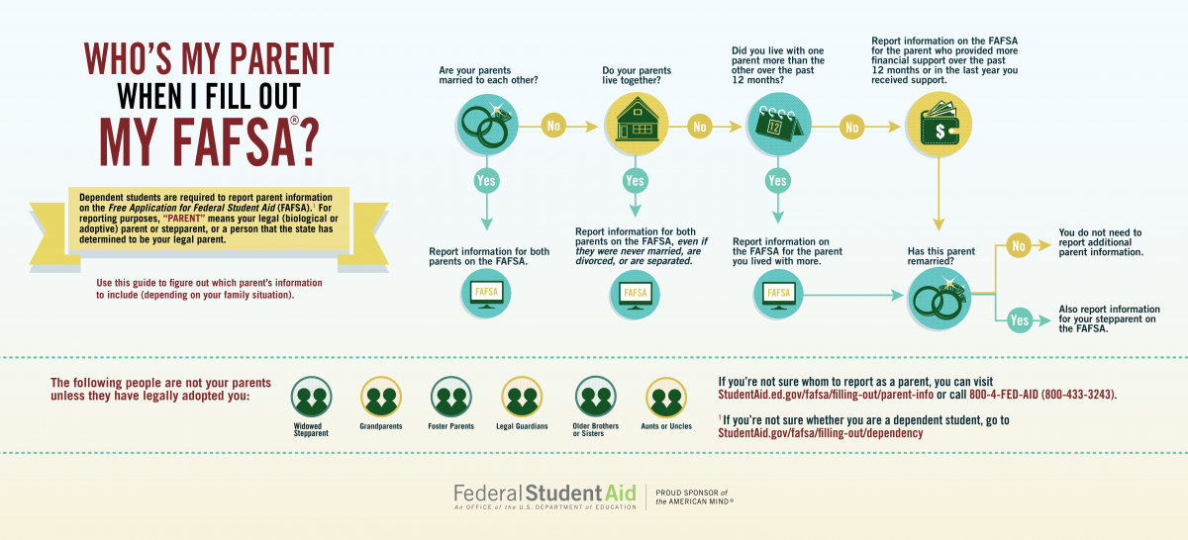

Slide 15
Parent Marital Status
Never Married
Unmarried but living together
Married
Remarried
Divorced or separated
Widowed
Notes:
If the parent’s marital status is:
Never Married: include the parent that you lived with most during the last 12 months. If you did not live with one parent more than the other, provide information about the parent who provided more financial support during the last 12 months or during the most recent year that you actually received support from a parent.
Unmarried and both parents living together: include both of your parents
Married: include both of your parents
Remarried (after being widowed or divorced): include the parent and stepparent
Divorced or separated: include the parent that you lived with most during the last 12 months. If you did not live with one parent more than the other, provide information about the parent who provided more financial support during the last 12 months or during the most recent year that you actually received support from a parent.
If the parents’ marital status is:
Widowed: include the parent who is living

Slide 16
Student Aid Report (SAR)
Provides basic information about federal student aid eligibility
Received (after you submit the FAFSA) via email within 3-5 days if you provided an email address
Received via mail within 7-10 days if you did not provide an email address
Correct errors, if needed
Will contain an expected family contribution (EFC)
Assists institutions in the financial aid award packaging process
COA (Cost of Attendance)-EFC=Financial need
Notes:
Once you submit your FAFSA you will receive a SAR (Student Aid Report)
It is important to ensure that the SAR is received and reviewed according to these timeframes. If the SAR is not received, the student must investigate why it has not been received. It may be in a spam folder, it may have not processed correctly due to an error, etc. When the student receives their copy of the SAR, the institution(s) will receive an electronic version referred to as an ISIR.
If corrections need to be made, the student should work with a financial aid administrator to determine who will make the corrections (student or school). If a student needs to make corrections, they will do so online at www.fafsa.gov.
The institution will review the SAR for accuracy and begin the financial aid award process. The EFC is used to award need-based aid. As outlined on the slide, cost of attendance – expected family contribution = financial need. An institution will begin layering a financial aid package in an effort to cover the entire cost of attendance. As the cost of attendance can vary from institution to institution, it is important that students and families apply for all federal, state, institutional and local resources in an effort to assist the institution in building a strong financial aid package.

Slide 17
Additional Information
Contact institution to determine award disbursement process
Contact institution for special circumstances or professional judgment needs
Contact institution to determine what other types of aid applications are available
Use student loans as a LAST RESORT
Notes:
Students must contact their institution to determine the award process. For example, one institution may email the student. Another may require the student to log-in to a student portal and check their status online. The student must monitor the process closely! Otherwise, they may miss out on key deadlines or funding.
If students and families complete the FAFSA and are concerned that the form does not reflect their current situation, they may contact a financial aid administrator to discuss their specific needs. Professional judgment and/or Professional Judgement are optional and schools have the direct authority in this area.
Students can also contact the institution to determine what other aid applications are available. An institution may have a foundation department that has a separate application and funding process that students may want to apply for. Additionally, department chairs may have access to not only institutional funds, but may also have access to other industry-based resources students can apply for.
Lastly, student loans are often included in the initial award process. Students have a right and responsibility to determine if they should accept, decline or reduce any student loan or loans being offered. Students should borrow conservatively. It’s important to live frugally while in college. If a student does not borrow conservatively and live frugally, he/she will struggle throughout student loan repayment.

Slide 18
Additional Information
Verification Process
Financial Aid Award Notification
Communication with the Post Secondary Institution
Formula: Cost of Attending –Expected Family Contribution = Financial Need
Scholarships/Grants (Institutional/Federal/State)
Florida Prepaid-529 Plans (Check with your Institution)
Federal Loans: Student/Parent
Subsidized (USDOE pays interest – in school)
Unsubsidized (Student responsible interest)
Subsidized/Unsubsidized (Principal + interest begins after graduation or not enrolled for 6 months)
Private Loans
Notes:
Students must contact their institution to determine the award process. For example, one institution may email the student. Another may require the student to log-in to a student portal and check their status online. The student must monitor the process closely! Otherwise, they may miss out on key deadlines or funding.
If students and families complete the FAFSA and are concerned that the form does not reflect their current situation, they may contact a financial aid administrator to discuss their specific needs. Professional judgment and/or Professional Judgement are optional and schools have the direct authority in this area.
Students can also contact the institution to determine what other aid applications are available. An institution may have a foundation department that has a separate application and funding process that students may want to apply for. Additionally, department chairs may have access to not only institutional funds, but may also have access to other industry-based resources students can apply for.
Lastly, student loans are often included in the initial award process. Students have a right and responsibility to determine if they should accept, decline or reduce any student loan or loans being offered. Students should borrow conservatively. It’s important to live frugally while in college. If a student does not borrow conservatively and live frugally, he/she will struggle throughout student loan repayment.

Slide 19
Mapping Your Future (MYF) www.mappingyourfuture.org
Mapping Your Future is a non-profit organization dedicated to combining person-to-person financial counseling with online resources to help students plan for their future with:
College preparation
School selection
Career exploration
Money management
www.mappingyourfuture.org
Notes:
Through OSFA’s sponsorship, all of Mapping Your Future’s (MYF) products and services are free of charge to Florida’s students and families. Mapping Your Future’s goal is to help students plan for higher education by offering reliable and unbiased money management advice and counseling. Online and offline resources include college preparation, school selection, career exploration, and counseling aimed at helping students and families better understand student loan obligations. Mapping Your Future also provides information about practical money management solutions to ensure healthy finances while in school and beyond.

Slide 20
Navigating your Financial Future (NyFF) www.navigatingyourfuture.org
Financing higher education
Managing day-to-day money
Career planning
School/Life management
Resources available at no cost
www.navigatingyourfuture.org
Notes:
OSFA offers free resources and guidance through the Navigating Your Financial Future website. Please visit www.NavigatingYourFuture.org to see all of the free brochures, online trainings, financial calculators and more.

Slide 21
Office of Student Financial Assistance (OSFA) Contacts
Email:
osfa@fldoe.org
Telephone:
1-888-827-2004
OSFA Director Outreach Services:
Pete Hernandez | 850.245.1821 | Pedro.Hernandez@fldoe.org
Notes:
If you need assistance or further information, please do not hesitate to contact us. We are here to help!
Thank you for attending this presentation. We hope you have a successful transition into postsecondary education.

