Slide 1
How do I get to what’s next?
Graduation Requirements, Applying to College, Paying for College, College Fairs, Testing, Careers, Military

Slide 2
High School Graduation Requirements
4 credits in English
4 credits in Math
3 credits in Social Studies
3 credits in Science
1 additional credit in Science OR Social Studies
1 credit of HOPE
1 credit of performing fine art or practical art
3 Honors OR 3 CTE Credits
.5 credit in Career Research
7.5 Elective Credits
______________________________
Total = 26 credits
Online course
Pass FSA/ELA & Algebra 1 EOC OR earn a concordant/comparative score
Cumulative GPA of at least 2.0

Slide 3
Junior & Senior Meetings
Senior Meetings
Begin Monday September 23rd and run through the month of October
Counselors will meet with EVERY senior
Students will receive senior folder and status letter
Junior Course Registration
Spring of every year
Counselor sits with every student individually to pick senior year classes
Copy of transcript is provided – LOOK IT OVER

Slide 4
Applying to College
You MUST research! Start Early Junior Year (summer)
State University System (SUS) Matrix
Check out individual college websites
Visit Colleges
Attend our College Fairs and visit with representatives when they are on campus
Big Future - https://bigfuture.collegeboard.org
Make a short list
Will I be comfortable at this school for 4 years or more?
What programs/majors do they offer?
Do I or Will I meet admissions requirements?

Slide 6
Register for Your College Fair Barcode
and get scanned to receive more information
Go to:
STRIVEFAIR.COM
or just Snap this code:
Already have a barcode? Need to edit your profile?
Click Resend My Barcode at the top of the page and enter your email or phone. Use the Update link in your barcode email, or just re-register.

Slide 7
Applying to College Vocabulary
Common Application
1 application that applies to several colleges
Institutional Application
Individual colleges application – found on their webpage
Early Decision
Binding – if accepted as an ED applicant you must attend
Early Action
Nonbinding – you receive an early response to your application but do not have to commit until the normal reply date of May 1
Rolling Admissions
Make acceptance decisions throughout the year – earlier you apply earlier you hear - seats do fill up as year progresses
SSAR – limited schools
Student Self Reported Academic Record
Deadline
It’s a real thing – you miss the deadline, you miss the opportunity

Slide 8
Applying to College with Your Story
College Essay
Think about what will make you stand out.
Have you overcome
Awards/Recognitions
Volunteer experiences
Academic Record
Explain any hiccups in your record
Transcripts
Electronic vs Snail Mail
SSAR – complete with an unofficial transcript in front of you
Be 100% honest
Request in guidance office using our transcript request form - $1 each
Final Transcript – will need to send, will get specific form end of year, not available until mid July

Slide 9
Applying to College with Your Story
Recommendation Letters
Plan ahead
Give your recommender plenty of time
Provide an academic resume to help them be specific about you
Clubs & Activities
Awards & Recognitions
Volunteer Experiences
Academic summary
Common app requires counselors to enter a recommendation on students

Slide 10
Applying to EFSC
Go Higher Get Connected
February 19, 2020
Parents are welcome
If dual enrolled you only need to update information with the admissions department and present a final transcript when received.
After graduation you register for classes through their online system
If starting for the first time you will need to complete an online application and follow the steps provided.

Slide 11
College Acceptance Process
May 1 – deadline for accepting offers of admission at most colleges
Offers of admission arrive in late March early April
Financial aid award letters are sent around the same time, if applicable
As soon as you make a decision notify the college you’ve decided to attend. Send the following:
Your acceptance letter
A deposit
Notify the colleges whose offers you are declining – this frees up space for others
Financial aid acceptance letter, if required
Any other required items

Slide 12
$$$ Paying for College $$$
Grants
Money granted to you; usually by the government through FASFA or directly from the college/university – you do not have to pay back
Scholarships
Money given to you based on your merit or meeting certain qualifications – you do not have to pay it back
Loans
Money loaned to you – you do have to pay this back with interest
Work Study
You work at the school in exchange for costs

Slide 13
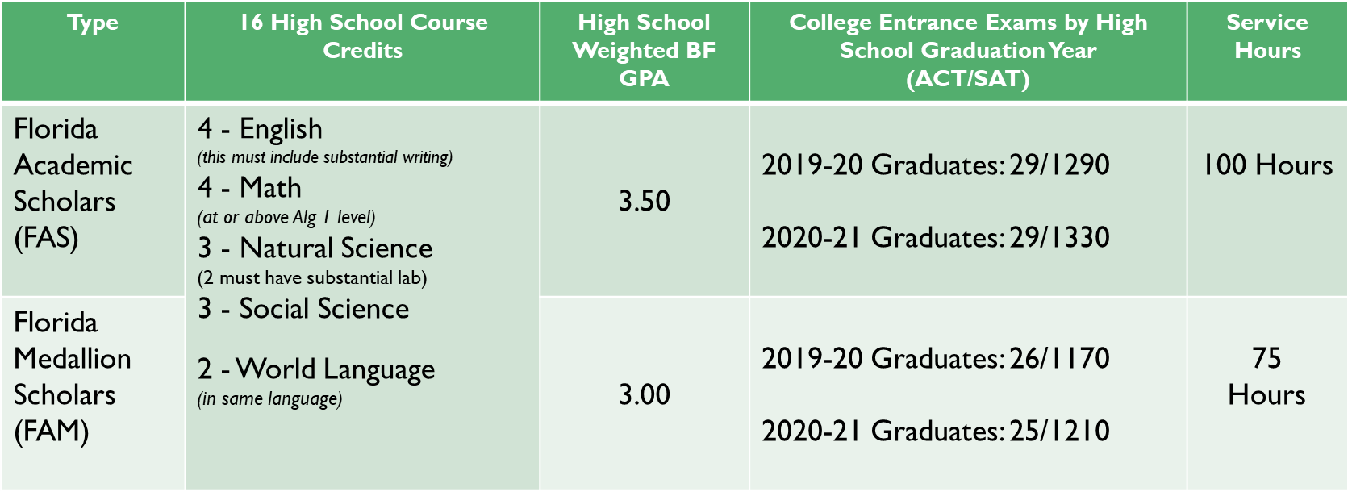
Bright Futures Senior Application opens October 1st https://www.floridastudentfinancialaidsg.org
https://www.floridashines.org/ * Go to College * Pay for College * Check Now * 050####### (# = stdt #)

Slide 14
FAFSA Free Application for Federal Student Aid Opens for Seniors October 1st
Many schools require you to complete before they will offer you a financial package
Evaluates you for Grants, Loans and Work Study
The earlier you apply the more money you are likely to receive
Uses prior prior (2017) year tax data so you do not need to wait until you have filed your taxes to apply

Slide 16
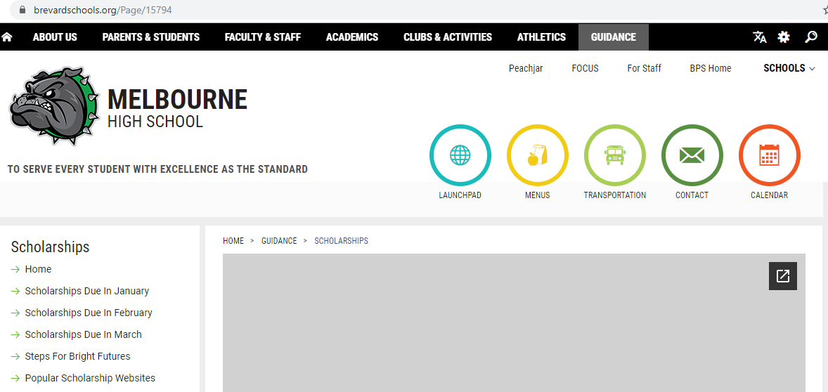
Scholarships
No one stop shop
Have to search, search, search
MHS Guidance webpage keeps a running list as we hear about them
Organized by due date
https://www.brevardschools.org/MelbourneHS

Slide 17
TESTING Most colleges require test scores for admissions
SAT
Given to all 11th graders free of charge on March 4, 2020 – called school day test
DO NOT let this be the only time you test
Collegeboard.org
ACT
Act.org
Recommend you take each test 1 time, then retake the test you are most comfortable with until you reach desired score
Most Colleges/Universities and Bright Futures will Super Score
Students on Free/Reduced lunch can get 2 fee waivers

Slide 18
Careers
Florida Shines – Find a Career
https://www.floridashines.org/
Create an account
Gives you three assessments that will tell you your interests, skills confidence, and work values and how to apply them to a career
ASVAB
Skills and interest inventory given free of charge
October 15th at MHS – will be given again in the Spring
Military recruiters will get your contact information
Vocational Programs
EFSC has many programs with state of the art facilities

Slide 19
Military
Air Force
Berlin Aniciete 321-724-4138
Army
DeeJay D Norby 813-732-1324
Marines
Nathan Waterhouse 321-724-6920
Navy
Gunner Dahlke 321-724-5575
Coast Guard
407-352-3897
National Guard
Through the Army
Academies
Based on branch

Slide 20
Graduation Day
May 22, 2020
7 PM
Thomas W. McIntyre Stadium

