Slide 1
WELCOME to Sophomore Parent Night at MIHS
Ellen Shepard- Sophomore Class Counselor
Class of 2026

Slide 2
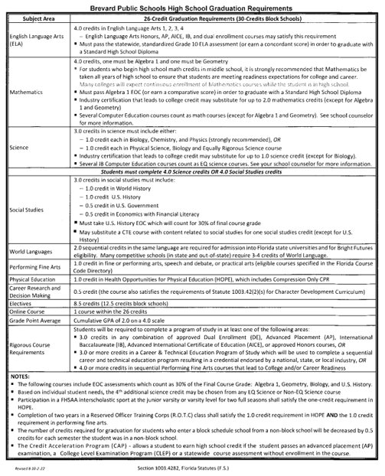
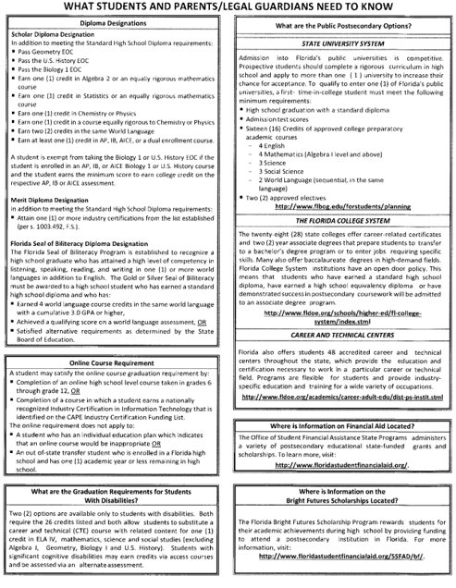
BPS High School Graduation Requirements

Slide 3
Graduation Requirements
MIHS expectation that required electives be finished before 11th grade
Career Research and Decision Making (.5 credit)
HOPE (1.0 credit)
Performing/Practical Arts (1.0 credit)
MIHS / State DOE Expectations
Students graduate as “college and/or career ready” (AP test, DE class, CTE certification)

Slide 4
Purpose of PSAT
To determine college readiness and provide opportunity for Algebra EOC concordant
Scores available November 6th
Each student will be required to set up a College Board Acct
Score roll-out best practices and consequences - please talk to your students and plan accordingly.

Slide 5
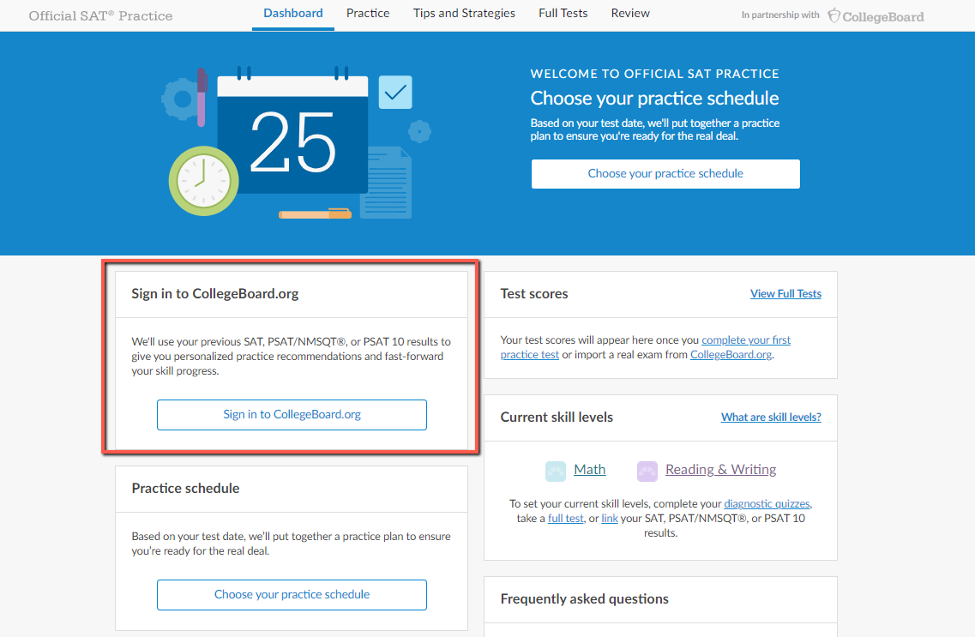
How to Connect PSAT scores to Khan Academy
If you haven’t gone through this process or decided to link your account to College Board later, you can always refer back to your SAT dashboard. The “Sign in to CollegeBoard.org” modal will be there whenever you want to complete the linking.

Slide 6
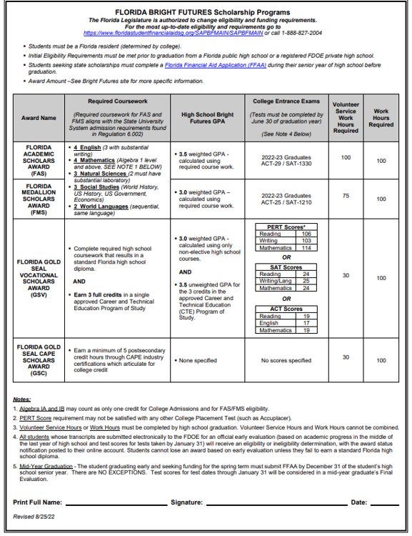
Bright Futures
5 Requirements for Bright Futures​
​
Apply senior year​
Complete all required coursework​
The GPA used is based on core courses (will use 2 additional core courses if needed)​
Required Volunteer / Work Hours ​
TESTS – ACT or SAT (last test that can be used is June 2026 administration). MUST send scores to at least 1 public university in FL.​

Slide 7
Dual Enrollment / Early College
Dual enrollment allows students to take classes at EFSC while still in high school receiving BOTH high school AND college credit
Students who qualify (3.0 GPA) will be notified in January 2024
Students must earn a qualifying score on the PERT (Reading, Writing and Math)
Student may pursue an Associate of Arts (A.A.) degree by entering the Early College program. Students who enter EC enter on a “fast track” and may be required to Early Admit their senior year.
Students who have met qualifications may also take dual enrollment courses without being on a track to complete their A.A.

Slide 8
Dual Enrollment / Early College
THINGS TO CONSIDER
Students must be independent and have a higher level of maturity
Students must be eager for academic challenges
Students must be able to advocate and communicate with professors
Students must be able to balance “college” and “high school” life simultaneously

Slide 9
Advanced Placement Courses (AP)
AP Courses are ideal for students who are willing to challenge themselves academically
AP Courses require students to take an exam in May each year. A qualifying score of 3, 4 or 5 will earn students college credit at most colleges/universities across the country.
AP courses communicate to prospective colleges/universities that these students are “college ready” and willing to stretch themselves academically to master material and grow as an individual
MIHS offers one of the largest selections of AP courses of any high school in Brevard
Students also have the opportunity to earn an AP Capstone Diploma (Reqs: AP Research, AP Seminar, 4 other AP courses)
Students can also apply to the AP Academy in February 2024.
AP Academy students are guided to a Capstone Diploma, receive advising from Mrs. Ash, and are given opportunities such as college visits, community projects, etc.

Slide 10
Advanced Placement Courses (AP)
Capstone Courses
AP Seminar (10-11th)
AP Research (11-12th)
Social Studies Courses
AP World History (9th)
AP U.S. History (10th)
AP Human Geography (10-12th)
AP Psychology (10th-12th)
AP Comparative Govt & Politics (10-12th)
AP U.S. Govt & Politics (11th)
AP European History (10-12th)
AP Microeconomics (12th)
AP Macroeconomics (12th)
Elective Courses
AP Studio Art: 2D-Design (11-12th)
AP Studio Art: Drawing (11-12th)
AP Music Theory (10-12th)
AP Spanish Language & Culture (10-12th)
English Courses
AP Language and Composition (11th)
AP Literature and Composition (12th)
Science Courses
AP Biology (10th)
AP Chemistry(11th)
AP Physics(11-12th)
AP Environmental Science (10-11th)
Math Courses
AP Calculus A/B (11-12th)
AP Calculus B/C (12th)
AP Statistics (11-12th)

Slide 11
Exploring Post-Secondary Opportunities
Checklist for College Bound Sophomores
Make sure you are taking challenging courses to help prepare you for college
Take the PSAT. Use the feedback you receive to work on any academic weaknesses (Khan Academy)
If you are interested in the military you may want to request a pre-candidate questionnaire from the appropriate branch.
Attend college and career fairs (Brevard College and Career Fair is anticipated to be rescheduled for sometime in the Spring 2024).
Participate in school activities and volunteer efforts. Extracurricular activities can help you develop time management skills and enrich your high school experience. Activities also help you stand out to prospective colleges and universities.
Tour college campuses. If your family is travelling near a college campus, take advantage of the opportunity and go for a tour. MIHS is working to increase the number of opportunities students have to visit colleges during school.

Slide 12
Exploring Post-Secondary Opportunities

Slide 13
Exploring Post-Secondary Opportunities
EFSC Vocational Programs (A.S./Adv Tech Certs)
38 A.S. degrees some of which include Accounting, Aerospace Technology, Culinary, Dental Hygiene, Drafting, EMS, Medical Assistant, Radiography, Veterinary Nursing
4 Advanced Technical Certificates - Adult Cardiac Sonography, Network Security Forensics, Vascular Sonography, and Veterinary Practice Management
16 Career and Technical Certifications some of which include Aviation Mechanic, Cosmetology, Fire Fighter, HVAC, Patient Care Assistant, Welding Technology
Universal Technical Institute - over 35 different career paths/programs including automotive, welding, HVAC, marine, diesel, robotics, wind power
Full Sail University - Masters, Bachelors, Certificates - 3D Arts, Audio Arts, Audio production, Computer Animation, Cinematography, Digital Marketing

Slide 14
Exploring Post-Secondary Opportunities
Career Interviews​
Fire Rescue/Paramedic​
Real Estate Broker​
Social Media Director ​
Dentist/Orthodontist​
Universal Technical Institute​
Local construction companies

Slide 15
Exploring Post-Secondary Opportunities
EVERY STUDENT NEEDS TO HAVE A PLAN!!!​
Internships​
Vocational programs​
Workforce​
Apprenticeship​
Travel (gap year)​
Study Abroad​
​

Slide 16
Counselor Contact Information
QR code
Shepard.nancy@brevardschools.org
321-454-1000​

Slide 17
QUESTIONS?

