Slide 1
Merritt Island High School
Class of 2027

Slide 2
Class of 2027 - Becoming a MUSTANG!
FOCUS Points for Every MUSTANG
Attend School Everyday
Be On Time
Strive For Excellence
Be Respectful and Responsible

Slide 3
Class of 2027 - Earning CREDITS
For each class you take and pass you will receive .50 credit (semester class) or 1.0 credit (year long class).
Most classes earn .50 credit each semester.
For classes with an End of Course Exam (Algebra 1, Geometry, Biology, U.S. History) students earn 1.0 full credit at the end of the year.
If you pass all of your classes in one year, you will earn 7 credits.
Students need a total of 26 credits to graduate.

Slide 4
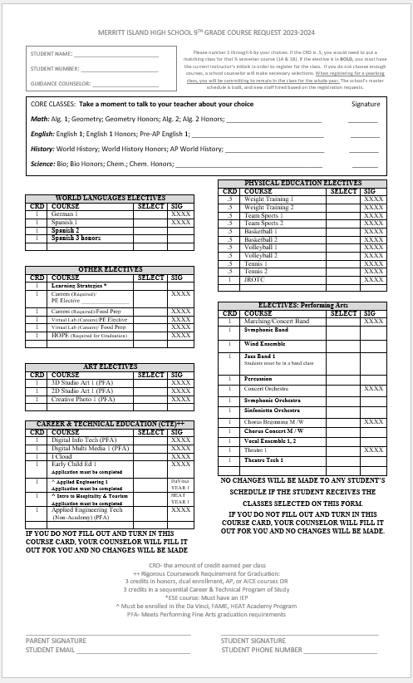
Class of 2027 - Academic Classes
Academic Classes are your 4 Core Classes
ENGLISH (Regular, Honors or Advanced Placement)
MATH (Regular, Honors or Advanced Placement)
SCIENCE (Regular, Honors or Advanced Placement)
SOCIAL STUDIES (Regular, Honors or Advanced Placement)
Your current teachers will make these recommendations and sign your Course Request Card.

Slide 5
Class of 2027 - 9th Grade CORE Academics
Algebra 1 (Regular); Geometry (Reg / Honors); Algebra 2 (Reg / Honors)
English 1 (Reg / Honors / Pre-AP)
World History (Reg / Honors / AP)
Biology (Reg / Honors) / Chemistry (Reg / Honors)
**Dual Enrollment is available for students grades 10-12.

Slide 6
Class of 2027 - Career Research & Decision Making
This is a REQUIRED course for graduation (most students take this in 9th grade).
This is a one semester course so you will have to choose another one semester course to complete the opposite semester (Ex. PE, Virtual Lab, Food Prep, etc).

Slide 7
Class of 2027 - Electives
Any course not a CORE academic is an elective.
Required Electives for Graduation:
1.0 credit HOPE (Health Opportunities for Physical Education)
1.0 credit of a Performing/Fine/Vocational Arts
1 online course (usually taken in a virtual lab)
*Read Course Descriptions Carefully. There are no schedule changes for a course chosen on the Course Request Card.

Slide 8
Class of 2027 - Performing/Fine/Vocational Arts
1.0 Credit of a Performing/Fine/Vocational Arts is required for graduation
Performing Arts: Band / Chorus / Orchestra / Drama / Theater
Fine Arts: 2-D Art / 3-D Art / Photography
Vocational Arts: Digital Information Technology / Digital Media / Applied Engineering Technology / JROTC
*2 years of JROTC will satisfy BOTH the 1.0 HOPE credit AND the 1.0 Performing Arts credit

Slide 9
Class of 2027 - Rigorous Coursework
3 credits of Rigorous Coursework is required for graduation
Honors / Advanced Placement / Dual Enrollment OR
Career & Technical Education (CTE) Courses

Slide 10
Class of 2027 - Career & Technical Education
Merritt Island High School offers the following CTE programs:
Applied Engineering Technology
Automotive Technology
Childcare Education
Digital Media
JROTC*
*This program does NOT meet the Bright Futures Gold Seal Scholarship requirements.

Slide 11
Class of 2027 - College Prep Courses
College Admissions require students to take rigorous courses (Honors / AP / Dual Enrollment) and 2 years of a Foreign Language.
Spanish
German

Slide 12
Focus is in the field of Engineering and Aerospace Technology
Technical Coursework and preparation for the 21st century workforce
Course Progression
Engineering Tech 1 - Engineering design process
Engineering Tech 2 - Engineering principles, 2D Drawing to 3D manufacturing and object assembly
Engineering Tech 3 - Principles of Flight
Engineering Design and Development - Internship opportunities

Slide 13
Focus is on skills needed in career fields that deal with human relations and hospitality.
Prepare to work in fields such as: Hotel Management, Cruise Careers, Airline Careers, Culinary, Small-Business Startup
Job shadowing
Compensated Internships
Course Progression:
Introduction to Hospitality
Principles of Food/Prep Science (Certification)
Hospitality Entrepreneurship and Hospitality Marketing (Social Media Strategist Certification)
OJT/Internships

Slide 14
Focused on the field of Fine Arts and Multi-Media Entertainment through academic performance and technical coursework
Students must select an area of focus
Performing Arts includes: Theater, Band, Chorus, Orchestra, communications
Visual Arts includes: Drawing, Painting, Ceramics, Photography, Stagecraft, Digital Arts/Digital Design
Technical Arts includes: TV Production, Music Editing, Movie Directing, Game Design, 3-D Animating

Slide 16
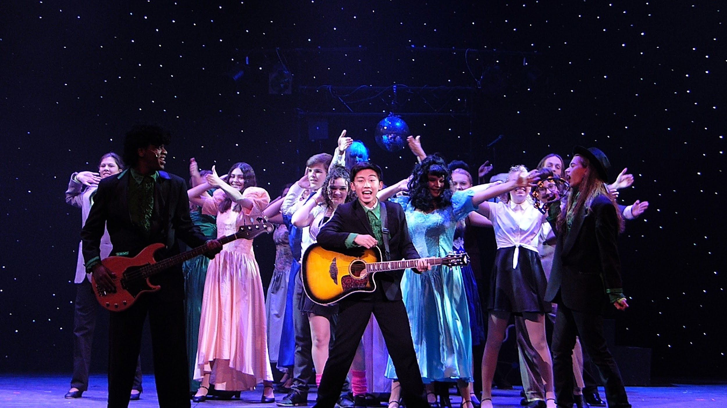
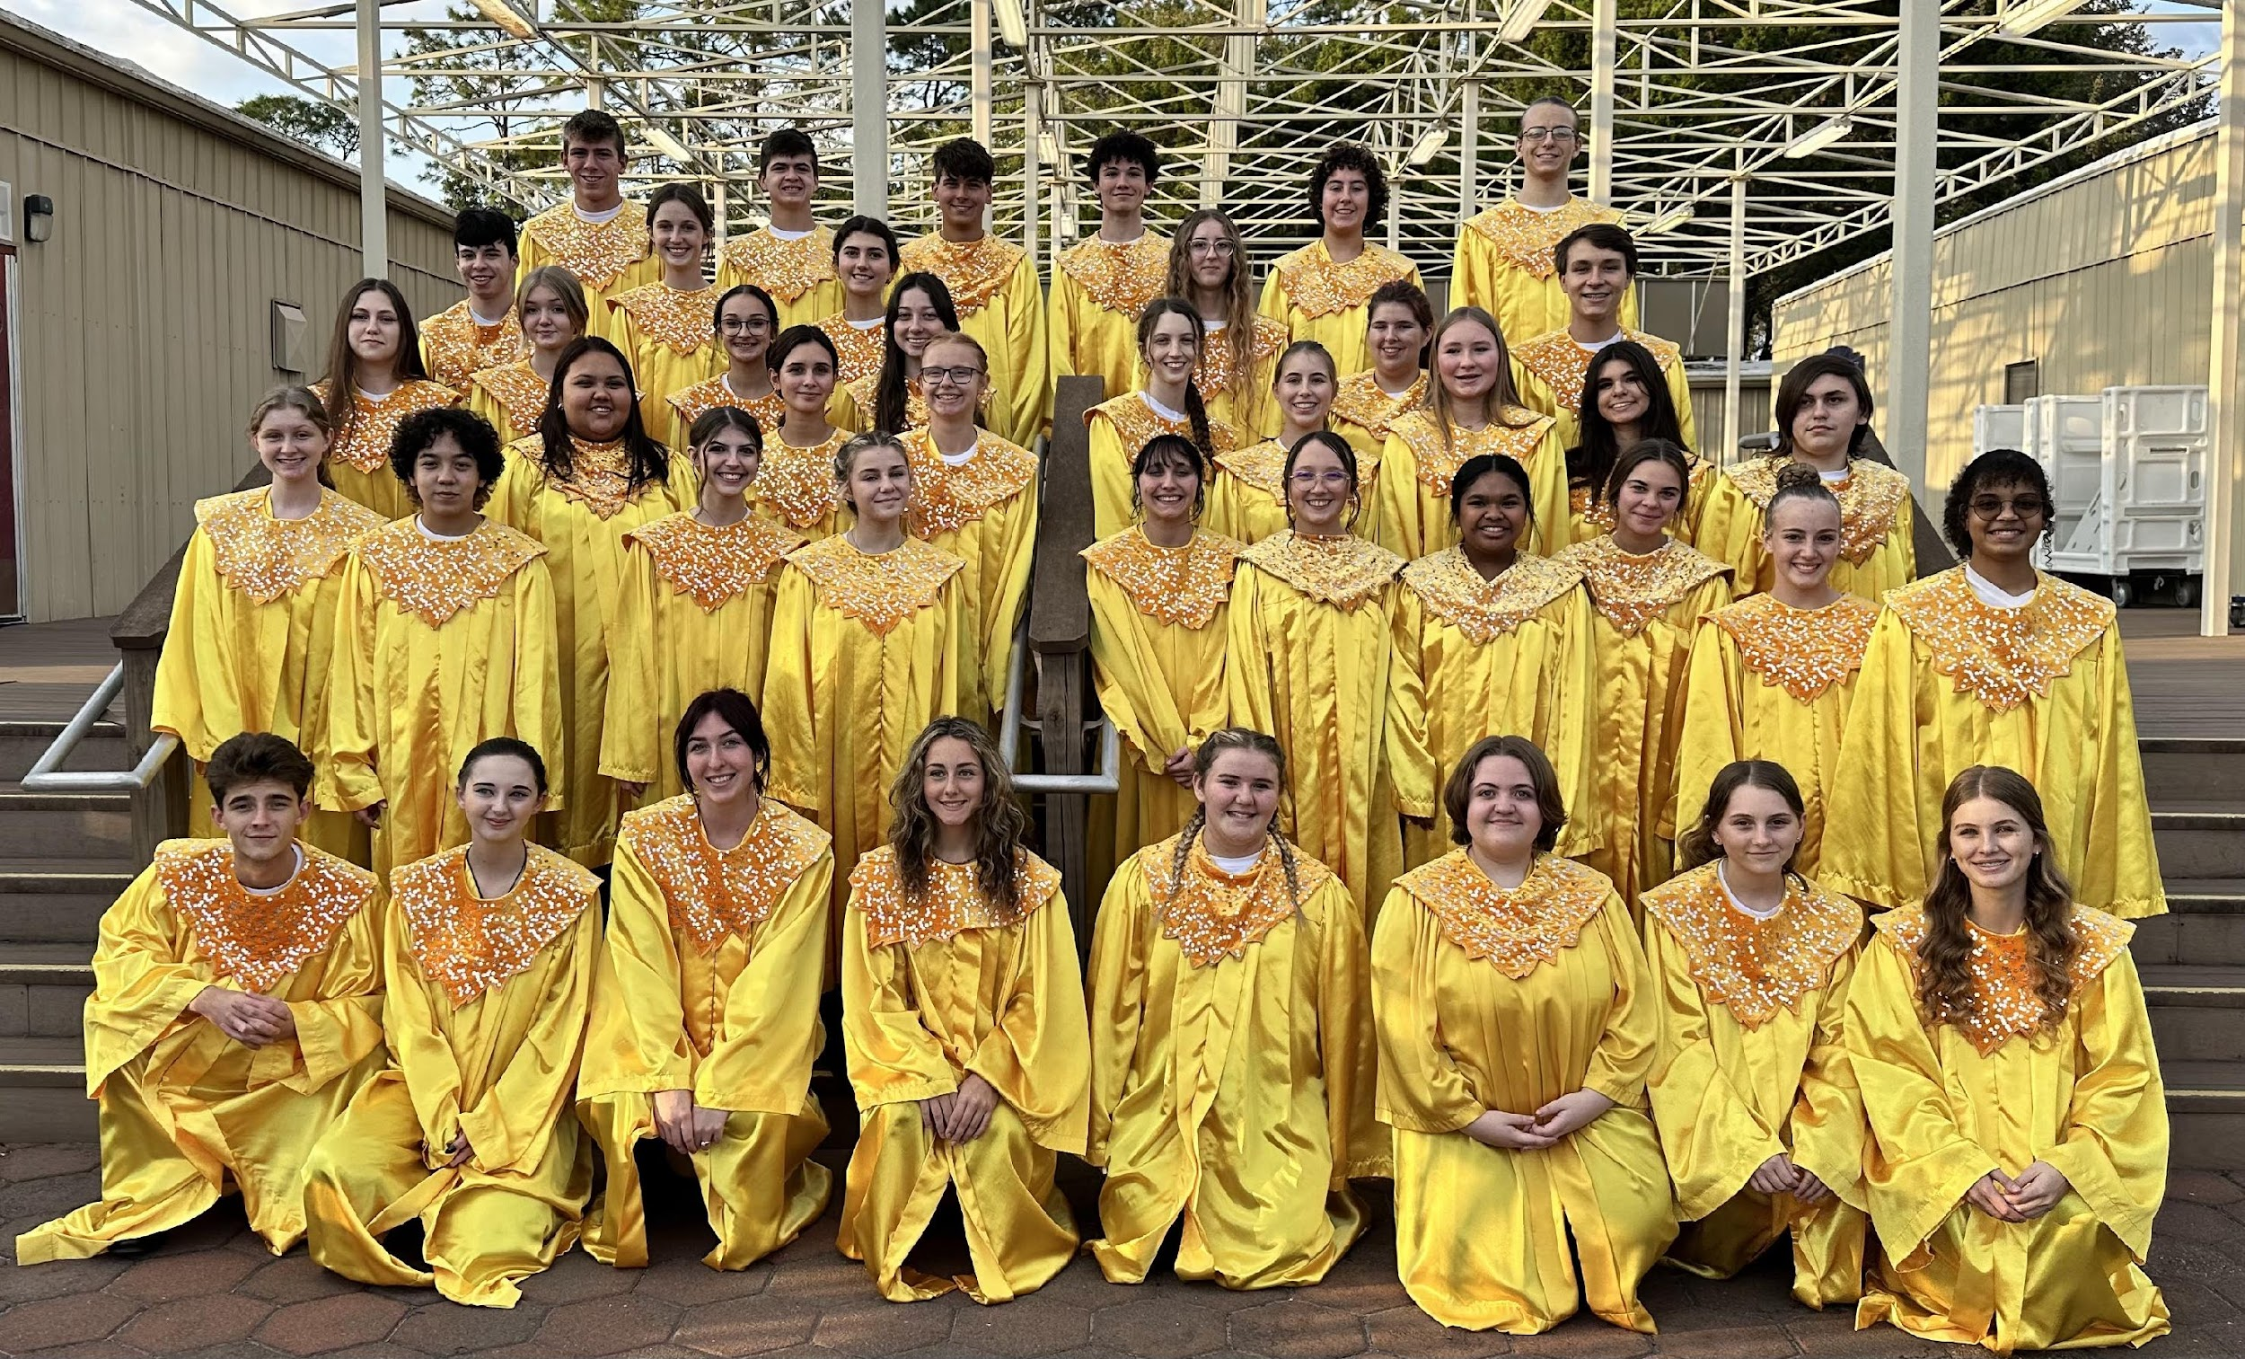
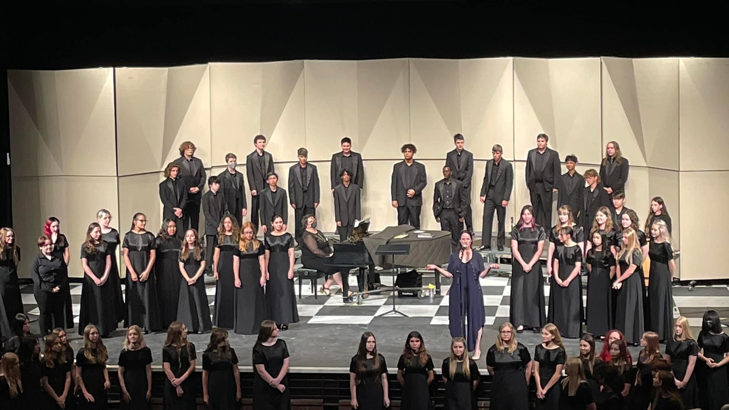
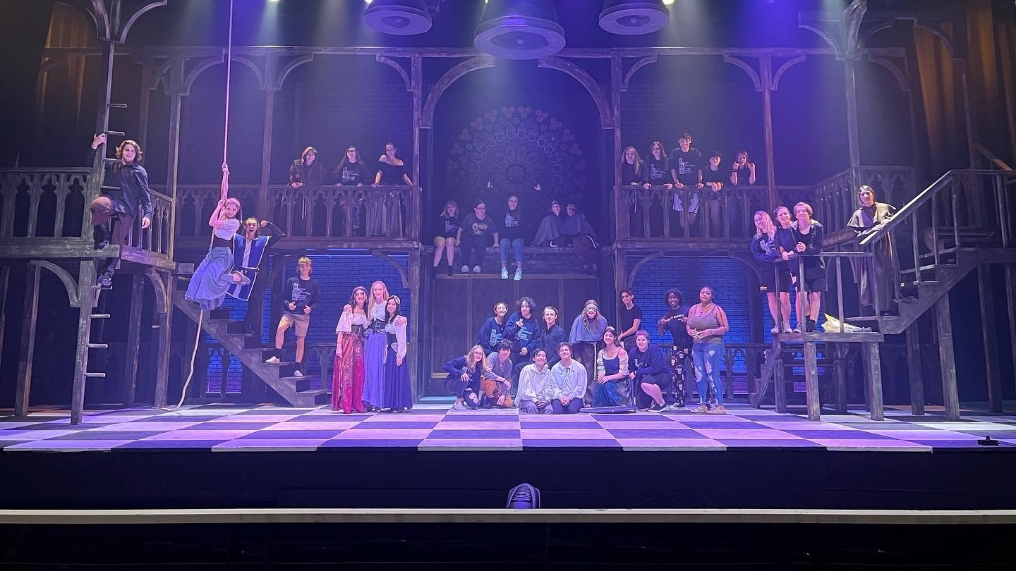
Performing Arts

Slide 17
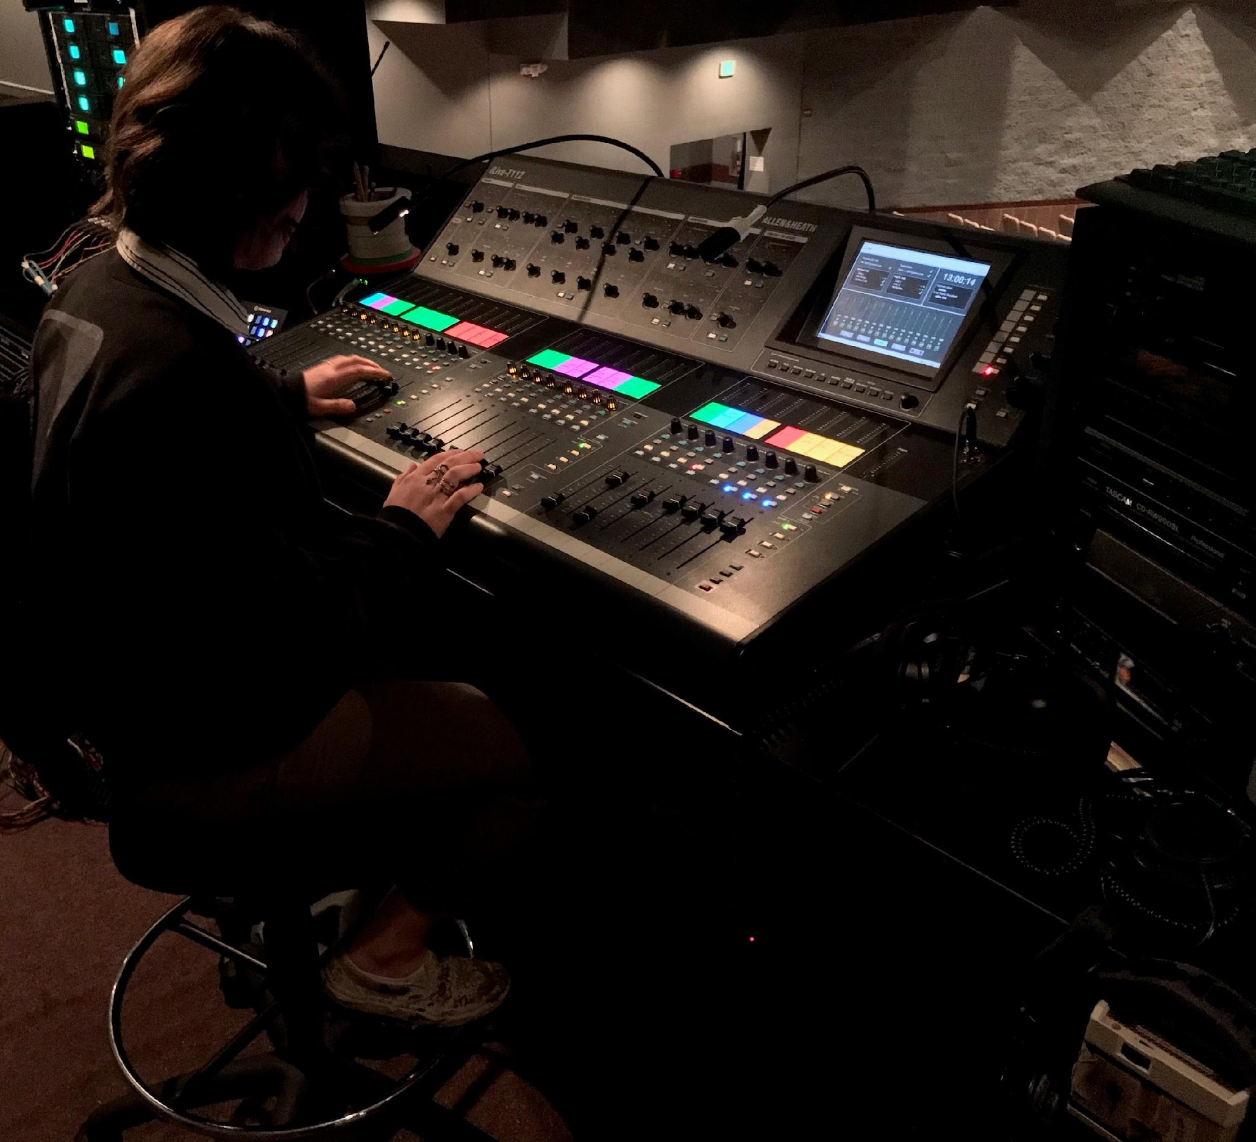
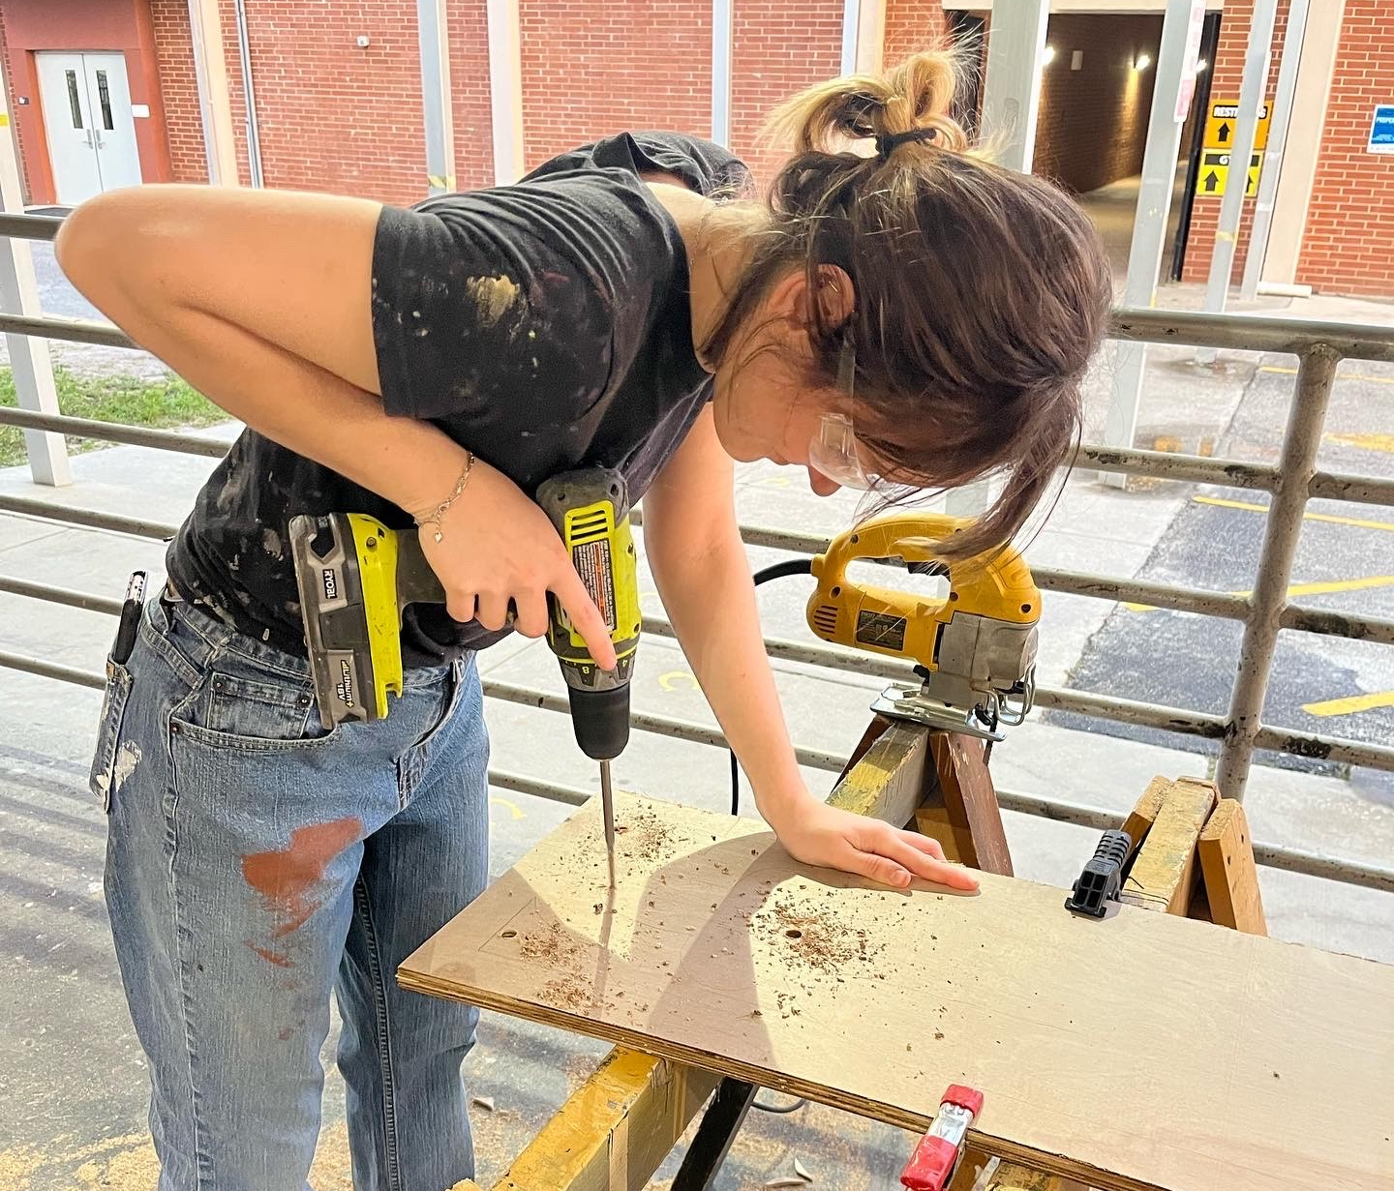
Technical Arts

Slide 18
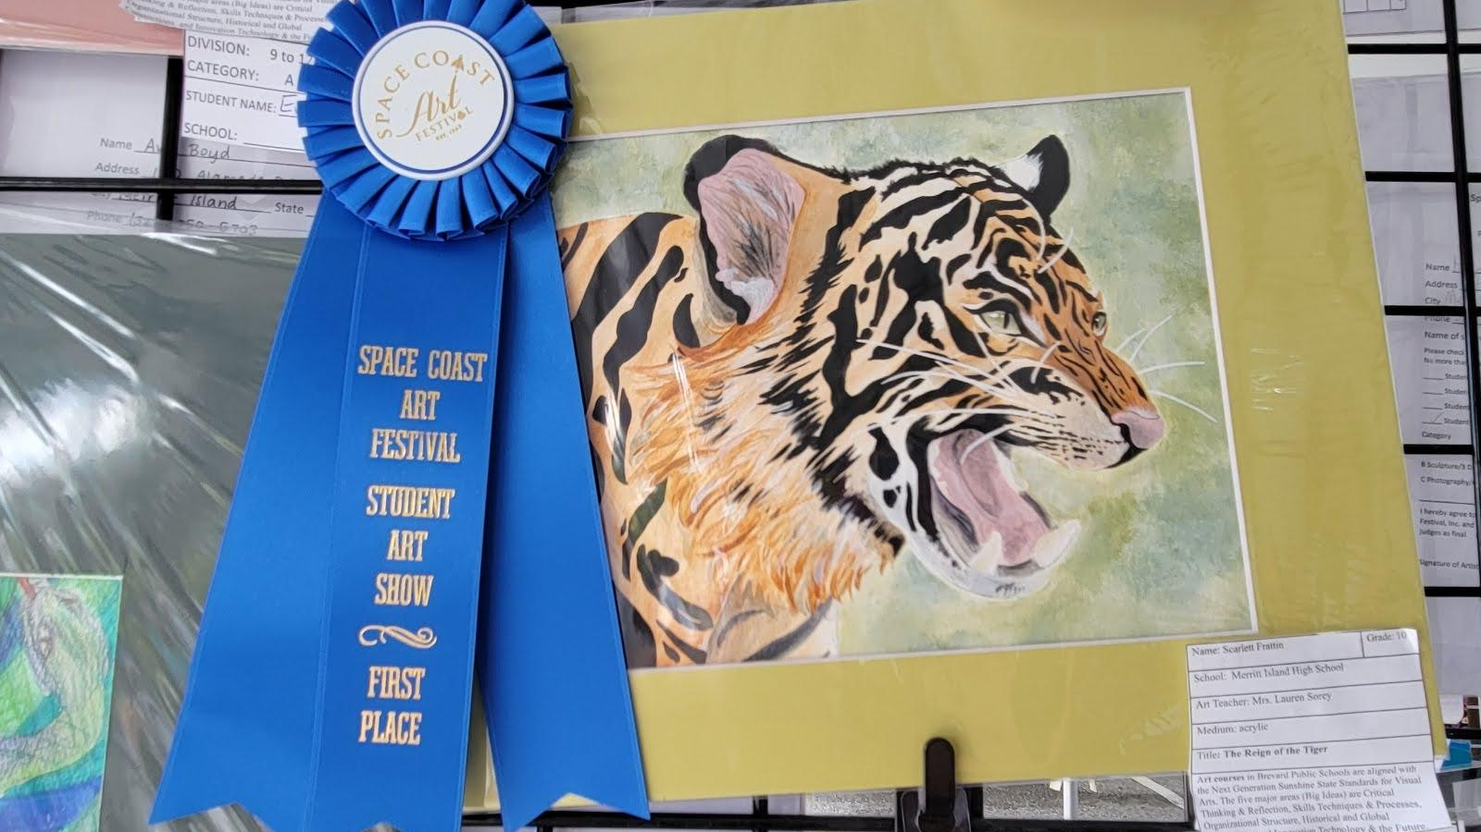
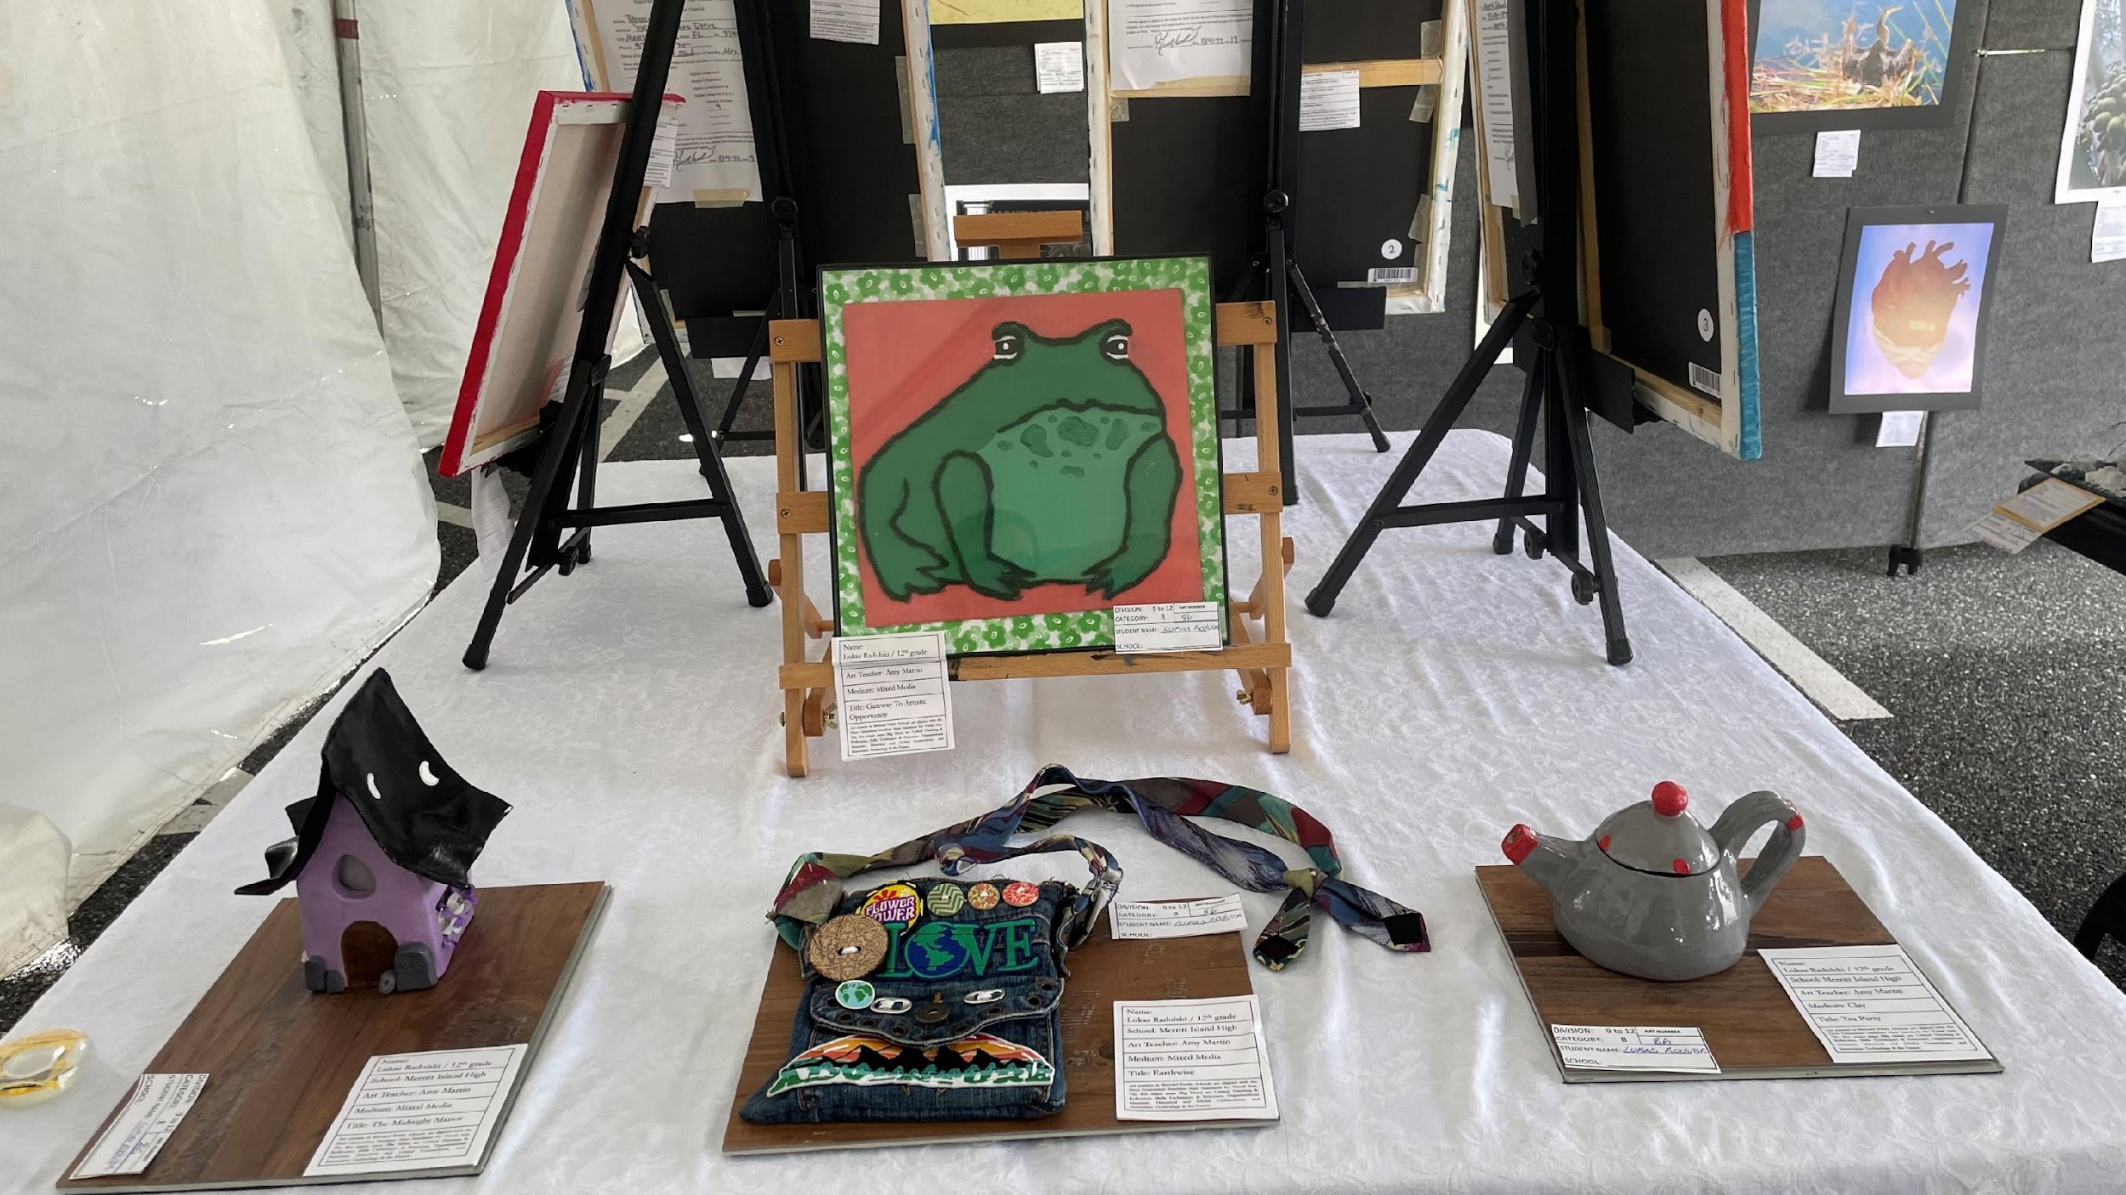
Visual Arts

Slide 19
AP Academy
What is the AP Academy?
An organization that is dedicated to helping motivated students experience success.
Students are placed on a track for the AP Capstone Diploma

Slide 20
AP Capstone Diploma
Students will earn their high school diploma and
simultaneously earn a NATIONALLY recognized AP Capstone Diploma.
Requirement for AP Capstone Diploma:
6 full-year AP credits or combination of full-year courses and semester courses totaling 6 credits:
4 credits from AP courses offered at MIHS
1 credit from AP Seminar
1 credit from AP Research
Minimum score of 3 on each course examination

Slide 21
What are AP classes?
College-level courses on campus
Earning BOTH high school AND college credit
Challenging/rigorous coursework that:
Provides access to high quality education
Accelerates learning
Rewards achievement
Enhances both high school and college program success
Provides a structured path to successful entrance into college

Slide 22
AP Academy
Advantages
Earn high school credits alongside college credit with a qualifying score on each AP Exam
Prepare for college by completing rigorous coursework
Students become more competitive when applying to highly selective institutions
Coordinated college visits
AP Advisors
Opportunities for service hours / Guest speakers
Requirements
Maintain a 3.0 GPA
100 Community Service Hours
Adherence to the Honor Code
Stay on track/seeking a Capstone Diploma
Participation in Clubs/Athletics

Slide 23
FAQs
Do students have to be in the AP Academy in order to take AP Classes? - NO
Can students participate in a choice academy and the AP Academy? - YES
Can a student do dual enrollment and the AP Academy? - YES

Slide 24
How to Apply
Complete the paper application and return to Mrs. Ash at MIHS or turn into Mrs. House. Be sure to provide recommendation forms to your teachers.
Call or email Mrs. Ash for questions and further explanation.
ash.gabrielle@brevardschools.org
321-454-1000 Ext. 25262

Slide 25
Class of 2027
Course Request Cards are DUE to your teacher
MONDAY FEBRUARY 13th
**Write this at the top of your Course Request Card

Slide 26
Class of 2027 - Completing Elective Course Requests
Number your course selections #1-6
Write 1 next to Career Research and t to the semester course you request opposite of Careers.
Numbers 2 & 3 will be your first choices.
*Courses in BOLD require a teacher signature/recommendation
Numbers 4-6 will be your alternate selections (in case your first choices are not available).
*Remember, semester courses must be chosen in pairs.

Slide 27
Class of 2027 - Important Dates
Course Request Cards are DUE no later than MONDAY, February 13th!!
*Make sure all signatures have been completed!

Slide 28
Class of 2027
Welcome to the Home of the MUSTANGS!!
At Merritt Island you will be part of a great FAMILY of teachers, guidance counselors, administrators and staff working each day to help you succeed and be the BEST you can be!!
FAMILY ~ PRIDE ~ TRADITION
GOOOOOOOOOO Mustangs!!!!!

