Slide 1

Applying to Colleges and Universities

Slide 2
How many colleges and universities are in the United States?
Over 5,000 colleges and universities

Slide 3
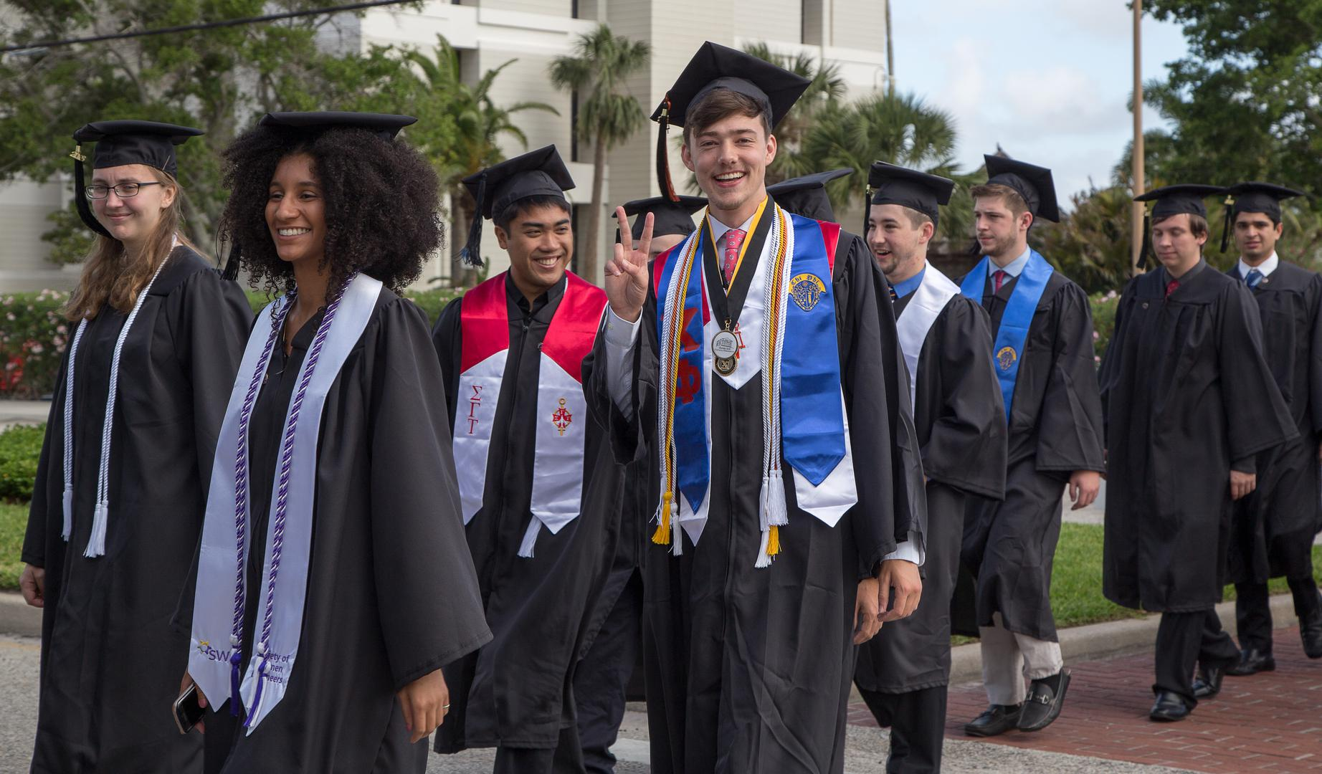
Higher Education Options
What are my options?

Slide 4
Higher Education Options
Universities
  Multiple disciplines or fields of study
  Confer both undergraduate and graduate degrees
Colleges
  May offer multiple disciplines
  Confers only undergraduate degrees
Private Colleges represent approximately 50% of all Colleges in the U.S. (approximately 2,500)
The oldest universities in the US are private (Harvard 1636; Yale 1701)

Slide 5
Harvard (1636); Yale (1701)

Slide 6
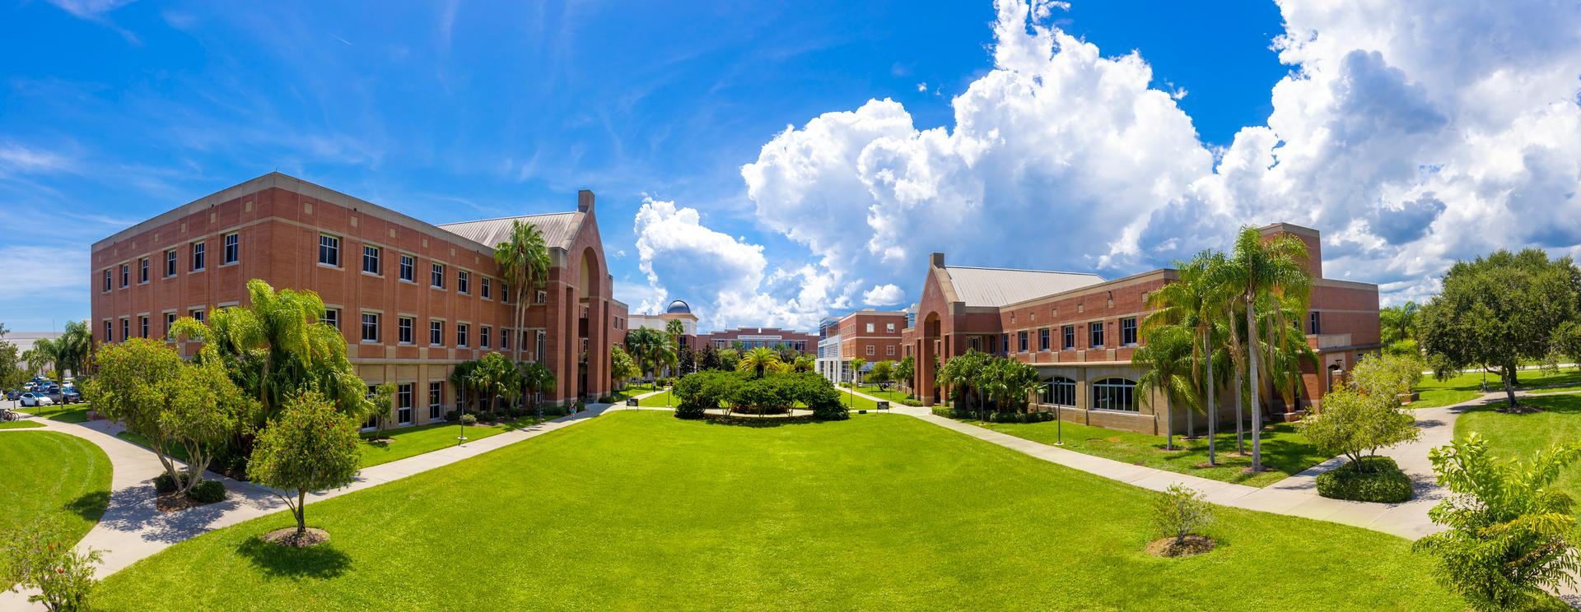
Private Colleges and universities of Florida (PCUF)

Slide 7
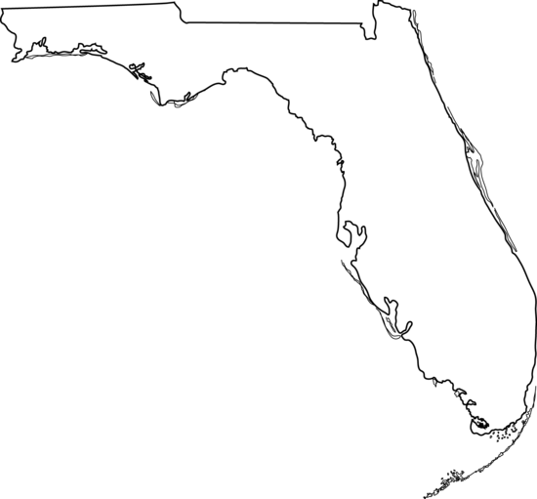
Private Colleges and universities of Florida (PCUF)
22 regionally accredited degree granting colleges and universities (Univ. Of Miami, FIT, Univ. of Tampa, Rollins, Florida Southern, Eckerd, Stetson, Lynn, ERAU etc…)
Serve 155,000 students annually
Overall completion rate of degree seeking students is 84% (compared to 56% in State University of Florida System)
Overall placement rate is 68% (compared to 56% national average)

Slide 8

PCUF
Granted in excess of 210,000 degrees in the last 6 years
Awarded 38% of STEM degrees in Florida
25% of the Bachelor level degrees in Florida
  Average earnings exceed SUS by 16%
40% of all the Master level degrees in Florida
  Average earnings exceed SUS by 10%
50% of all the Ph.D. level degrees in Florida
  Average earning exceed SUS by 11%

Slide 9
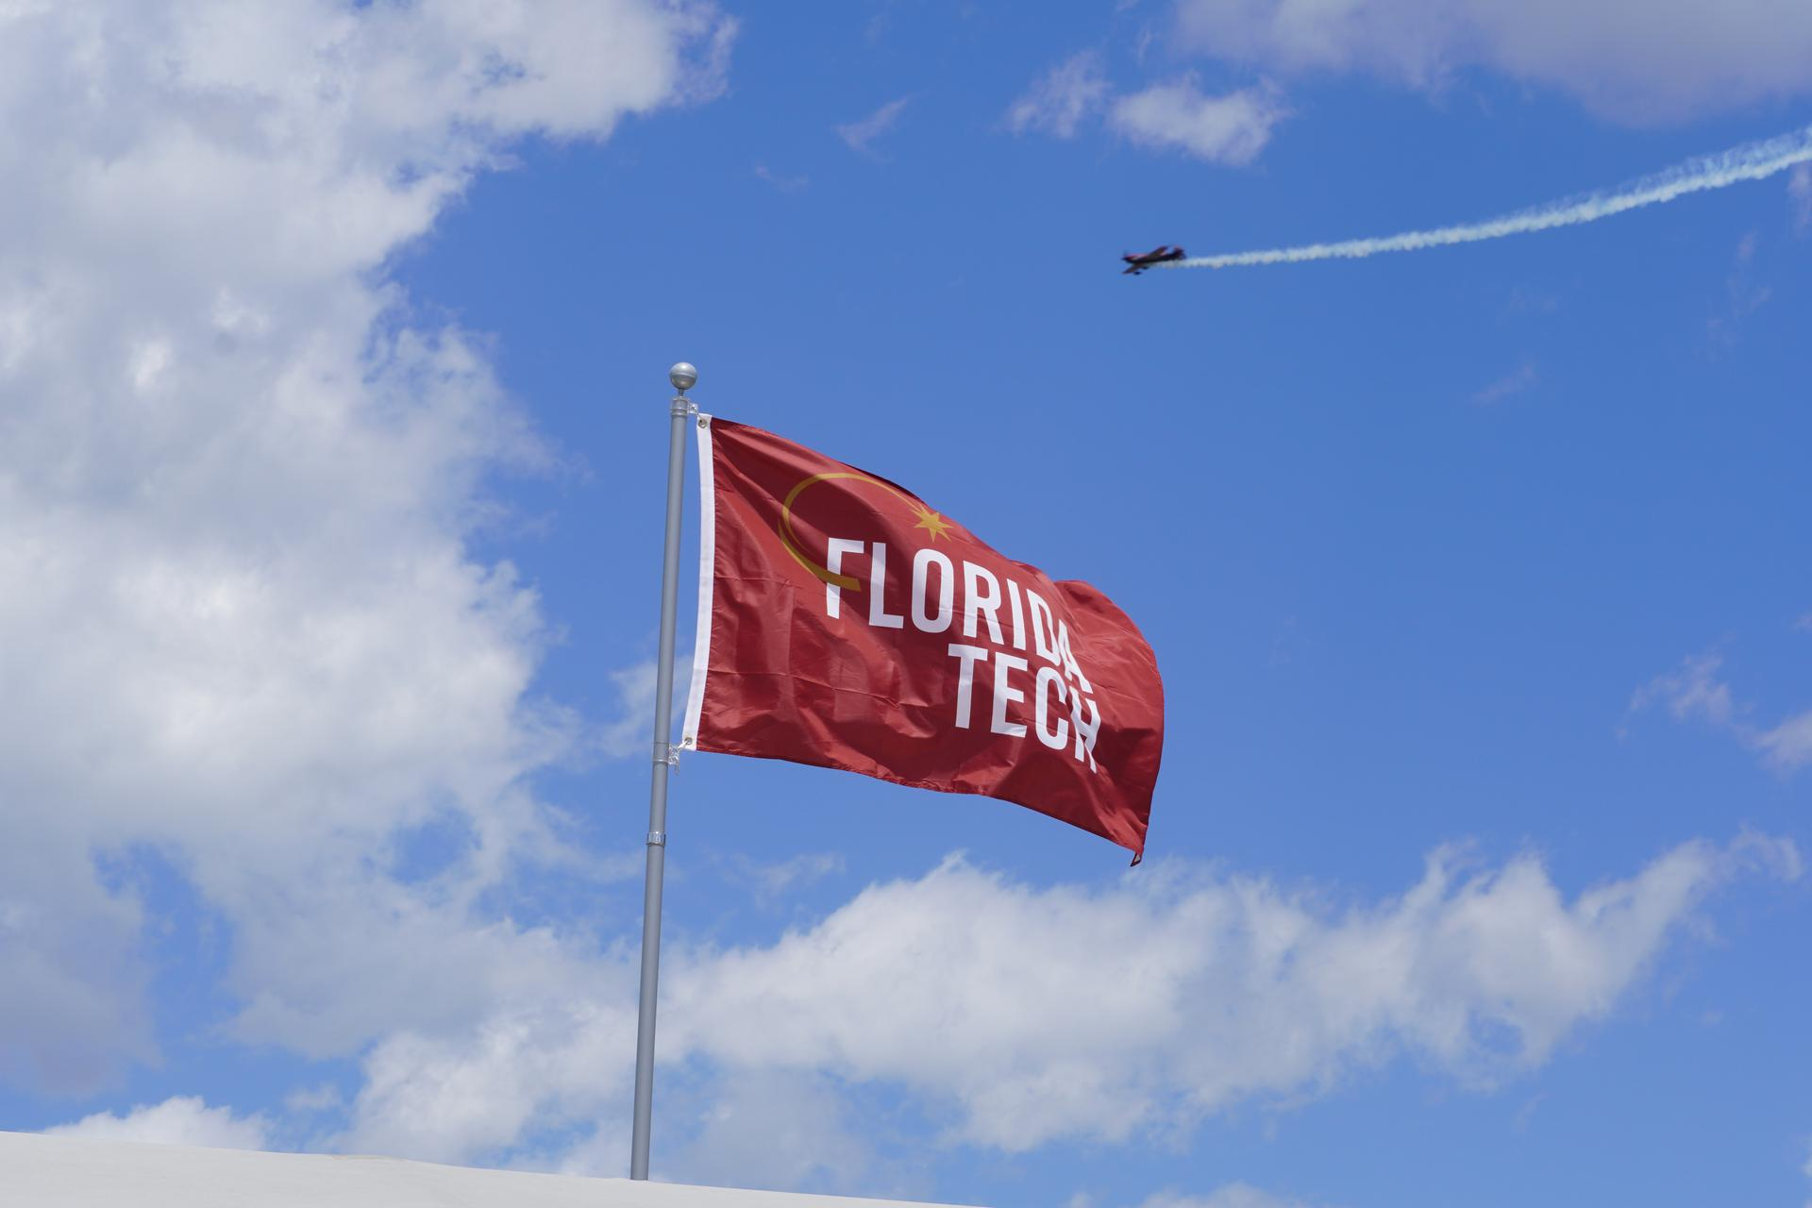
What Private Universities Want

Slide 10
What Private Universities Want
Assurance of success in enrollment (target profile)
  Adequate number of students enrolled in all majors
  Students most likely to enroll (matriculate)
  Students least likely to attrite (leave college early)
Higher academic profile
Students who will graduate, have great careers and be good ambassadors for the school

Slide 11

How Students Decide Where To Go

Slide 12
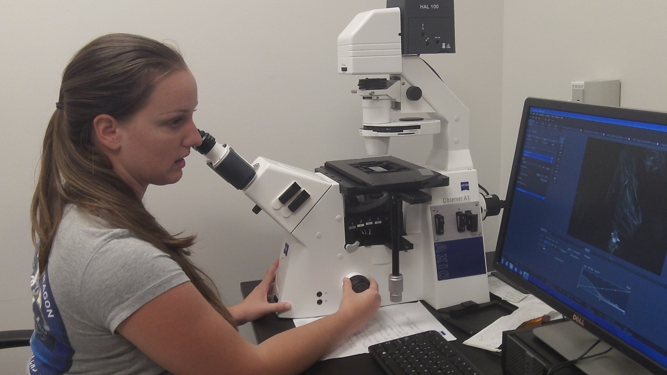
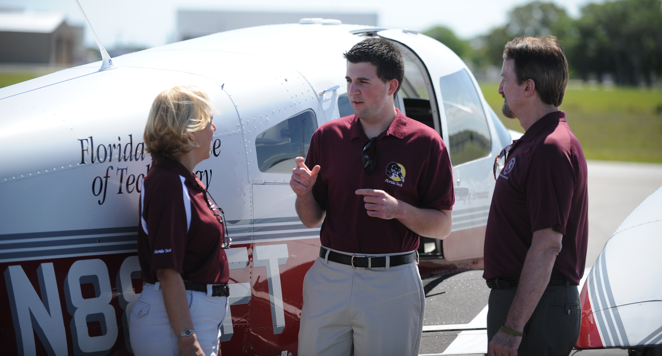
How Students Decide Where To Go
Academic Major/Field Of Study
  Do they have my major
  Quality of the educational majors available
  National academic reputation
Location (close to home, water, mountains)
Prestige of the college/university
Cost
Financial aid available
Athletic programs available
Clubs and organizations available
Research opportunities
Quality of campus life
Where friends are going
Parental input (Alma Mater/Legacy students)
Who will accept them for admission

Slide 13
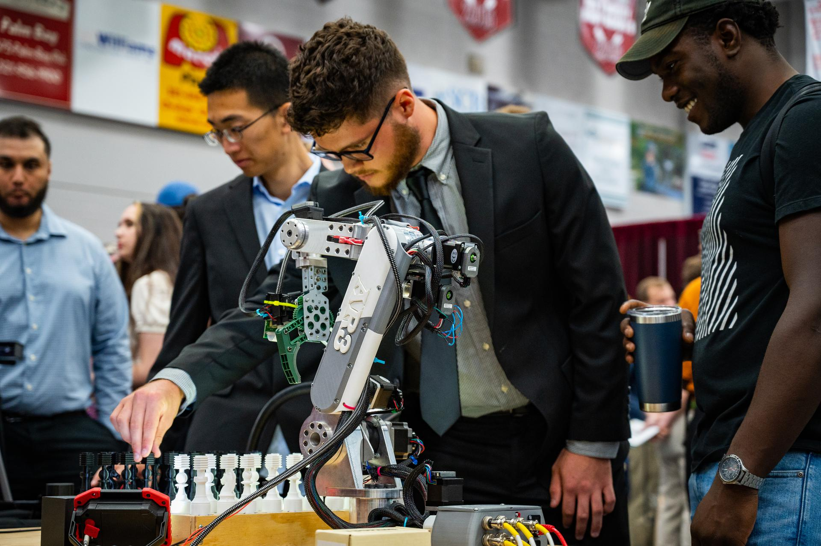
Evaluation Criteria
Admissions

Slide 14
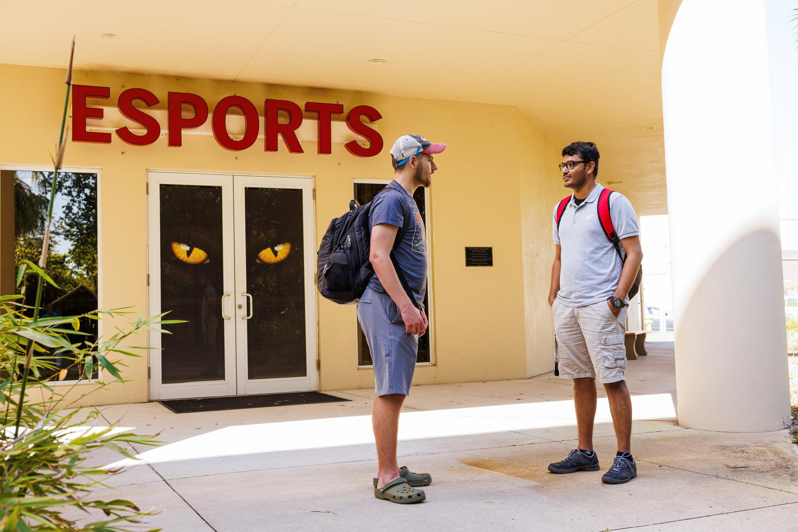

Evaluation Criteria
Application for Admission
  Transcripts
  SAT or ACT results (some are test optional)
  Essay
  Letters of Recommendation
Interview
Extra-curricular activities
Contacts with the college or university (Engagement)
College/University specific test

Slide 15

Standards for Admission
Strength of High School Curriculum (AP, IB, AICE, Dual Enrolled)
  Math (4)
  Science (3)
  English (4)
  Social Studies (3)
  Foreign Language (2)
Cumulative GPA (Weighted)
  4.0 regular classes
  4.5 honors classes
  5.0 AP, IB, AICE, Dual-Enrollment Classes
Outstanding Grades (A’s and B’s)
SAT; ACT (30% of FL privates are test optional) – most super score
Essay – did you answer the question? (A second pair of eyes helps!)
Letters of Recommendation (who wrote them) – Teachers, Counselors, Supervisors
Extra-Curricular (do you have a talent) – Athletics, Music, Community Service

Slide 16

Skills for Success
Prepare for College
  Assertiveness
  Time-management
  Critical-Thinking
  Organization
  Leadership
  Collaboration
  Problem-solving
  Self-motivating
  Communication

Slide 17
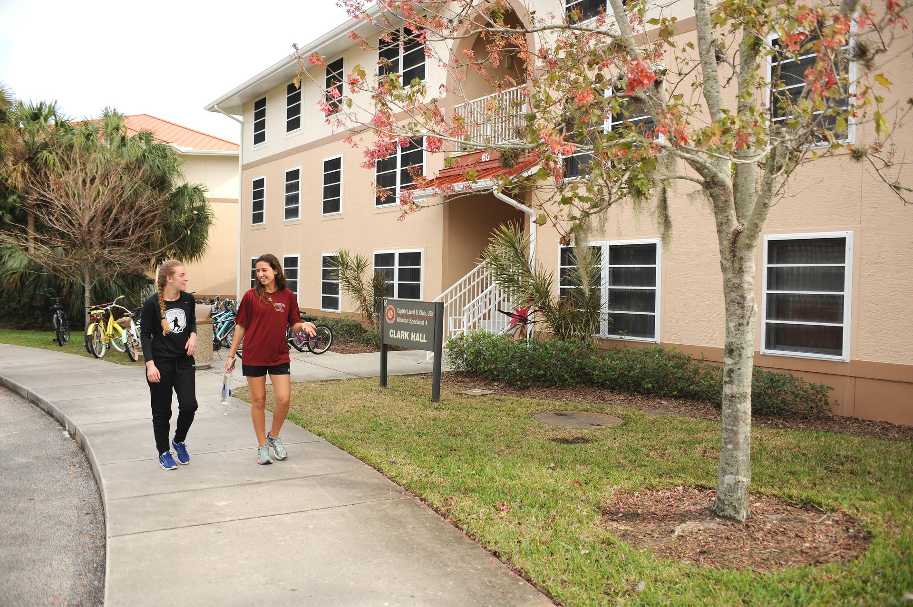
Keys To Success
Prepare for College
  Take challenging courses
  ***Ask an admission counselor to recommend classes for your intended major***
  Take highest course level you can handle
  Take extra
  Build a resume’
Visit
Know what application materials are needed
Apply early

Slide 18
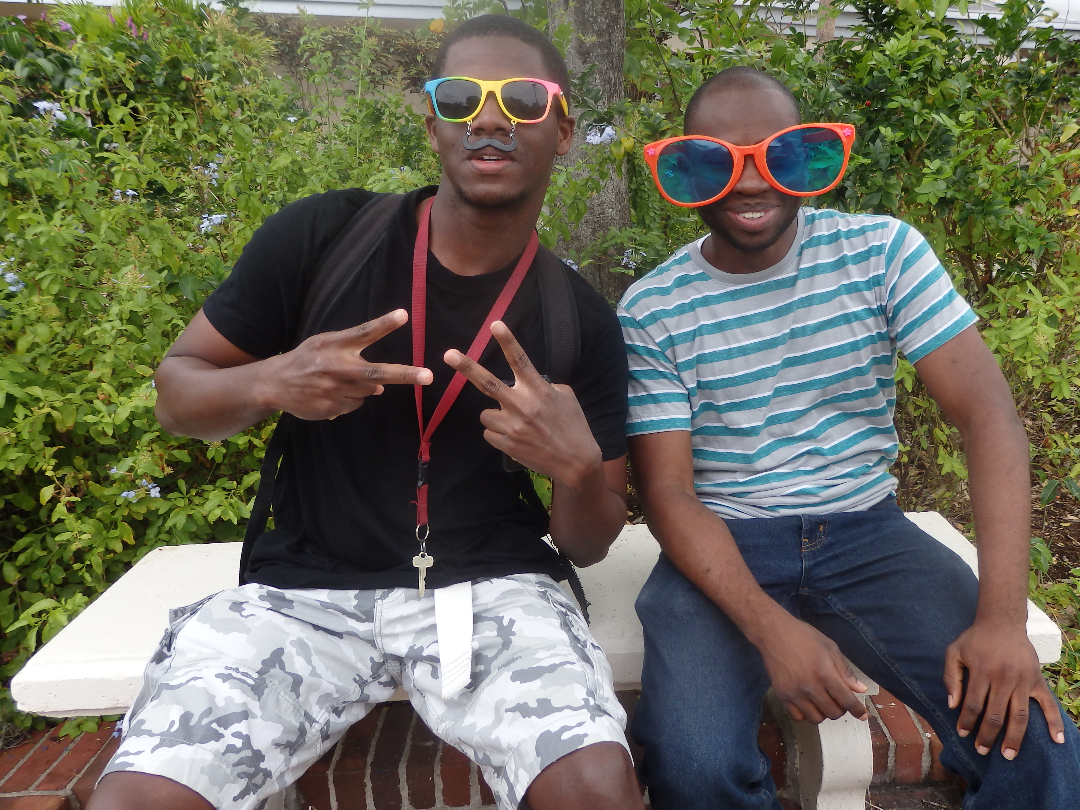
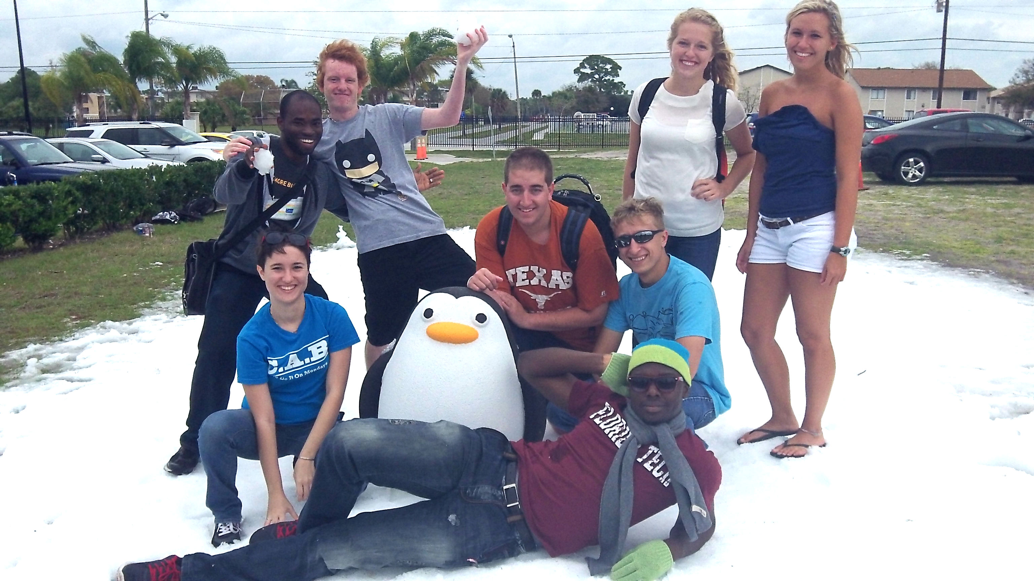
Plan for College
Freshmen
  Plan your class schedule
  Enroll in challenging course
  Get involved (extra-curricular activities)
  Go to a college fair
  Learn about majors
  Start Preparing for SAT/ACT
Sophomores
  Take PSAT (October)
  Get on mailing lists
  Start researching colleges/universities online

Slide 19
Plan for College
Rising Seniors (This Summer)
Refine list of interests, preferences and qualities
  Visit colleges (meet with Admission Counselor)
  Take SAT or ACT (retake it if needed)
  Develop a short list of schools to apply
Seniors (This Fall)
  Apply for Admission
  Apply for Scholarships/Financial Aid
  Visit colleges
  Make decision on attendance

Slide 20
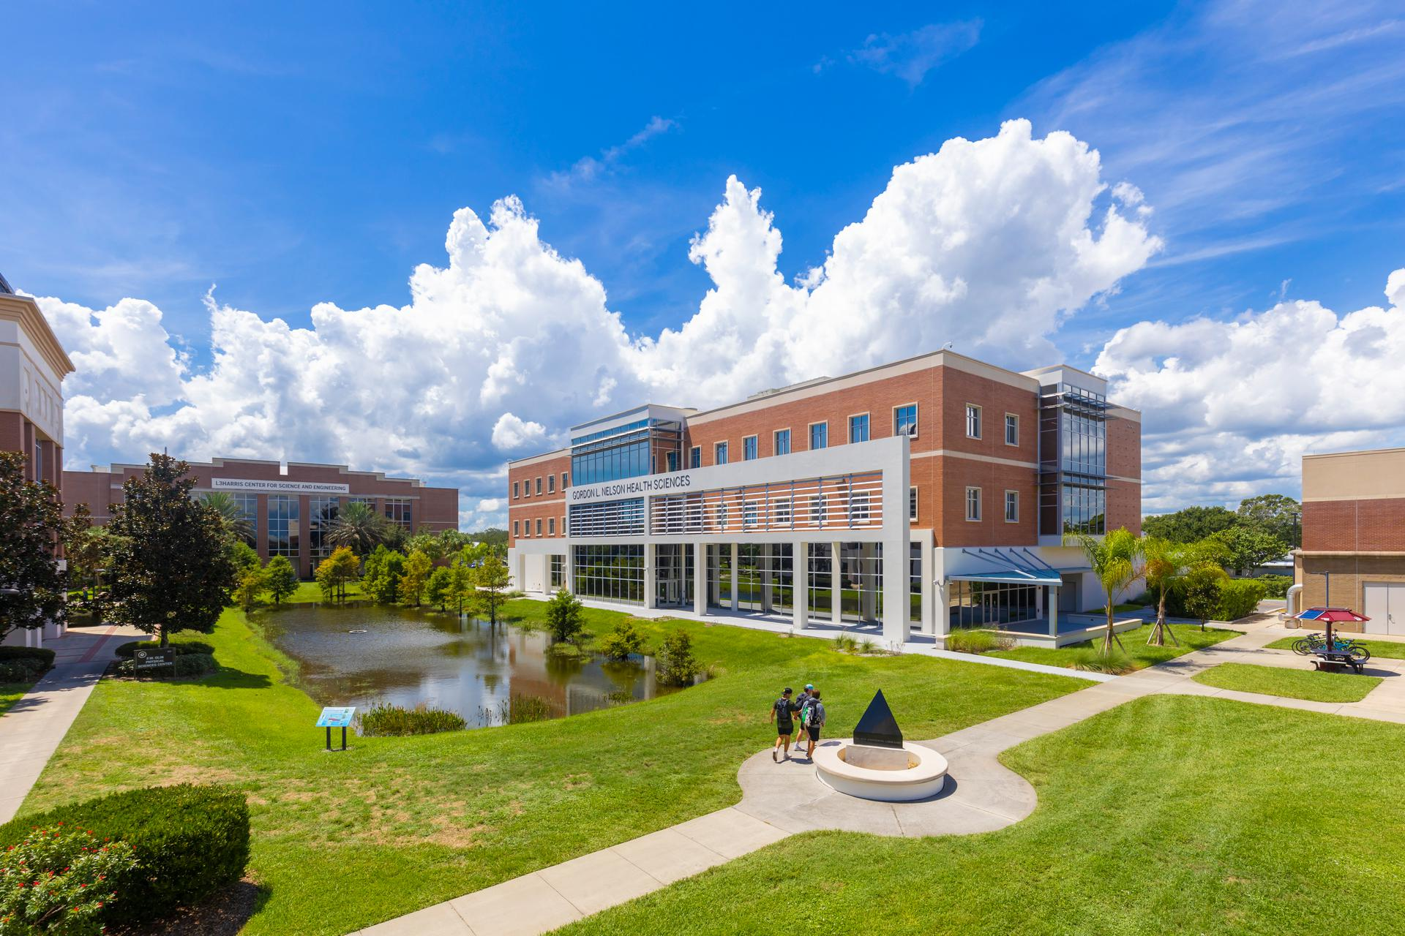
Visit Colleges
Campus Tours

Slide 21
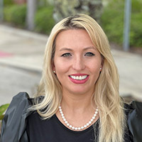
During your College visits
Talk to current student: Student Ambassadors
Meet your admission counselor
Ex:
Ask about: research, athletics, clubs, internships, majors, student support, career services, study abroad, housing, dining options, honors college
Talk to Financial Aid
scholarships, grants, cost of attendance

Slide 22
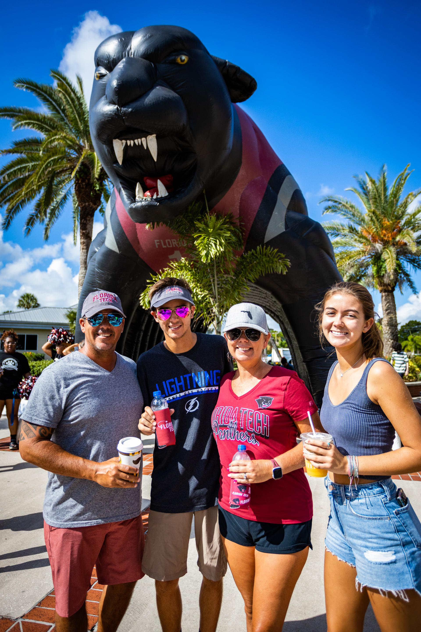
Paying for College

Slide 23
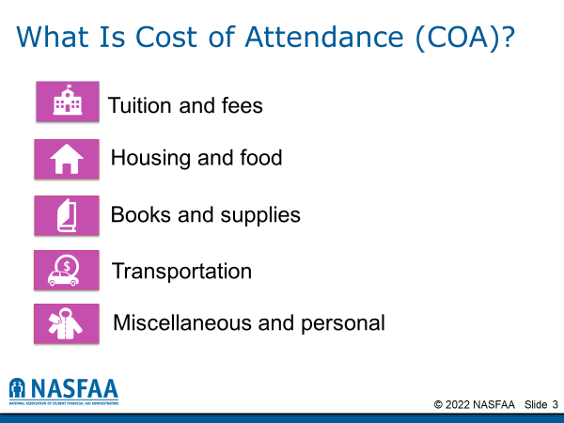

Slide 24
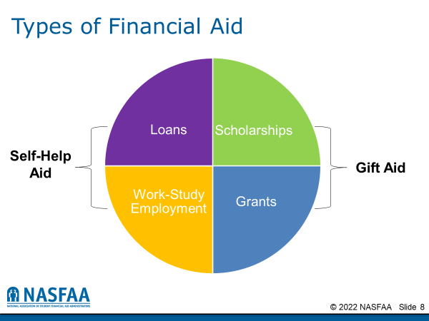

Slide 25
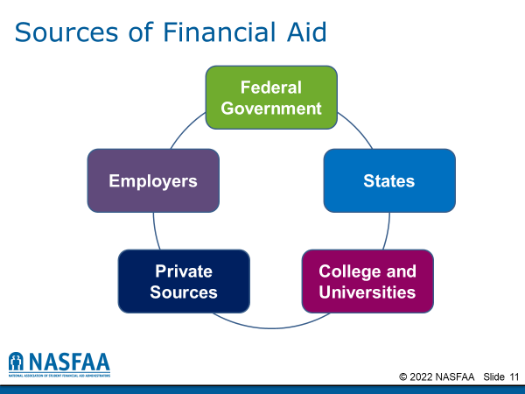

Slide 26
Free Application for Federal Student Aid (FAFSA®)
Application usually opens October 1st
  Delays are expected this year
Colleges may set FAFSA priority dates
  Some Colleges may ask for a College Profile Form from the college Board
Meet Colleges deadlines
  File early, form will use 2022 tax information

Slide 27
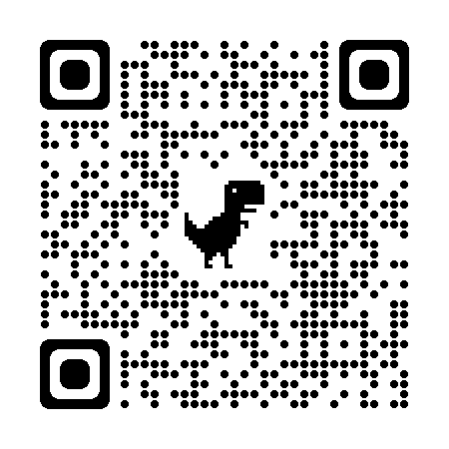
Florida Student Scholarship & Grant Program
Goes live on Oct. 1st, 2023, for Fall 2024

Slide 28
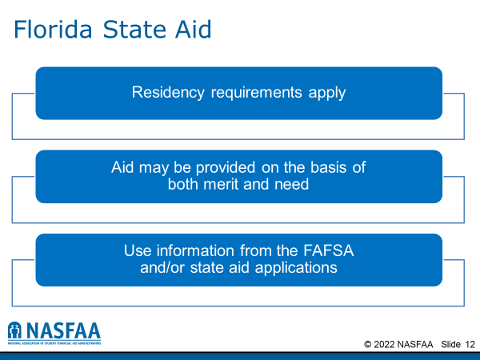

Slide 29
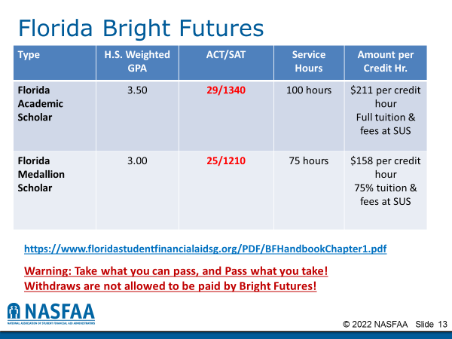

Slide 30
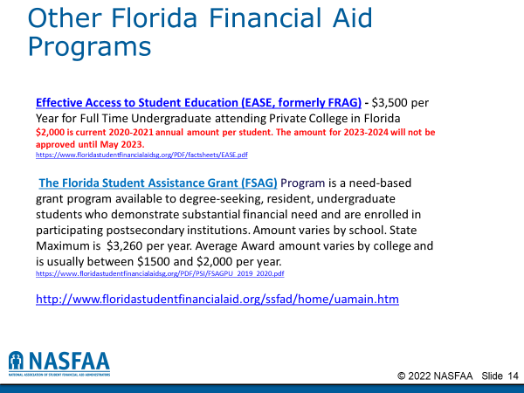

Slide 31
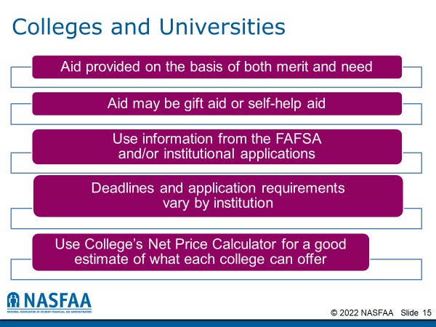

Slide 32
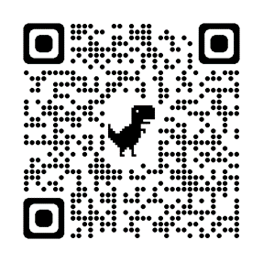
Florida Tech In-house Scholarship
Example: Panther Distinguished Scholar Award
4 year, Full-tuition Scholarship: Deadline Feb. 1st
Complete the Florida Financial Aid Application while still in high school
Qualify for the Bright Futures Florida Academic Scholars award
Apply and be admitted to Florida Tech as a full-time, on-campus, degree-seeking student by February 1 of the year immediately preceding your first semester.
Complete and submit the Free Application for Federal Student Aid (FAFSA) listing Florida Tech as a receiving institution (financial aid code: 001469) by February 1 of the year immediately preceding your first semester.
Complete the Florida Tech Panther Distinguished Scholar Application by February 1

Slide 33
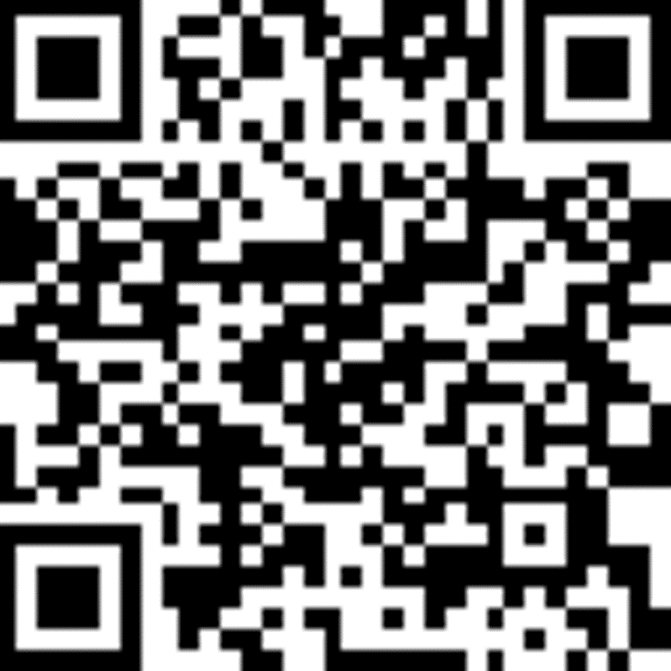
Join us for Discovery Day !
Saturday, November 18 at 8:30 AM-3:30 PM

Slide 34
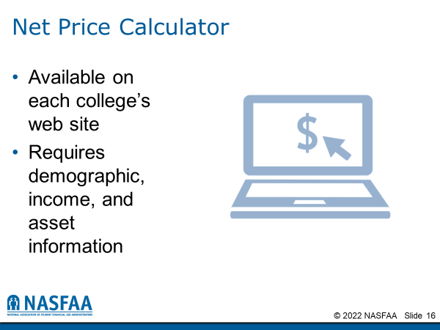

Slide 35
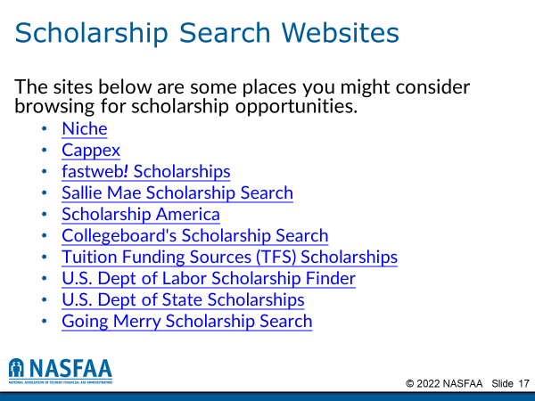

Slide 36
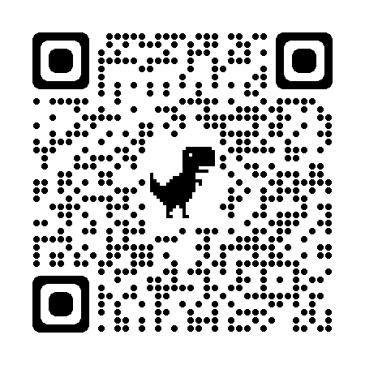
Connect with an Admission Counselor
Interested in Florida Tech?
Matylda Zamudio | Admission Counselor
Florida Tech | Office of Undergraduate Admission
Undergraduate Admissions
(321) 674-8030 – Main Admission Office
(321) 674–7710 – My Direct Landline
(321) 339-2791 – Text Only

Slide 37
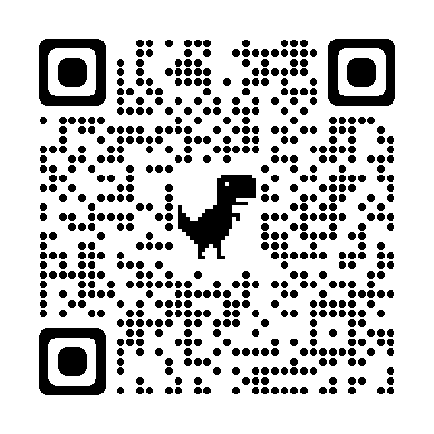
Join us for a campus tour!

