Slide 1
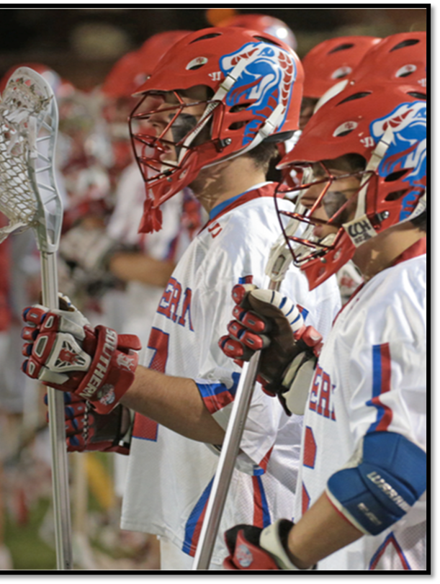
College Athletics: Levels of Competition and the Recruiting Process

Slide 2
Facts about NCAA Sports
S
Source: NCAA.org

Slide 3
Playing Sports in College
Varsity Sports: College representative, compete against other college teams, programs receive some type of funding to operate their programs.
*Governed by sports associations:
National Collegiate Athletic Association (NCAA) - Division I, II, III
National Junior College Athletic Association (NJCAA) - Division I, II, III
National Association of Intercollegiate Athletics (NAIA)
Club & Intramural Sports: Alternative participation option, compete against other club and intramural teams.
Clubs: Student run, may have travel, regional and national championships
Intramural: Teams from the same school play each other

Slide 4
NCAA: National Collegiate Athletic Association
The NCAA is the largest and most well known of the college sports associations. When you watch college sports on TV, you’re usually watching NCAA athletes.
The NCAA oversees three levels of play:
Division I is the biggest and most competitive NCAA division. Full scholarships, partial scholarships, recruited walk-ons, and walk-ons (no scholarship) are included on teams as athletes.
Division II athletic programs often as competitive as those in Division I but more regional. Most student-athletes don’t get full-ride scholarships, but those who do receive financial aid for playing have the ability to stack scholarships with merit aid at most schools. Partial scholarships, recruited walk-ons, walk-ons.
Division III athletic progams do not offer sports-related financial aid. Still, these schools recruit walk-ons and offer tryouts for walk-ons; being a recruited athlete may help you get into a college that wants you in its program.
***NJCAA schools have same structure for scholarship awarding

Slide 5
NCAA DIVISIONS OVERVIEW

Slide 6
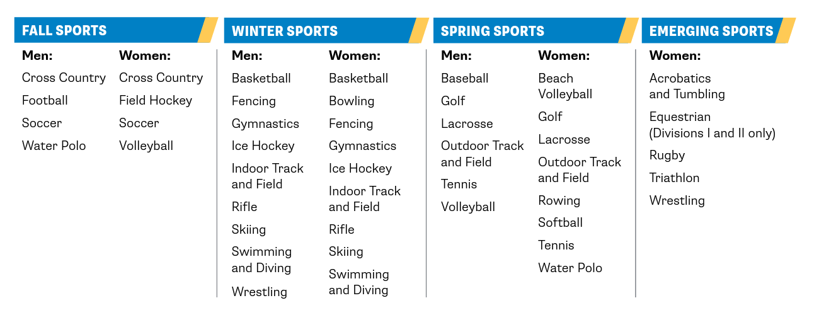
NCAA Sports
IF you do not see the sport that you play on this list, your sport may be governed by NAIA or possibly another association.
Not All Schools compete in every sport****

Slide 7
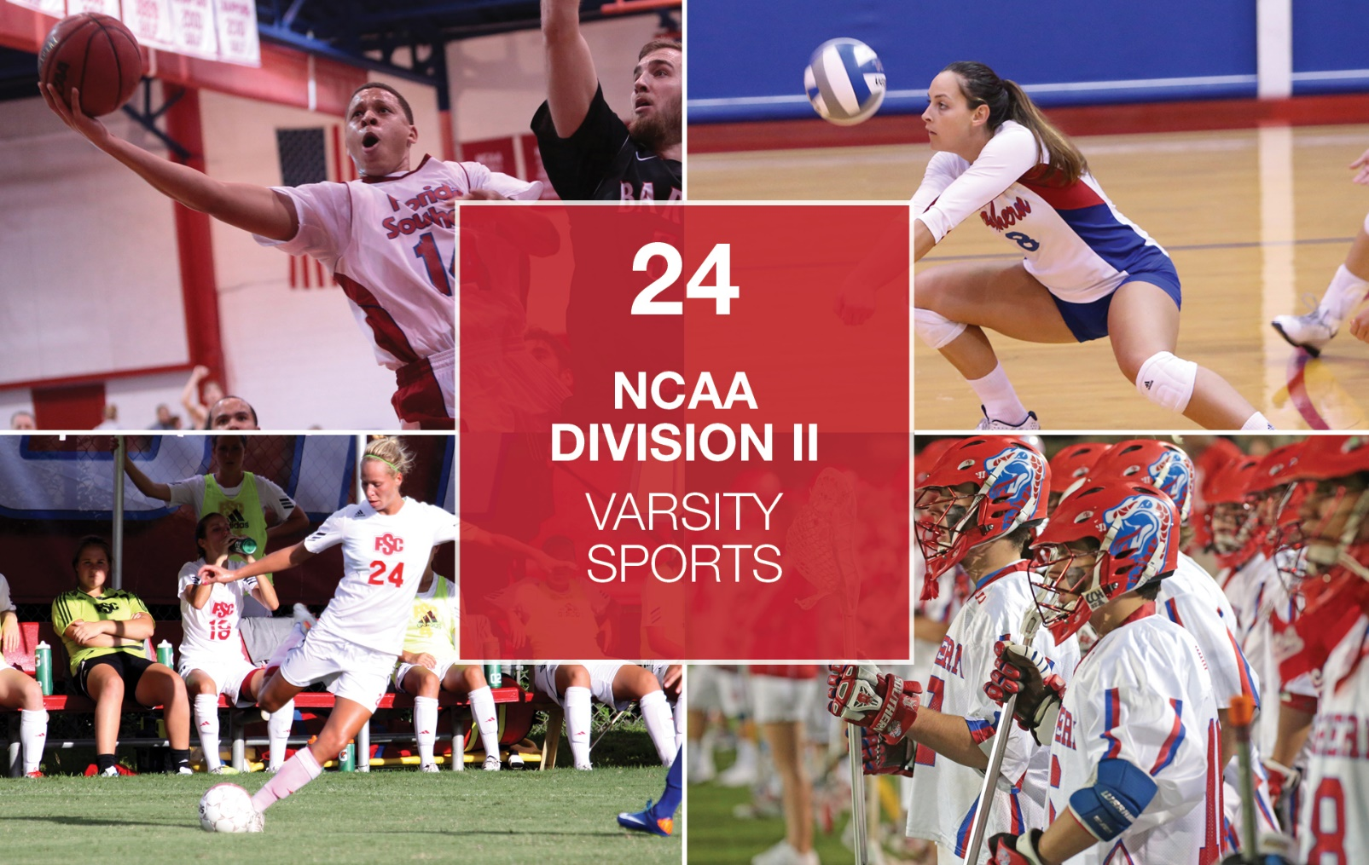
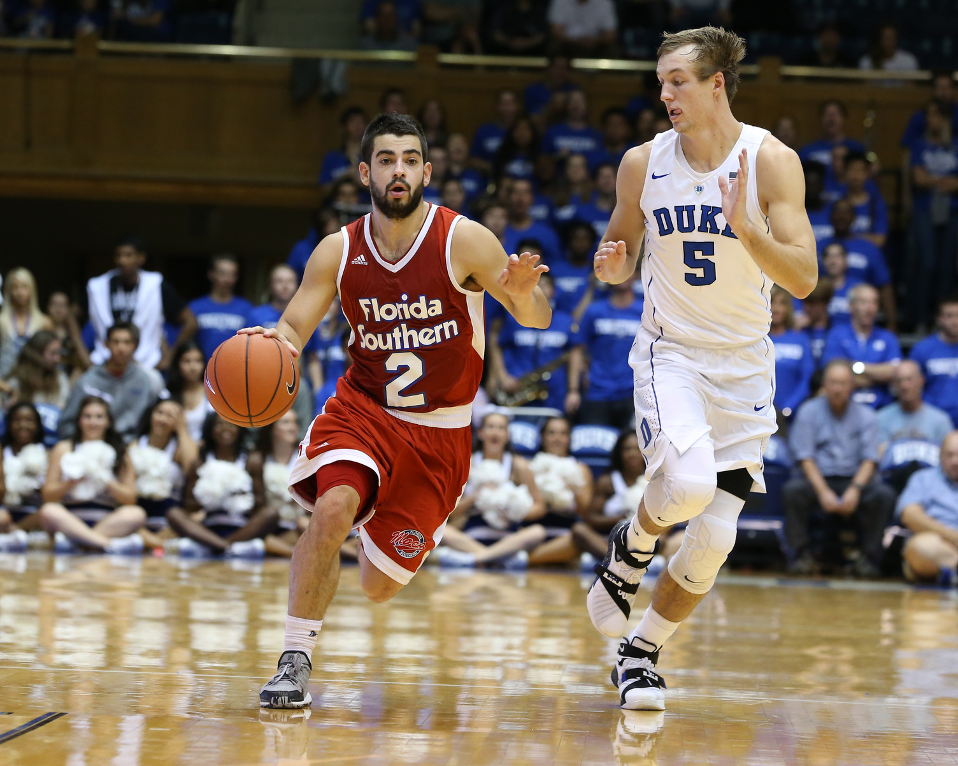
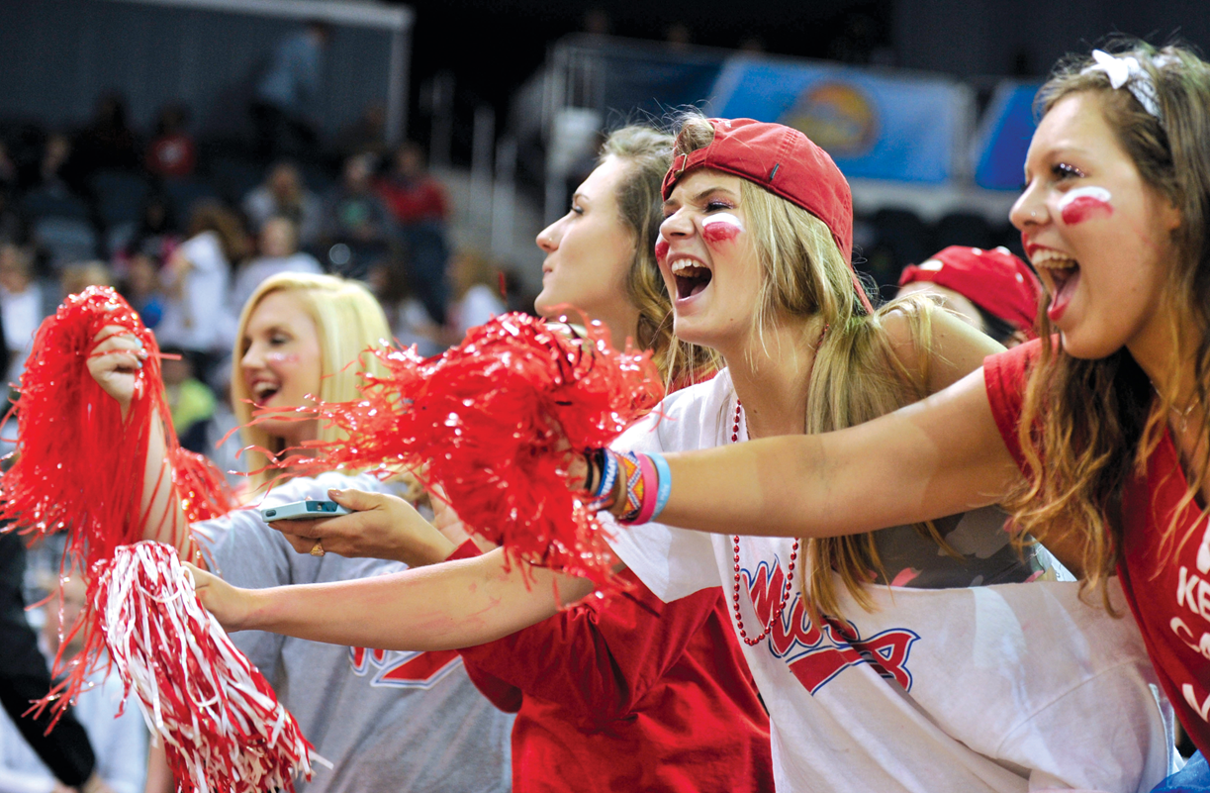
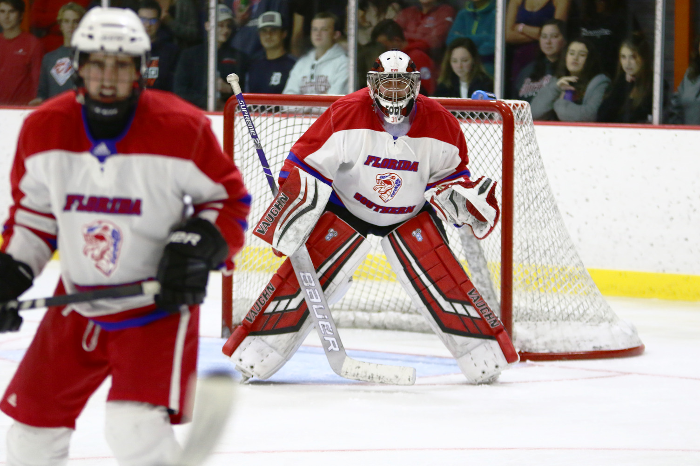
20 VARSITY SPORTS
30
NCAA DIVISION II
NATIONAL CHAMPIONSHIPS
CLUB SPORTS EQUESTRIAN
ESPORTS
ICE HOCKEY
CHEERLEADING
Notes:
Athletics + Wellness

Slide 8
Process to Compete
If you want to compete in NCAA sports, you need to register with the NCAA Eligibility Center at: eligibilitycenter.org.
ELIGIBILITY REQUIREMENTS DIFFER BASED ON DIVISION AND SCHOOL. YOU MUST BE ADMITTED TO A SCHOOL IN ORDER TO BE ELIGIBLE TO COMPETE AS AN ATHLETE.
http://fs.ncaa.org/Docs/eligibility_center/Student_Resources/CBSA.pdf
https://www.ncaa.org/sports/2014/10/13/home-school-students.aspx
https://www.facebook.com/ncaaec/
Scholarship Athlete – offered some type of athletic aid of any amount
Recruited Walk-On – recruited and offered a spot in the program but not offered any scholarship aid
Walk-On – offered a spot on the team following a tryout or other form of recruitment while on campus and enrolled at the school

Slide 9
Process to Compete - Academic Eligibility Overview
DIVISION I (through the class of 2024)
Complete 16 NCAA core courses (10 by the end of junior year)
Core Course Breakdown:
English (4 years)
Math (3 years)
Science (2 years)
Social Science (2 year)
Additional Year (English, Math, Science)
Additional Core Course (4 years)
English, Math, Science, Social Science, world language, comparative religion/philosophy
Qualifier: Core Course GPA of 2.3 or higher
Pass/Credit grades awarded “C+” value if it helps an athlete qualify academically
DIVISION II (through the class of 2024)
Complete 16 NCAA core courses
Core Course Breakdown:
English (3 years)
Math (2 years)
Science (2 years)
Social Science (2 years)
Additional Years ( 3 combined English, Math, Science)
Additional Core Course (4 years)
English, Math, Science, Social Science, world language, comparative religion/philosophy
Qualifier: Core Course GPA of 2.2 or higher
Pass/Credit grades awarded “C+” value if it helps an athlete qualify academically

Slide 10
Process to Compete – High School Timeline
Plan
Register
Study
Graduate
Grade 9
Review core course guidelines listed in the College-Bound Athlete Guide
Earn the best grades possible.
Review the NCAA course listing
Grade 10
Register with the NCAA Eligibility Center at https://web3.ncaa.org/ecwr3/
Make sure to let your counselor know your plans.
If you fall off track- check back in with your counselor about your academic alternatives.
Grade 11
Confirm with your counselor that you are on track to complete core coursework on time.
At the end of the year- sign up to take SAT or ACT, have scores sent to NCAA using code 9999
Request to have your final junior transcript uploaded to the NCAA portal by our registrar. Make sure official records are sent from all schools you have attended.
Grade 12
Take the SAT or ACT again, if necessary.
Complete required core coursework, with the necessary grades to maintain an eligible Division I/II GPA.
Request final amateurism cert. starting 4/1 (fall enrollees), through your NCAA account.
Request a final transcript (end of senior year) be uploaded to the NCAA portal, with proof of graduation.

Slide 11
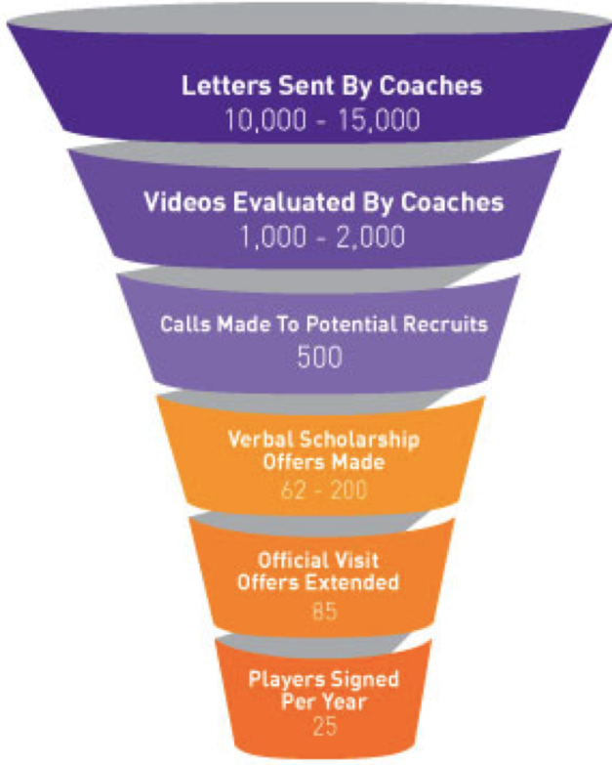
THE RECRUITMENT PROCESS SHARED FROM COACHES
Coaches inboxes are inundated with prospective student athletes inquiries and simply do not have the time or resources to vet every single player that expresses interest.
Camps are a way for coaches to evaluate skills to and multiple programs at one time Showcase events are a way for multiple colleges to evaluate talent in one location at one time.
While coaches are more readily accessible, ineffective communication from a student can end the recruiting process before it begins.
Number of students competing for spots (athletically and academically) is larger than ever

Slide 12
THIS PLAN TAKES A TON OF PREPARATION, COMMITMENT, DRIVE, FOCUS in ALL AREAS OF ACADEMICS, ATHLETICS, EXTRACURRICULARS:
NCAA Student Athlete Responsibilities
TIPS FOR THE RECRUITMENT PROCESS SHARED DIRECTLY BY ATHLETIC DIRECTORS
Know when to reach out to the coaches by email and manage your expectations - if a coach is in season, their focus is COACHING, winning games, and trying to win conference, regional, and/or national championships.
Depending on the school, especially for NCAA Division II, III, and NAIA schools, if you email a coach and share you did an OFFICIAL tour of campus with an admissions office, that immediately shows you already know more about the school than a random email that comes in from another student wanting to be an athlete.
At NCAA Division I and Division II schools, coaches recruit athletes; Admissions has nothing to do with the process.
When emailing coaches - keep it short and informative, include basic bio info and video is great (nothing super produced). (Name, position, grad year, REAL unweighted GPA, your high school, your email.
NCAA Division I, II, III Coaches cannot start actively recruiting (calling/emailing) students generally until the start of Junior year of high school.
Not every school has tryouts - don’t assume you will be able to join a team through a tryout

Slide 13
Resources
2022-2023 NCAA Guide for the College-bound Student-athlete:
http://fs.ncaa.org/Docs/eligibility_center/Student_Resources/CBSA.pdf
2022-2023 Guide for Homeschool Students
https://www.ncaa.org/sports/2014/10/13/home-school-students.aspx
NCAA Eligibility Center
https://web3.ncaa.org/ecwr3/
https://www.facebook.com/ncaaec/
NAIA Member Schools and Recruiting Information
https://www.naia.org/schools/index

