Slide 1
WELCOME to JUNIOR Parent Night at MIHS
James Rehmer - Principal
Debbie Lubbers - Asst Prin
Class of 2024
Wanda Luthman - Junior Class Counselor
Gabrielle Ash - College & Career Specialist

Slide 2
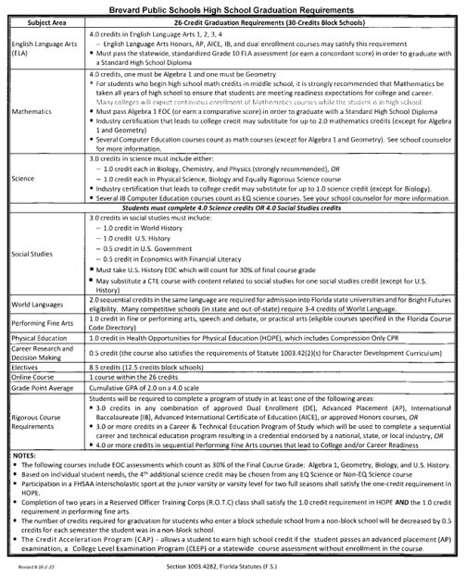
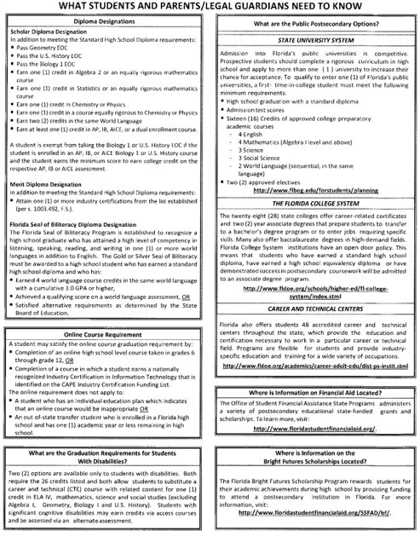
BPS High School Graduation Requirements

Slide 3
Exploring Post-Secondary Opportunities
Checklist for College Bound Juniors
Begin building an academic resume
Make sure you are taking challenging courses to help prepare you for college
Take the SAT/ACT. Use the feedback you receive to work on any academic weaknesses (Khan Academy)
Attend college and career fairs (Brevard College and Career Fair is anticipated to be rescheduled for sometime in the Spring 2023).
Participate in school activities and volunteer efforts. Extracurricular activities can help you develop time management skills and enrich your high school experience. Activities also help you stand out to prospective colleges and universities.
Tour college campuses. If your family is travelling near a college campus, take advantage of the opportunity and go for a tour. MIHS is working to increase the number of opportunities students have to visit colleges during school.
SAT ~ March 1, 2023

Slide 4
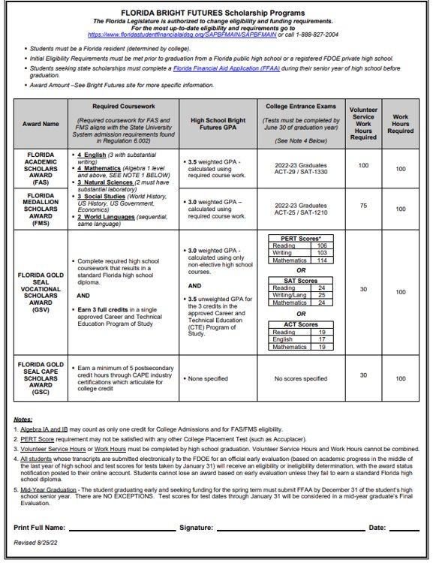
Bright Futures
5 Requirements for Bright Futures​
​
Application window opens Oct. 1st – apply by graduation​
Complete all required coursework​
The GPA used is based on core courses (will use 2 additional core courses if needed)​
Required Volunteer OR Work Hours ​
TESTS – ACT or SAT (last test that can be used is June 2024 administration). MUST send scores to at least 1 public university in FL.​

Slide 5
Dual Enrollment / Early Admissions
Dual enrollment allows students to take classes at EFSC while still in high school receiving BOTH high school AND college credit
Students must have a 3.0 GPA
Students must earn a qualifying score on the PERT (Reading, Writing and Math)
Students who have met qualifications may take dual enrollment courses with or without being on a track to complete their A.A. (some students have been working toward their A.A.)
DE class on campus (SLS 1101) if they haven’t met the CCR requirement
Students wishing to Early Admit need to watch for the application window to open in late February/early March. Students seeking Early Admissions attend EFSC full time - no classes at MIHS.

Slide 6
Dual Enrollment / Early College
THINGS TO CONSIDER
Students must be independent and have a higher level of maturity
Students must be eager for academic challenges
Students must be able to advocate and communicate with professors
Students must be able to balance “college” and “high school” life simultaneously
Students wishing to Early Admit need to understand the differences between DE and EA

Slide 7
Advanced Placement Courses (AP)
AP Courses are ideal for students who are willing to challenge themselves academically
AP Courses require students to take an exam in May each year. A qualifying score of 3, 4 or 5 will earn students college credit at most colleges/universities across the country.
AP courses communicate to prospective colleges/universities that these students are “college ready” and willing to stretch themselves academically to master material and grow as an individual
MIHS offers one of the largest selections of AP courses of any high school in Brevard
Students also have the opportunity to earn an AP Capstone Diploma (Reqs: AP Research, AP Seminar, 4 other AP courses)
Students can also apply to the AP Academy in February 2023.
AP Academy students are guided to a Capstone Diploma, receive advising from Mrs. Ash, and are given opportunities such as college visits, community projects, etc.

Slide 8
Advanced Placement Courses (AP)
Capstone Courses
AP Seminar (10-11th)
AP Research (11-12th)
Social Studies Courses
AP World History (9th)
AP U.S. History (10th)
AP Human Geography (10-12th)
AP Psychology (10th-12th)
AP Comparative Govt & Politics (10-12th)
AP U.S. Govt & Politics (11th)
AP European History (10-12th)
AP Microeconomics (12th)
AP Macroeconomics (12th)
Elective Courses
AP Studio Art: 2D-Design (11-12th)
AP Studio Art: Drawing (11-12th)
AP Music Theory (10-12th)
AP Spanish Language & Culture (10-12th)
English Courses
AP Language and Composition (11th)
AP Literature and Composition (12th)
Science Courses
AP Biology (10th)
AP Chemistry(11th)
AP Physics(11-12th)
AP Environmental Science (10-11th)
Math Courses
AP Calculus A/B (11-12th)
AP Calculus B/C (12th)
AP Statistics (11-12th)

Slide 9
Exploring Post-Secondary Opportunities
*Meet with a recruiter
*Request a pre-candidate questionnaire

Slide 10
Exploring Post-Secondary Opportunities
EFSC Vocational Programs (A.S./Adv Tech Certs)
38 A.S. degrees some of which include Accounting, Aerospace Technology, Culinary, Dental Hygiene, Drafting, EMS, Medical Assistant, Radiography, Veterinary Nursing
4 Advanced Technical Certificates - Adult Cardiac Sonography, Network Security Forensics, Vascular Sonography, and Veterinary Practice Management
16 Career and Technical Certifications some of which include Aviation Mechanic, Cosmetology, Fire Fighter, HVAC, Patient Care Assistant, Welding Technology
Universal Technical Institute - over 35 different career paths/programs including automotive, welding, HVAC, marine, diesel, robotics, wind power
Full Sail University - Masters, Bachelors, Certificates - 3D Arts, Audio Arts, Audio production, Computer Animation, Cinematography, Digital Marketing

Slide 11
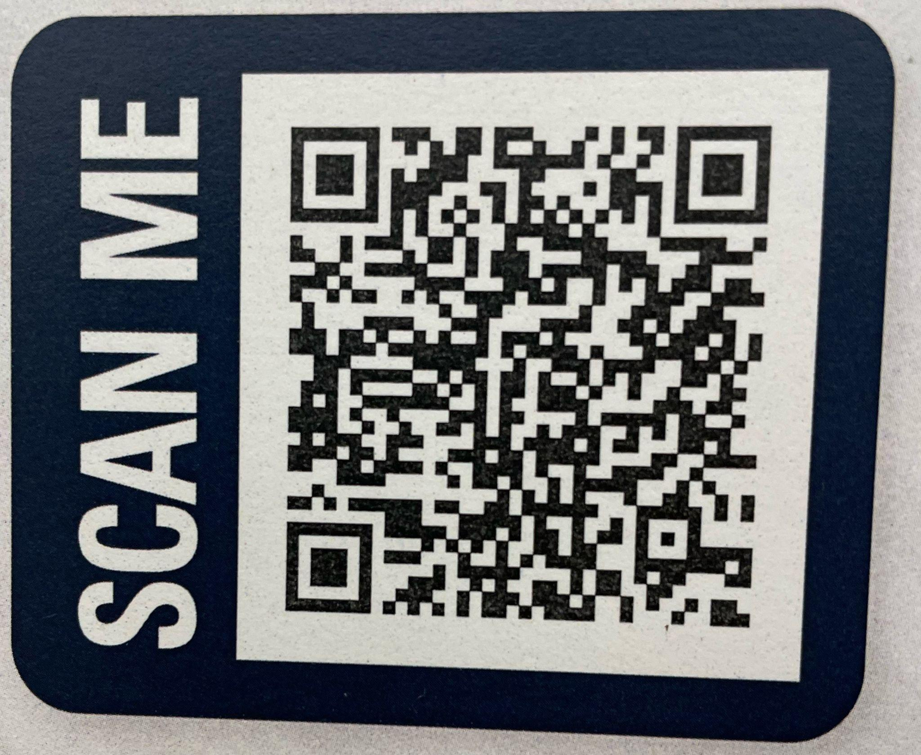
Exploring Post-Secondary Opportunities
Career Interviews​
Fire Rescue/Paramedic​
Real Estate Broker​
Social Media Director ​
Dentist/Orthodontist​
Blackhawk Helicopter Pilot​
Universal Technical Institute​
Teaching Interventions Keeping Individuality, Inc. (RBT)​
Blue Marlin Realty​
Local construction companies

Slide 12
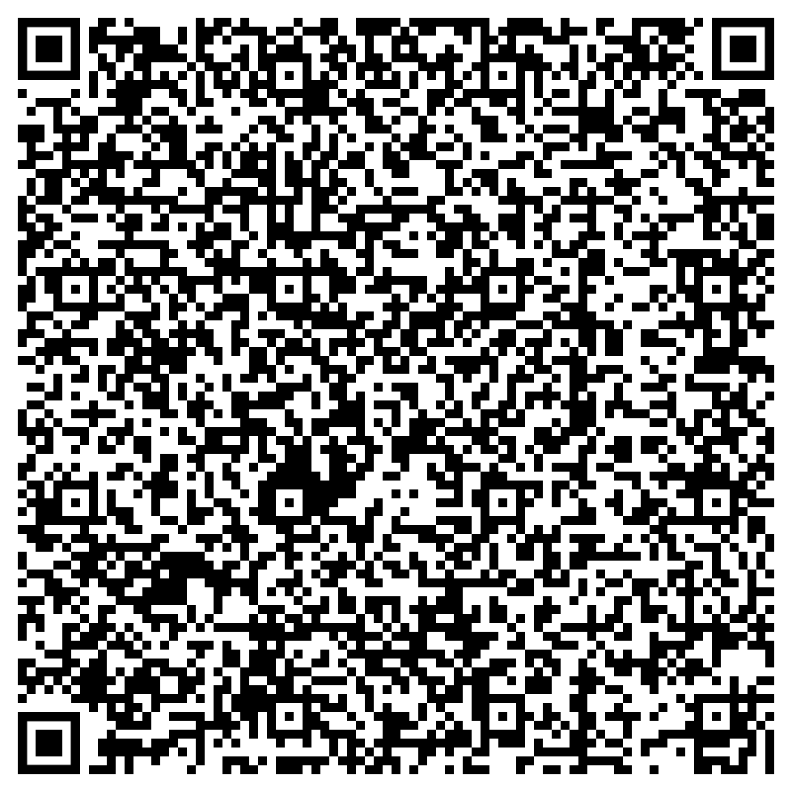
Exploring Post-Secondary Opportunities
We strive to help every student find success
GET INVOLVED
Make an appt to see Mrs. Ash and discuss post-graduation plans. ​
EVERY STUDENT NEEDS TO HAVE A PLAN!!!​
Internships​
Vocational programs​
Workforce​
Apprenticeship​
Travel (gap year)​
Study Abroad​
​
Book an Appt w/Mrs. Ash

