Slide 1
Welcome to Parent SENIOR Night
MIHS Class of 2023

Slide 2
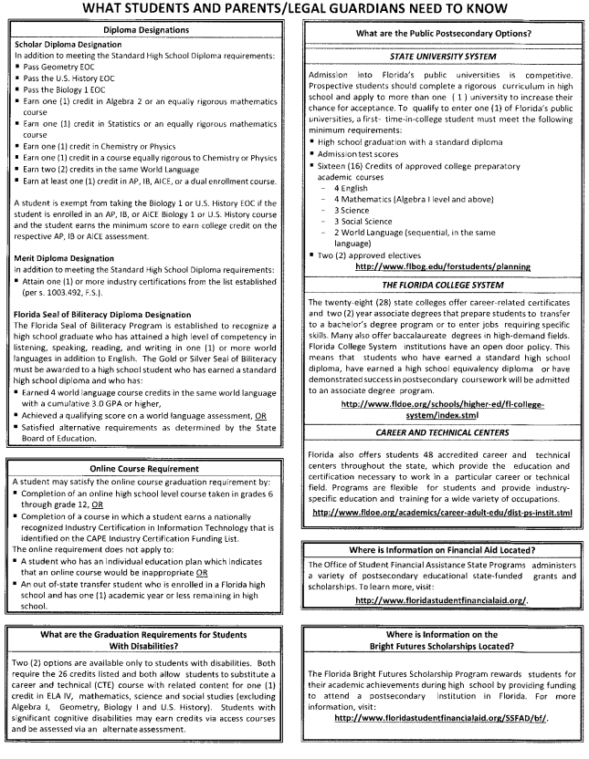
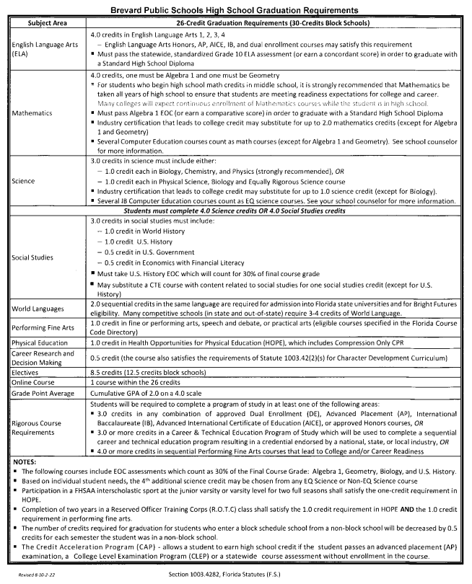
BPS High School Graduation Requirements

Slide 3
College Admissions
TIPS from Admissions Directors
Apply Early
Check and read your email
Check Status
Check and read your email
Take SAT/ACT multiple times
Check and read your email
Check and read your email
Apply directly through the institution OR the Common App – do NOT do both!

Slide 4
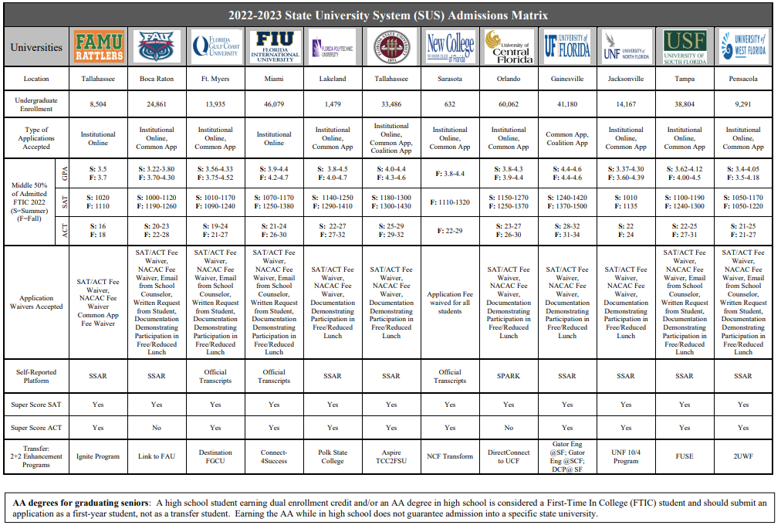
State University System Admissions Matrix

Slide 5
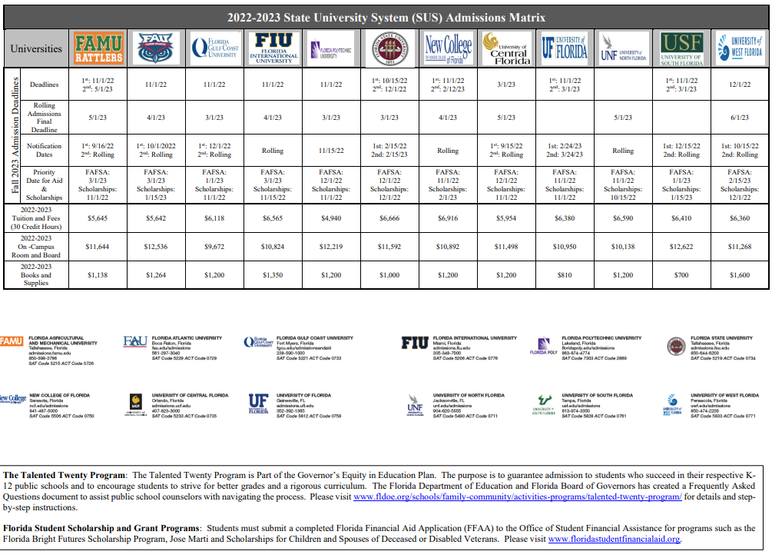
State University System Admissions Matrix

Slide 6
Bright Futures
5 Requirements for Bright Futures
Application window opens Oct. 1st – apply by graduation
Complete all required coursework
The GPA used is based on core courses (will use 2 additional core courses if needed)
Required Volunteer OR Work Hours
TESTS – ACT or SAT (last test that can be used is June 2023 administration). MUST send scores to at least 1 public university in FL.

Slide 7
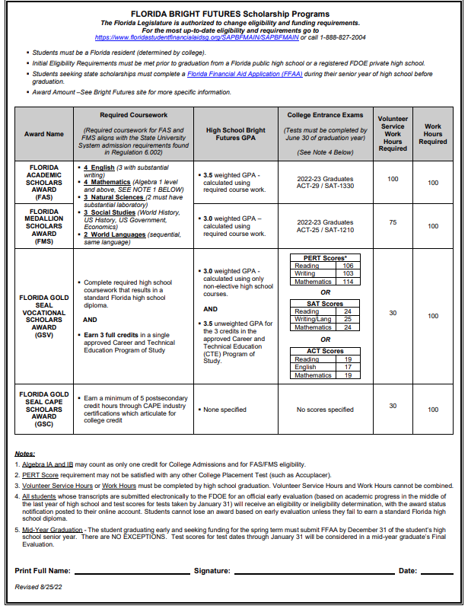
Bright Futures

Slide 8
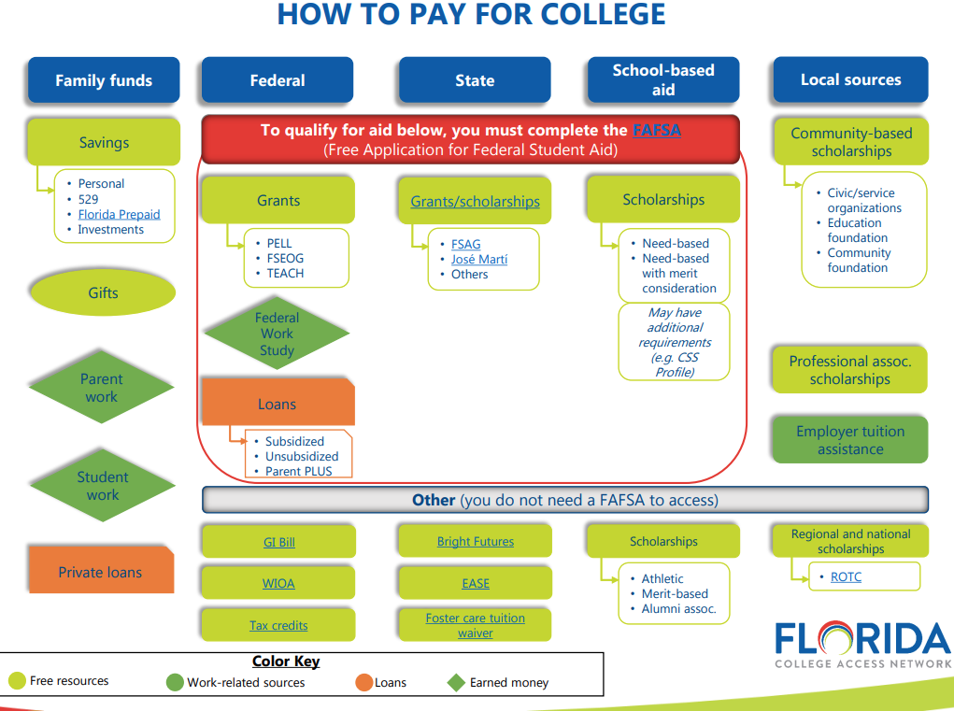
How to Pay for College

Slide 9
Florida Shines.org FREE webinars
How to Fund College?
October 10, 2022
6:00 - 7:00 p.m. ET
You’ve applied. Now, how do you pay for college?
Don’t let the cost of college stop you from achieving your dreams. Find out how to lower your cost through scholarships, grants, and other financial aid options.
https://www.floridashines.org/go-to-college/get-ready-for-college/college-101-event
Filling Out the FAFSA
October 19, 2022
6:00 - 7:00 p.m. ET
Have you completed your Free Application for Federal Student Aid (FAFSA) yet?
This free online webinar includes a step-by-step demonstration on how to complete your FAFSA, and an opportunity to have your questions answered by financial aid experts.
https://www.floridashines.org/go-to-college/get-ready-for-college/college-101-event
EVERY Senior should complete the FAFSA and Bright Futures applications.

Slide 10
FAFSA Workshops at EFSC
Tuesday, Oct. 11 – Cocoa Campus 5-7:30pm
Bldg 3 Room 112
Wed, Oct. 12 – Melb Campus
5-7:30pm
Bldg. 2 Room 201
A financial aid specialist will be on had to answer any questions. Please bring the following:
Active email for students and parents
Copy of 2021 tax return & W-2
Student and parents’ social security number

Slide 11
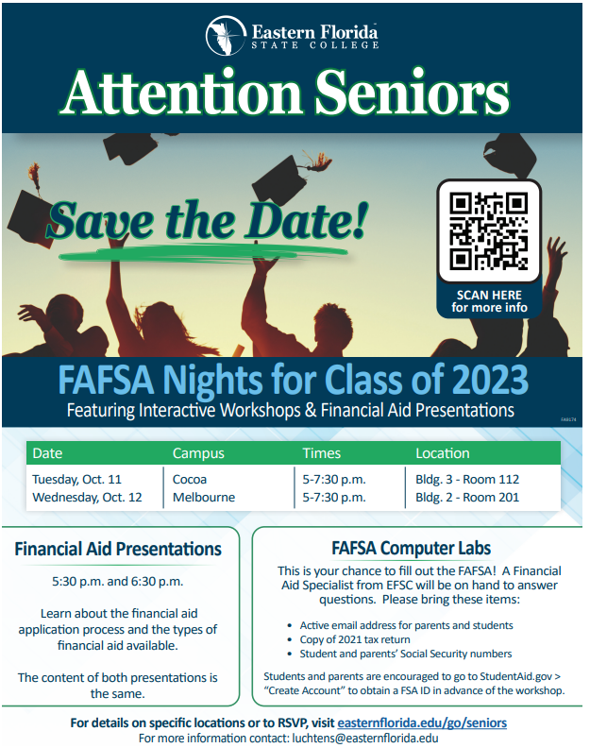
FAFSA Workshops at EFSC

Slide 12
Scholarships
We are in the process of updating the Scholarships listed on the Guidance web page.
Read the newsletter weekly for scholarship opportunities
Students can make appts with Mrs. Ash to discuss specific scholarships
Mrs. Ash has a working binder with scholarship information – students may come and peruse at any time.

Slide 13
Scholarships
College Board Big Future
FASTweb.com
Merit scholarships through Admissions Office at the Universities/Colleges to which you apply
University/College Foundation Scholarships
Alumni Scholarships
Brevard Schools Foundation (applications available Spring 2023)
Studentscholarships.org newsletter

Slide 14
Senior Dates
Schedule your SENIOR picture at www.dsp-photo.com. You MUST be photographed by Dec. 6 in order to appear in the yearbook (purchase not necessary to appear in the yearbook - $25 booking fee can be refunded or put towards a package).
Order your SENIOR Islander Yearbook at www.Jostens.com. The price is $70 but will increase.
Prom is scheduled for March 25th at the Pavilion at the Radisson in Port Canaveral.
Universal’s GRAD BASH is scheduled for April 22nd.
Graduation – TBD by BPS
Senior Ads can be purchased by going to Jostens.com and click on “create my ad”. Early bird pricing ends 11/11/22.

Slide 15
United States Military

Slide 16
Career Highlights
Career Interviews
Fire Rescue/Paramedic
Real Estate Broker
Social Media Director
Dentist/Orthodontist
Blackhawk Helicopter Pilot
Universal Technical Institute
Teaching Interventions Keeping Individuality, Inc. (RBT)
Blue Marlin Realty

Slide 17
Post Secondary Plans/Opportunities
Make an appt to see Mrs. Ash and discuss post-graduation plans.
EVERY SENIOR NEEDS TO HAVE A PLAN!!!
Internships
Vocational programs
Workforce
Apprenticeship
Travel (gap year)
Study Abroad

Slide 18
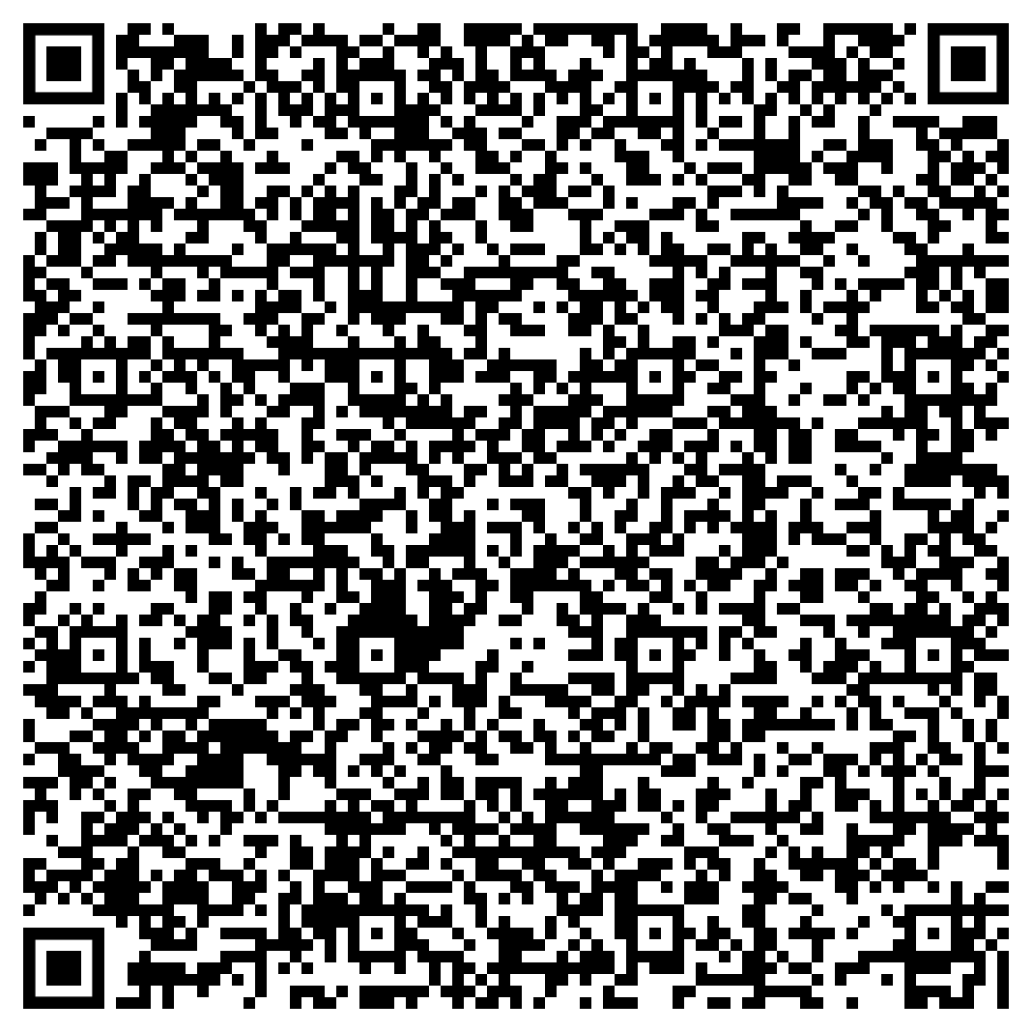
Have your student make an appointment with Mrs. Ash

Slide 19
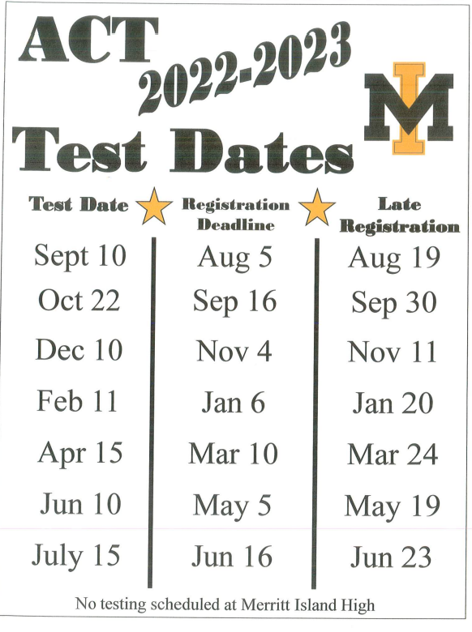
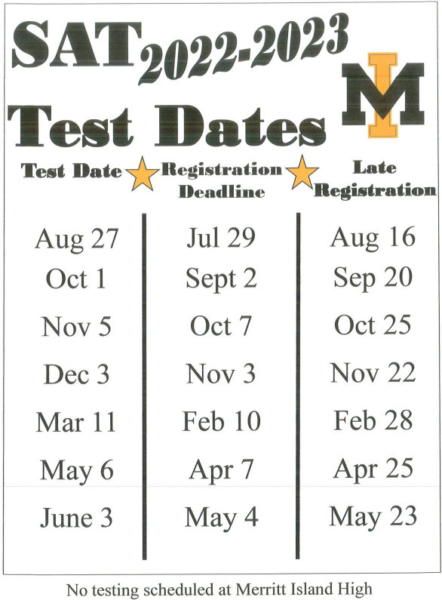
SAT/ACT Test Dates

Slide 20
SAT/ACT Test
Khan Academy – Free (SAT)
Kaplan – Paid Service (ACT)
Private Tutors
Study books (stop by and see Mrs. Ash in E-126)

Slide 21
Questions?

Slide 22
Don’t forget to stop by the Project Graduation Table in the Lobby!

