Slide 1
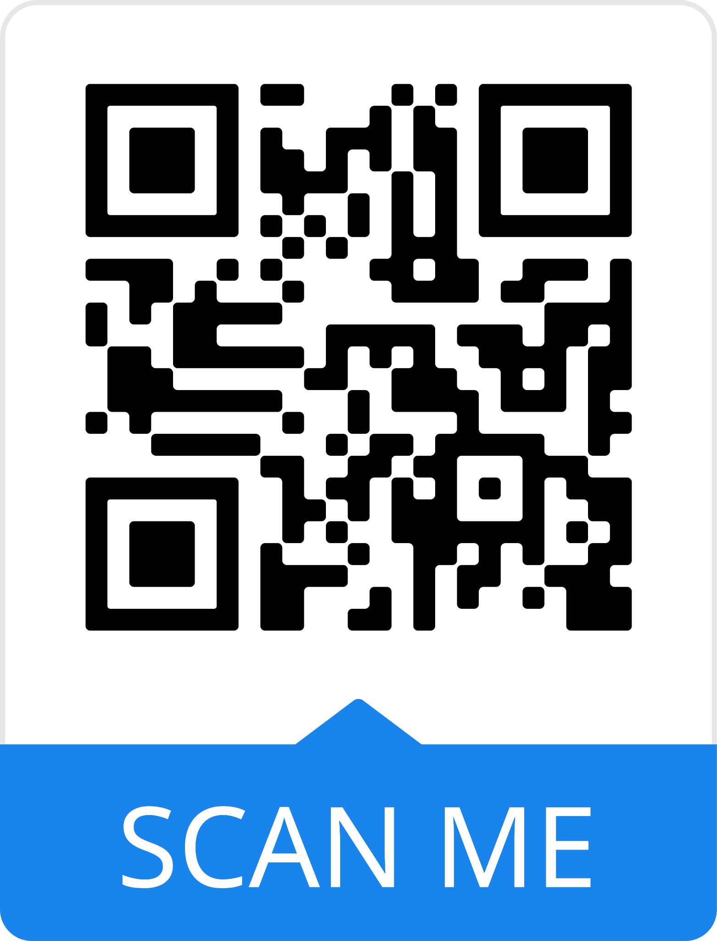

Slide 2
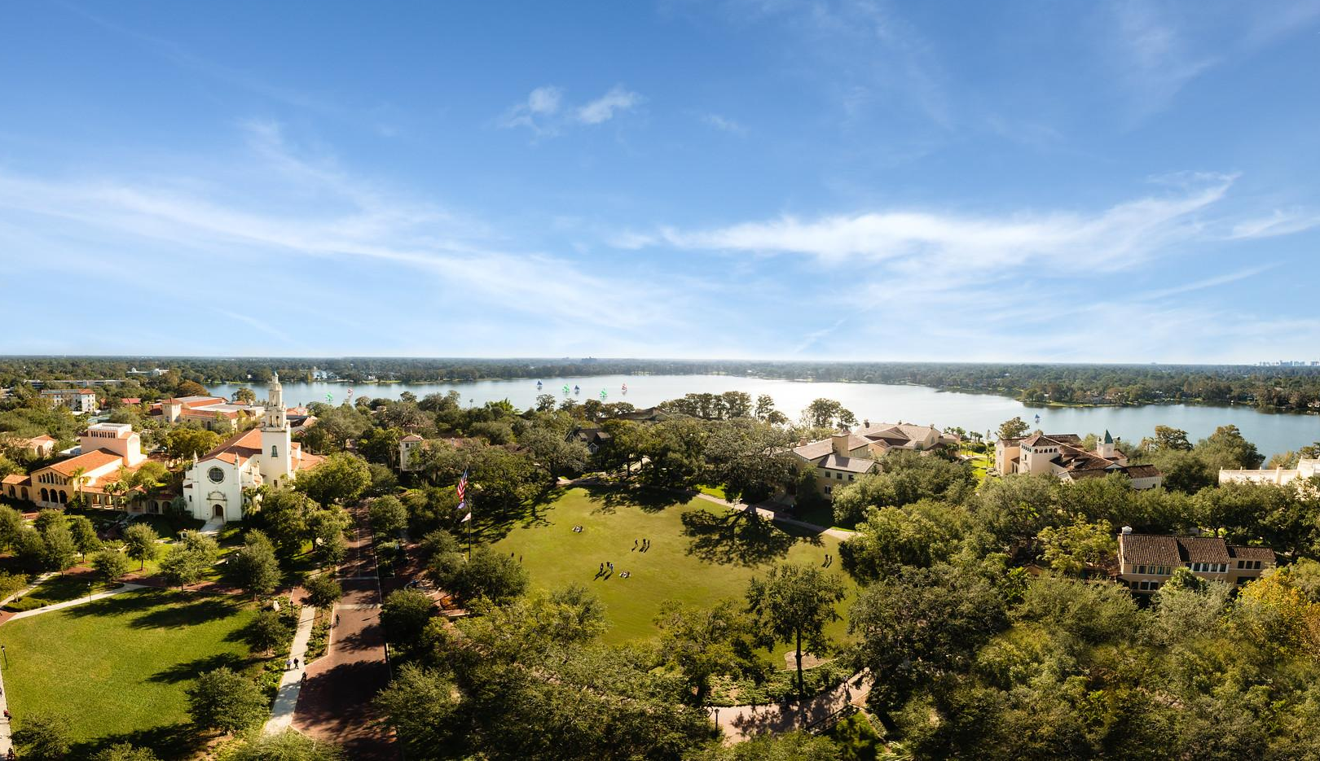
College of Liberal Arts
Founded in 1885
#1 Regional University in the South U.S. News & World Report
Winter Park | Orlando, FL

Slide 4
Future-Proof Education
Liberal Arts in Action
Rollins Results

Slide 5
11:1
Student to Faculty Ratio
17 Average Class Size
#1 for Strong Commitment to Undergraduate Teaching
U.S. News & World Report
Student-Faculty Collaborative Research Program
Phi Beta Kappa Society

Slide 6
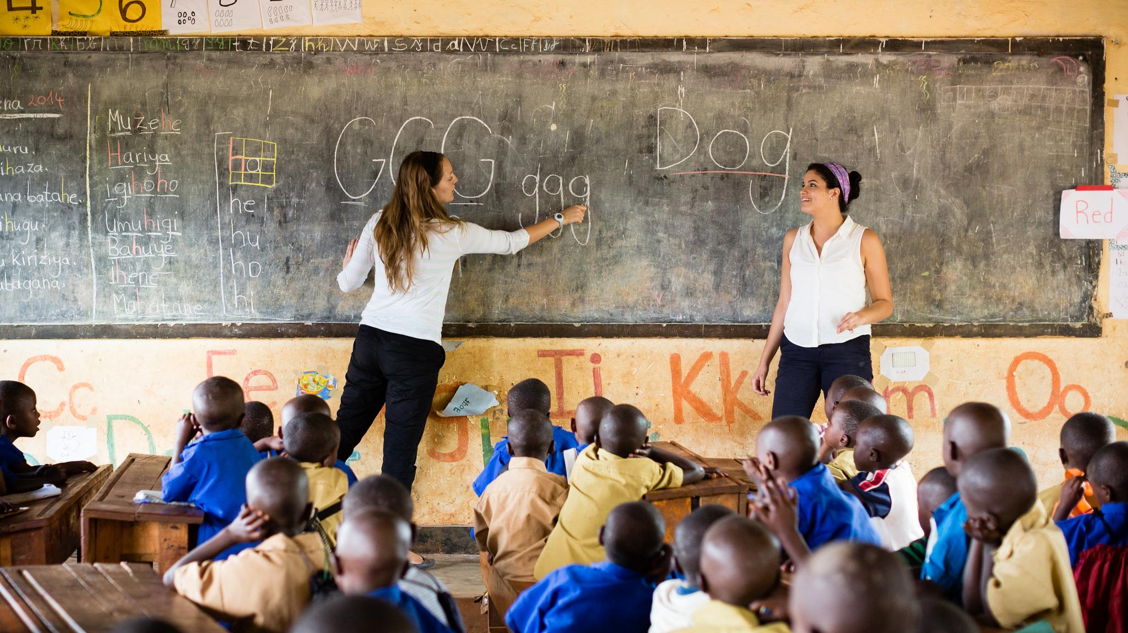
77% Study Abroad 60+ Programs
Argentina
Australia
China
Costa Rica
France
Germany
Greece
Israel
Italy
Japan
Morocco
New Zealand
Spain
United Kingdom
Semester Programs, Summer Programs, Field Studies

Slide 7
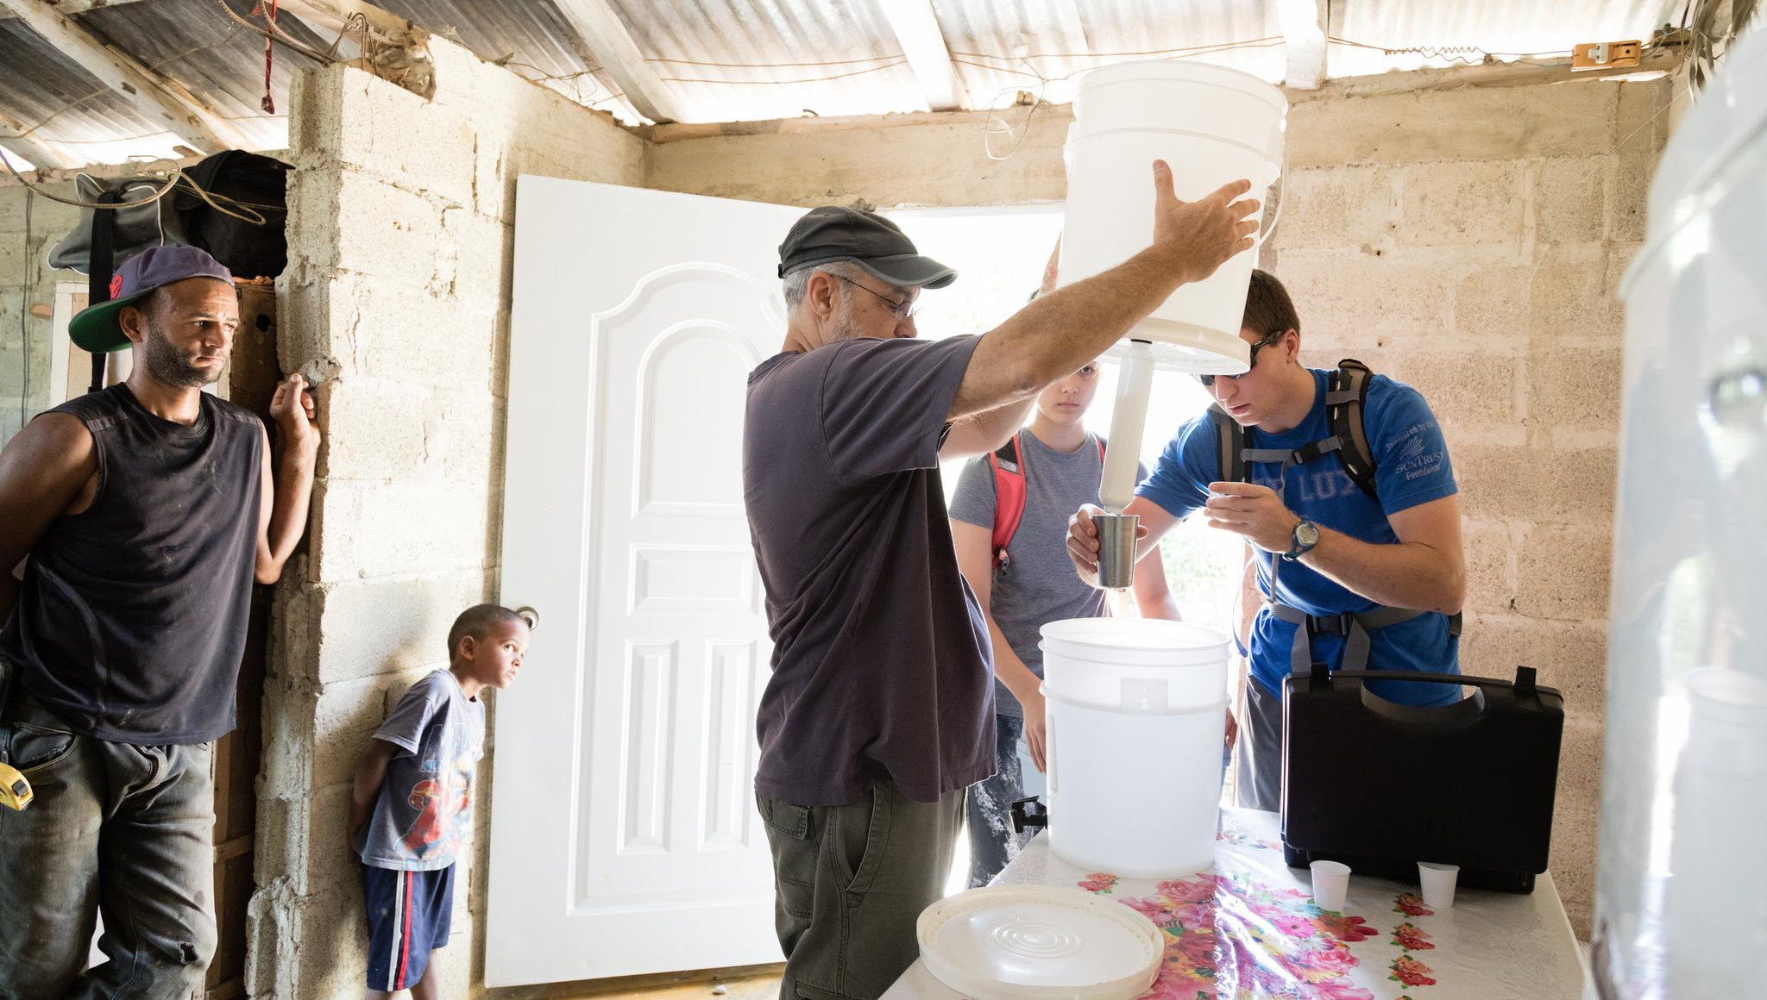
SPARC Day (Service, Passion, Action, Rollins College)
Immersion & Alternative Breaks
Community Engagement Courses

Slide 8
125 Student Organizations
Debate
Student Media
Student Government Association
Religious & Cultural
Fraternity & Sorority Life
Political
Expressive Arts
Service

Slide 9
94% of graduates are engaged in the workforce, graduate school or volunteer service 12 months after graduation.

Slide 10
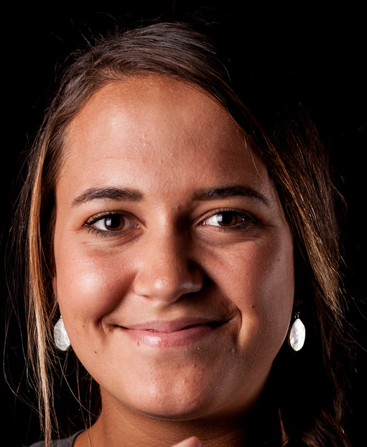
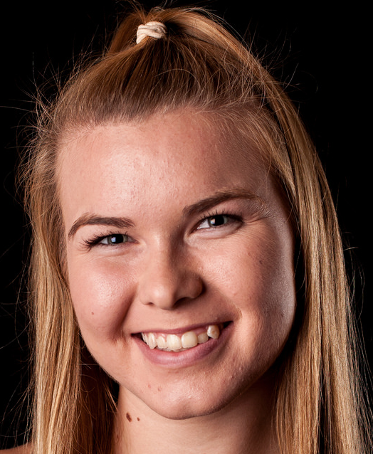
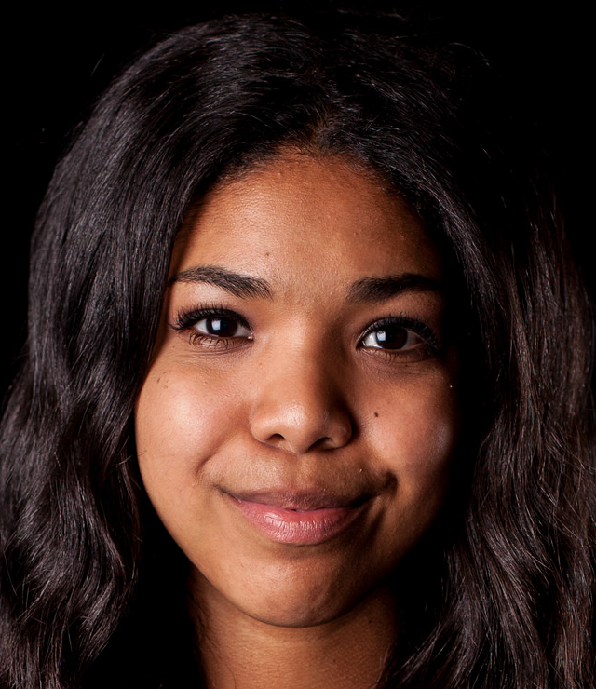
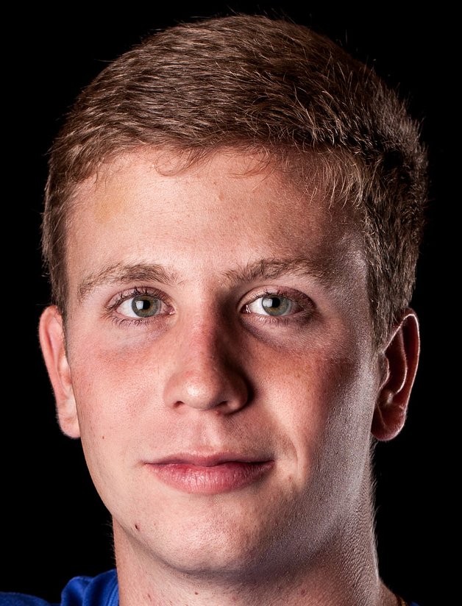
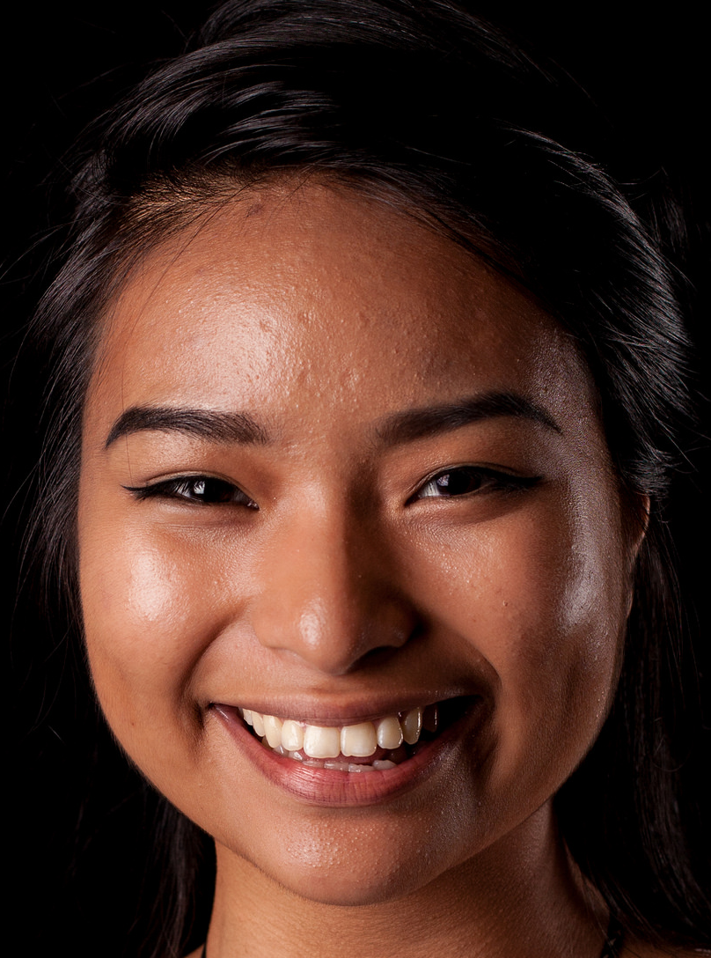
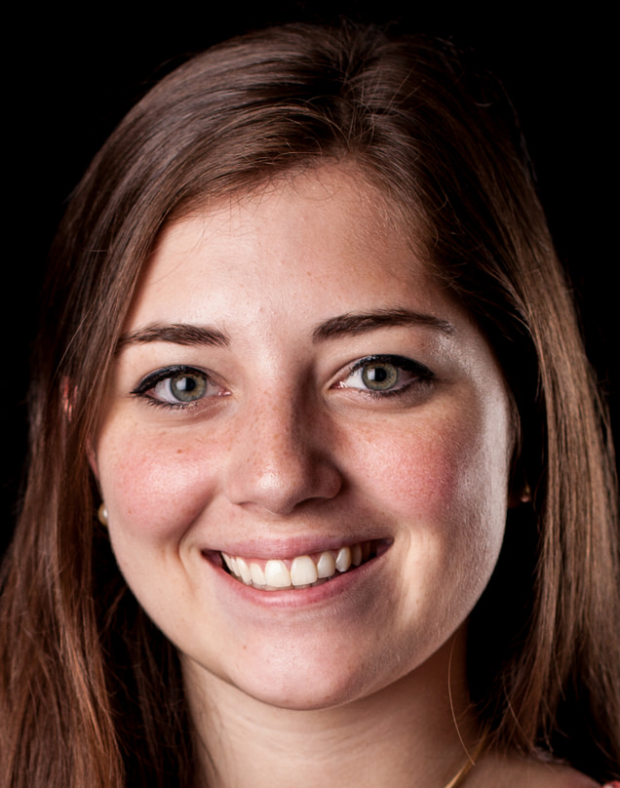
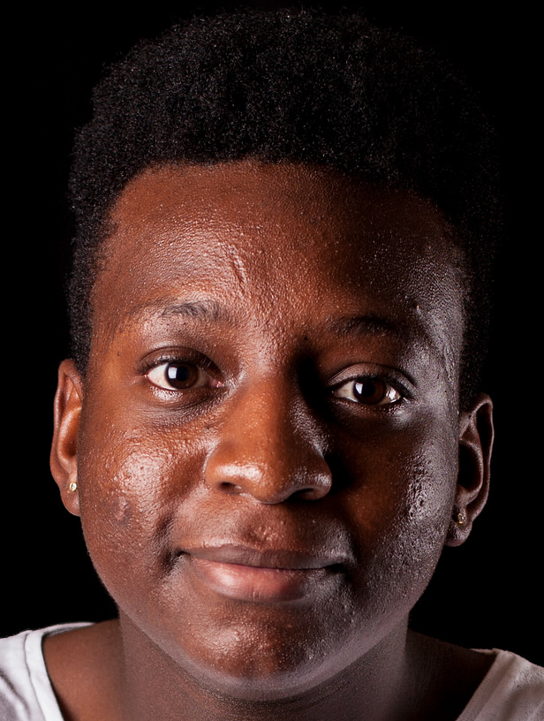
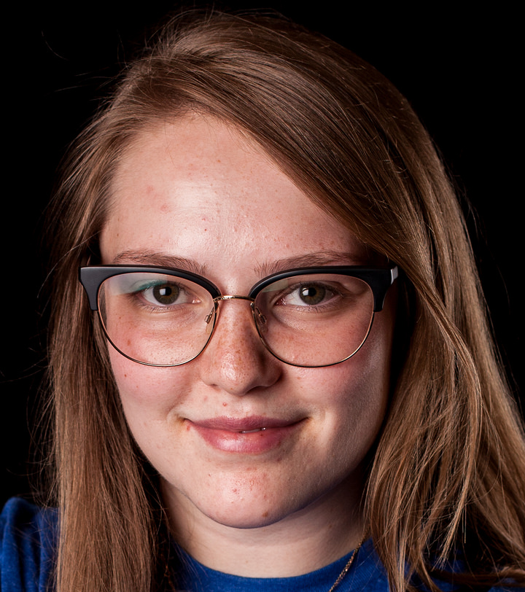
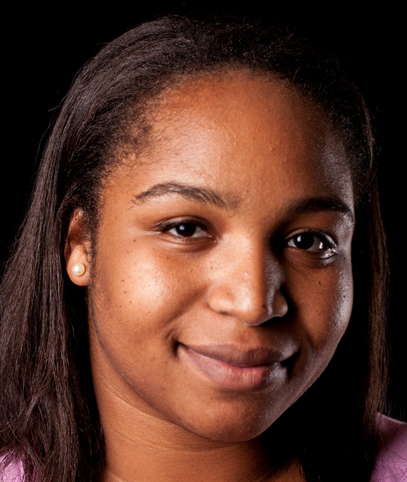
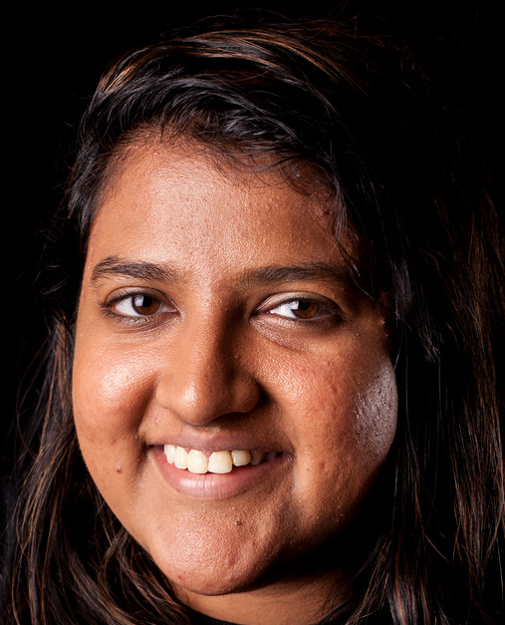
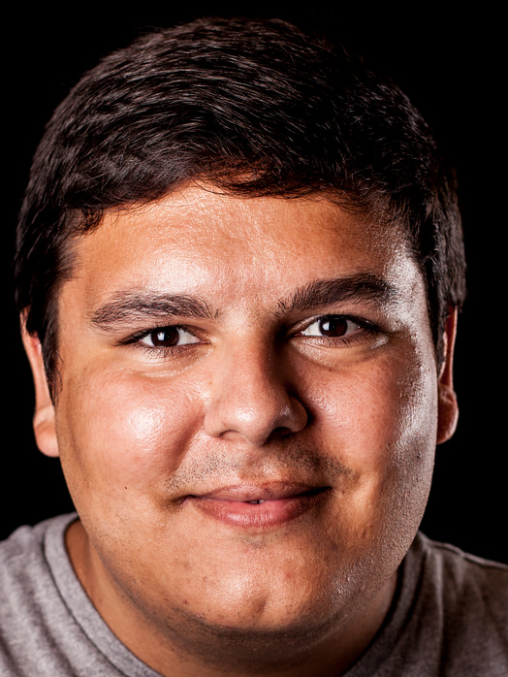
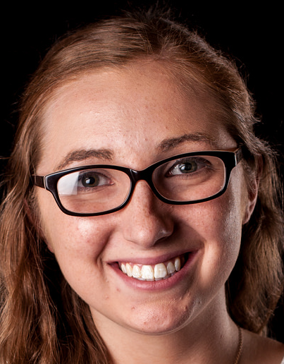
Admission Profile
Holistic Review
Essay
Involvement
Recommendation Letter
Average Core Unweighted GPA
3.5
Standardized Tests
1240-1330 (SAT)
27-30 (ACT)
Test Optional

Slide 11
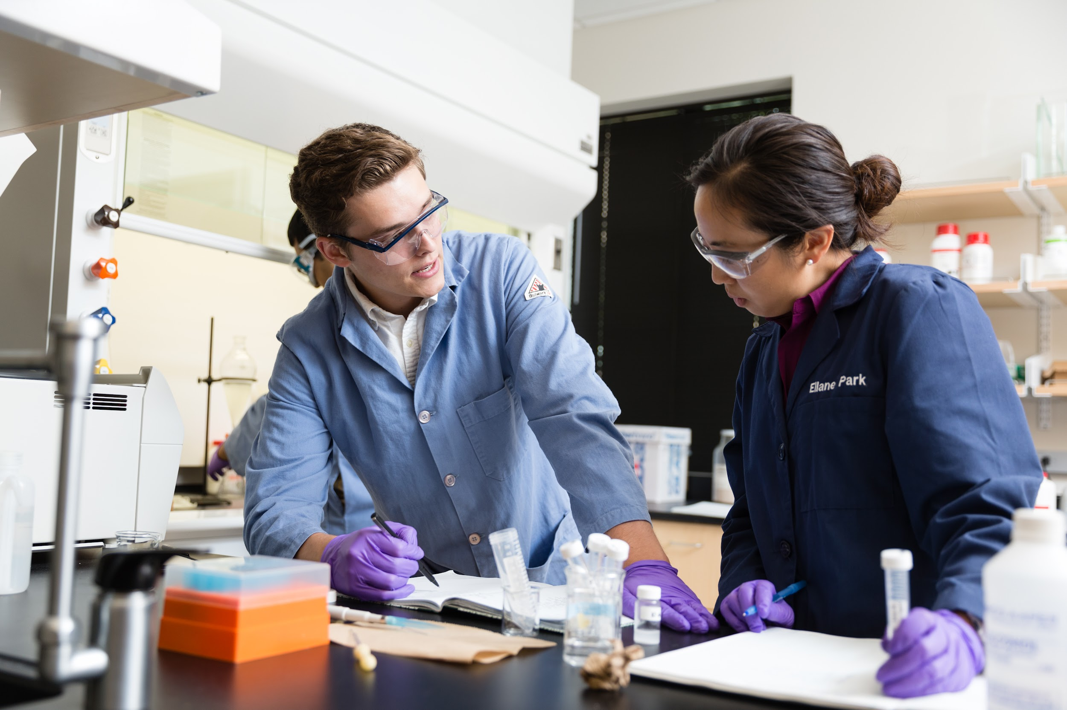
Applying Regular Decision Priority Scholarship: November 15 application deadline (Non-Binding)
Notification Date: By April 1
Regular Decision: February 1 application deadline (Non-Binding)
Notification Date: By April 1

Slide 12
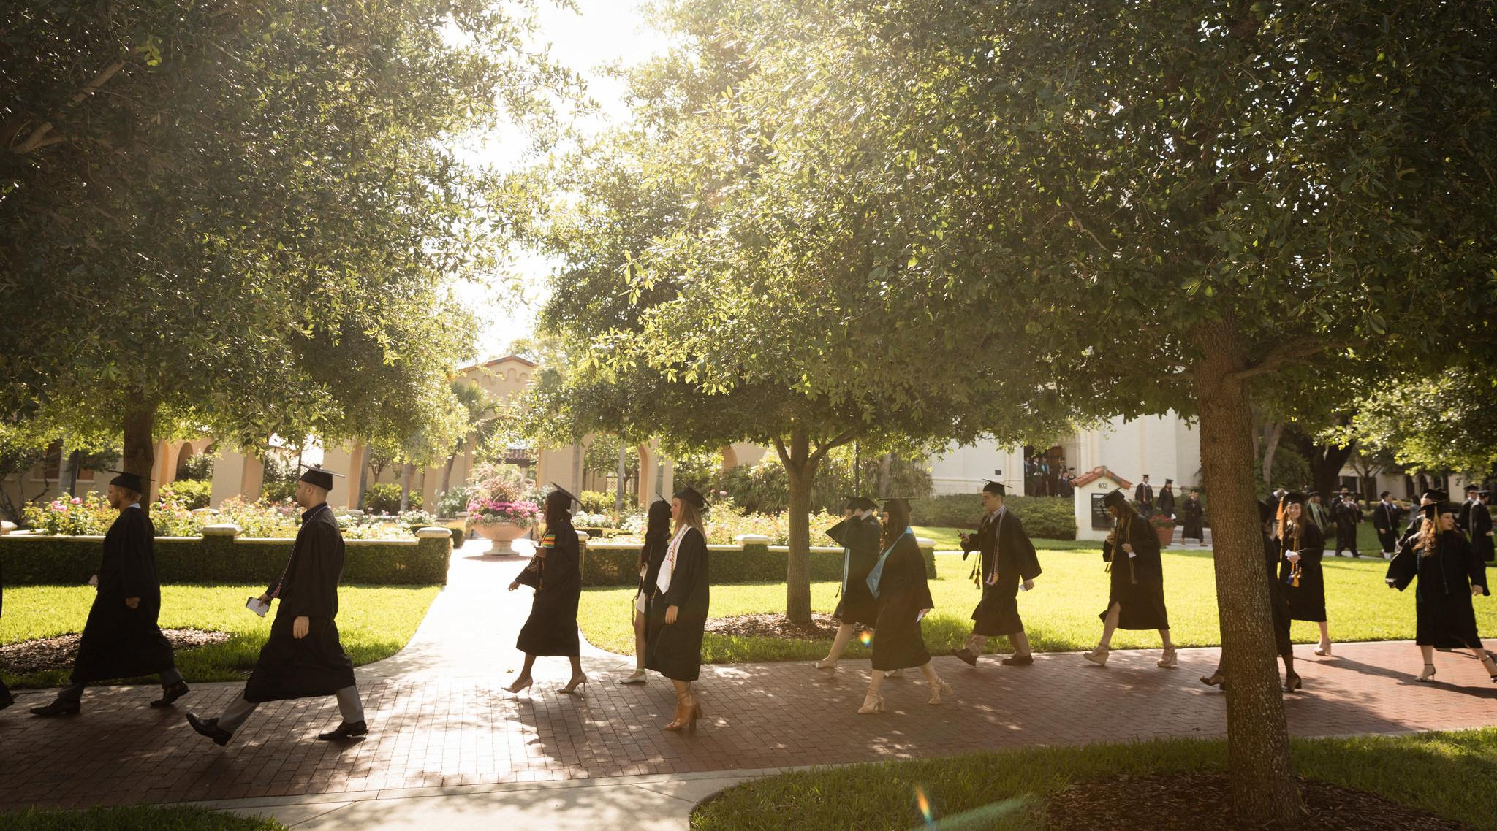
Top Ten Best Value School
(U.S. News & World Report 2022)
96% of Students Receive Some Form of Financial Aid
Partial Academic Scholarships $15K - $32K
Florida Prepaid | Florida Bright Futures | EASE Grant
Notes:
Slide #17 on financial aid: Rollins is now #10 on the best value school list (Best Value Universities in the South 2022): https://www.usnews.com/best-colleges/rankings/regional-universities-south/best-value

Slide 13
Stay Connected!
@RollinsCollege
#RollinsLife

