Slide 1
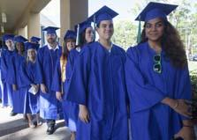
Early College Program (formerly Collegiate High School)
A Dual Enrollment Opportunity for
Motivated High School Students!

Slide 2
What is Dual Enrollment?
High school students earn high school and college credit at the same time.

Slide 3
Part-Time
Up to 3 EFSC classes per term and
1 summer class
Early College
Up to 3 classes per term and 2 summer classes. AA Track. Bus available for 10th graders
Dual Enrollment Options
Early Admission
Fall and Spring semester of 12th grade on EFSC campus
Full-Time
Spring semester of 12th grade on EFSC campus

Slide 4
Dual Enrollment Course Weight
Dual Enrollment courses are weighted the same as AP, IB, and AICE:
When your high school calculates your overall weighted high school GPA
When state universities calculate your high school GPA in the core academic classes for university admission decisions

Slide 5
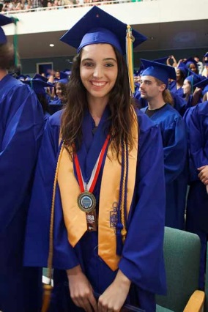
Early College Program A partnership initiative between the Brevard Public School District and EFSC
Developed for students whose goal is to graduate from high school with a university-transfer Associate in Arts (AA) degree

Slide 6
Early College Program Expectations
Participants are expected to:
Complete selected EFSC and high school classes each year.
Maintain program eligibility.
Successfully complete AA degree general education requirements.
Finish entry-level requirements for selected university major.
Remain on track for AA degree by high school graduation.

Slide 7
Associate in Arts Degree
Two-year degree for students whose goal is a bachelor’s degree or higher at a university
Equivalent to freshman and sophomore years at a state university
Combination of academic and elective courses chosen to meet selected university major prerequisites
Total of 20 college courses equaling at least 60 credit hours
Students graduating with an AA enjoy first-time-in-college (FTIC) benefits at state universities

Slide 8
Three-Year Track
10th Grade ……………………………………..12 credit hours
Fall 2 EFSC classes
Spring 2 EFSC classes
11th Grade ……………………………………..24 credit hours
Summer 2 EFSC classes
Fall 3 EFSC classes
Spring 3 EFSC classes
12th Grade ….…………………………………24 credit hours
Summer 2 EFSC classes
Fall 3 EFSC classes
Spring 3 EFSC classes
.

Slide 9
Admission Requirements Three -Year Track
State cumulative unweighted GPA of 3.0 or higher.
Completion of Algebra 1 by the end of 9th grade.
College-ready Reading and Writing scores on a college placement test. (PERT, SAT, ACT, or ACCUPLACER)
High school record of good attendance and responsible behavior.
Meet all program deadlines and requirements.
Completion of EFSC Online Dual Enrollment Orientation.

Slide 10
Two-Year Track
11th Grade…………………………………..24 credit hours
Summer 2 EFSC classes
Fall 3 EFSC classes
Spring 3 EFSC classes
12th Grade Early Admission…………….36 credit hours
Summer 2 EFSC classes
Fall 5 EFSC classes
Spring 5 EFSC classes
College credit from AP, AICE, or IB exams may be used to meet degree requirements

Slide 11
EFSC Class Times
10th grade students
EFSC classes meet 10:50 AM – 12:05 PM
1 EFSC class M/W; 1 EFSC class T/Th
High school periods 3 and 4 at EFSC
Friday: No EFSC classes – Periods 3 and 4 at the high school for study, community service, and enrichment
11th and 12th grade students
EFSC classes meet at the beginning and/or end of school day or in the evening
Face-to-face, online, or hybrid
Friday: Attendance at the high school is NOT required during EFSC class periods

Slide 12
Bus Transportation
Guaranteed for 10th graders in the three-year track during designated Early College class periods
11th and 12th graders may ride bus if space is available
Not provided on BPS school holidays (i.e. President’s Day)
11th and 12th graders responsible for their own transportation to and from EFSC

Slide 13
Required Minimum Entry Scores
READING WRITING
PERT 106+ 103+
SAT (after 3/11/2016) 24 25 (&Lang.)
ACT 19 17 (English)
ACCUPLACER 256 253

Slide 14
College-Ready Math Score By 12th Grade
MAC 1105 or MGF 1106 Minimum Score
PERT 123
ACT 20
SAT 27.5
ACCUPLACER 268-300
MAC 1105 – College Algebra; MGF 1106 – Topics in Math

Slide 15
Testing Anxiety?? Get prepared!!!
Google PERT Study Guide; take PERT Practice Tests.
Take the PERT at your school.
Retest on PERT or ACCUPLACER 30 days after original test date.
Go to RegisterBlast on EFSC website to schedule a PERT retest.
Go to Placement Testing Services on EFSC website to schedule a remote ACCUPLACER retest.

Slide 16
Requirements to STAY in the Early College Program
“C” or higher in courses requiring writing skills and math competencies
State cumulative high school GPA of 3.0 or higher
College GPA of at least 2.0 each term
On track to receive diploma and AA degree at graduation
Qualify for MAC 1105 or MGF 1106 by the fall term of 12th grade

Slide 17
Benefits of Early College Program
The Early College Program enables students to:
Complete the first two years of college with no tuition, textbook costs, or lab fees
Get used to college expectations while still in high school
Use their college courses to explore career interests and identify possible majors
Earn a university-transfer Associate in Arts (AA) degree with their high school diploma

Slide 18
Estimated Cost of Attendance
2022-23 Academic Year UF Undergraduate
Tuition/Fees $6,380
Books & Supplies 810
Computer/ Cell 1,240
Housing 6,350
Food 4,600
Transportation 1,120
Clothing Maintenance 890
Personal/Health Ins. 420
TOTAL BUDGET $21,810
Source: www.sfa.ufl.edu/cost/

Slide 19
Your Pathway to Success in the Early College Program
Focus on your career goals and select a major by spring of 11th grade
Choose your intended university
Select courses that meet your major prerequisites and AA degree requirements
If you change your major, college advisors will work with you to adjust your program

Slide 20
How will EFSC staff help you chart your pathway?
EFSC Dual Enrollment advisors help students:
Plan their degree program
Register for classes
Use “myGPS” to track courses toward their degree program
Access academic support services
EFSC offers:
Career Planning & Development Centers to help students identify career interests and skills
Elective courses, such as Discover Your Major and Career and Success Strategies College & Life (SLS)
Seminars and clubs in selected career fields

Slide 21
Factors to Consider
Additional study expectations required with college coursework
Courses designed for adults – NO modifications made to accommodate age and maturity level
EFSC grades stay on permanent college and high school transcript
Poor grades can impact scholarships and university admission

Slide 22
Factors to Consider
Summer classes may be needed to earn degree by graduation
Balancing college, high school, and extracurricular demands is necessary
Must meet high school and AA degree requirements
Arrange transportation on BPS school holidays and for classes taken outside of the Early College designated periods

Slide 23
Considerations for Parents
High school counselor and the Early College Contact are points of contact for parents seeking information about student
Parents may not contact college instructors for student information (FERPA)
Family must follow both high school and EFSC calendars
Student is responsible for purchasing required consumables (i.e. workbooks and lab manuals)
The college does NOT have an excused absence policy; attendance requirements are specified in each course syllabus

Slide 24
Getting Started!
Attend the Early College High School Information Presentation at your school.
Submit Student Interest Form/Google Form to the high school counselor by the deadline.
Take the PERT either at your school or EFSC and meet the minimum scores in Reading and Writing.
Submit the online EFSC Application for Admission.
Once you receive your acceptance letter with student ID, complete the online Dual Enrollment Orientation.
EFSC will request your high school transcript.

Slide 25
Then….
Turn in the Early College Program Student/Parent Agreement to your counselor by your school’s deadline.
Attend ONE of four required Early College Orientations (dates to be announced).
Complete the Dual Enrollment Registration Form with Mrs. Ash.
Submit your Registration Form when EFSC’s registration window opens.
Check your student Titan email for information about your registration status.
Follow your high school’s directions to obtain your college textbooks!

Slide 26
Important Dates
► PERT administered at high school: February 2, 2023
► Student/Parent Agreement Form deadline: May 1, 2023
► Summer Registration Window opens: April 10, 2023
► Last day to pick up textbooks for Summer: TBA
► EFSC Fall Registration Window opens: TBA

Slide 27
Important Dates (continued)
► Summer 2023 Terms
May 15 – August 4: Summer A (12-weeks)
May 15 – June 23: Summer B (6-weeks)
June 12 – August 4: Summer C (8-weeks)
June 26 – August 4: Summer D (6-weeks)
► 9th Grade Students
Limited to Summer C and D
► Fall 2023 Term: TBA

Slide 28
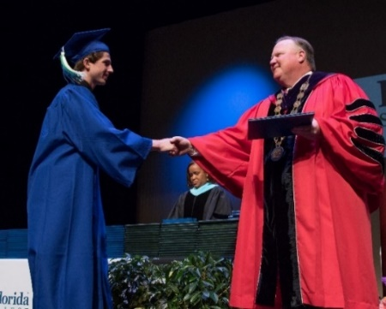
Contact Information
Guidance: 321-454-1000
EFSC Testing: Go to EFSC website: www.easternflorida.edu
Insert RegisterBlast in the search box to schedule your PERT testing appointment online.

Slide 29
Achieve the Early College Program Goals!
1. Complete the lower-level prerequisites for your major.
2. Graduate with your diploma and AA degree.
3. Continue your education as a junior at a four-year university!
In 2021-2022, 349 high school seniors
graduated with an AA!

