Slide 1
Financial Aid &
How to Pay for College

Slide 2
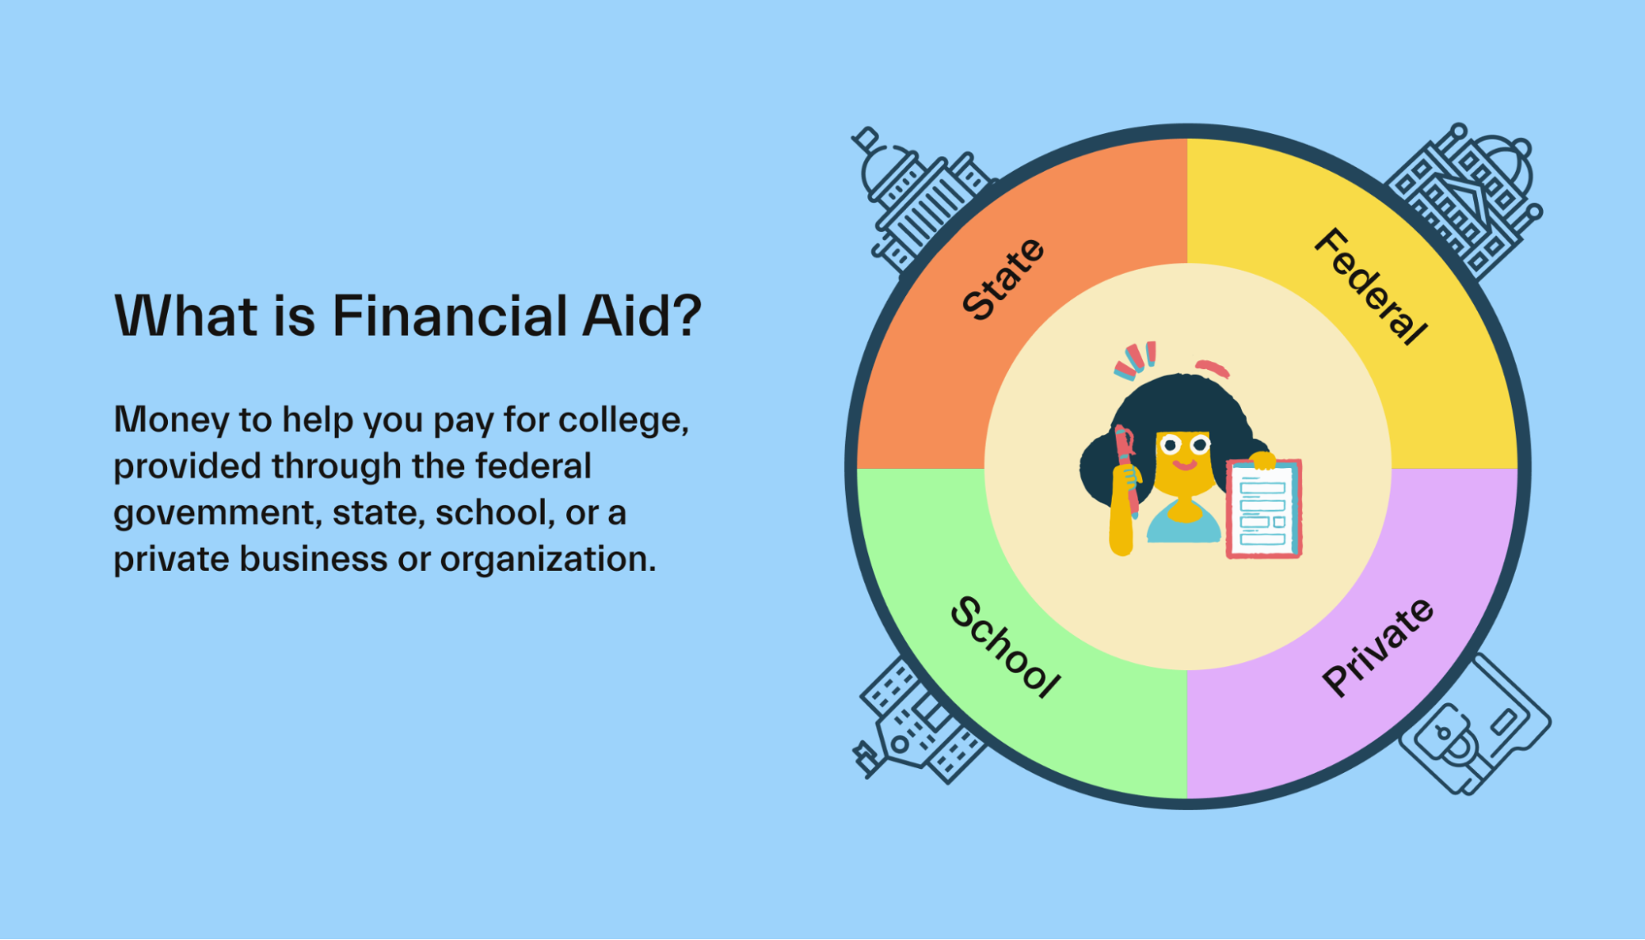

Slide 3
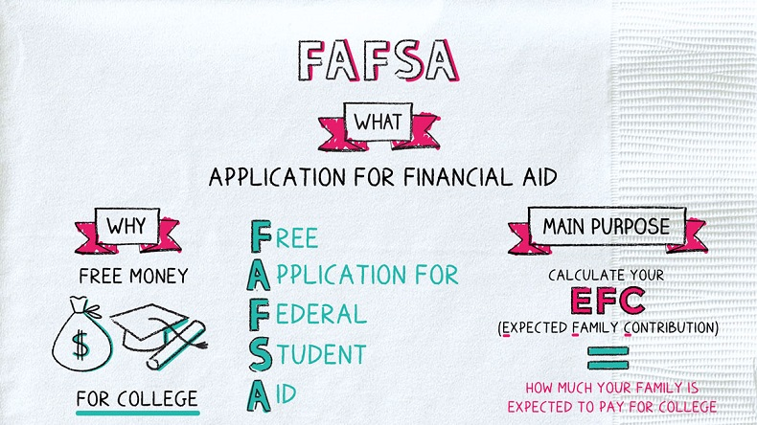

Slide 4
FAFSA: Free Application for Federal Student Aid Presented by Federal Student Aid

Slide 7
$CHOLAR$HIP RESOURCES
www.fastweb.com
www.unigo.com
www.dosomething.org
www.brightfuture.org
www.cappex.com
www.goodcall.com
www.facts.org
www.findaid.org
www.collegequest.com
www.collegescholarships.com
www.college-scholarships.com
www.collegiatefunding.com
www.theoldschool.org
www.salliemae.com
www.scholarship-page.com
www.CKSF.org
www.gmsp.org
www.scholarsnapp.org
www.tmcg.org

Slide 8
Amie L. Brown, MS.Ed.
Community Relations
Coordinator

