Slide 1
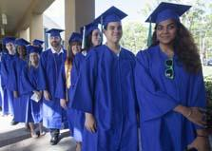

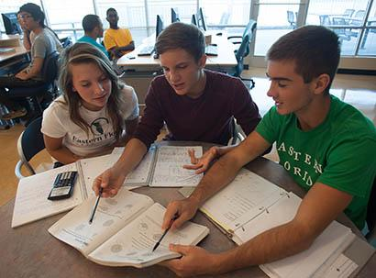

Early College Program
A Dual Enrollment Opportunity for
Motivated High School Students!

Slide 2

What is Dual Enrollment?
High school students earn high school and college credit at the same time.

Slide 3
Dual Enrollment Options
Part-Time
Up to 3 EFSC classes per term and
1 summer class
Full-Time
Spring semester of 12th grade on EFSC campus
Early Admission
Fall and Spring semester of 12th grade on EFSC campus
Early College
Up to 3 classes per term and 2 summer classes. Associate Degree Track. Bus available for 10th graders

Slide 4
Dual Enrollment Course Weight
Dual Enrollment courses are weighted the same as AP, IB, and AICE:
When your high school calculates your overall weighted high school GPA
When state universities calculate your high school GPA in the core academic classes for university admission decisions

Slide 5
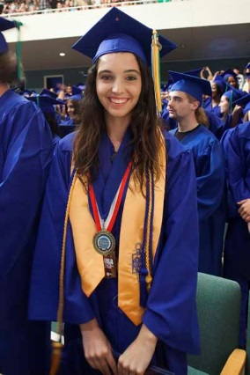
Early College Program
A partnership initiative between the Brevard Public School District and EFSC
Developed for students whose goal is to graduate from high school with an Associate in Arts (A.A.) or
Associate in Science (A.S.) degree

Slide 6
Benefits of Early College Program
The Early College Program enables students to:
Complete two years of college with no tuition, textbook costs, or lab fees
Get used to college expectations while still in high school
Use their college courses to explore career interests and identify possible majors
Earn an Associate degree along with their high school diploma

Slide 7
Associate in Arts Degree
Two-year degree for students whose goal is a bachelor’s degree or higher at a university
Equivalent to freshman and sophomore years at a state university
Combination of academic and elective courses chosen to meet selected university major prerequisites
Total of 20 college courses equaling at least 60 credit hours
Students graduating with an AA enjoy first-time-in-college (FTIC) benefits at state universities

Slide 8
Associate in Science Degree
Two-year career education degree to prepare students for direct entry into the workforce
Combination of general education core courses, major courses, and technical electives
Typically, a total of of 20 college courses equaling at least 60 credit hours
Students graduating with an A.S. degree can articulate their degree into a Bachelor’s degree

Slide 9
Early College Program Expectations
Participants are expected to:
Complete selected EFSC and high school classes each year.
Maintain program eligibility.
Successfully complete associate degree general education requirements.
Finish prerequisite requirements for selected university major or A.S. program major and technical electives.
Remain on track for an associate degree by high school graduation.

Slide 10
Three-Year Track*
10th Grade ……………………………………..12 credit hours
Fall 2 EFSC classes
Spring 2 EFSC classes
11th Grade ……………………………………..24 credit hours
Summer 2 EFSC classes
Fall 3 EFSC classes
Spring 3 EFSC classes
12th Grade ….…………………………………24 credit hours
Summer 2 EFSC classes
Fall 3 EFSC classes
Spring 3 EFSC classes
*College credit from AP, AICE, or IB exams may be used to meet degree requirements
.

Slide 11
Two-Year Track*
11th Grade…………………………………..24 credit hours
Summer 2 EFSC classes
Fall 3 EFSC classes
Spring 3 EFSC classes
12th Grade Early Admission…………….36 credit hours
Summer 2 EFSC classes
Fall 5 EFSC classes
Spring 5 EFSC classes
*College credit from AP, AICE, or IB exams may be used to meet degree requirements

Slide 12

Admission Requirements
State cumulative unweighted high school GPA of 3.0 or higher.
College-ready Reading and Writing scores on a college placement test (i.e. PERT, SAT, ACT, PSAT or ACCUPLACER).
High school record of good attendance and responsible behavior.
Meet all program deadlines and requirements.
Completion of EFSC Dual Enrollment Online Orientation and mandatory In-Person Early College Orientation.
Completion of Algebra 1 by the end of 9th grade (Two-Year Track) or completion of Geometry by the end of 10th grade (Three-Year Track).

Slide 13

EFSC Class Times
10th grade students
  EFSC classes meet 10:50 AM – 12:05 PM
  1 EFSC class M/W; 1 EFSC class T/Th
  High school periods 3 and 4 at EFSC
  Friday: No EFSC classes – Periods 3 and 4 at the high school for study, community service, and enrichment
11th and 12th grade students
  EFSC classes meet at the beginning and/or end of school day or in the evening
  Face-to-face, online, or hybrid
  Friday attendance at the high school is NOT required during EFSC class periods

Slide 14
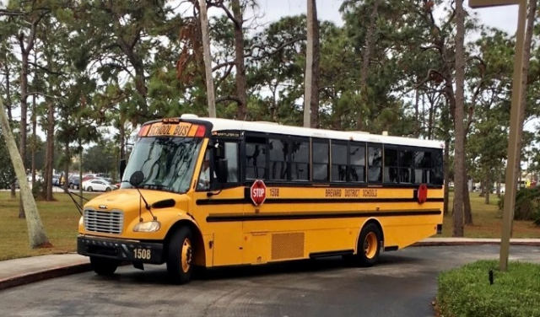
Bus Transportation
Guaranteed for 10th graders in the three-year track during designated Early College class periods
11th and 12th graders may ride bus if space is available
Not provided on BPS school holidays (i.e. President’s Day)
11th and 12th graders responsible for their own transportation to and from EFSC

Slide 15
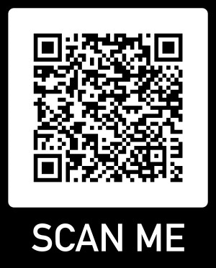
Required Minimum Entry Scores
Students must meet the minimum college-ready test scores in Reading and Writing for placement into ENC 1101- Composition 1.
Students must meet the meet the minimum college-ready mathematics test score for College Algebra or Topics in Math by the beginning of their senior year.
View the placement requirements at:
https://www.easternflorida.edu/testing/placement-testing/assessment-scores.php

Slide 16
EFSC Placement Testing on the High School Campus
EFSC will offer the PERT on the high school campus
Students will receive their score report the day of testing

Slide 17

Testing Anxiety??
Get prepared!!!
Google PERT Study Guide; take PERT Practice Tests.
Take the PERT at your school.
Retest on PERT or ACCUPLACER 30 days after original test date.
Go to RegisterBlast on EFSC website to schedule a PERT retest.
Go to Placement Testing Services on EFSC website to schedule a remote ACCUPLACER retest.

Slide 18
Requirements to STAY in the Early College Program
“C” or higher in courses requiring writing skills and math competencies
State cumulative unweighted high school GPA of 3.0 or higher
College GPA of at least 2.0 each term
On track to receive diploma and Associate degree at graduation
Qualify for MAC 1105 or MGF 1106 by the fall term of 12th grade

Slide 19
Estimated Cost of Attendance
2023-24 Academic Year
UF Undergraduate
Tuition/Fees $6,380
Books, Supplies, Equipment 1,450
Living Expenses 11,500
Transportation 1,570
Misc. Personal Expenses 2,194
TOTAL BUDGET $23,094
Source: www.sfa.ufl.edu/cost/

Slide 20

How will EFSC staff help you chart your pathway?
  EFSC High School Outreach Advisors help students:
    Plan their degree program
    Register for classes
    Use “myGPS” to track courses toward their degree program
    Access academic support services
  EFSC offers:
    Career Services to help students identify career interests and skills
    Elective courses, such as Discover Your Major and Career and Success Strategies College & Life (SLS)
    Seminars and clubs in selected career fields

Slide 21
Factors to Consider
Additional study expectations required with college coursework
Courses designed for adults – NO modifications made to accommodate age and maturity level
EFSC grades stay on permanent college and high school transcript
Poor grades can impact scholarships, financial aid, and university admission

Slide 22
Factors to Consider
Summer classes may be needed to earn degree by graduation
Balancing college, high school, and extracurricular demands is necessary
Must meet high school and Associate degree requirements
Arrange transportation on BPS school holidays and for classes taken outside of the Early College designated periods

Slide 23
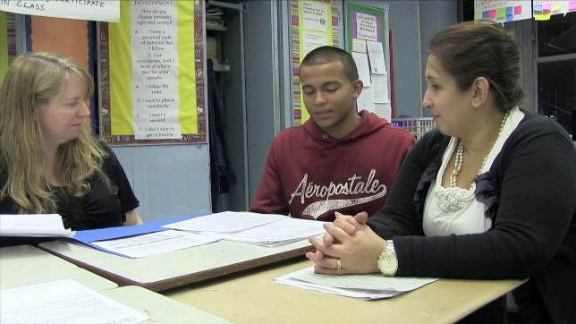
Considerations for Parents
High school counselor is point of contact for parents seeking information about student
Parents may not contact college instructors for student information (FERPA)
Family must follow both high school and EFSC calendars
Student is responsible for purchasing required consumables (i.e. workbooks and lab manuals)
The college does NOT have an excused absence policy; attendance requirements are specified in each course syllabus

Slide 24
Getting Started!
Submit Student Interest Form to the high school counselor by the deadline.
Take the PERT either at your school or EFSC and meet the minimum scores in Reading and Writing.
Submit the online EFSC Application for Admission.
Once you receive your acceptance letter with student ID, complete the online Dual Enrollment Orientation.
Schedule your Dual Enrollment Initial Advising appointment with your EFSC High School Outreach Advisor.
EFSC will request your high school transcript.

Slide 25

Then….
Turn in the Early College Program Student Performance Contract to your counselor by your school’s deadline.
Attend ONE of four required in-person Early College Orientations.
Check your student Titan email for information about your registration status.
Follow your high school’s directions to obtain your college textbooks!

Slide 26
Important Dates
► PERT administered at high school: February 12, 2024
► Early College Program Student Performance Contract deadline: May 1, 2024
► Summer Registration Window opens: April 1, 2024
► EFSC Fall Registration Window opens: TBA

Slide 27
Important Dates (continued)
► Summer 2024 Terms
  May 13 – August 2: Summer A (12-weeks)
  May 13 – June 21: Summer B (6-weeks)
  June 10 – August 2: Summer C (8-weeks)
  June 24 – August 2: Summer D (6-weeks)
► Fall 2024 Term: TBA

Slide 28
Important Dates (continued)
► Mandatory In-person Early College Orientation
Attend one of the following upon receiving college-ready test scores in reading and writing.
  Monday, March 18, 2024: Titusville High School Auditorium
  Wednesday, March 20, 2024: Merritt Island High School Auditorium
  Tuesday, April 2, 2024: Eau Gallie High School Auditorium
  Tuesday, April 9, 2024: Bayside High School Auditorium
  Doors open at 5:45 PM for registration. Presentation begins at 6:30 PM.

Slide 29
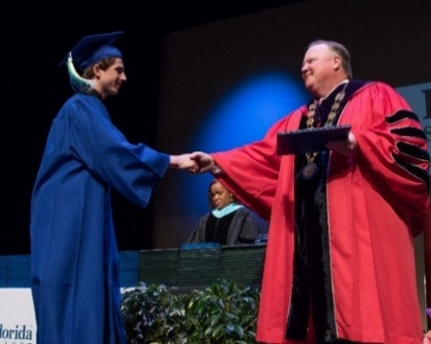
Contact Information
Guidance: 321- 454-1000 Ext. 25262
EFSC Testing: Go to EFSC website: www.easternflorida.edu
Insert RegisterBlast in the search box to schedule your PERT testing appointment online.

Slide 30

Achieve the Early College Program Goals!
1. Complete the lower-level prerequisites for your major.
2. Graduate with your diploma and Associate degree.
3. Continue your education at a four-year university!
In 2022-2023, 355 high school seniors
graduated with an Associate Degree!

