Slide 1
Welcome to Parent SENIOR Night
MIHS Class of 2024
Debora Lubbers, Principal
Angela Owens, Assistant Principal
Wanda Luthman, Senior Counselor
Gabrielle Ash, College & Career Specialist

Slide 2
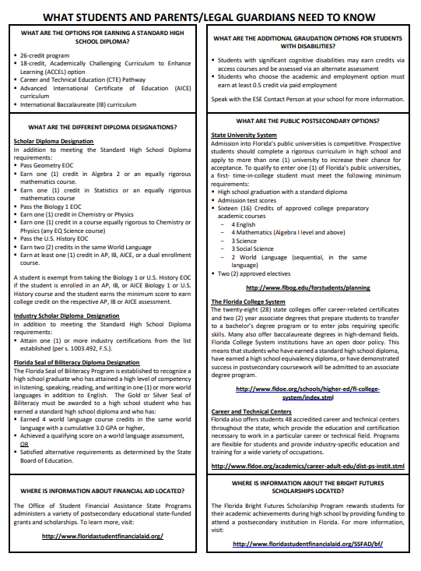
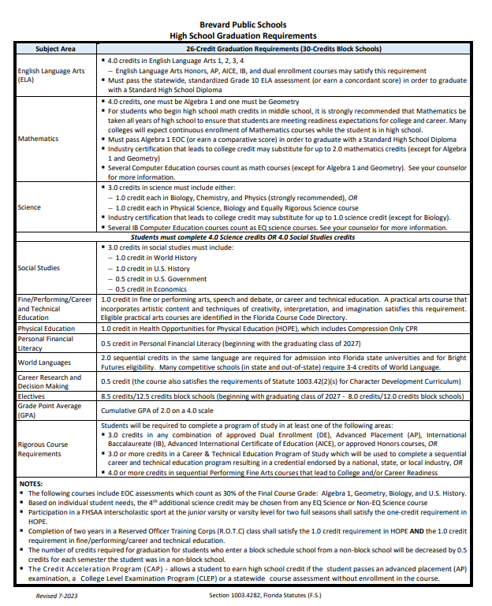
BPS High School Graduation Requirements

Slide 3
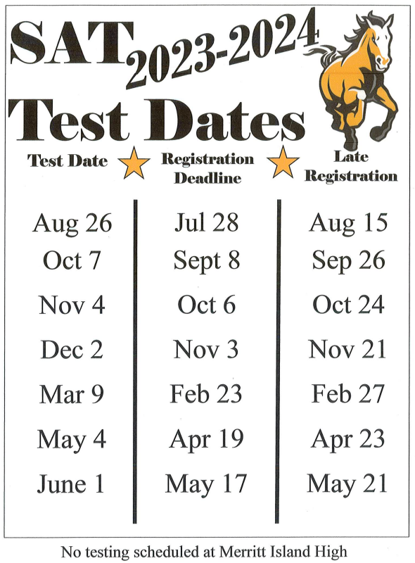
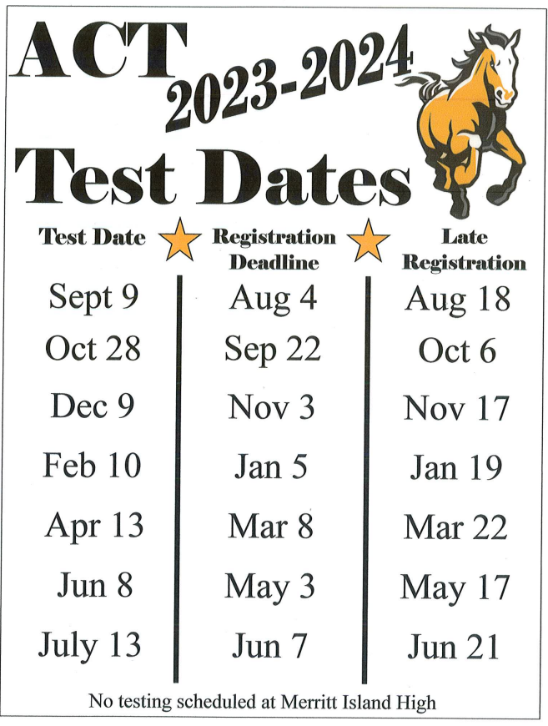
SAT and ACT Dates

Slide 4
SAT/ACT Test Prep
Khan Academy – Free (SAT)
Kaplan – Paid Service (ACT)
Private Tutors
Study books (stop by and see Mrs. Ash in E-126)

Slide 5
College Admissions
TIPS from Admissions Directors
Apply Early
Check and read your email
Check Status
Check and read your email
Take SAT/ACT multiple times
Check and read your email
Check and read your email
Apply directly through the institution OR the Common App – do NOT do both!

Slide 6
College Recruiters at MIHS
Sept. 25th @2:00pm – Univ of Florida
Sept. 25th @2:30pm – Univ of South FL
Sept. 26th @1:00pm – FL Poly Univ
Sept. 27th @1:00pm – FL Gulf Coast Univ
Oct. 5th @1:00pm – FIU
Oct. 9th @1:00pm – Univ of North FL
Oct. 10th @10:30am – FL Tech
Nov. 2nd @10:00am - SCAD

Slide 7
Off to College Night
Tuesday, October 17th 6:00-8:00PM in the Media Center
5 different College Representatives will be speaking on all topics related to general college admissions (refreshments will be provided)
Colleges include: UCF, Florida Tech, EFSC, Keiser, Florida Southern, and Rollins College

Slide 8
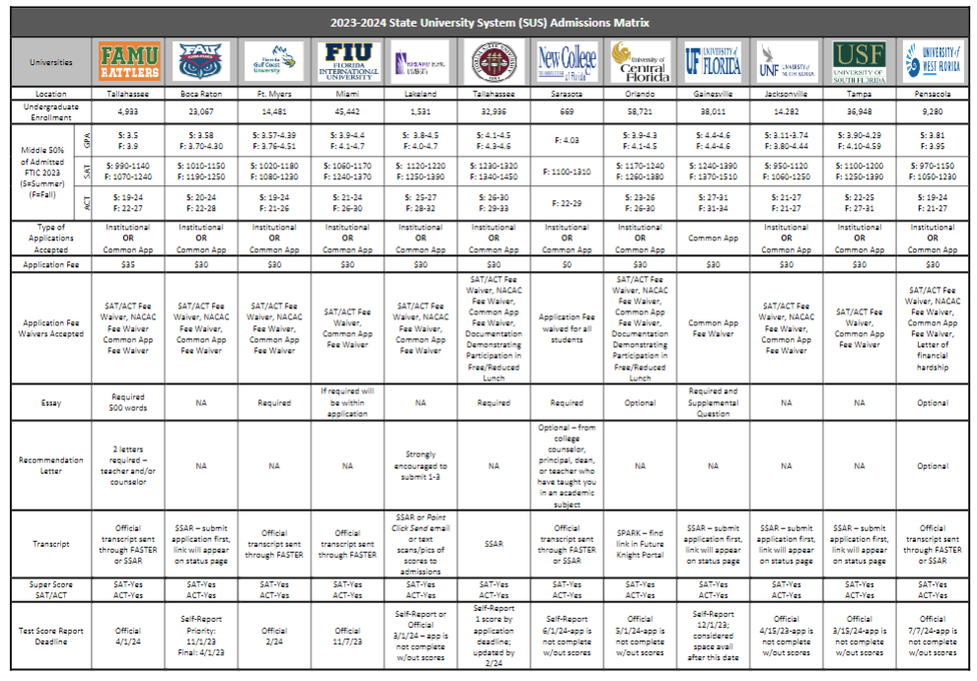
State University System Admissions Matrix

Slide 9
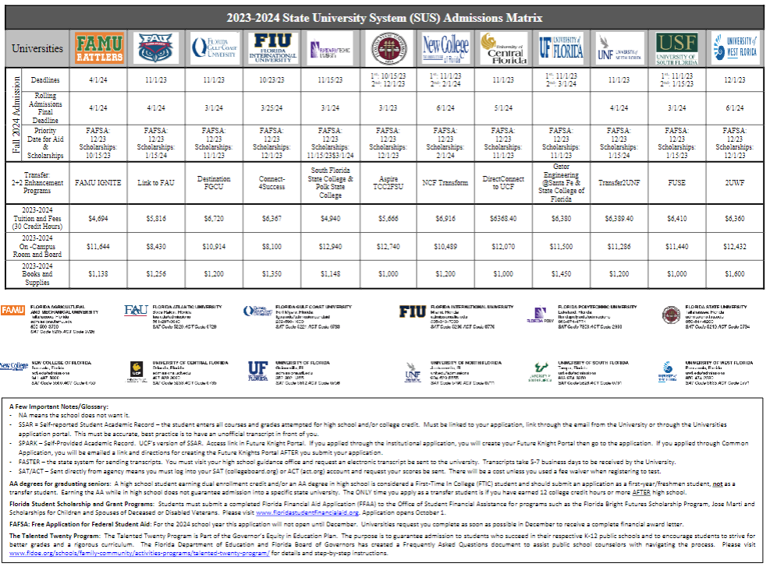
State University System Admissions Matrix

Slide 10
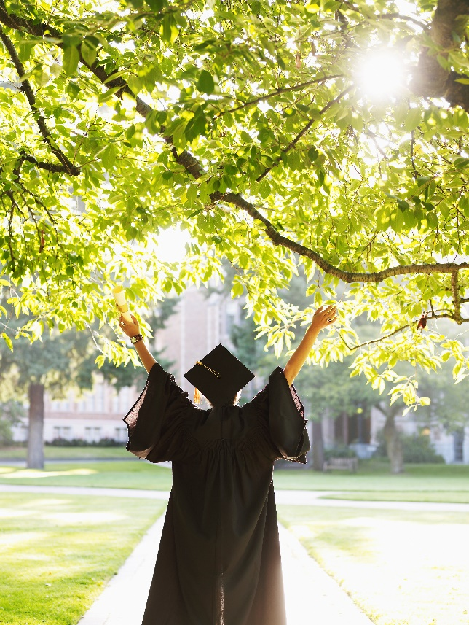
Bright Futures
5 Requirements for Bright Futures
Application window opens Oct. 1st – apply by graduation
Complete all required coursework
The GPA used is based on core courses (will use 2 additional core courses if needed)
COMBINATION OF Volunteer & Work Hours
TESTS – ACT or SAT or CLT (last test that can be used is August 2024 administration). MUST send scores to at least 1 public university in FL.

Slide 11
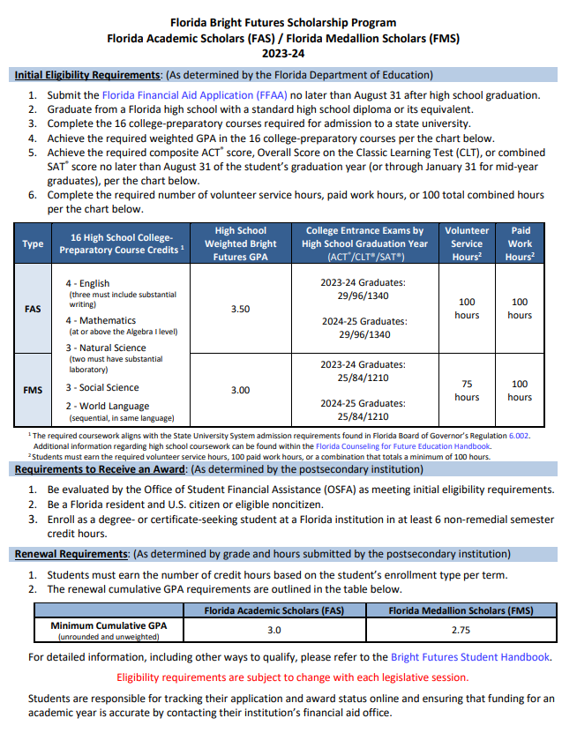
Bright Futures Scholars & Medallion Awards

Slide 12
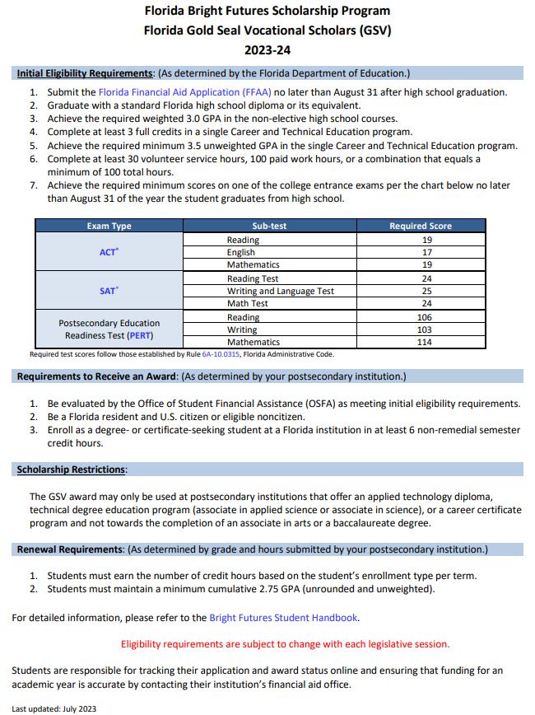
Bright Futures FL Gold Seal Vocational Scholars

Slide 13
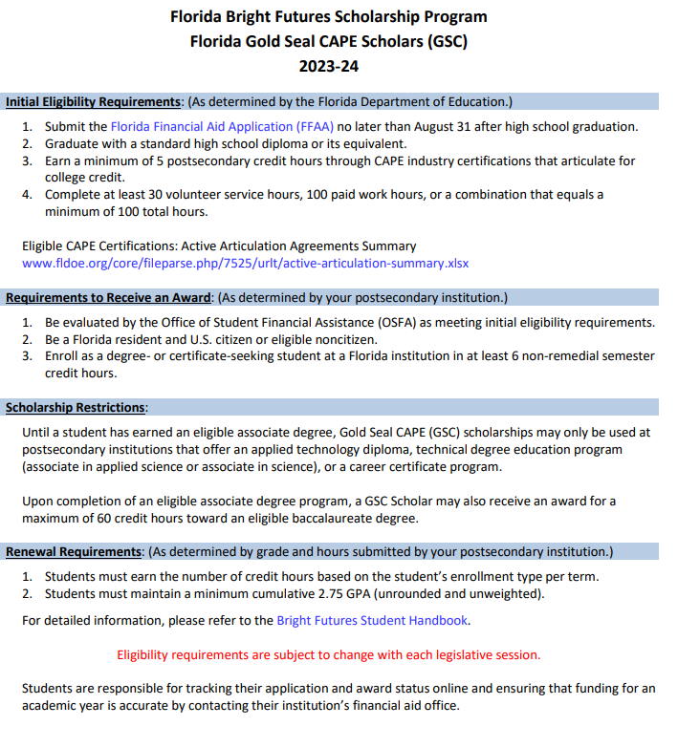
Bright Futures FL Gold Seal CAPE Scholars

Slide 14
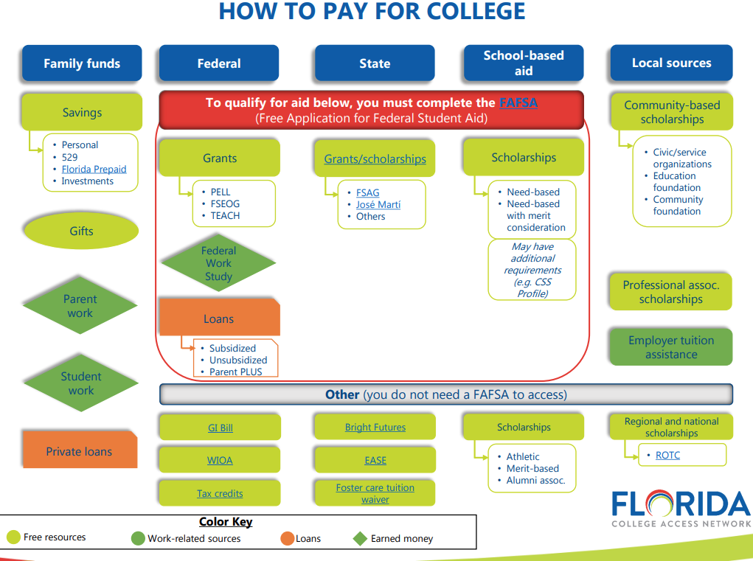
How to Pay for College

Slide 15
Florida Shines.org FREE webinars
FL Shines offers advice/webinars for applying to colleges and seeking scholarships.
https://www.floridashines.org/go-to-college/pay-for-college
EVERY Senior should complete the FAFSA and Bright Futures applications.

Slide 16
FAFSA is Changing
FAFSA Workshop
January 16, 2024
6pm
MIHS Media Center
Every graduating senior should complete the FAFSA.
Opens in December
Please bring the following:
Active email for students and parents
Copy of 2022 tax return & W-2
Student and parents’ social security number

Slide 17
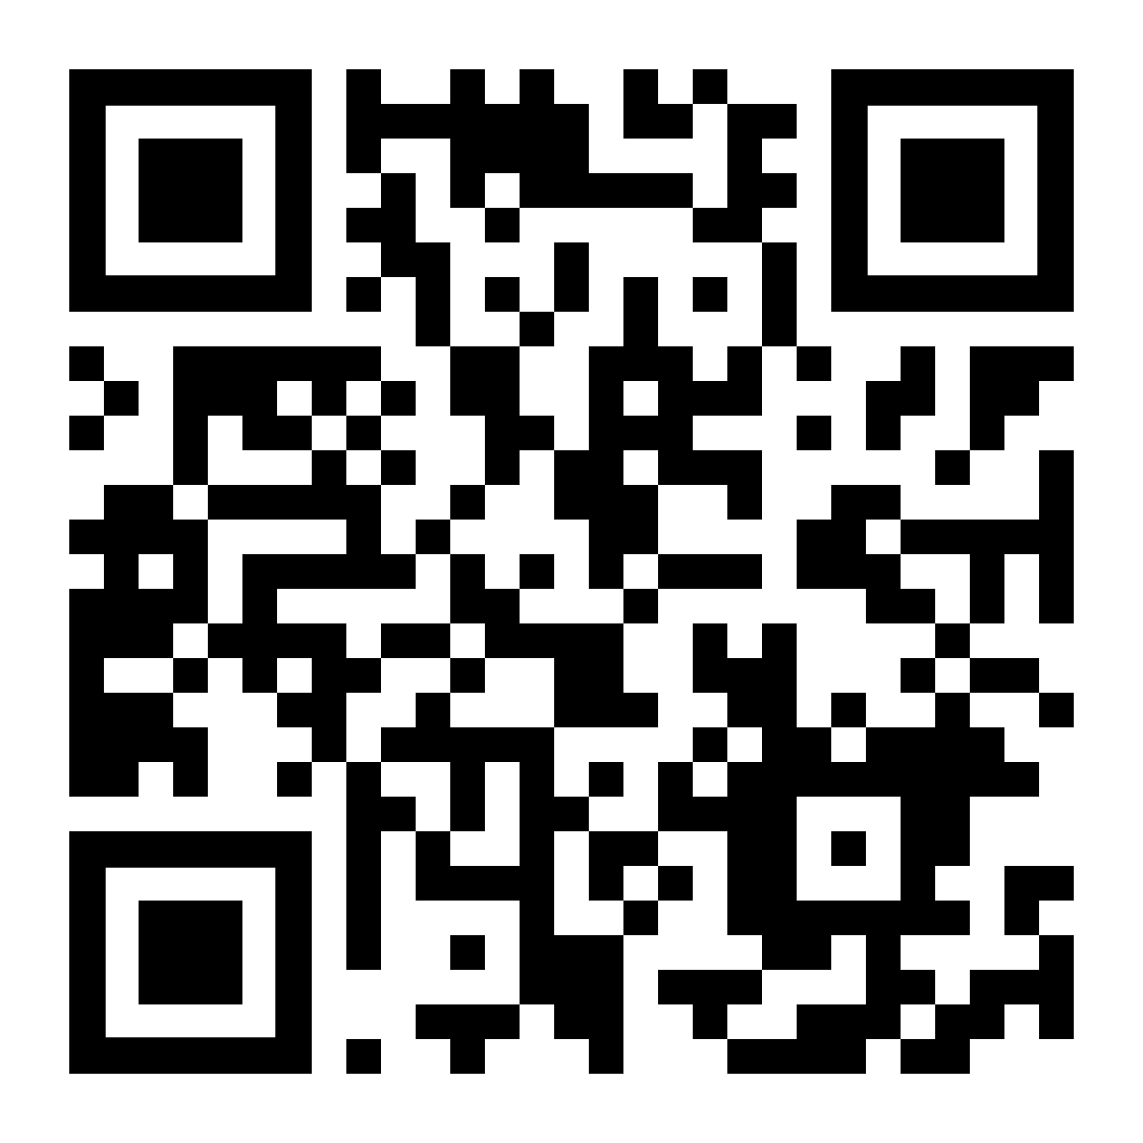
Scholarships
The scholarship page is updated weekly
Read the newsletter weekly for scholarship opportunities
Students can make appts with Mrs. Ash to discuss specific scholarships
Mrs. Ash has a working binder with scholarship information – students may come and peruse at any time.

Slide 18
Scholarships
College Board Big Future
FASTweb.com
Merit scholarships through Admissions Office at the Universities/Colleges to which you apply
University/College Foundation Scholarships
Alumni Scholarships
Brevard Schools Foundation (applications available Spring 2024)
Studentscholarships.org newsletter

Slide 19
Senior Dates
Schedule your SENIOR picture at www.dsp-photo.com. You MUST be photographed by Dec. 7 in order to appear in the yearbook.
Order your SENIOR Islander Yearbook at www.Jostens.com. The price is $80 but will increase.
Prom is scheduled for April 13, 2024 at the Pavilion at the Radisson in Port Canaveral.
Universal’s GRAD BASH TBD
Graduation – TBD by BPS
Senior Ads can be purchased by going to Jostens.com and click on “create my ad”. Early bird pricing ends Nov. 3, 2023 for discounted price. Final deadline Jan. 26, 2024.
Senior Sunrise
Oct. 13, 2023
Time: TBD
Cap and Gown Order Deadline Dec. 1, 2023
www.Jostens.com

Slide 20
United States Military

Slide 21
Career Highlights
Career Interviews
Fire Rescue/Paramedic
Real Estate Broker
Social Media Director
Dentist/Orthodontist
Blackhawk Helicopter Pilot
Universal Technical Institute
Teaching Interventions Keeping Individuality, Inc. (RBT)
Blue Marlin Realty

Slide 22
Career Fair
Career FAIR
March 19, 2024
6pm
MIHS Gym

Slide 23
Post Secondary Plans/Opportunities
Make an appt to see Mrs. Ash and discuss post-graduation plans.
EVERY SENIOR NEEDS TO HAVE A PLAN!!!
Internships
Vocational programs
Workforce
Apprenticeship
Travel (gap year)
Study Abroad

Slide 24
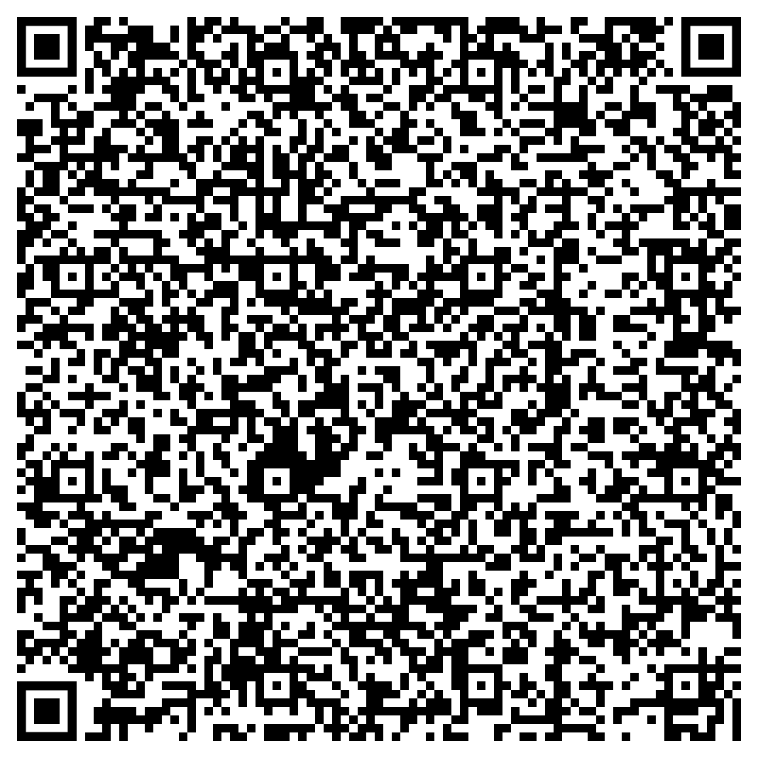
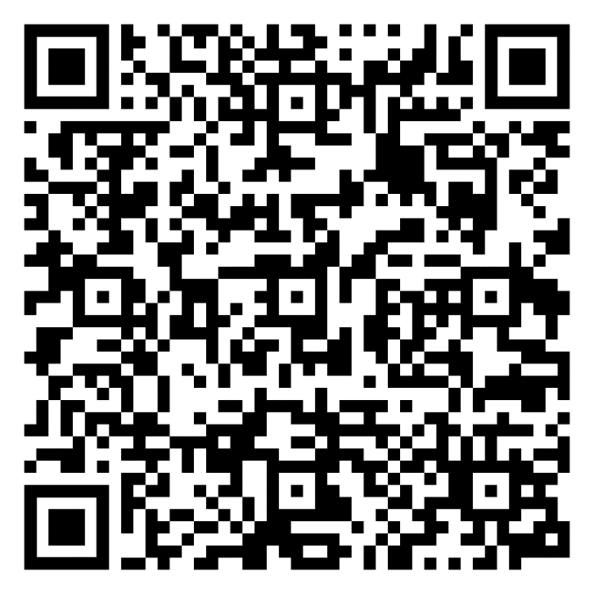
Make an Appointment with Mrs. Ash
Make an
Appointment with
Mrs. Luthman

