Slide 1
WELCOME to JUNIOR Parent Night at MIHS
James Rehmer - Principal
Debbie Lubbers - Asst Prin
Class of 2024
Wanda Luthman - Junior Class Counselor
Amira Rodriguez – Testing Coordinator

Slide 2
Testing for Grade 11
FSA ELA Retakes
Fall & Spring
To fulfill graduation requirement
Algebra EOC Retakes
Fall, Winter, and Spring
FCLE – Florida Civic Literacy Exam
SAT School Day
March
For most, first time taking SAT
College/Career Readiness

Slide 3
Preparing for the SAT School Day
Khan Academy
Linked to their PSAT Score
FREE SAT tutoring
Full SAT practice tests
SAT SD Student Guide
Distributed by a teacher on campus

Slide 4
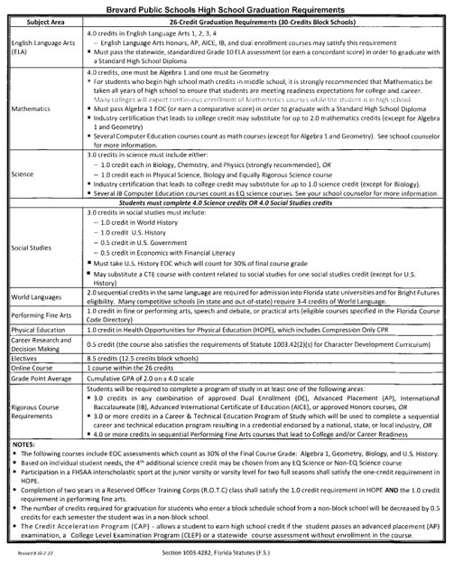
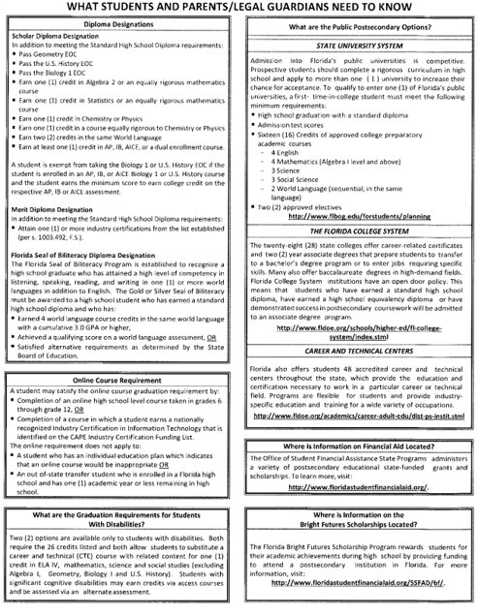
BPS High School Graduation Requirements

Slide 5
Scheduling for Senior Year
Take academic challenging classes
Must be in 7 periods

Slide 6
Scheduling for Senior Year (Rigorous Coursework)
Must complete the Rigorous Course of Study (3 Honors, AP, or Dual Enrollment Courses OR 3 Career & Technical Education (CTE) Courses in a Program)
To be College & Career Ready…must pass an AP test with a 3 or higher; OR pass a Dual Enrollment Class with a “C” or better; OR pass the Industry Credential in your CTE Program

Slide 7
Scheduling for Senior Year (NEW Courses)
Math
AP Pre-Calculus
Data & Financial Literacy
PE Elective
Swimming

Slide 8
Scheduling for Senior Year (HOPE)
If you are waiving your HOPE credit with a Sport (2 seasons) or if you’re waiving your HOPE AND your Performing/Fine/Practical Art credit with JROTC (2 years), you need to complete the Form (available in Guidance) for it to post to your transcript

Slide 9
Scheduling for Senior Year (Teacher Assistant--TA)
Can be a Teacher Assistant (TA) IF you are a role model citizen; have a 3.0 GPA; have enough credits to have a class period in your day that doesn’t earn credit
You DO earn Community Service Hours for being a TA.
You MUST complete Community Service Paperwork PRIOR before the Hours can count

Slide 10
Scheduling for Senior Year (Courses you may find on your schedule)
Intensive Reading
Fundamentals of Math Skills
SLS 1101 College Success Strategies

Slide 11
Scheduling for Senior Year (On Time Graduation)
IF you have failed a course(s) and/or are behind on credit—you need to make those up PRIOR to senior year so you are on track (Adult Ed., Credit Retrieval, Summer School, or FLVS as options)

Slide 12
Exploring Post-Secondary Opportunities
Checklist for College Bound Juniors
Begin building an academic resume (Participate in school activities and volunteer efforts. Extracurricular activities can help you develop time management skills and enrich your high school experience. Activities also help you stand out to prospective colleges and universities.)
Take the SAT/ACT at least 3x for superscore. Use the feedback you receive to work on any academic weaknesses (Khan Academy)
Attend college and career fairs (Brevard College and Career Fair has been rescheduled for March 7, 2023).
MIHS will be offering College & Career Night on March 21, 2023
Tour college campuses. If your family is traveling near a college campus, take advantage of the opportunity and go for a tour. MIHS is working to increase the number of opportunities students have to visit colleges during school.
College Applications (most due Nov. 1st) (May use Common App)
SAT ~ March 1, 2023

Slide 13
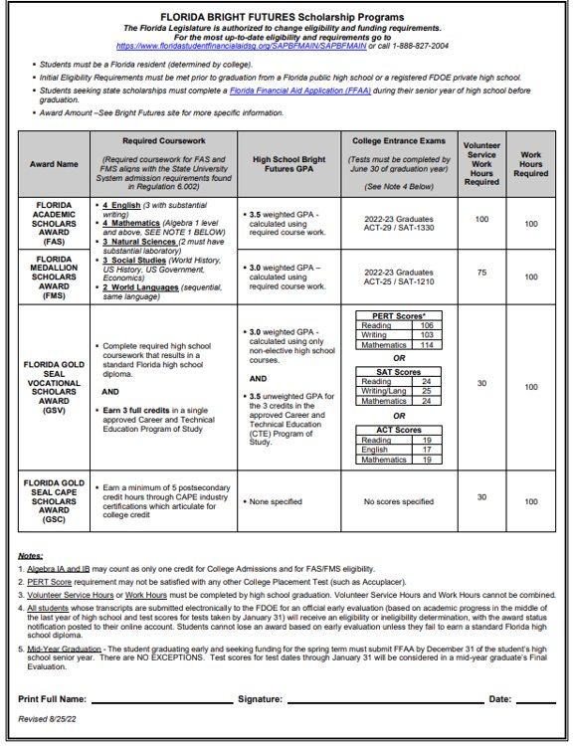
Bright Futures
5 Requirements for Bright Futures​
​
Application window opens Oct. 1st senio year– apply by graduation​
Complete all required coursework​
The GPA used is based on core courses (will use 2 additional core courses if needed)​
Required Volunteer OR Work Hours ​
TESTS – ACT or SAT (last test that can be used is June 2025 administration). MUST send scores to at least 1 public university in FL.​

Slide 14
Dual Enrollment / Early Admissions
Dual enrollment allows students to take classes at EFSC while still in high school receiving BOTH high school AND college credit
Students must have a 3.0 GPA
Students must earn a qualifying score on the PERT (Reading, Writing and Math) or SAT/ACT
Students who have meet qualifications may take dual enrollment courses with or without being on a track to complete their A.A. (some students have been working toward their A.A.)
DE class on campus (SLS 1101) if they haven’t met the CCR requirement
Students wishing to Early Admit need to watch for the application window to open in late February/early March. Students seeking Early Admissions attend EFSC full time - no classes at MIHS.

Slide 15
Dual Enrollment / Early Admission
THINGS TO CONSIDER
Students must be independent and have a higher level of maturity
Students must be eager for academic challenges
Students must be able to advocate and communicate with professors
Students must be able to balance “college” and “high school” life simultaneously
Students wishing to Early Admit need to understand the differences between DE and EA

Slide 16
Advanced Placement Courses (AP)
AP Courses are ideal for students who are willing to challenge themselves academically
AP Courses require students to take an exam in May each year. A qualifying score of 3, 4 or 5 will earn students college credit at most colleges/universities across the country.
AP courses communicate to prospective colleges/universities that these students are “college ready” and willing to stretch themselves academically to master material and grow as an individual
MIHS offers one of the largest selections of AP courses of any high school in Brevard
Students also have the opportunity to earn an AP Capstone Diploma (Reqs: AP Research, AP Seminar, 4 other AP courses)(*HB on floor that may make it Bright Futures eligible)
Students can also apply to the AP Academy in February 2023.
AP Academy students are guided to a Capstone Diploma, receive advising from Mrs. Ash, and are given opportunities such as college visits, community projects, etc.

Slide 17
CTE Internships
Must be a Senior
Must have completed 2 years of the same CTE Program with a “C” or better (preferably 3 or plan to complete 3rd one senior year)
Apply by deadline (March 31st)
Counselor needs to sign off on application to verify that you qualify
Runs August-May, but preferred that you begin work this summer
Can take 1 or 2 periods of CTE Internship
For each period you are in CTE Internship, you MUST work a minimum of 5 hours/week
Grades are based on going to work, doing a good job, and turning in your timecard every Tuesday (internships can be paid or unpaid)
Your internship needs to aligned with your CTE Program of Study
Must be on track to graduate and have room in your schedule for elective(s)
April 15th you will receive a letter notifying you of your acceptance into the CTE Internship Program
BENEFITS: earn High School credit, gain valuable work experience, get a head start on your career and more
If you have any questions or need help finding an internship, see Ms. Forbes in Bldg. 5, Room 101

Slide 18
THANK YOU FOR COMING!
Wanda Luthman, Guidance Counselor
for Graduating Class of 2024
Email: luthman.wanda@brevardschools.org
Phone number: (321) 454-1000 x 25023
Amira Rodriguez, Testing Coordinator
Email: Rodriguez.amira@brevardschools.org
Phone number: (321) 454-1000 x25252

Slide 19
Advanced Placement Courses (AP) (listed on Course Selection Card)
Capstone Courses
AP Seminar (10-11th)
AP Research (11-12th)
Social Studies Courses
AP World History (9th)
AP U.S. History (10th)
AP Human Geography (10-12th)
AP Psychology (10th-12th)
AP Comparative Govt & Politics (10-12th)
AP U.S. Govt & Politics (11th)
AP European History (10-12th)
AP Microeconomics (12th)
AP Macroeconomics (12th)
Elective Courses
AP Studio Art: 2D-Design (11-12th)
AP Studio Art: Drawing (11-12th)
AP Music Theory (10-12th)
AP Spanish Language & Culture (10-12th)
English Courses
AP Language and Composition (11th)
AP Literature and Composition (12th)
Science Courses
AP Biology (10th)
AP Chemistry(11th)
AP Physics(11-12th)
AP Environmental Science (10-11th)
Math Courses
AP Calculus A/B (11-12th)
AP Calculus B/C (12th)
AP Statistics (11-12th)

Slide 20
Exploring Post-Secondary Opportunities
*Meet with a recruiter
*Request a pre-candidate questionnaire

Slide 21
Exploring Post-Secondary Opportunities
EFSC Vocational Programs (A.S./Adv Tech Certs)
38 A.S. degrees some of which include Accounting, Aerospace Technology, Culinary, Dental Hygiene, Drafting, EMS, Medical Assistant, Radiography, Veterinary Nursing
4 Advanced Technical Certificates - Adult Cardiac Sonography, Network Security Forensics, Vascular Sonography, and Veterinary Practice Management
16 Career and Technical Certifications some of which include Aviation Mechanic, Cosmetology, Fire Fighter, HVAC, Patient Care Assistant, Welding Technology
Universal Technical Institute - over 35 different career paths/programs including automotive, welding, HVAC, marine, diesel, robotics, wind power
Full Sail University - Masters, Bachelors, Certificates - 3D Arts, Audio Arts, Audio production, Computer Animation, Cinematography, Digital Marketing

Slide 22
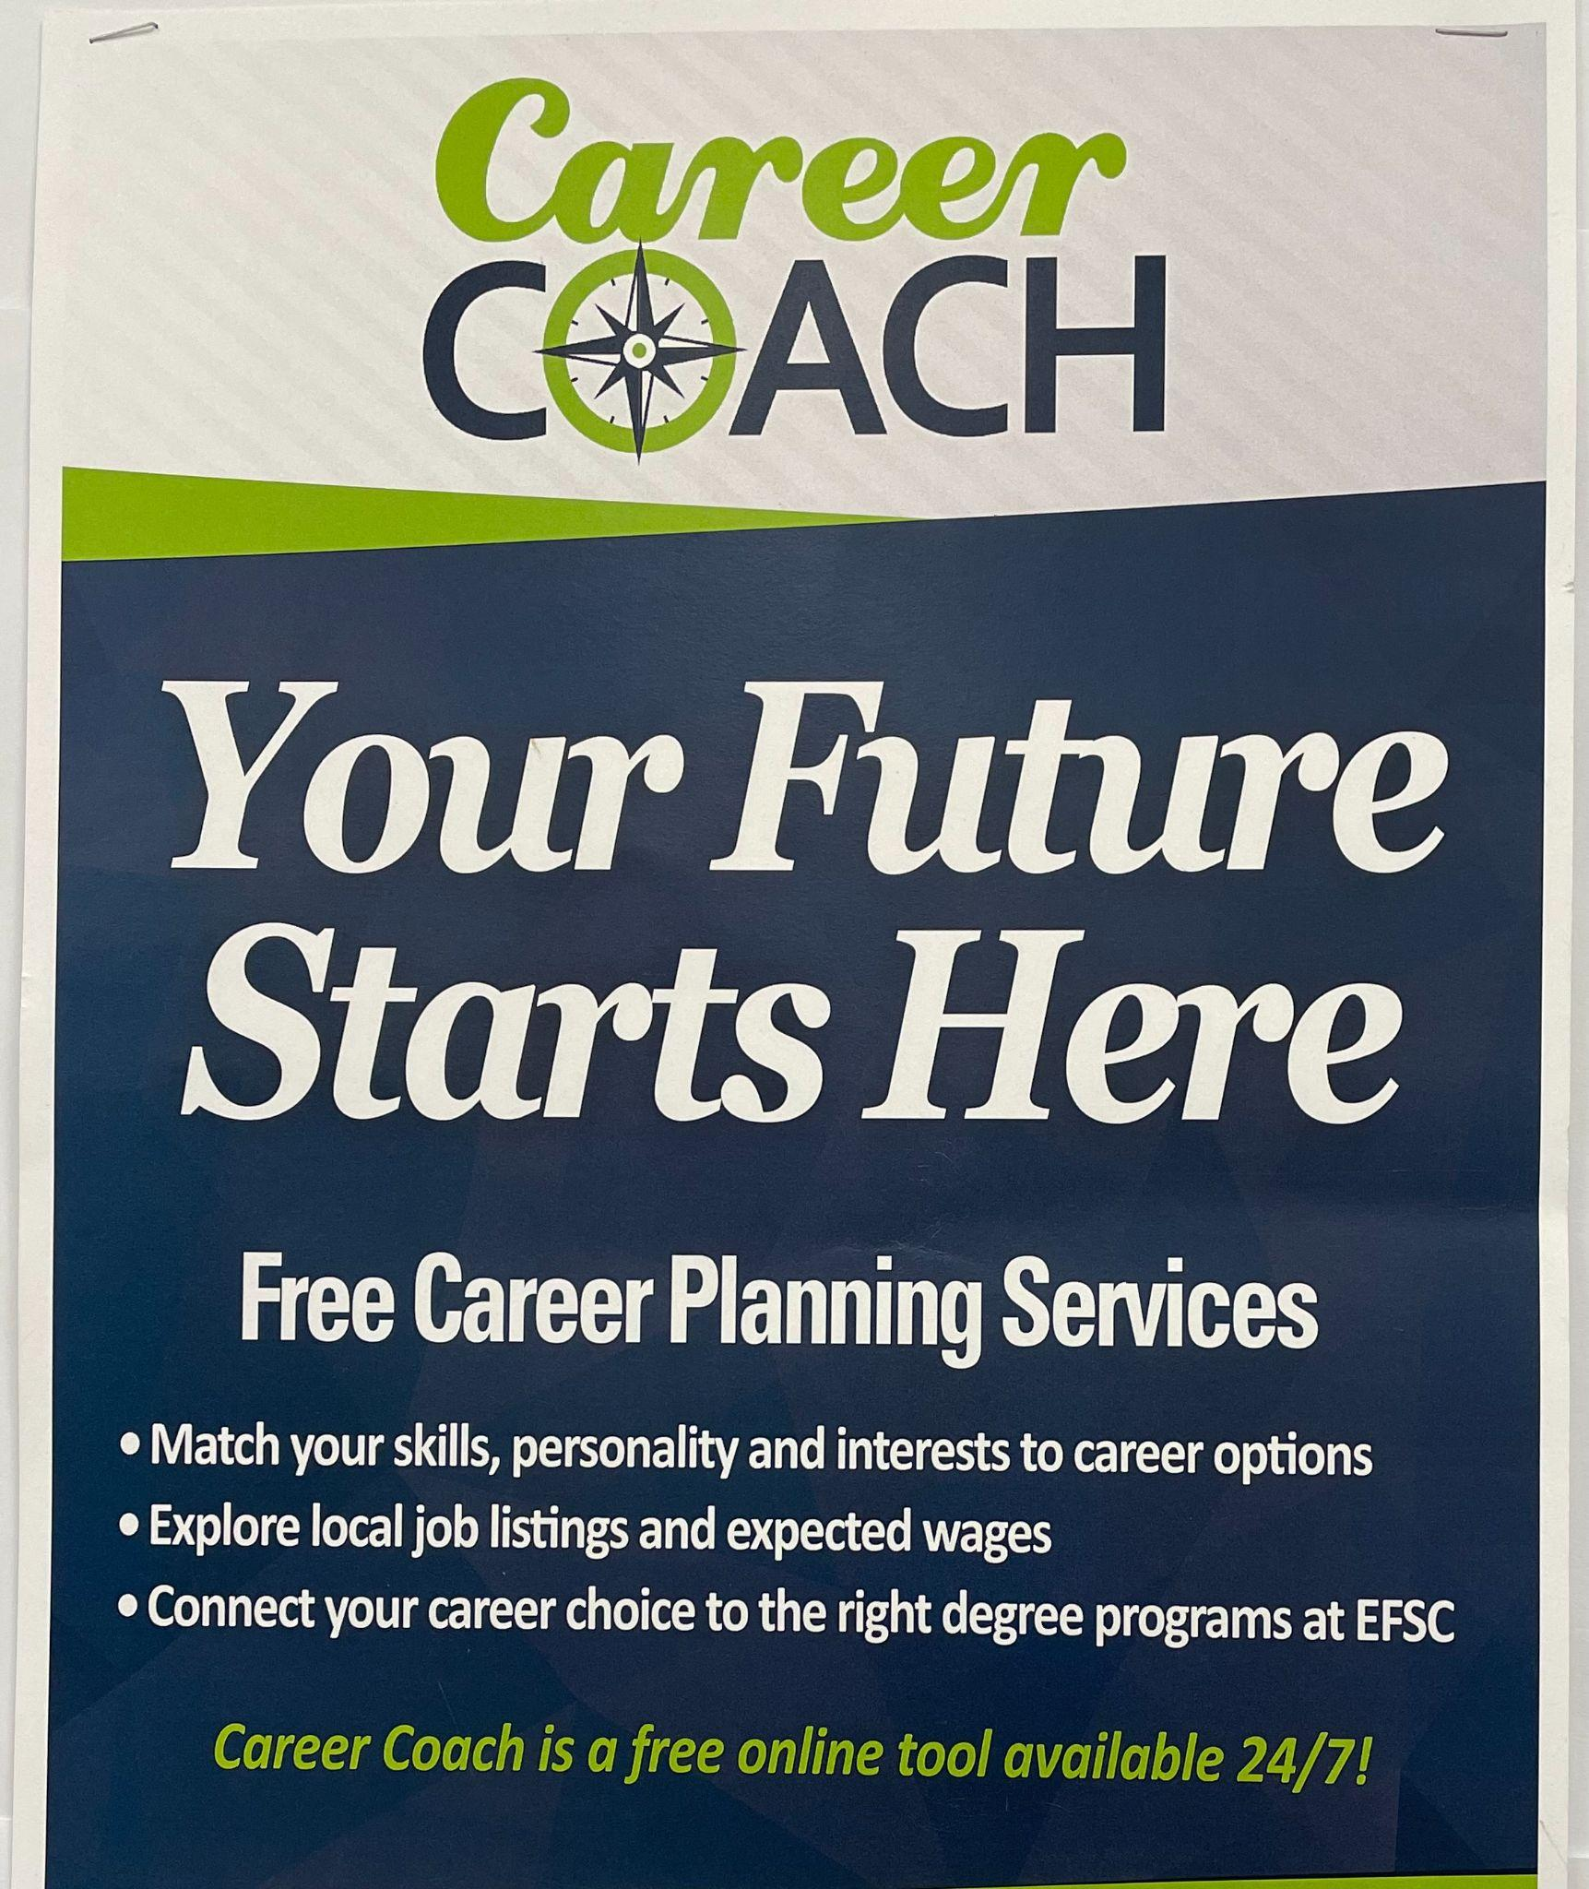
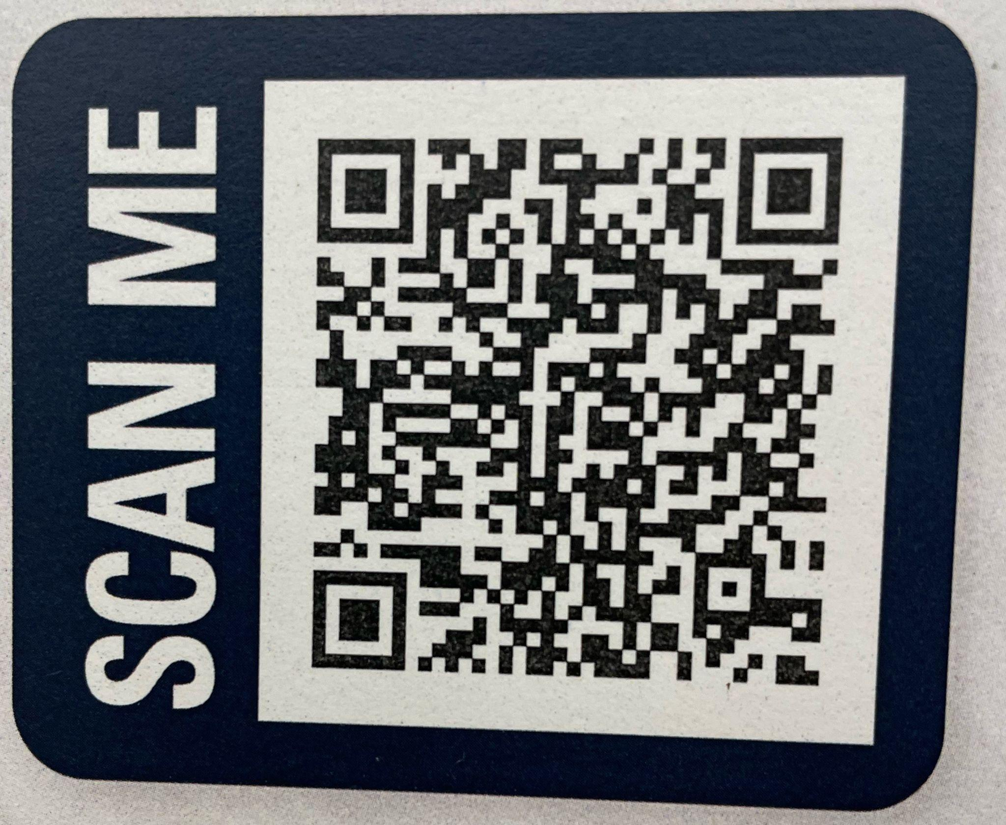
Exploring Post-Secondary Opportunities
Career Interviews​
Fire Rescue/Paramedic​
Real Estate Broker​
Social Media Director ​
Dentist/Orthodontist​
Blackhawk Helicopter Pilot​
Universal Technical Institute​
Teaching Interventions Keeping Individuality, Inc. (RBT)​
Blue Marlin Realty​
Local construction companies

Slide 23
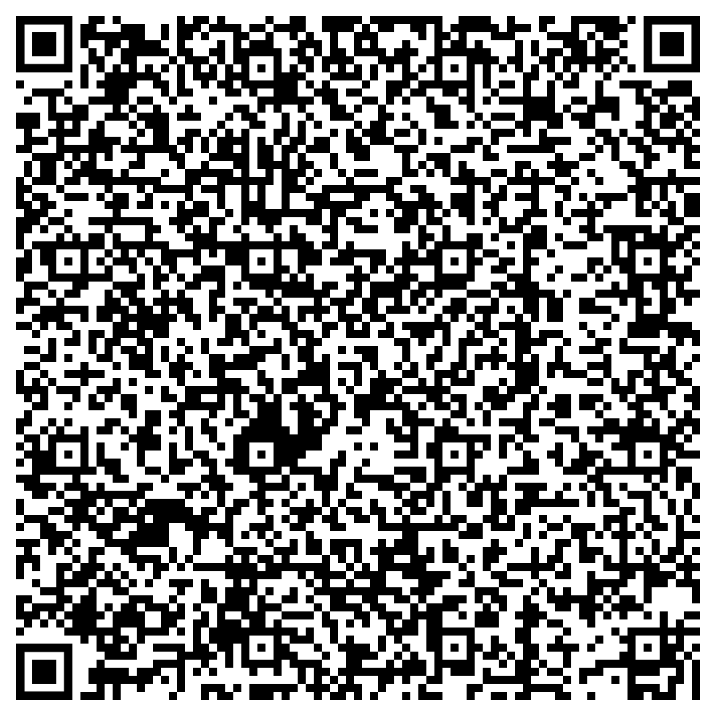
Exploring Post-Secondary Opportunities
We strive to help every student find success
GET INVOLVED
Make an appt to see Mrs. Ash and discuss post-graduation plans. ​
EVERY STUDENT NEEDS TO HAVE A PLAN!!!​
Internships​
Vocational programs​
Workforce​
Apprenticeship​
Travel (gap year)​
Study Abroad​
​
Book an Appt w/Mrs. Ash

