Slide 1
2023-24 TITLE I ANNUAL MEETING
MILA Elementary
FY24

Slide 2
According to the Every Student Succeeds Act (ESSA), schools are required to have an Annual Meeting to explain:
The Title I program, which includes:
Parent and Family Engagement Plan (PFEP)
School-Parent Compact
Parents’ Right to Know
The School Improvement Plan (SIP) Goals
The importance of parent and family engagement
The use of funds
FY24

Slide 3
WHAT IS TITLE I?
Title I is a federal grant that:
Ensures all children have the opportunity to obtain a high-quality education and reach proficiency on challenging state academic standards and assessments
Provides supplemental funds to school districts to assist schools with high concentrations of poverty to meet educational goals
Requires schools to train parents on how to support their children academically at home
Requires schools to train teachers on how to work effectively with parents and families in order to help improve academic achievement
Requires parents to have an active role in their child’s academic achievement
FY24

Slide 4
TITLE I FUNDING
Districts allocate Title I funds to qualifying schools based on direct certification data
Title I funds must supplement, not take the place of district funds
A specified amount of Title I funds must be spent on family engagement. Parent input is critical so schools can provide trainings/events that are relevant to families
Parents have the right to give input regarding how the school will use its Title I funds
FY24

Slide 5
WHO DECIDES HOW FUNDS ARE USED?
Your administrative team considers data and feedback collected throughout the school year to write the school’s Title I Plan. The team at MILA Elementary consists of Dr. O’Brien and Mrs. McFall.
Use of Title I funds must align with the goals of the School Improvement Plan (SIP).
Every school has a School Advisory Council (SAC) composed of:
parents, teachers, staff, community members, administrators, and students (at middle and high schools)
The School Advisory Council helps determine how to use Title I funds. Please consider joining we need your voice!
Copies of the Title I Plan and the School Improvement Plan (SIP) are available for families in the
Title I Parent Notebook in the front office.
FY24

Slide 6
TITLE I PROGRAMS
All Title I public schools in Brevard are school-wide programs, meaning Title I funds, along with other local, state, and federal funding sources are used to support all students in the school
The primary focus of the Title I program is to support the students most at-risk for academic failure
School identify specific groups of students that need more intensive academic support. These subgroups are show in the School Improvement Plan (SIP)
FY24

Slide 7
SCHOOL ASSESSMENT RESULTS
ELA Results
School | Grade | %3-5 2023 | %3-5 2022 | %3-5 2021 | %3-5 2019 | %3-5 2018 | Level 1 2023 | Level 1 2022 | Level 1 2021 | Level 1 2019 | Level 1 2018
MILA | 3 | 22 | 41 | 39 | 57 | 42 | 49 | 33 | 29 | 13 | 22
 | 4 | 37 | 35 | 58 | 48 | 43 | 41 | 35 | 15 | 28 | 31
 | 5 | 37 | 56 | 33 | 48 | 35 | 37 | 10 | 27 | 21 | 38
 | 6 | 56 | 52 | 50 | 54 | 48 | 15 | 26 | 13 | 17 | 16
FY24

Slide 8
SCHOOL ASSESSESSENT RESULTS
MATH Proficiency
School | Grade | %3-5 2023 | %3-5 2022 | %3-5 2021 | %3-5 2019 | %3-5 2018 | Level 1 2023 | Level 1 2022 | Level 1 2021 | Level 1 2019 | Level 1 2018
MILA | 3 | 37 | 46 | 33 | 63 | 66 | 45 | 29 | 40 | 7 | 14
 | 4 | 33 | 47 | 51 | 47 | 52 | 46 | 33 | 19 | 19 | 24
 | 5 | 29 | 36 | 20 | 44 | 48 | 47 | 34 | 53 | 31 | 20
 | 6 | 71 | 61 | 49 | 76 | 82 | 14 | 20 | 16 | 6 | 7

Slide 9
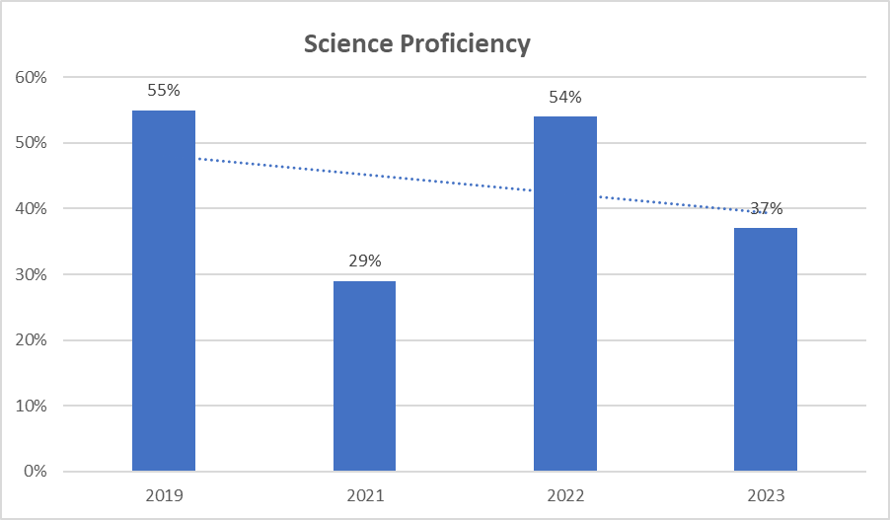
SCHOOL ASSESSMENT RESULTS

Slide 10
2023-24 SCHOOL IMPROVEMENT PLAN GOALS
The SIP goals were developed based on the Comprehensive Needs Assessment and the 2022-2023 scores on slides 7-9.
Increase math proficiency in grades 3-6 through coaching, reviewing scores, planned intervention, and parent support.
Increase ELA proficiency in K-6 by working with the State, literacy coach, providing planned intervention, supporting magnetic reading in grades K-2, using Lexia, planning parent engagement in literacy, and monitoring core instruction.
Increase proficiency in science by utilizing PENDA, the 5E model, vocabulary, and hands-on science. Provide parent engagement through Orlando Science Center night.
Increase outcomes for students with disabilities by working with resource teachers, utilizing high leverage practices, collaborating with general education , and looking at overall instructional strategies based on performance outcomes and Individual needs.
FY24

Slide 11
MILA Elementary TITLE I PLAN FOR 2023-24 SCHOOL YEAR
MILA is provided with $270,864 to pay for services and programs for our students.
School-based Title I funds pay for the following:
Two Teachers and one instructional assistant
Zoo School for 5th grade students
Lagoon Quest for 4th grade students
Lexia for all students K-6
School supplies and materials
Technology
Parent and family engagement nights
All of our Title I funds support our School Improvement Plan (SIP) goals.
FY24

Slide 12
EDUCATIONAL STANDARDS
Florida’s academic content standards establish high expectations for all students in the areas of reading, mathematics, writing, and science
The Florida Benchmarks for Excellent Student Thinking (B.E.S.T.) Standards for Language Arts and Math identify what your child needs to know and be able to do. Information can be found at:
www.cpalms.org Click on the “Standards” tab at the top of the page
If you need help accessing the B.E.S.T. Standards on Cpalms
please ask your child’s teacher ☺
FY24

Slide 13
TESTING
Parents/families will be provided information regarding the level of achievement of their child on each state academic assessment that is required by law
Parents/families must be provided materials to support their child if they are performing below grade level on the state academic assessments in reading and/or math
Parents/families of students that are identified as substantially deficient in reading based on the state academic assessments must be provided with a “Read at Home” Plan
To the extent that is feasible, testing information must be translated into a language the parents/families can understand
FY24

Slide 14
2023-24 SCHOOL ASSESSMENTS
MILA will follow the district approved testing calendars. Information will be sent home through flyers and posted on FOCUS, and Facebook before each testing window.
For grades 3-6 grade level proficiency is a level 3 or better on the end of the year FAST exam. PM 1 and PM 2 will be used to assess students progress before end of the year testing. IReady will be used to diagnose areas of concern and plan for instruction.
MILA uses the district adopted Benchmark and Saavas for ELA and Ed Gems and Reveal for math instruction. The BEST Florida State adopted standards are used for ELA and math. The Florida Common Standards are used for Science.
All data and information for your student will be available on their FOCUS portal.
FY24

Slide 15
PARENT AND FAMILY ENGAGEMENT PLAN (PFEP)
Each Title I school must annually write, with input from families, teachers, and community members a written Parent and Family Engagement Plan (PFEP)
The Parent and Family Engagement Plan (PFEP) describes how the school will carry out parent engagement requirements, including the development of a School-Parent Compact
The Parent and Family Engagement Plan (PFEP) and the School-Parent Compact can both be found in the Title I Parent Notebook found in the front office.
FY24

Slide 16
PARENT AND FAMILY ENGAGEMENT REQUIREMENTS
Title I schools must:
Have an annual evaluation of the effectiveness of the school’s Parent and Family Engagement Plan (PFEP) then use that evaluation to design and revise the plan
Explain the curriculum, assessments, and the minimum standards that students are required to meet
Provide academic trainings/events to help parents better help their children at home
Offer a flexible number of meeting dates and times to accommodate parents' schedules
Involve parents in making decisions about how Title I funds for parent engagement should be spent
Show evidence of continuous communication between school and families
FY24

Slide 17
2022-2023 PARENT SURVEY RESULTS
Parents at MILA responded that they like Flyers and messages through text and social media to find out about school events and information.
96% of parents said they feel welcome at MILA. We are always looking for parent involvement, volunteers, SAC members, and involvement with your students.
90% of MILA families are happy with the Principal. Administration wants to talk to you. Please request a meeting if you need anything. We are here for you!
80% of MILA parents would like more information about decision making for the school. Join SAC, come to parent events, read the information that comes home, complete the surveys that go out, come talk to us.
MILA Loves our families, come ask us how you can be involved.
FY24

Slide 18
SCHOOL-PARENT COMPACT
Each school must have a School-Parent Compact that is written by parents, teachers, and students
The compact outlines the shared responsibilities of students, parents, and teachers for improved student academic achievement
The compact will be reviewed with families throughout the year
The compact is required to be revised each year using input from parents, students, and teachers.
FY24

Slide 19
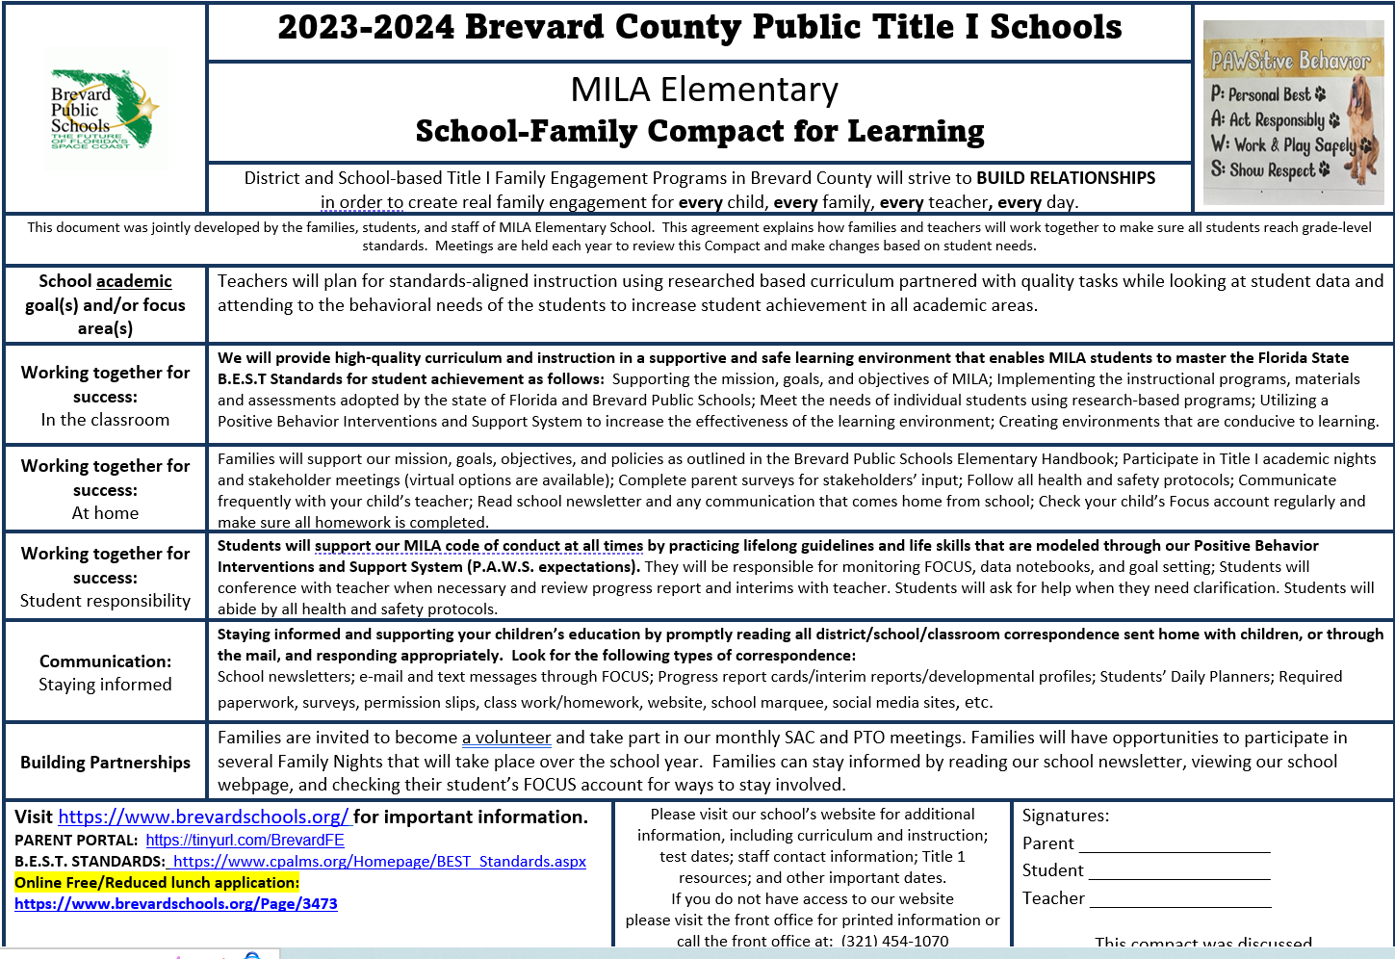
2023-24 SCHOOL-PARENT COMPACT
FY24

Slide 20
PARENTS’ RIGHT TO KNOW
Parents have the right to request and receive timely information regarding the professional qualifications of their child’s teachers and paraprofessionals
Parents must be notified if their child is assigned to or taught for four or more consecutive weeks by a teacher who is not state certified
FY24

Slide 21
TITLE I COMPLAINT PROCEDURE
Parents have the right to submit comments regarding district and/or school Title I plans
Comments should be turned in to the school principal
The school principal will forward the comments to the district Title I Department
FY24

Slide 22
RESEARCH SHOWS…
No matter the socio-economic status, when parents are engaged, students are more likely to:
attend school regularly
earn better grades
get better test scores
have more self-confidence
be promoted to the next grade
have better social skills
graduate
continue their education
FY24

Slide 23
TIPS FOR SUCCESS:
Communicate with your child’s teacher often throughout the year! Start at the beginning of the year…how do you want to communicate with each other?
Give your input on the schools Title I Plan
Consider joining the PTO/PTA, School Advisory Council (SAC) or the District Parent Leadership Team. Let your voice be heard!
Some Title I schools have Parent Resource Centers that provide materials that families may check out to use at home. If your child’s school does not have a Parent Resource Center ask your child’s teacher for materials to help you at home.
Reach out to Cynthia Dawson to discuss available materials
FY24
Notes:
Discuss your parent resource room, what is offered, and what is available.

Slide 24
WAYS TO STAY INFORMED
https://www.brevardschools.org/MILAES
Did you know you can change the language on our website?
*Please join our Facebook page and check FOCUS often for updates!
FY24

Slide 25
BEFORE YOU LEAVE!
Don’t forget to sign up for your FOCUS account. Monitor your child’s grades and stay in touch with their teacher!
Please consider volunteering in your child’s classroom this year! We’d love to have you!
Please complete the Annual Meeting Feedback form. Your opinions matter to us!
FY24

