Slide 1
Math Night What does it mean to be good at math?
Palm Bay Elementary
Michelle Hume Math Coach
Notes:
Welcome
Tonight we are going to take a look at what does it mean to be good at math?
How do we get our kids to see they can be good at math?
I’m Ms. Hume and I am the math coach here at Palm Bay Elementary.
Let get started.

Slide 2
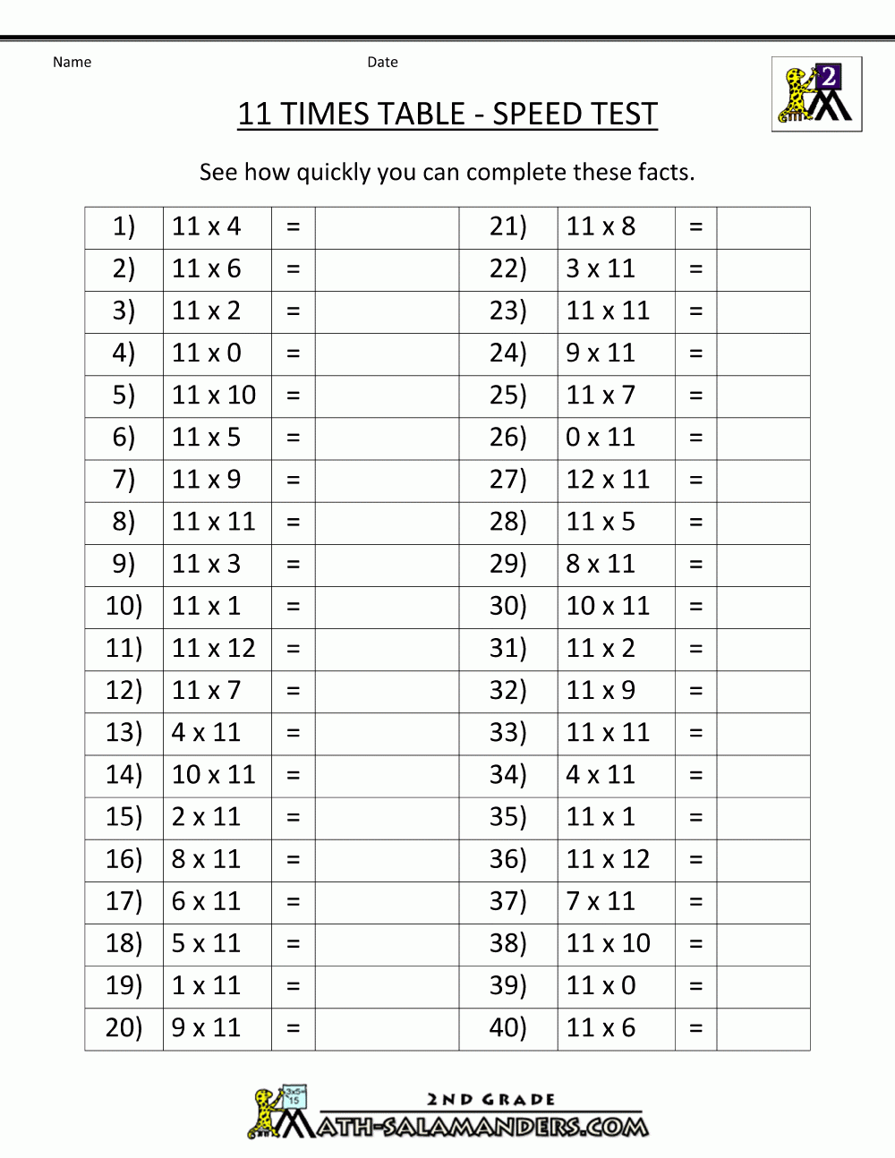
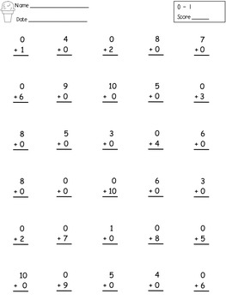
Timed Tests
Notes:
How many of you remember these?
Timed tests.
People tend to react one of two ways when they see these.
They either groan and say I hated those, or they put a smile on their face and say yeah, I remember those.
It all depends are how these tests made you feel.
Many people believe being good at math as being able to complete one of these tests quickly and accurately.
Don’t get me wrong there is definitely a need to be fluent in basic math facts, however that is only one piece of the puzzle. Let’s dig a little deeper.

Slide 3
What does it mean to be good at math?
Redefining What It Means to Be Good at Math - Bing video
Notes:
Here is a brief video by Mike Flynn about redefining what it means to be good at math.
Mike Flynn is a teacher that work with the National Council of Teachers of Mathematics to bring Professional Development in math to other teachers.
Things I heard:
Being good at math is means you are a flexible thinker.
It is okay to move back and forth through the strategies of making model, representations and solving with equations.
It is important to make connects between the strategies.

Slide 4
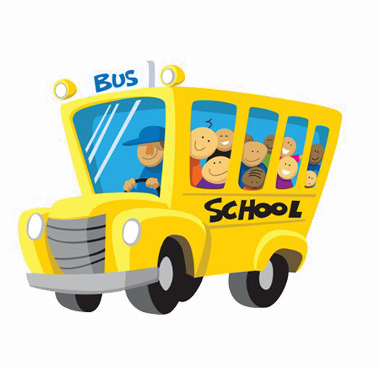
Let look at the following problem:
Palm Bay Elementary has 76 students that are going on a fieldtrip. Each bus can hold 30 students. How many buses does Palm Bay Elementary need to have all students go on the fieldtrip?
76 $÷30=2 remainder 16$
This Photo by Unknown Author is licensed under CC BY-NC
Notes:
This is a fifth grade problem.
Many students are able to do the math and come up with the correct answer of 2 remainder 16 and they stop there or they say the answer is 2 buses.
As a teacher or parent, we then have to guide the students to look back at the problem.
Asking questions like what does the remainder of 16 represent.
Ask students what are you going to do with the 16 students that are left over.
Are they coming to the field trip? Are they staying at school?
Then they can see oh, I need 3 school buses.
Going back to our video, we need students to look back at the task and see if their answer makes sense.

Slide 5
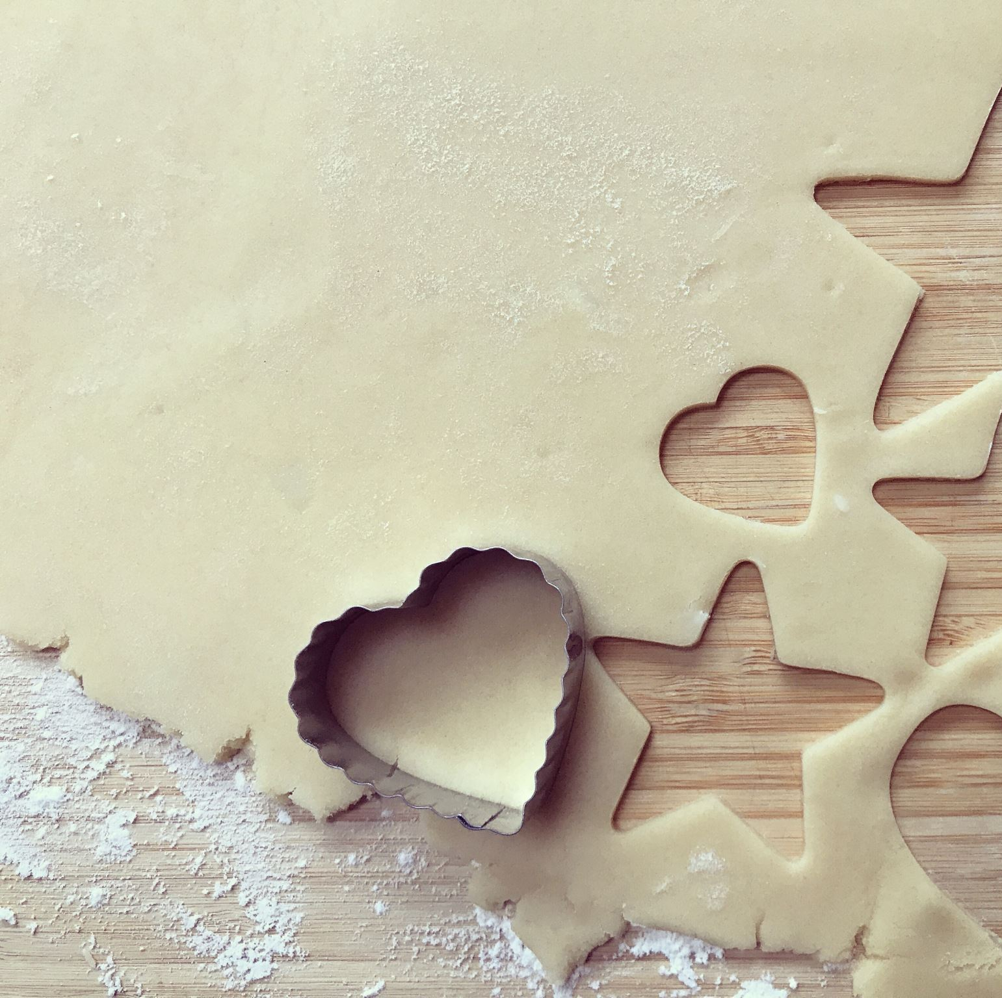
Let’s look at another:
Blossom and her 4 friends want a snack. Blossom’s mom brings them a plate of 10 cookies. How many cookies does each person receive?
Notes:
Some students will read this problem and say okay I need to use the 10 and 4 and if I divide 10 by 4, each person will get 2 cookies with two cookies left over.
We need to teach our kids to read carefully and think about the problem posed. Not just look at the numbers and perform some operation. The real world does not work that way. We add, subtract, multiply or divide for a reason. I may be buying party favors for a birthday party or balancing my checkbook. There is context to math in the real world.
So we might ask this student, what is going on in the problem and through asking these questions. Students can identify their own mistake. Oh, it is Blossom and her 4 friends. There are 5 people sharing cookies and they will correct themselves.
Asking questions allows students to grow.

Slide 6
How do we grow problem solvers?
By asking thought provoking questions:
What is going on in the problem?
What do you know?
What are you trying to find?
Once they know the context of the problem ask:
Can you use a model or drawing to represent the problem?
Are there any tools you can use?
Do you see a pattern?
What strategy/operation could you use?
After I solve the problem ask:
Did I answer the question?
Does my answer make sense?
Notes:
You were given a handout when you came in that gives you some questions to ask during the problem solving process.
Read each section.
Tool can be a ruler, number line, or objects to help you count.
Being good at math does not mean a student has memorized all their facts. Although fluency of basic facts is important.
It means you are a problem solver a thinker. That you can use a variety of strategies to solve problems.
Let’s grow problem solvers.
I hope you found today’s information helpful. Now lets have some fun with our kids. On your agenda you picked up on the way in, you can find location based on your child’s grade level to go play a game tonight. There are two sessions so you can visit more than one grade level. At the end of the your visit please turn in your survey to get a take home game. In center court you will find Kona Ice for sale it is a fund raiser for our attendance incentive program and free books to take home.
Enjoy your night.

Slide 7
Let’s grow problem solvers. Thank you
Notes:
Welcome
Tonight we are going to take a look at what does it mean to be good at math?
How do we get our kids to see they can be good at math?
I’m Ms. Hume and I am the math coach here at Palm Bay Elementary.
Let get started.

