Slide 1
Evaluation of Palm Bay Elementary School’s Title I Program for FY22
Presented by: Michelle Hume, Title I Contact
Notes:
Instead of using the title Framework Evaluation with stakeholders, please use something that is more transparent like Evaluation of our FY21 Title I Program.
This sample PPT is just one way a presentation could be designed. Your school data and how you present it is an individual school decision. As you create it, always put yourself in the place of the least informed person that would be viewing it to ensure you do not use confusing language or acronyms without explanation. I have not written a script in the notes section on these slides since this is just a sample, if you are recording the presentation and will have audio available, then notes are not necessary. If you are not recording it and just posting it on your school website, I would post it with a script in the notes and the notes pages visible when it opens.

Slide 2
What is Title I?
Title I is a federal grant that:​
provides financial assistance to schools with high percentages of children from low-income families to help ensure that all children meet challenging state academic standards.​
assists with building capacity of parents and teachers; and​ encourages parents to be involved in their children’s education.
Funds come from the federal government through the state to districts.

Slide 3
What is the school’s allocation based on? (How much Title I money do we get and what can we spend it on?)
Title I funds for each school are primarily based on the number of qualifying students counted during what is called FTE week which occurs in early February the previous year.
These federal funds may be spent in three areas and the purchases must be above and beyond what the district/charter is already expected to be purchasing for students and teachers.
The three general areas that funds can be used to support are:
student achievement in the areas the school has identified as needing support/improvement
professional development (teacher trainings) to help teachers improve their teaching skills in the areas that have been identified as needing support/improvement
parent and family engagement activities to teach parents and caregivers to academically support their children at home or to assist parents with other needs that may influence their child’s academic success such as bullying or other behaviors.

Slide 4
What is the Title I Framework and Evaluation document?
This is one document that is partially completed at the beginning of the year with the plan for spending and then the school goes back into the same document at the end of the year and fills in the results from each planned strategy/purchase. The document includes:
all school planned strategies/purchases using Title I dollars
planned strategies/purchases must support improvement in the areas that have been identified by the school’s comprehensive needs assessment activities (like this one).
a method to determine if the strategy/purchase made a positive difference in the area of weakness it was intended to strengthen.

Slide 5
Section 1 – Instructional Support (Lists the extra people that were hired with Title I funds to support students related to the weak areas that were identified in the school’s improvement plan.)
Spent a total of $295,760.00 (this includes all benefits such as FICA, insurance, workman’s comp., etc.)
2 Interventionists
This included 2 teachers instructing small groups of students in reading during our “Intensive Reading” blocks. Some went into the classroom and/or instructed small groups to support students in math. These teachers worked with Tier 2 and Tier 3 students and the goal was to move at least 10% to the next Tier.
.5 Reading Coach (the other .5 is paid by the district) and 1 Math Coach
The purpose of these positions is to promote enhanced academic instruction and student learning by coaching and working with teachers to develop more effective teaching practices and by sharing information addressing the way students learn. They hold data meetings to assist teachers in understanding and using diagnostic and test results to improve instruction. Their goal was to move at least 10% of students in Tier 2 or Tier 3 to the next Tier by end-of-year.
Notes:
This may take several slides but this is just an example. I would simply bundle the costs for employees.

Slide 6
Section 1 – Instructional Support (Lists the extra people that were hired with Title I funds to support students related to the weak areas that were identified in the school’s improvement plan.) Continued …
Spent a total of $295,760.00 (this includes all benefits such as FICA, insurance, workman’s comp., etc.)
1 Science Lab Teacher
The science lab teacher focused on grades 3-5 in science instruction. The classes enjoyed hands on lessons in the lab. The science teacher also analyzed our science data and worked with teachers creating engaging lessons for the classroom.
Notes:
This may take several slides but this is just an example. I would simply bundle the costs for employees.

Slide 7
iReady Results FY22
The data below indicates the percent of students that showed growth from the beginning of the year diagnostic to the end of the year diagnostic in reading and math. Our goal was that there would be a 10% increase in students scoring proficient and a decrease of 10% of students scoring 2+ years below grade level, in each grade level.
Reading students scoring proficient: All grade levels met or exceeded the goal. Hurray!
Reading students scoring 2+ years below grade level: Many grade levels made this goal with the exception of 1st and 4th grade. 1st grade increase this category by 1% and 4th grade decreased this category by 5% instead of 10%..
Math students scoring proficient: All grades met the goal. Hurray!!!
Math students scoring 2+ years below grade level: Many grade levels met this goal, except 1st grade. 1st grade decrease the number of students in this category by 6% instead of 10%.
Notes:
Data can be presented many different ways. Choose a method that is easily understood by your stakeholders. You may want to add data slides when speaking to teachers in order to add more detail. Graphs are easily understood and that may be the best way to display data.

Slide 8
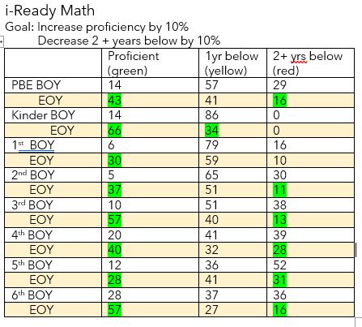
End of Year iReady Data % of Students in Grades K Through 6th Who Moved Tiers by EOY iReady Diagnostic

Slide 9
Science Test Results PENDA
Goal: Increase students scoring 70% or above on assessments by 10%.
3rd grade increase the number of students scoring 70% or above on assessments from 11% to 30%.
4th grade increased the number of students scoring 70% or above on assessments from 13% to 19%.
5th grade increased the number of student scoring 70% or above on assessments from 8% to 31%.
This shows that 3rd and 5th grade met the goal and 4th grade increase by 6% not meeting the 10% goal
 | BOY # of students who scored 70%+ | EOY # of students who scored 70%+
Grade 5 (74) | 6 (8%) | 23 (31%)
Grade 4 (70) | 9 (13%) | 13 (19%)
Grade 3 (53) | 6 (11%) | 16 (30%)

Slide 10
Student Engagement (instructional walk throughs)
Goal: Increase student engagement by 10%
BOY 80%+ engaged | EOY 80%+ engaged
66% | 80%

Slide 11
Supplemental Resources (These are extra items purchased to help students and teachers be more successful in the areas the school identified as weak. This is in addition to materials provided by the district to all schools.)
Total Funds Spent: $7,819.28
$3,199.00: AVID licensing and materials. This program focuses on organizational skills, teaching strategies and student engagement structures to support students being successful in the classroom. See Student Engagement Data
$181.28: Math manipulatives, dry erase boards and markers, and chart papers used to increase student engagement. See Student Engagement Data.
$4,439.00: ELA Intervention programs, assessment kits and instructional anchor charts. These supplies are used to increase student achievement in ELA. See i-Ready results.
Notes:
Feel free to steer them back to previously presented data or when presenting the data initially, tell parents or teachers which areas the data was used as evidence of growth.

Slide 12
Professional Development (These dollars are spent to improve teaching skills at the school which in turn should increase student success.)
Total Spent: $7,286.00
Conscious Discipline: A team consisting of an administrator and teachers will be attending the Conscious Discipline training this summer. This program supports students learning life skills, such as conflict resolution, working together (community building) and many others.
Notes:
You may need to further explain details if you use acronyms or talk about certain curriculum. In this slide we present the PATH curriculum and when presenting you may want to just briefly explain how the curriculum is used (e.g. grades, time during the day, etc.)

Slide 13
How does the school decide what to purchase with parent and family engagement funds?
The focus is to provide families with adult learning opportunities and materials to support them helping their children learn/practice at home. Funds must link to parent/family needs identified through the comprehensive needs assessment process (like this one). This is one of the areas that parent/family input is so important.
Examples of where the school gets their data from:
BPS District Parent Survey Results
Exit slips from parent/family events
Input from parents that attended special meetings like this one (other input opportunities include School Advisory Council, Annual Title I meeting and other parent meetings held throughout the year)
The following slides are examples of input from parents that we used to plan this year’s parent/family events.
If you would like to see a summary of each event’s exit slips, please contact Ms. Hume
Notes:
Informing parents and staff what data sources the school used to inform decision making is important. Again, if I’m a parent and am always receiving opportunities to complete yet another survey, I really want to know it gets reviewed and considered. This may encourage more parents to participate in future feedback opportunities.

Slide 14
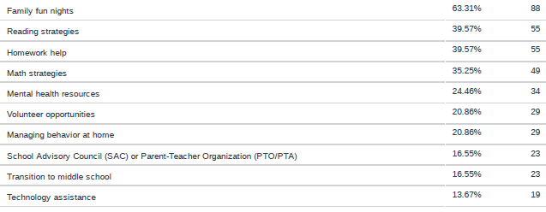
Parent Survey Data
Notes:
Including the district parent survey results is a great way to let parents see what other parents think about the various questions asked.

Slide 15
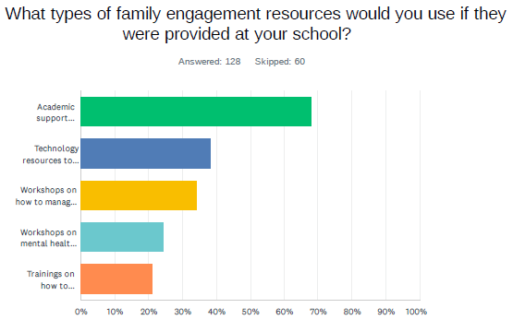
Parent Survey Data

Slide 16
Parent and Family Engagement
Total Spent: $5,790.72
Literacy Night: ($0 spent) Families rotated through grade level specific stations focused on teaching literacy skills with their children; each family received books. 39 families attended. Second most requested academic area of assistance. This year we targeted the students that qualified for the New Worlds Reading initiative. If we opened up the invite to all families, we could have had a larger turn out.
Academic Parent Teacher Team Meetings: ($4,691.97 for 3 events throughout the year) Families met with their child’s teacher to discuss their child’s academic performance in math and reading. Families were given basic reading and math skills practice activities that were sent home to all students, even if parents were unable to attend. APTT 1 – 90, APTT 2 -68, APTT 3 - 46. APTT 1 was the most attended Title I event this year. Wonder how to keep momentum going?
Welcome to Kindergarten: ($1,098.75) Families were invited to a presentation both virtually or in-person to help promote school readiness skills for their incoming kindergarten student, Kindergarten readiness activities were provided to each family. 29 families attended. Event is required by the Title I program.
All the input collected after each of these events is used along with the other input sources to decide what to do with the funds in the following year. Your input matters!
Notes:
I colored-coded this to try to show the same information for each event, I shared the attendance, why the event was planned in the first place, and what general feedback was received from the participants. You may have a better idea of what you want to share and how to do it. I think sometimes parents need to see if an event was requested by parents and what kind of turn out the school experienced. If they see dollars attached, maybe that will inspire change. Some of you may want to include RSVLP numbers versus actual attendance if you have a consistent problem in that area. There is a fine line to walk with wanting to inspire but not irritate. If you are buying materials in large quantities and then not many parents show up for the activity, that isn’t fiscally responsible. Maybe that is a great kickstart to a bit of brainstorming on how to get more parents participating.

Slide 17
Technology (This money is in addition to any technology the district may provide to schools and is used to increase success in the areas of focus the school identified.)
Technology purchases: $599.00
Title 1 Tools: $599.99 On-line program for compliance documentation.

Slide 18
Other Possible Data Sources
District Science Assessment Data
Math Curriculum Assessment Data
Attendance
Discipline
District Parent Survey Results
Small Group Intervention Data

Slide 19
As a Valued Member (Stakeholder) of this school - We Need You…
to be part of our decision-making activities by completing the exit slip for this meeting/presentation. We use all input to determine our focus areas.
to tell us what you want us to spend next year’s Parent and Family engagement funds on that will help you to help your child at home.
to let us know what is working and what you feel we need to update, get rid of, or create new.
to be an active part of our school family.
All input is reviewed and considered by the Comprehensive Needs Assessment Team.
Notes:
An appeal for input.

Slide 20
How can I be more involved in decision-making at the school
The input we receive from our families is so important! We truly use it to build and improve our Title I program. Families provide valuable insight into how their children learn best! Remember, your opinion matters! Your voice in your child’s education is needed! This is a TEAM EFFORT!
Attend our events!
Complete exit slips at events and surveys that we send home! We read every single one and welcome positive and negative feedback!
Consider joining our SAC committees, or CNA Team! We need to know what is working and what needs improvement at our school.
Share information and encourage other parents to get involved in school activities and planning.

