Slide 1

Theatre Presentation
How to parlay a Theatre hobby into possible careers
A PowerPoint slideshow by…
Tammy Herburger

Slide 2
PBMHS Theatre Season
September 08 First Thespian Meeting (meets every other Thursday, check callboard
15-16 Twelfth Night 7pm/$5.00/PBMHS Theatre; updated, short, fast, and funny
22 Theatre II Shakespeare in the Classroom
October TBA Zombie Walk/ Haunted House Participation (Thespian/ Bright Future Points)
22 District Individual Events TPA
27 Thespian Fall Party and Open House
November 17 Theatre II: Classical Scene Performance
December 1 District One Act Festival TPA in-school show; period 7
2-3 District One Act Festival TPA; Merritt Island High School
5-6 Spring Musical Auditions: SHREK THE MUSICAL JR.
TBA Thespian Holiday Party (Thespian/ Bright futures point)
January 12 Spring Musical Production Meeting
17 Musical Rehearsals Begin
February 14-17 Theatre I Original Playwriting
23 Theatre II 1-Act Play
March 2-3 SHREK THE MUSICAL 7PM/$5.00/ PBMHS THEATRE
15-19 STATE THESPIAN CONFERENCE TPA. TAMPA, FL
April 3-7 Juries Level I and II- Performance Exams
10-14 Spring Break
20 ADVANCED JURIES
20 Thespian Officer Voting
21 Random Acts of Shakespeare
27 dessert Theatre- Cafeteria 6:30 Food Fest/ Variety Show/ Officer Announcements
May Final Exams/ Summer I.E. Project/ Play readings

Slide 3
Theatre Course Offerings
Drama 1
Consists of essentials of theatre: basic terminology, simple technique, and origins.
Performance requirements: 2 contrasting monologues, extended Scene work, Playwriting and Production, practical final exam consisting of a scene presented for adjudication, and periodic written exams, quizzes, and script work.
Focus on: beginning student, developing “comfort level” onstage utilizing basic stage dynamics
ALL WORK IS CONFINED TO STUDIO THEATRE.

Slide 4
Drama 2
Adds to the basics learned in Drama I: various acting styles, methods, and characterizations.
Introduce and highlight some main periods of Drama (i.e. Greco/Roman theatre, Elizabethan (Shakespeare), and Modern Drama.)
Performance requirements: 1 Shakespearean scene assignment, 1 ‘Period’ performance piece, a One-Act play performed for class audiences each semester, and a Practical Final Exam consisting of a scene prepared for adjudication.
Additionally, periodic written tasks, quizzes, and exams.
ALL WORK CONFINED TO STUDIO THEATRE.

Slide 5
Advanced Drama (3 and above)
Focus on single play each semester, students will conduct in-depth Research and Analysis of play’s history (i.e. cultural, socioeconomics, class structure, political, and author’s background.
Students will form teams and be assigned to categories for presentations of their research. End result will be intelligent understanding and portrayal of another era and culture.
Occasionally a school musical may be chosen but academic groundwork shall remain unchanged.
ALL PERFORMANCES IN MAIN THEATRE. OUTSIDE REHEARSALS ARE MANDATORY.
All Advanced students required to participate in Thespian Troupe activities and Competitions, as these students reflect the school’s Theatre program, policies, and standard of our Theatre expectations.

Slide 6
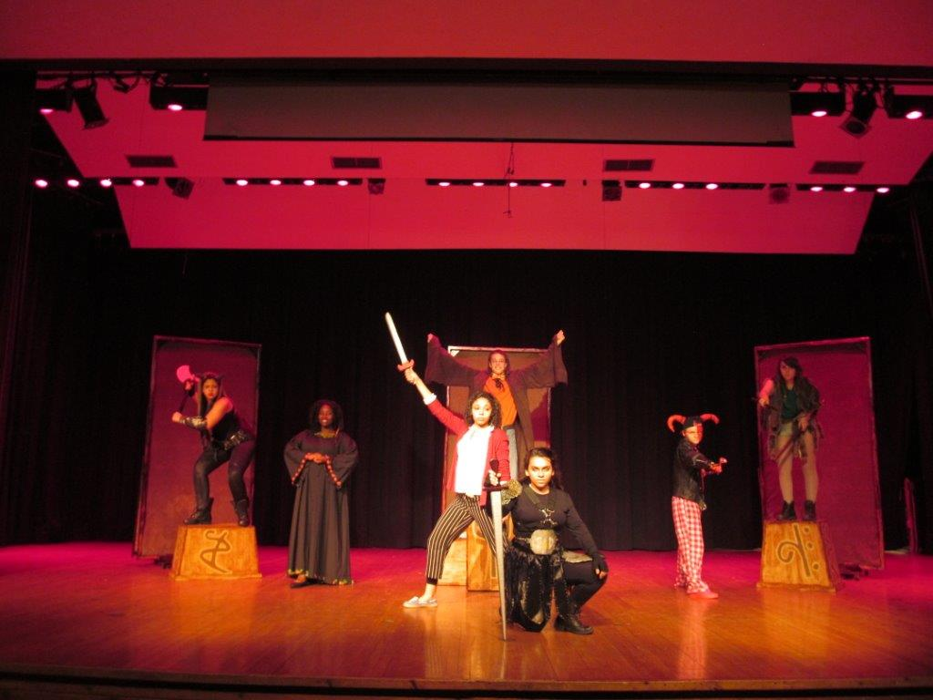
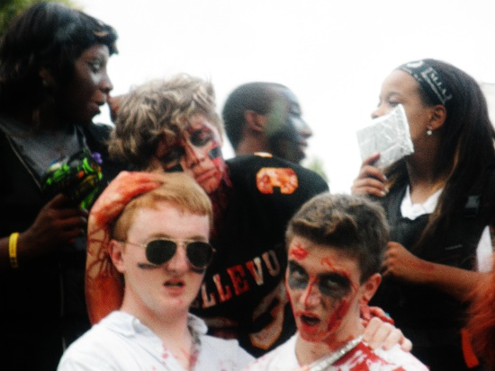
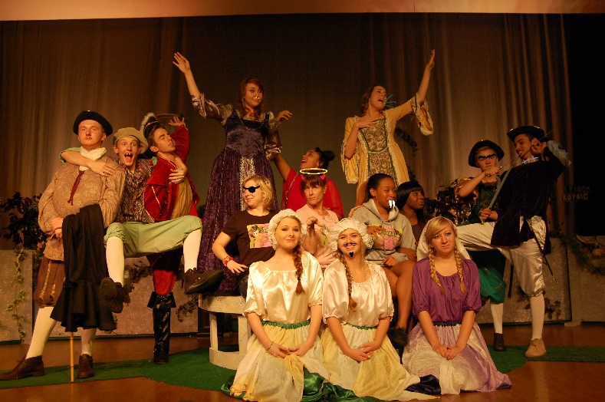
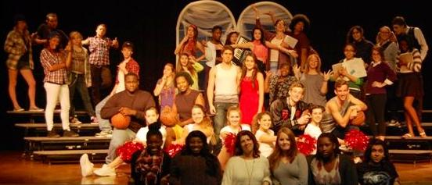
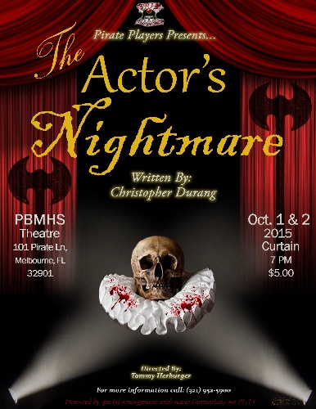
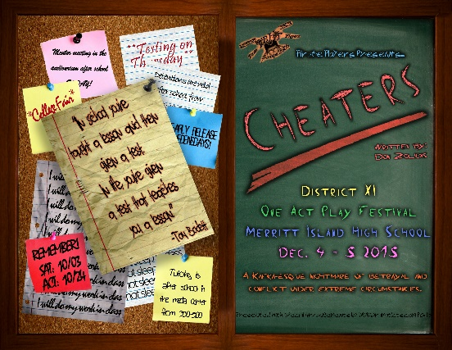
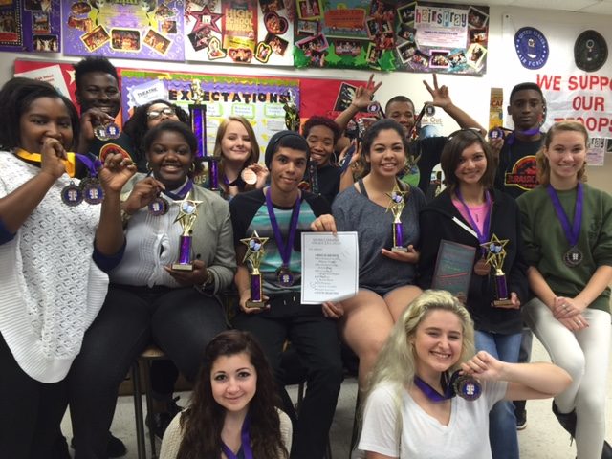
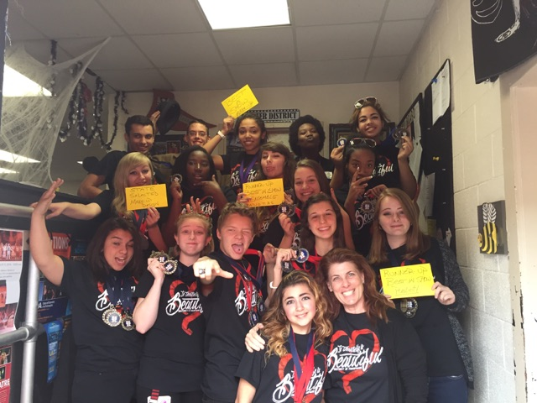
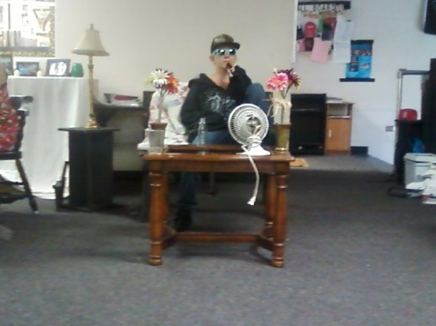

Slide 7

Theatre Careers
Theatre baseline education provides for varied and multilayered career options.
Actor- Film, TV, commercials, live Industrials, Internet, marketing performers
Director: see categories above
Technical Theatre- public schools, college, community and professional houses
Theatre Management: see categories above
Designers- Sets/Costumes/Makeup in TV, Film, Stage
Cruise line Industry
Entertainment-theme parks, theme restaurants, live entertainment
Sound engineers
Lighting engineers
Writing- playwright, critical reviews

Slide 8
Careers related to a Theatre Background
Public speaking
Sales and marketing
Law career
Politics
Education
Construction- electrical, Special f/x
Hospitality Industry
Broadcast Journalism
Communications/Public Relations

Slide 9
Why Teach Theatre In Our Schools?
Theatre is a SCIENCE
Theatre is MATHEMATICS
Theatre is a FOREIGN LANGUAGE
Theatre is HISTORY
Theatre is PHYSICAL EDUCATION
Theatre is LANGUAGE ARTS
Theatre is ART
Theatre is BUSINESS
Theatre is TECHNOLOGTY
Theatre is ECONOMICS
Theatre is taught in schools
Not because you are expected to major in theatre,
Not because you are expected to perform all through life,
Not so you can relax,
Not so you can have fun,
But
So you will recognize BEAUTY,
So you will be SENSITIVE,
So you will be closer to in INFINITE BEYOND IN THIS WORLD,
So you will have more LOVE,
More COMPASSION,
More GENTLENESS,
More GOOD,
In short,
More LIFE
Of what value will it be to make a prosperous living
Unless you know how to live?
That is why theatre is taught in our schools. Adapted with permission from Music Educators National Conference MIOSM Planning Guide

Slide 10
Coupe de Gras
Academically speaking…
Students who participate in arts programs consistently outperform their peers on the math and verbal section of the Scholastic Aptitude Test (SAT).
Just 15 minutes a week of music introduction dramatically improves a preschoolers ability to learn math and science.
Students in arts programs scored 30% higher in basic academic skills testing than students who were not enrolled in such programs. They also demonstrated greater creativity and superior communication skills.
Students of the arts develop essential tools of thinking itself: careful observation of the world; mental representation of what is observed or imagined; abstraction from complexity; pattern recognition and development; qualitative judgment; symbolic, metaphoric, and allegorical representation. These same thinking tools are used in science, philosophy, math, and history.

Slide 11
Florida Theatre Programs
http://www.edref.com/college-degrees/performing-and-visual-arts/drama-and-theater-arts/florida
Drama And Theater Arts Schools in Florida
Detailed profiles of schools for Drama And Theater Arts in Florida from the EdRef college search portal.
The information above is designed to help people explore potential careers, as well as find information about the schools that offer training in the areas of interest.
There is not much doubt about the fact that advanced education helps people earn more throughout their lives. Of course, students also benefit from selecting a career area which will hold their interest long-term and help them lead fulfilling lives. Reading about and contacting multiple schools is the best way to find the right school for each individual.

Slide 12
Florida College Theatre Programs
SchoolCityStudents (FTE)
Barry University Miami8,733
Eckerd College Saint Petersburg2,544
Flagler CollegeSaintAugustine2,537
Florida Agricultural and Mechanical UniversityTallahassee11,562
Florida Atlantic University Boca Raton26,193
Florida International UniversityMiami38,182
Florida Southern CollegeLakeland2,295
Florida State UniversityTallahassee40,555
Full Sail Real World Education Winter Park6,150
Jacksonville UniversityJacksonville3,212
Palm Beach Atlantic University-West Palm Beach West Palm Beach3,291
Rollins College Winter Park3,453
Stetson UniversityDeland3,721
The University of West FloridaPensacola10,358
University of Central FloridaOrlando48,398
University of FloridaGainesville51,725
University of Miami Coral Gables15,449
University of South FloridaTampa44,870

Slide 13
College/Scholarship
Theatre Major Requirements:
3.0 minimum GPA (the higher the better)
2-4 yrs. High School Theatre
Consistent award ratings at District/State Thespian Competitions &/or F.T.C.
Prepared contrasting monologues- 1 of which is classical
Letters of Recommendation from Directors
Musical Theatre- all of above and:
Singing audition- 16 bars up tempo & ballad
Proficient with at least 1 musical instrument
Movement and dance experience
Additionally:
8 x 10 headshot + résumé
Outside performing experience- local theatres, summer stock, internships
Performance reel of past shows
Recommendations from Industry members

Slide 14

Tammy Herburger- Director
Jillianne Tamillo- President
Amber Abu Obeid- Vice President
Rachael Palanzi- Secretary
Sam Williams- Treasurer
Hannah Kramer- Scribe/ Historian

