Slide 1




Title I Annual Meeting
Pinewood Elementary September 21, 2023

Slide 2
Purpose of Meeting
According to the Every Student Succeeds Act (ESSA), schools are required to host an Annual Meeting to explain and discuss:
The Title I program, which includes:
Parent and Family Engagement Plan (PFEP)
School-Parent Compact
Parents’ Right to Know
The School Improvement Plan (SIP) Goals
The importance of parent and family engagement
The use of funds

Slide 3
What is Title I?
Title I is a federal grant that:
Ensures all children have the opportunity to obtain a high-quality education and reach proficiency on challenging state academic standards and assessments
Provides supplemental funds to school districts to assist schools with high concentrations of poverty to meet educational goals
Requires schools to train parents on how to support their children academically at home
Requires schools to train teachers on how to work effectively with parents and families in order to help improve academic achievement
Requires parents to have an active role in their child’s academic achieve

Slide 4
Title I Funding
Districts allocate Title I funds to qualifying schools based on the number of students eligible to receive free/reduced price meals
Title I must supplement, not supplant district funds
A specified amount of the Title I grant must be spent on family engagement and professional development. Parent input is critical so schools can provide trainings/events that are relevant to families.
Parents have the right to give input regarding how the school will use its Title I funds

Slide 5
Who decides how funds are used?
Your administrative team considers data and feedback collected throughout the school year to build their Title One plan. The team at Pinewood Elementary consists of Mrs. Robinson and Mrs. Smith.
Every school has a School Advisory Council (SAC) composed of:
Parents, teachers, staff, community members, principal and students (at middle and high schools)
The School Advisory Council helps determine how to use Title I funds. Please consider joining!
  Copies of these documents are available for review in the school office (translated, when possible)

Slide 6
Title I Programs
All Title I public schools in Brevard are school-wide programs, meaning Title I funds, along with other local-, state- and federal funding sources are used to support all students in the school
The primary focus of the Title I program is to support the students most at-risk for academic failure
Specific groups in need of more intensive academic support are reflected in the School Improvement Plan (SIP)

Slide 7
Testing
iReady Reading Results from the 20-21 School Year
  To ensure preparedness for the tests, Mathematics Florida Standards and Language Arts Florida Standards drive all instruction, curriculum, and assessments that take place in the classroom
Grade Level | 2022-2023 End of Year ELA Data Proficiency Percentages
Kindergarten (Early Literacy) | 65%
1st Grade (Early Literacy) | 44%
2nd Grade (STAR) | 58%
3rd Grade (FAST) | 61%
4th Grade (FAST) | 62%
5th Grade (FAST) | 68%
6th Grade (FAST) | 76%
ESE students | 35%

Slide 8
School Assessment Results

Slide 9
School Assessment Results

Slide 10
School Assessments

Slide 11
School Assessments

Slide 12
2023-2024
School Improvement Plan Goals
Tier 1 instruction
Proficiency of ESE students
Positive Culture and Engagement
Intervention

Slide 13
School Grade Information
The last school grade issued to Pinewood was an “B.”
Our goals this year are to:
Enhance core instruction (Tier 1)
  Enhanced planning
  Classroom walk-throughs
  Feedback
Increase Student with Disabilities (SWD) proficiency
  Currently 35% proficient; Goal 45% proficient
  Tracking data
  Classroom support
  Targeted interventions
Positive Culture & Environment (EWS)
  Mentors and Check-ins
  Build relationships
  Goal Setting
Intervention
  Data: 39% need ELA intervention; 36% need Math intervention
  Targeted interventions
  Data reviews

Slide 14
Use of Title I Funds
Pinewood Elementary is provided with $262,223 to pay for services and programs for our students.
School-based Title I funds pay for the following:
  The salaries of one Title I teacher, two Title I Instructional Assistants and half of the salary of our Literacy Coach.
  Materials and Supplies needed to implement our School Improvement Plan (Curriculum & Training)
  Parent & Family Engagement Materials
  Subscription Fees & Instructional Related Technology

Slide 15
Educational Standards
Florida’s academic content standards establish high expectations for all students in the areas of reading, mathematics, writing, and science
The Florida Benchmarks for Excellent Student Thinking (B.E.S.T.) Standards for Language Arts and Math identify what your child needs to know and be able to do. Information can be found at:
  www.cpalms.org Click on the “Standards” tab at the top of the page
If you need help accessing the B.E.S.T. Standards on Cpalms
please ask your child’s teacher ☺

Slide 16
Testing
Parents are to be provided information regarding the level of achievement of their child on each state academic assessment required by law
To the extent that is feasible, testing information must be translated into a language the parents can understand
Parents/families of students that are identified as substantially deficient in reading based on the state academic assessments must be provided with a “Read at Home” Plan
Parents/families must be provided materials to support their child if they are performing below grade level on the state academic assessments in reading and/or math

Slide 17
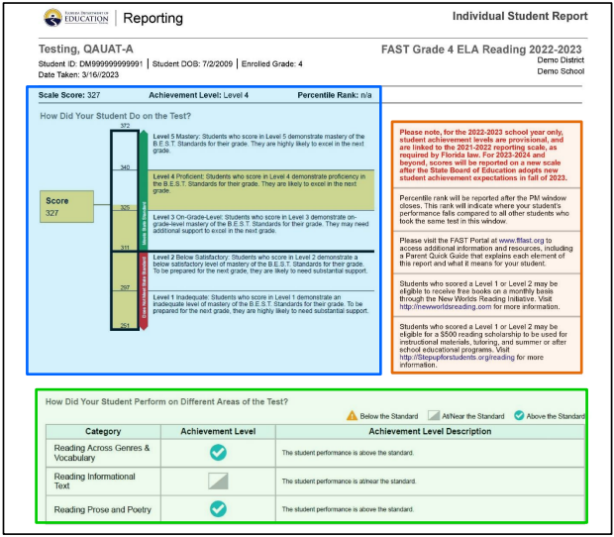
2023-2024 School Assessments

Slide 18
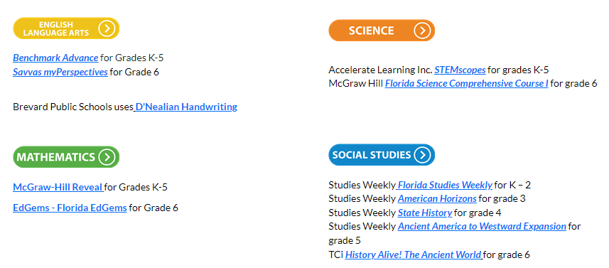
2023-2024 School Assessments
Grades 3-6 FAST results are accessible through Focus (email sent to families)
Instructional Programs for Brevard:

Slide 19

Parent Access
B
https://brevardk12.focusschoolsoftware.com/focus/?skipSAML=true
Access through Brevard Public Schools
Access through your child’s Launchpad

Slide 20
School Assessments
Diagnostic: iReady
K-2 Reading/Math
  October 2nd-9th
3-6 Reading/Math
  December 4th-11th
PM 2 (FAST, STAR)
K-2 Reading/Math
  December 5th & 6th
3-6 Reading/Math
  January 10th & 11th

Slide 21
Parent and Family Engagement Plan (PFEP)
Each Title I school must annually write, with input from families, teachers, and community members a written Parent and Family Engagement Plan (PFEP)
The Parent and Family Engagement Plan (PFEP) describes how the school will carry out parent engagement requirements, including the development of a School-Parent Compact
The Parent and Family Engagement Plan (PFEP) and the School-Parent Compact can both be found in the Title I Parent Notebook found in the front office.

Slide 22
Parent and Family Engagement Plan (PFEP)
Title I schools must:
Have an annual evaluation of the effectiveness of the school’s Parent and Family Engagement Plan (PFEP) then use that evaluation to design and revise the plan
Explain the curriculum, assessments, and the minimum standards that students are required to meet
Provide academic trainings/events to help parents better help their children at home
Offer a flexible number of meeting dates and times to accommodate parents' schedules
Involve parents in making decisions about how Title I funds for parent engagement should be spent
Show evidence of continuous communication between school and families

Slide 23
Parent Survey
At Pinewood we use a variety of ways to stay in communication with Home and our Community.
  FOCUS phone calls/text messages/emails
  Facebook Page
  Monthly School Newsletter
  Classroom newsletters, Dojo, planners, etc.
  School Advisory Council
  Parent Nights
Please complete surveys to ensure your voice is heard!

Slide 24
School – Parent Compact
Each school must have a School-Parent Compact that is written by parents, teachers, and students
The compact outlines the shared responsibilities of students, parents, and teachers for improved student academic achievement
The compact will be reviewed with families throughout the year
The compact is required to be revised each year using input from parents, students, and teachers.

Slide 25
School-Parent Compact
Each school must have a School-Parent Compact that is written by parents and school personnel
The compact outlines the responsibilities of the students, parents, and school staff in striving to raise student achievement
The compact will be reviewed with families throughout the year
The compact is to be reviewed each year by the parent, student, and teacher

Slide 26

School-Parent Compact

Slide 27
Right to Know
Parents have the right to request and receive timely information regarding the professional qualifications of their child’s teachers and paraprofessionals
Parents must be notified if their child is assigned to or taught for four or more consecutive weeks by a teacher who is not state certified

Slide 28
Title I Complaint Procedure
Parents have the right to submit comments regarding district and/or school Title I plans
Comments should be turned in to the school principal
The school principal will forward the comments to the district Title I Department

Slide 29
Research shows…
No matter the socio-economic status, when parents are engaged, students are more likely to:
attend school regularly
earn better grades
get better test scores
have more self-confidence
be promoted to the next grade
have better social skills
graduate
continue their education

Slide 30
Tips for Success:
Communicate with your child’s teacher often throughout the year!
Give your input on the school’s Title One Plan
Consider joining the School Advisory Council (SAC) or the Title I District Advisory Council. Let your voice be heard!
Some Title I schools have Parent Resource Centers that provide materials and resources that families may check out to use at home
Reach out to Liana Coulson at 269-4530 (extension 48469) to discuss available materials.
Notes:
Discuss your parent resource room, what is offered, and what is available.

Slide 31
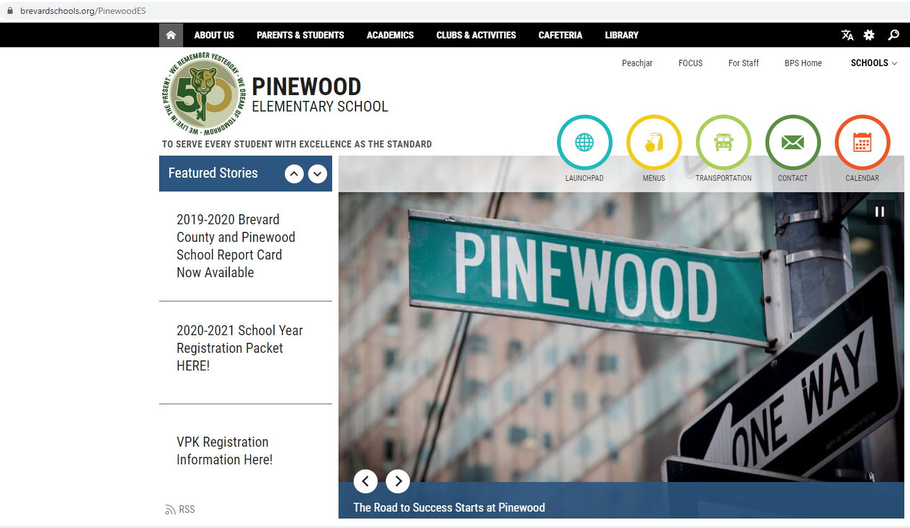
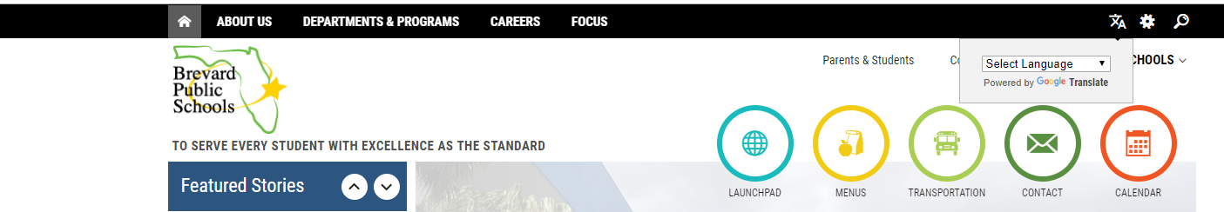
Stay Informed

Slide 32
Before You Leave:
Don’t forget to sign up for your FOCUS account. Monitor your child’s grades and stay in touch with their teacher!
Please consider volunteering in your child’s classroom this year! We’d love to have you!
Please complete the Annual Meeting Feedback form. Your opinions matter to us!

