Slide 1


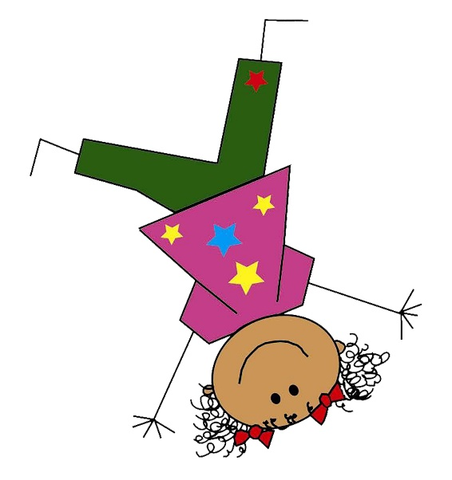
Kindergarten,
Here WE Come!
Transition to Kindergarten
Pinewood Elementary School
Spring 2024
Notes:
Importance of allowing families and schools to connect prior to children beginning Kindergarten to help ease fears of families, students, school staff.
This is the families first impression of your teachers, staff

Slide 2

The Mission:
To create a meaningful transition for families and establish authentic relationships as they take the journey into Kindergarten.

Slide 3

Families….
Thank you
for being here!

Slide 4
Brevard Public Schools
The mission of Brevard Public Schools is to “serve every student with excellence as the standard”.
Our vision:
Brevard Public Schools will serve our community and enhance students’ lives by delivering the highest quality education in a culture of dedication, collaboration and learning.
Our organizational values are:
We make decisions based on what is in the best interest of all students.
We uphold honesty and integrity as our guiding principles.
We treat one another with respect.
We set high expectations and demand quality performance.
We take responsibility for our actions and are accountable for the results.
We foster a safe, accessible and healthy environment.
We value diversity and the strength of individual differences.
We provide a positive, caring and supportive climate.
We work as a team to accomplish our mission.

Slide 5
About OUR school…..
Pinewood Elementary consistently demonstrates high performance at the district and state level
Title I School
  supplemental funds are provided to assist schools with high concentrations of poverty to meet educational goals;
  assists with building capacity of parents and teachers; and
  encourages parents to be involved in their children’s education.
Approximately 550 students age 4 to Grade 6
4 Kindergarten classrooms
Music, PE, Media, and Art
S.M.A.R.T. integrated into the school day

Slide 6
Kindergarten Registration Requirements
New Students
Copy of the birth certificate
Shot Record
Physical (less than one year old)
2 proofs of residency
Current Students
Updated shot record
2 proofs of residency

Slide 7
Instructional Staff
VPK
Jimmi Taylor, Teacher
Ann Marie Bodo, IA
Julie Beck, Teacher
Yvonne Hall, IA
Kindergarten
Michelle Hoppel
Kasey Studstill
Laura Savaglio
Tammy Harper

Slide 8

Important Details about starting school
We start school at 8:00 am and dismiss at 2:30 pm.
Notify your K teacher of how your child will be going home from school each day! (carloop, bus, community childcare, district school age childcare, etc).
Breakfast is served FREE everyday to every student.
Lunch can be brought from home or purchased. Free/Reduced lunch applications can be completed online or in the school office.
You can prepay online at https://mypaymentsplus.com/
or in the cafeteria, in the morning.

Slide 9

Arrival & Dismissal Transportation
Car Loop:
You will receive a name tag to store in your windshield for pick up. Anyone that is not recognized by school staff will have to park and sign their student out through the office.
Bus:
Every kindergarten student will wear a bus tag and MUST be picked up at the bus stop by an authorized adult who is indicated on their tag. If the adult is not at the bus stop, your child will be returned to school.
Aftercare:
School Age Child Care is available at schools for a fee. Please see the booth in the cafeteria for more information.

Slide 10
Kindergarten Curriculum
Instruction based on https://www.fldoe.org/academics/standards/just-read-fl/parent-guides-for-english-language-arts.stml
For Kindergarten students, work is play!
Balance of paper/pencil work and active learning opportunities
  Our learning tools may look different than other grade levels, think…….
  “Hands On, Minds On”

Slide 11

K Schedule at a Glance
Free Breakfast (available before school)
Writing (Language Arts instruction/Journals)
Activity (Music, Art, Computers, Media, PE)
Reading (Groups/Literacy Stations)
Lunch
Social Studies
Science
Physical Wellness (Recess)
Math (Groups/Learning Centers)

Slide 12

What do we need to know about making the transition to kindergarten?
The move from preschool/home to kindergarten is one of the most important transitions a child will make.
Children may feel:
Happy
Sad
Excited
Worried
Curious
Anxious
Uncertain
Overwhelmed
Insecure
Benefits of Transition Activities
Parental Involvement
Relationships
Reduces Stress
Notes:
For several of us, many emotions are associated with the start of our earliest school experience. As a parent, it means sending your child off into the world with a new set of expectations. It is important to recognize that families and children experience many feelings during this transition. Here are some that you and/or your child may experience. It is normal to have some or all of these feelings. As a parent, it is important to acknowledge feelings and help your child process change.
Parent Involvement- it is vital that you spend quality time preparing your child for this big step. Research supports that when parents are involved, children do better in school. Involving yourself in your child’s school experience can also ease separation anxiety for you and your child.
Relationships- build relationships with Pre-K teachers, kindergarten teachers, and other support staff. This sets the expectation that you are supportive and sends a strong message to your child that home and school value one another. It also allows you the ability to converse and talk about school strengths/ challenges as needs arise throughout the year. Always remember that children experience success in school when parents are involved.
Reduces Stress- the role that parents and teachers have in the life of a child can help to reduce stress because everyone is working together.

Slide 13

How can families support the transition process?
Positive School Talk
Big Day Preparation: Practice routines
Prepare a good-bye ritual (special handshake, hug, saying)
Read books about kindergarten and starting school
Parents of Pinewood VPK will receive materials in your child’s backpack to help with their transition to kindergarten.

Slide 14

Kindergarten Readiness
Kindergarten teachers share that MORE than any academic skill they want their students to be READY for learning.
Skills like:
Following directions
Getting along with peers
Regulating emotions
Handling self-care tasks
Families can support this by:
Being present for their children.
Reading together.
Listening and talking with your children.
Playing games.
Spending time outdoors.
Asking lots of questions!
Setting appropriate limits with your child.
Notes:
For several of us, many emotions are associated with the start of our earliest school experience. As a parent, it means sending your child off into the world with a new set of expectations. It is important to recognize that families and children experience many feelings during this transition. Here are some that you and/or your child may experience. It is normal to have some or all of these feelings. As a parent, it is important to acknowledge feelings and help your child process change.
Parent Involvement- it is vital that you spend quality time preparing your child for this big step. Research supports that when parents are involved, children do better in school. Involving yourself in your child’s school experience can also ease separation anxiety for you and your child.
Relationships- build relationships with Pre-K teachers, kindergarten teachers, and other support staff. This sets the expectation that you are supportive and sends a strong message to your child that home and school value one another. It also allows you the ability to converse and talk about school strengths/ challenges as needs arise throughout the year. Always remember that children experience success in school when parents are involved.
Reduces Stress- the role that parents and teachers have in the life of a child can help to reduce stress because everyone is working together.

Slide 15

On the First Day…..
Arrive early
Know the classroom location
Review the daily schedule
Plan for lunch (lunchbox or cafeteria)
Dismissal—How will your child go home?
New friendships!
Notes:
The big day is finally here!
Early Arrival- try to get to school early during the first few days to allow time to settle down.
Classroom Location- make sure you know the class location.
Daily Schedule- make sure you know class routines and how long the day will be. Your child may want to know if the kindergarten day will be like Pre-K or if it will be different.
Lunch- discuss lunchtime expectations such as whether your child will bring lunch from home or have a school lunch. The lunchroom/cafeteria can be a scary place so make sure to explain to your child what they can expect.
Dismissal- if your child will ride the bus, discuss the bus route and bus safety. If your child will not ride the bus, remember to share how your they will return home.
New Friendships- reassure your child that he will make many new friends.

Slide 16

Our school is looking forward to a great year with your family!

Slide 17
Questions?
School contact information:
3757 Old Dixie Highway, Mims, FL
321-269-4530
Wendy Keirsted, Office Clerk
Alisha Hickman, Bookkeeper
Cynthis Conaway, Secretary
Amber Smith, Principal
Courtney Shiffrin, Asst. Principal

Slide 18

Thank you for being here!
“At the end of the day, the most overwhelming key to a child’s success is the positive involvement of parents.”
-Jane D. Hull

