Slide 1
Framework Share
May 2021

Slide 2
Title I Framework Review: Personnel
3 Teachers (one full time teacher, one .8 teacher, one .4 teacher)
1 Instructional Assistant all year and 1 Instructional Assistant for the 2nd Semester
Half of the Salary of our Reading Coach
Projected Cost: $223,270 Actual Cost:$204,837.47
Our measurable goal for the 3 teachers and 2 instructional assistants was that each student serviced will make their typical growth for the year on iReady.
Our measurable goal for our Reading Coach was that 60% of all students at Pinewood will make typical growth for the year on iReady.

Slide 3
Title I Framework Review: Data
The full time Title I teacher worked with first and second graders with the greatest needs in the grade levels. 43% of the students she worked with made their typical growth for the year on iReady. 93% of the students made gains from the first to final diagnostic.
The .8 Title I teacher worked with second graders that were considered Tier 2. 80% of the students she worked with made their typical growth for the year on iReady. 100% of the students made gains from the first to final diagnostic.
The .4 Title I teacher worked with fourth, fifth, and sixth grade students with the greatest needs in the grade levels. 33% of the students she worked with made their typical growth for the year on iReady. 67% of the students made gains from the first to final diagnostic.
The full time IA worked with kindergarten students with the greatest need in the grade level. 25% of the students she worked with made their typical growth on iReady. 85% of the students made gains from the first to final diagnostic.
The full time IA worked with first, second, third, and fourth graders with Tier 2 and Tier 3 needs. 57% of the students she worked with made their typical growth on iReady. 71% of the students made gains from the first to final diagnostic.

Slide 4
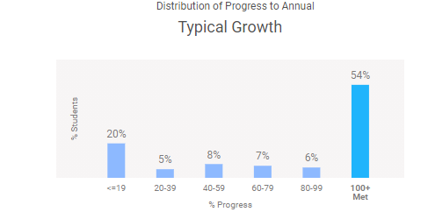
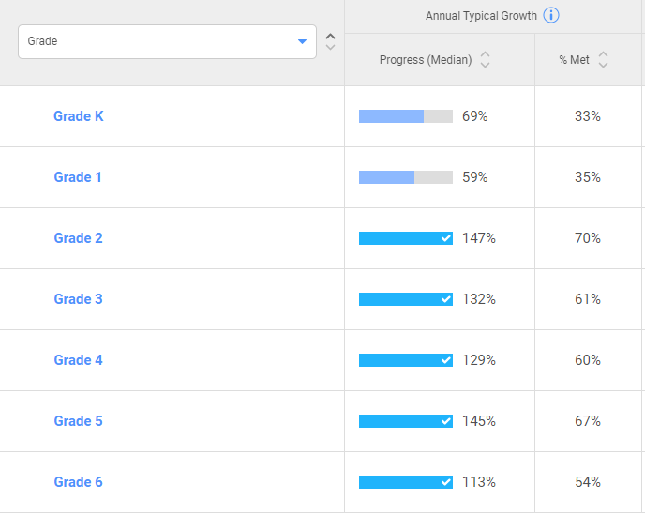
Title I Framework Review: Data

Slide 5
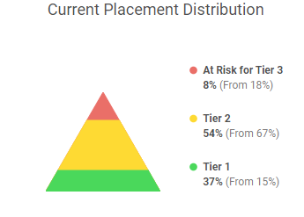
Title I Framework Review: Data

Slide 6
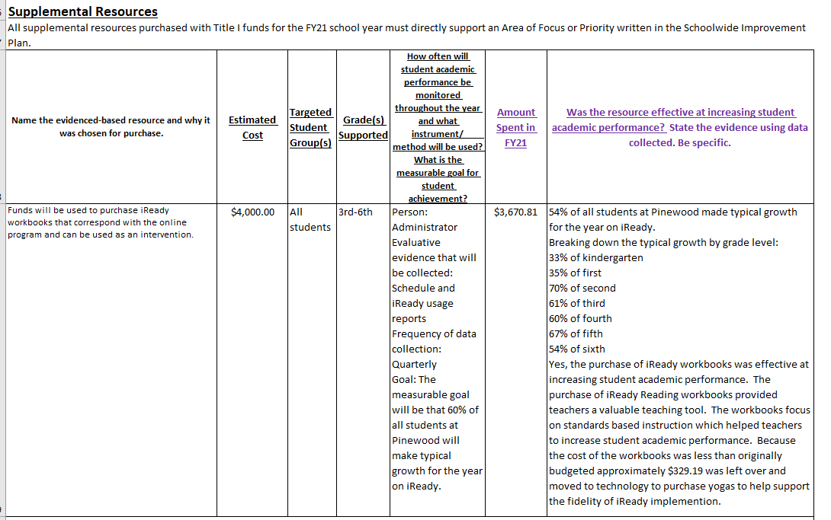
Title I Framework Review: Supplemental Resources

Slide 7
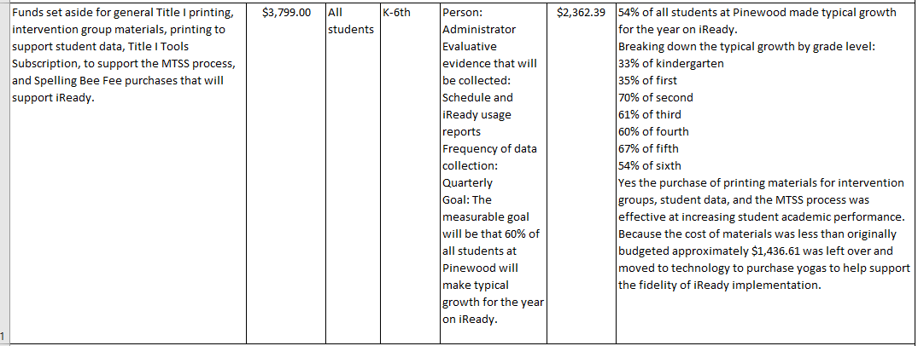
Title I Framework Review: Supplemental Resources Continued

Slide 8
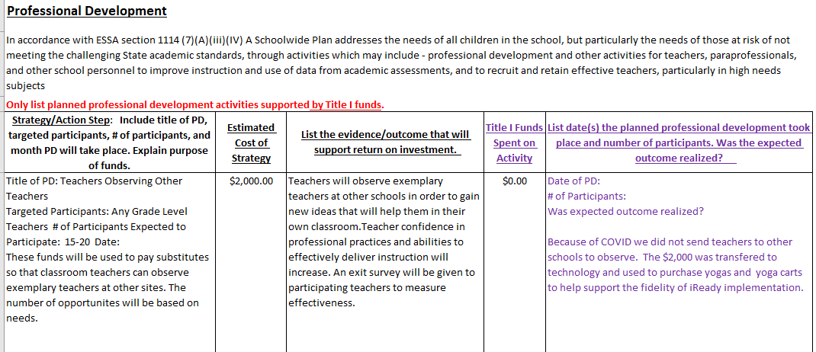
Title I Framework Review: Professional Development

Slide 9
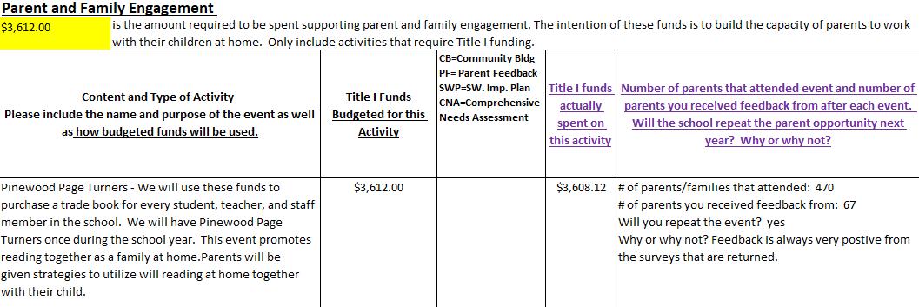
Title I Framework Review: Parent Involvement

Slide 10
Title I Framework Review: Parent Involvement Continued

Slide 11
Title I Framework Review: Planned Technology Purchases

Slide 12
Title I Framework Review: Planned Technology Purchases Continued

Slide 13
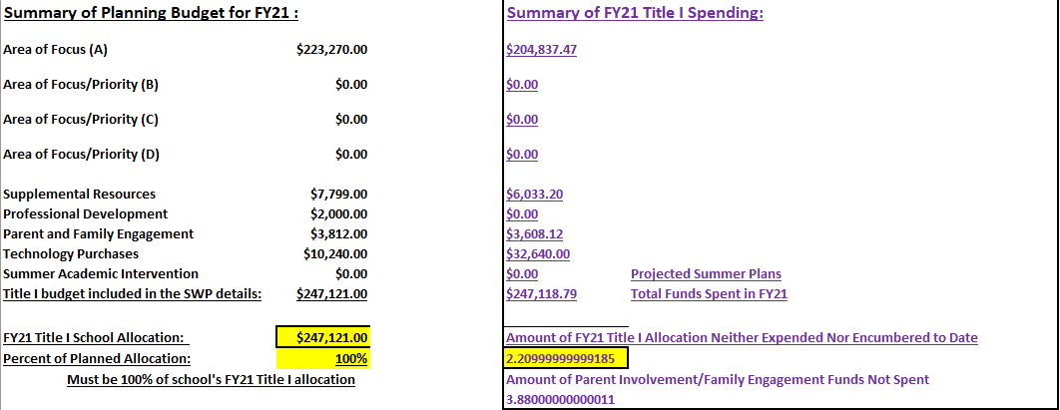
Title I Framework Summary of Budget

