Slide 1
Evaluation of Riviera Elementary School’s Title I Program for FY23
Presented by: Mrs. Daniela Brao Stephens, Title I Coordinator and Mrs. Beth Myers, Principal

Slide 2
What is Title I?
Title I is a federal grant that:​
provides financial assistance to schools with high percentages of children from low-income families to help ensure that all children meet challenging state academic standards.​
assists with building capacity of parents and teachers; and​ encourages parents to be involved in their children’s education.
Funds come from the federal government through the state to districts.

Slide 3
What is the school’s allocation based on? (How much Title I money do we get and what can we spend it on?)
Title I funds for each school are primarily based on the number of qualifying students counted during what is called FTE week which occurs in early February the previous year.
These federal funds may be spent in three areas and the purchases must be above and beyond what the district/charter is already expected to be purchasing for students and teachers.
The three general areas that funds can be used to support are:
student achievement in the areas the school has identified as needing support/improvement
professional development (teacher trainings) to help teachers improve their teaching skills in the areas that have been identified as needing support/improvement
parent and family engagement activities to teach parents and caregivers to academically support their children at home or to assist parents with other needs that may influence their child’s academic success such as bullying or other behaviors.

Slide 4
What is the Title I Framework and Evaluation document?
This is one document that is partially completed at the beginning of the year with the plan for spending the funds and then the school goes back into the same document at the end of the year and fills in the results from each planned strategy/purchase.
The document includes:
all school planned strategies/purchases using Title I dollars
planned strategies/purchases must support improvement in the areas that have been identified by the school’s comprehensive needs assessment activities (like this one).
a method to determine if the strategy/purchase made a positive difference in the area of weakness it was intended to strengthen.

Slide 5
Section 1 – Instructional Support (Lists the extra people that were hired with Title I funds to support all of our students who may need additional help related to the weak areas that were identified in the school’s improvement plan.)
Spent a total of $272,373.00 (this includes all benefits such as FICA, insurance, workman’s comp., etc.)
7 Interventionists: This included 2 teachers and 5 instructional assistants that instructed small groups of students in reading during our “Genius Time”. These teachers went into classrooms to support students in Reading/ELA. They worked with Tier 2 and Tier 3 students and the goal was at least 9% of those students would increase student achievement moving from 32% to 41%.
.5 Reading Coach (the other .5 is paid by the district) The purpose of this position is to promote enhanced academic instruction and student learning by coaching and working with teachers to develop more effective teaching practices and by sharing information addressing the way students learn. They hold data meetings to assist teachers in understanding and using diagnostic and test results to improve instruction. Their goal was also to have 20% of students in Tier 2 and Tier 3 in grades 3-6 increase their FAST score and 30% of students in Tier 2 and Tier 3 in K-2 increase their STAR score.
Notes:
At Riviera we believe people make a difference and you will see that most of our funds are spent on people.

Slide 6
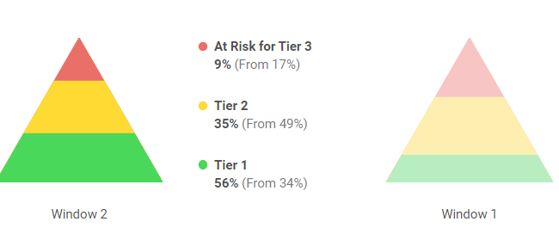
iReady Reading Results FY23
The data graph below indicates the percent of students that moved from Tier 2 to Tier 1 and from Tier 3 to Tier 2 in Reading.
Tier 3 decreased from 17% to 9%
Tier 2 decreased from 49% to 35%
Tier 1 increased from 34% to 56%
Mid Year
Beginning of Year
48
50
120
95
152
195
253
306
272
338
311
166
165
Notes:
As school we improved dramatically in such a short amount of time. We moved 145 students from the Tier 2 to the Tier 1 which is amazing! And cut our tier 3 students by almost half.

Slide 7
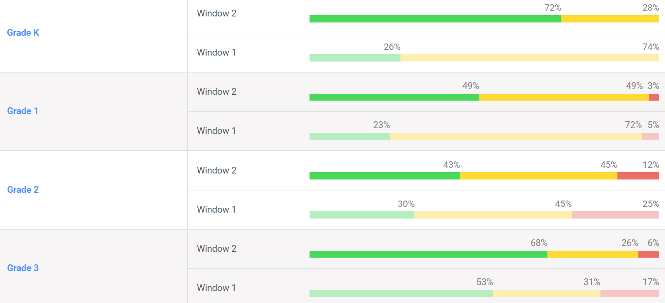
K-3rd grade BOY and MOY i-Ready Reading data
Notes:
As you can see here we haven’t quite finished all of our testing in math yet but so far trending we are showing huge gain in all grade levels. We are closing the gaps and minimizing the Tier 2 and Tier 3 students. In math it is surprisingly more difficult to achieve on grade level due to the building of concepts. Unlike reading
2nd grade made huge gains with their Tier 3 students they had 32% of their students who were more than 2 grade levels behind in math at the
beginning of the year. As a teacher that is a major concern when 1/3 of your students are working at K level or early 1st grade. In second grade you see tougher concepts that build on previously learned strategies and skills but if the students coming in do not have that foundation it makes it much more difficult to teach them what they need to know for 2nd grade and be ready for 3rd grade. The teachers truly put in a lot of hard work to try to close that gap. Although we see that half of the grade is still working 1 grade level below the teachers had to put in major work to get the 30 student on or above grade level and the now 41 students working in the yellow Tier 2.

Slide 8
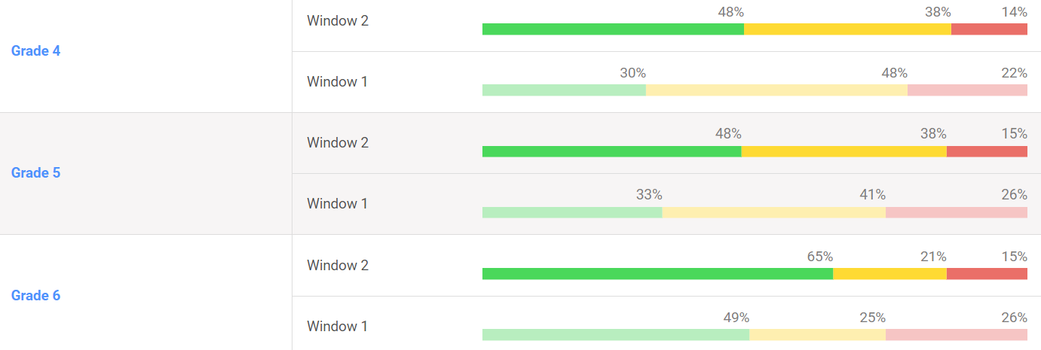
4th-6th grade BOY and MOY i-Ready Reading data
Notes:
Grade 4 began the year with having only 14 students testing on grade level and now they have 39 students which is right below the 50% mark and they began with 26 student two or more grade levels behind showing now only 10 students. They moved students to make gain in all tiers.
Grade 5 began the school year with 18 students testing on grade level to showing a huge improvement of 36 students on or above grade level. 5th grade greatly decreased their 19 students who were 3 or more grade levels behind to only 9 students.
Grade 6 more than doubled their students on grade level from 27% to 61% and decreased their tier 3 students from 25 students to 12.
With still a month left of school our hope is that the gaps will continue to close in the Tier 2 yellow and the Tier 1 green levels.

Slide 9
Grade level ELA Proficiency
Will we meet our goals ?!
Notes:
Explain the word Proficient, explain SIP- We are on track to meet our goals in
K- 5%
1st- 20%
2nd-6%
3rd- 17%
4th- 11%
5th-13%
6^{th – 7%}

Slide 10
VPK-2nd Grade, STAR Early literacy
Notes:
Our goal for VPK and Kinder was 60% and each grade level exceeded that amount!
You’ll notice the 7 first graders and 2 second graders who took the early literacy, those students are receiving intensive interventions to try to get them caught up to grade level.

Slide 11
Kindergarten-2nd Grade, STAR reading
Notes:
The goal for 1st was 60% and they met it! The goal for 2nd grade was 51% and they met the goal! They each however still have quite a few students in the Urgent intervention and those students will be focused on received additional services as soon as the school year begins.

Slide 12
3rd-6th Reading Proficiency Comparison

Slide 13
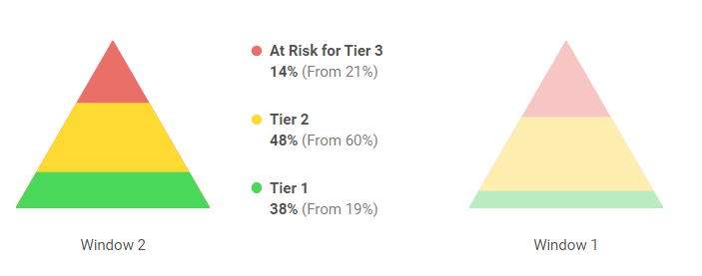
iReady Math Results FY23
The data graph below indicates the percent of students that moved from Tier 2 to Tier 1 and from Tier 3 to Tier 2 in Reading.
Tier 3 decreased from 21% to 14%
Tier 2 decreased from 60% to 48%
Tier 1 increased from 19% to 38%
Mid Year
Beginning of Year
77
116
265
331
210
104
Notes:
As school we improved dramatically from the beginning of the school year in moving our Tier 2 students on grade level along with making huge gains to close the gap of Tier 3 students who were 2 or more grade levels behind.

Slide 14
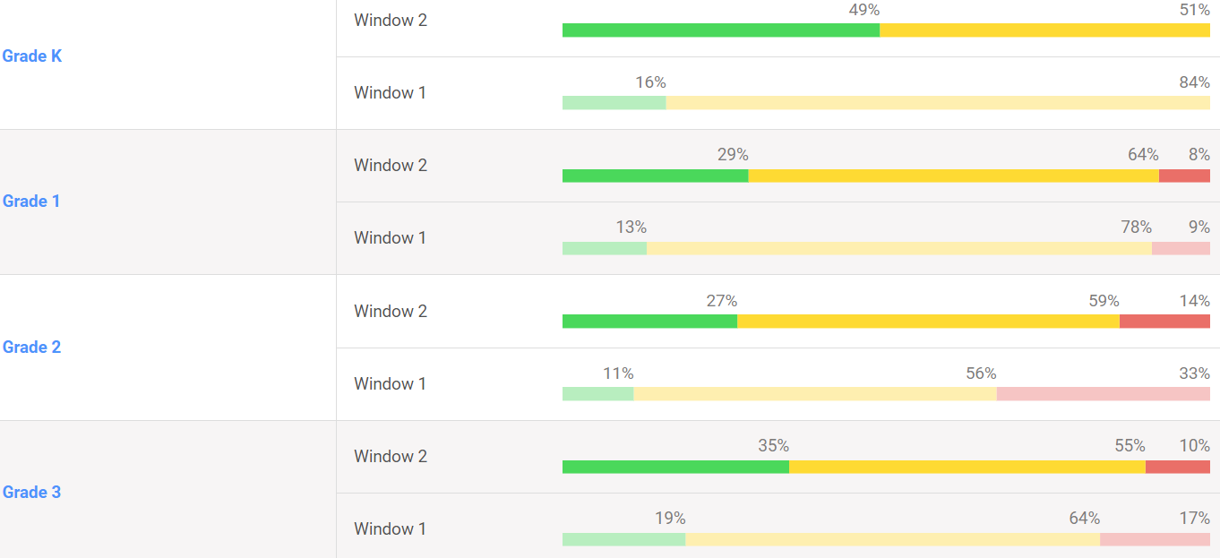
K-3rd grade BOY and MOY i-Ready Math data

Slide 15
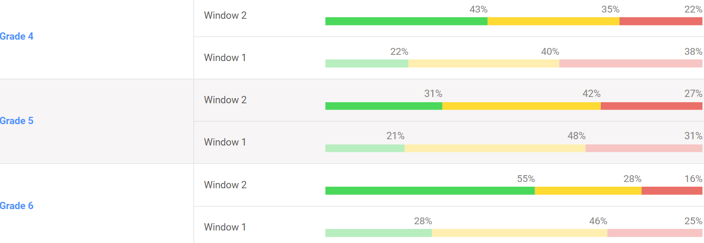
4th – 6th grade BOY and MOY i-Ready Math data

Slide 16
Kindergarten-2nd Grade, Math
Notes:
Our goal was 64% so we beat it in K-2!

Slide 17
3rd-6th Math Proficiency Comparison
Notes:
Our goal was 58% and as you can see all but 1 grade level reached that! And when averaged together we come out to 57% which last year we were at 48% so we did well in growth

Slide 18
Riviera School-wide grade data (unofficial for 2023)
 | 2021 | 2022 | 2023
Reading Proficiency | 49% | 46% | 56% (+10%)
Math Proficiency | 58% | 49% | 57% (+8%)
Science Proficiency | 54% | 52% | ?? (need 50%)
Total | 418 points (with LG) B | 331 points (with LG) C | Goal: 162 points or above B
*The above 2023 data is for students that count, not all students tested.

Slide 19
Supplemental Resources (These are extra items purchased to help students and teachers be more successful in the areas the school identified as weak. This is in addition to materials provided by the district to all schools.)
Total Funds Spent: $45,408
$5,007.00 iReady FL Magnetic Workbooks: Supplemental workbooks for grades 3-6 grade in ELA for new FAST test and iReady.
$600.00: Anvilar: Organizational tool required by Title 1 to be purchased as a way to prove our school is compliant in use of federal funds.
15,392.00: iReady Magnetic Reading Florida decodable library, grades 1-5 foundations student workbook and phonics
$8,653 Support Title I teachers and classroom teachers who work with small groups of students to improve reading and math proficiency to all 600 students in grade K-6^{th see I-ready results.}
$140 Starfall Writing Journal: Online learning tool to improve reading and math proficiency for Kindergarten students. KLS results will be available at the end of May
$11,900 Lexia: Online program to help students that are in need of Tier 2 and Tier 3 instruction
Notes:
Planbook 100% of our teachers used Planbook to collaborate and plan standard aligned instruction.

Slide 20
How does the school decide what to purchase with parent and family engagement funds?
The focus is to provide families with adult learning opportunities and materials focused on helping them help their children learn/practice at home. Funds must link to parent/family needs identified through the comprehensive needs assessment process (like this one). This is one of the areas that parent/family input is so important.
Examples of where the school gets their data from:
BPS District Parent Survey Results
Exit slips from parent/family events
Title I survey results
Input from parents that attended special meetings like this one or other input opportunities include School Advisory Council, and our fall Annual Title I meeting.
The following slides are examples of input from parents that we used to plan this year’s parent/family events.
If you would like to see a summary of each event’s exit slips, please contact Mrs. Brao Stephens
Notes:
This is why after events we are asking for you to complete surveys! We need your help to decide what we need. Your voice is heard. Last year we had a parent tell us that she wanted a Eureka Math night and guess what… we did that this year! Your voice matters.

Slide 21
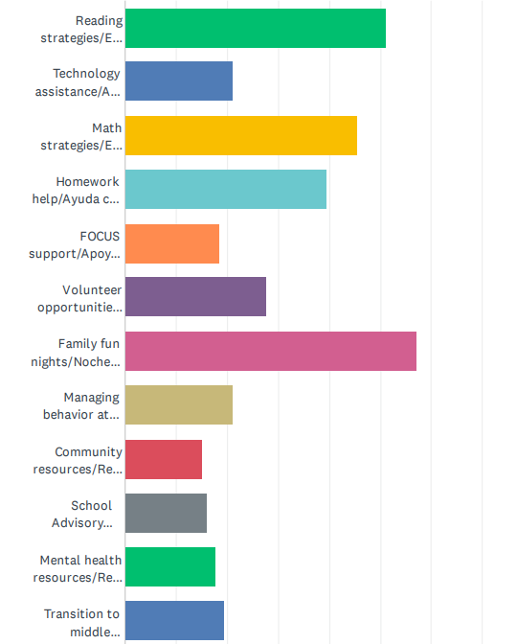
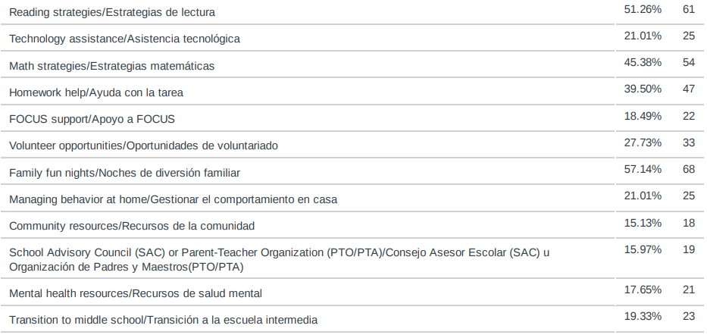
Parent Survey Data
Notes:
Family fun nights is our number 1- we did bring back harvest night this year and made game nights to attract more families
Reading strategies is our second highest which we will continue that!

Slide 22
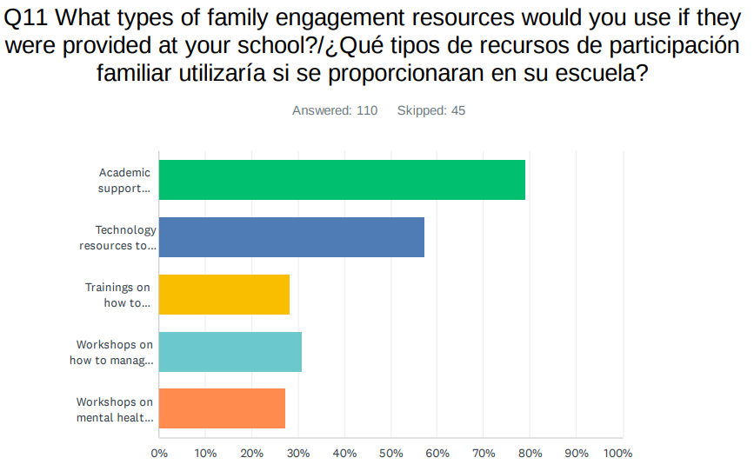
Parent Survey Data
Notes:
79% with academic support materials at home. This year we provided more take home packs and materials which we received great feedback on and would like to make similar purchases next year.

Slide 23
Parent and Family Engagement
Total Spent: $6,317.00
Math Night: ($2,858.00) Families were shown how to incorporate math concepts from the classroom into their daily conversations how to use a simple at home game or tools to improve math fluency. Each family attended their specific grade level and together learned and completed problems using strategies their students could utilize at home. 63 families attended. Event created per parent survey results. Majority of families gave positive feedback, enjoyed being back on campus along with learning the fun games/strategies that were easy to understand and can be used at home.
Literacy Game Night: ($3,020.00) Families were shown how to incorporate specific reading concepts from the classroom into games that can be played at home. Each family attended their specific grade level and played the game with their parent/guardian learning how to utilize skills taught in the classroom in the games being played. 104 Families attended. Event created per parent survey results and the most requested academic area of assistance
Welcome to Kindergarten!: ($439.20) Families were invited to attend our Kindergarten Orientation followed by a tour of the campus, teachers and staff will be in contact with the families of the future Kindergarteners that attended and give them more information of what their year will look like and how to access resources. 25 families attended. Event is required by the Title I program. The event received great feedback and gave kindergarten teachers along with administration a good idea of what else families need prior to beginning school in the fall.
All the input collected after each of these events is used along with the other input sources to decide what to do with the funds in the following year. Your input matters!
Notes:
Go through each talk about success with Book in bag, Math night needs to be done earlier from survey results, and FSA night was helpful…

Slide 24
Technology (This money is in addition to any technology the district may provide to schools and is used to increase success in the areas of focus the school identified.)
Technology purchases: $39,646.00
22 thinkpad computers to support i-Ready in grade 2 $11,660.00
Docking station/ cart for laptops $2,145.00
2 Promethean boards $17,550.00
SMORE- Newsletter - $1,799.00
800 Ear Headphones with jack adapters $5,892.00
Anvilar-Title 1 document platform $600.00
Notes:
All technology except the purchase of the SMORE Newsletter were to support the use of the iReady program in all classrooms. The iReady program supports all students in grades K through sixth in reading and math.

Slide 25
Where do we collect data from?
iReady Reading and Math Data
Attendance
Discipline
Insight Survey Results
District Parent Survey Results
Event feedback / Survey Monkeys!
Input from SAC meetings
Notes:
Have you looked at the Smore newsletter? Checked your email? Text messages or our school website?! We send surveys after our events and throughout the year to hear about you and your child’s experience at Riviera.

Slide 26
How can I be more involved in decision-making at the school?
The input we receive from our families is so important! We truly use it to build and improve our Title I program. Families provide valuable insight into how their children learn best! Remember, your opinion matters! Your voice in your child’s education is needed! This is a TEAM EFFORT!
Attend our events!
Complete exit slips at events and surveys that we send home! We read every single one and welcome positive and negative feedback!
Consider joining our SAC committee! It is more than just fundraising! We need to know what is working and what needs improvement at our school.
Share information and encourage other parents to get involved in school activities and planning.

Slide 27
As a Valued Member (Stakeholder) of this school - We Need You…
to be part of our decision-making activities by completing the exit slip for this meeting/presentation. We use all input to determine our focus areas.
to tell us what you want us to spend next year’s Parent and Family engagement funds on that will help you to help your child at home.
to let us know we are doing that is working and what you feel we need to update, get rid of, or create new.
to be an active part of our Riviera family!
All input is reviewed and considered by the Comprehensive Needs Assessment Committee.
Notes:
Input input input!!

Slide 28
Please complete the survey!
If you require this information to be translated please contact
Mrs. Brao Stephens for assistance
Braostephens.daniela@brevardschools.org

