Slide 1
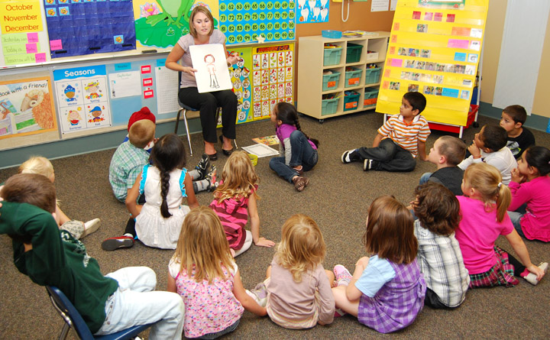
Kindergarten,
Here WE Come!
Transition to Kindergarten
Brevard Public Schools
Spring 2022
Notes:
Importance of allowing families and schools to connect prior to children beginning Kindergarten to help ease fears of families, students, school staff.
This is the families first impression of your teachers, staff

Slide 2

Thank you for being here!
“At the end of the day, the most overwhelming key to a child’s success is the positive involvement of parents.”
-Jane D. Hull
Notes:
Your presence today sends a great message to your children: that their school is important.

Slide 3
Brevard Public Schools
The mission of Brevard Public Schools is to
serve every student with excellence as the standard.
Notes:
Can personalize to school mission if you prefer.
Connecting families to our district mission.

Slide 4
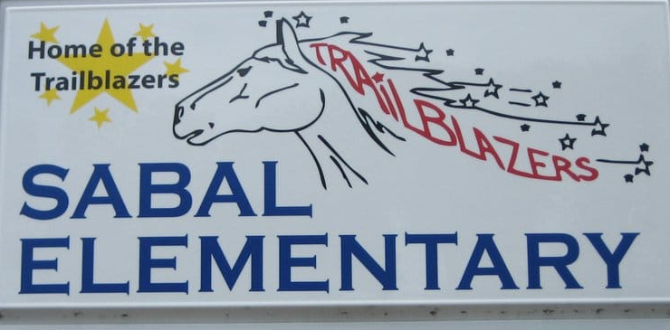
About OUR school…..
Vision – Motivate, Encourage, Inspire
Mission – Vision: Sabal Elementary will positively impact our community by delivering the highest quality education in a caring student-centered environment.
Title 1 School – Our Title 1 status grants additional funds to support student achievement, professional development, and parent involvement
Notes:
Overview Information (Philosophy and Vision)
Introduce your Administrators and Kindergarten teachers
Other possible topics:
# of Kindergarten classrooms
Activities/Special classes/programs offered
Family Engagement Opportunities
Make it fit your school!

Slide 5

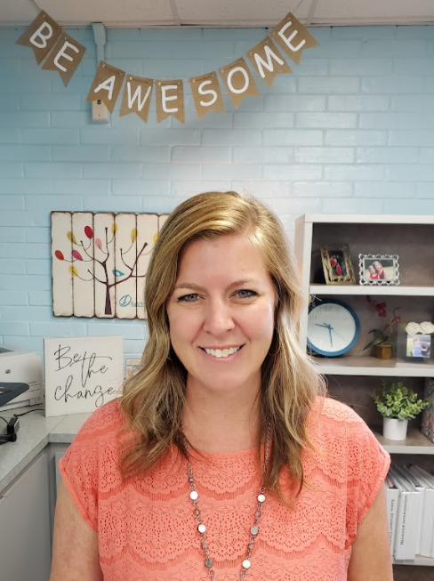
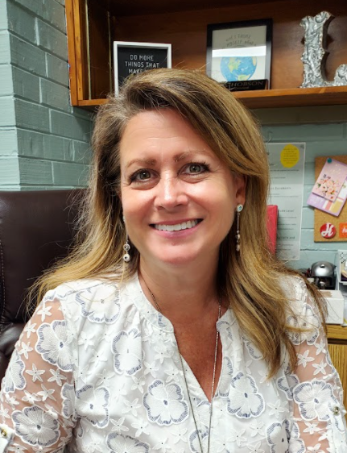
Administration
This Photo by Unknown Author is licensed under CC BY
Mrs. Paige Trosset Principal
Ms. Laura Hobson
Asst. Principal

Slide 6
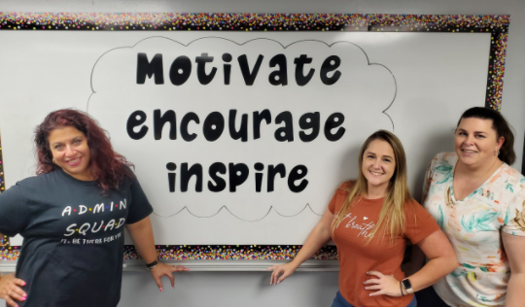
Office Staff
Mrs. Kelly Tellez, Mrs. Christina Sicilia and Mrs. Denise Marrs

Slide 7

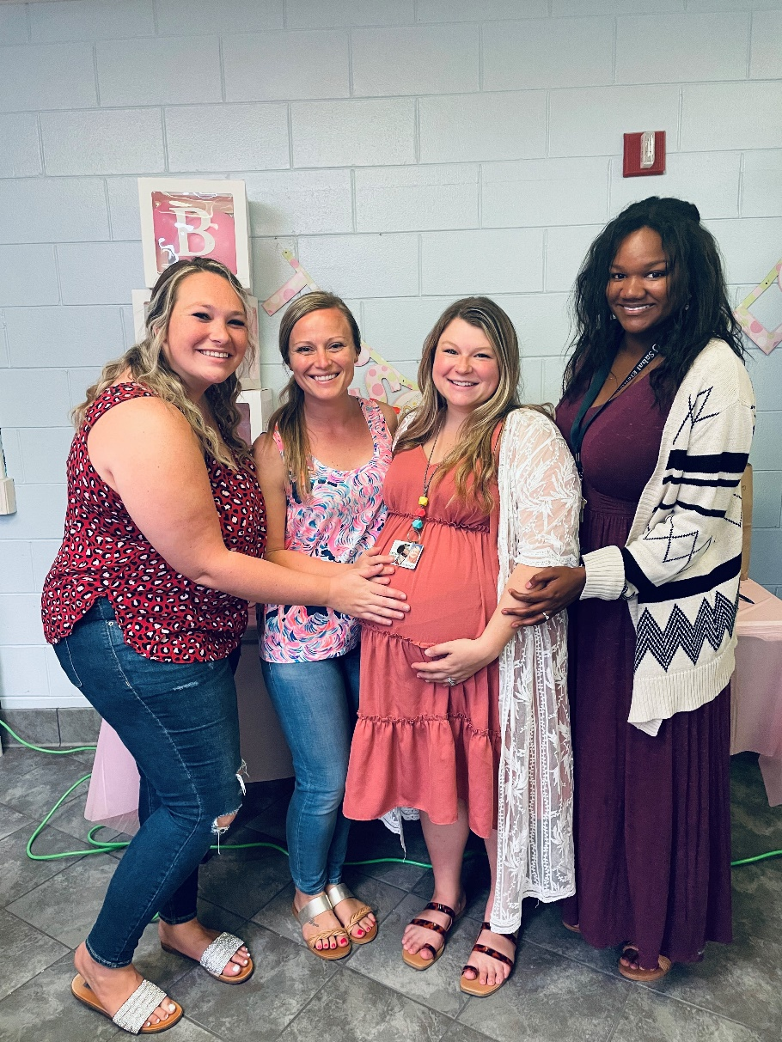

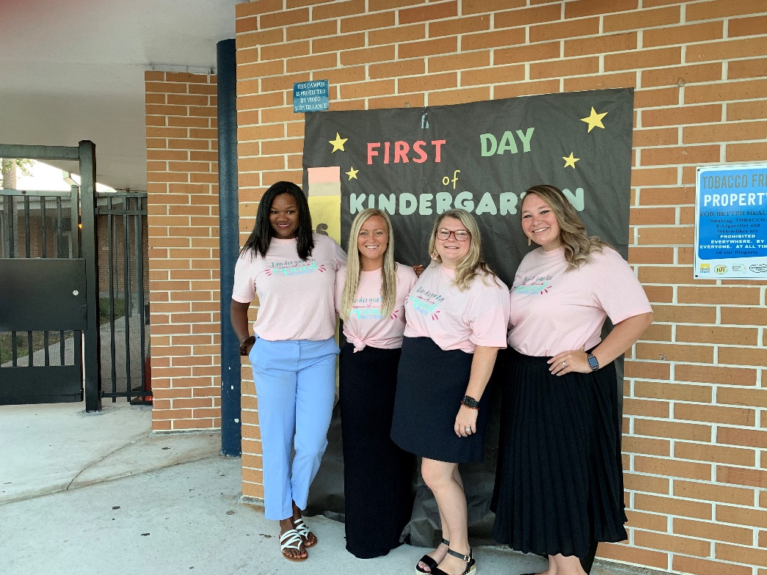
Kindergarten Teachers
Ms. Jackson, Mrs. Strenko,
Mrs. Rivera, Mrs. Middlebrook

Slide 8

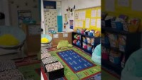
What Does a Kindergarten Room Look Like?

Slide 9
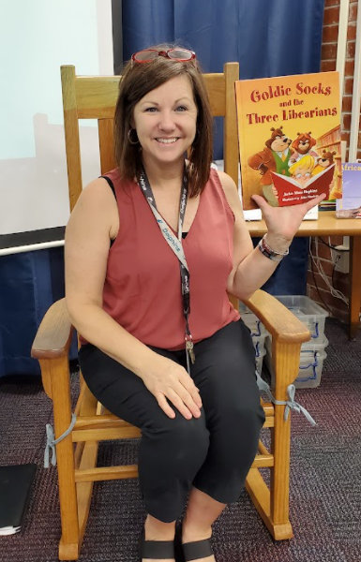
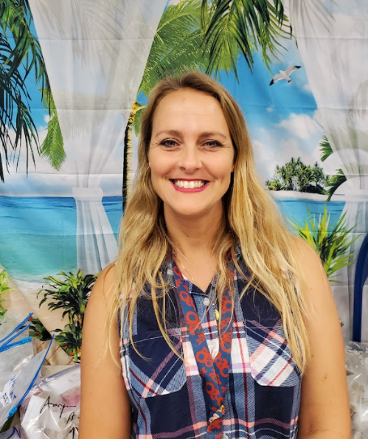
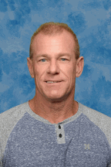
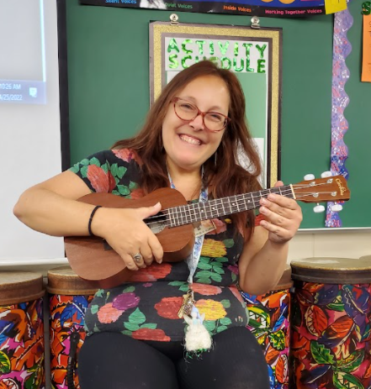
Activity Teachers
Ms. Herbert Mrs. Mumme Mr. Canuel Mrs. Richardson
Music Art Physical Education Media Specialist

Slide 10
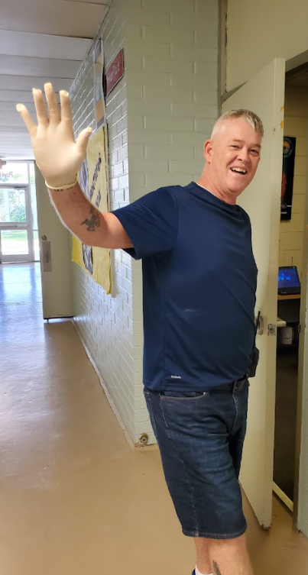
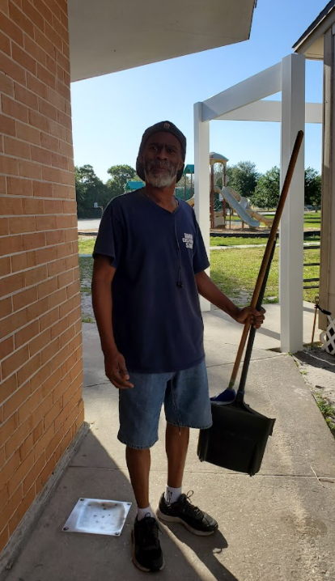
Our
Custodians
Mr. Tony
They work hard to keep our school community clean.
Mr. Joe

Slide 11
Our School-wide Expectations
Our school follows the SABAL expectations as a school-wide behavior system.
Safety First
Always Respectful
Be Responsible
Actively Engaged
Listen Attentively
Positive Behavior Intervention and Support (PBIS)

Slide 12

School Security
REMEMBER SAFETY FOR ALL STUDENTS IS OUR PRIORITY!
Notes:
Sign-In Procedures for our school:
All visitors/volunteers must sign-in at the front office using your state issued driver’s license or ID card. This is required in order to receive a badge to enter campus. You must have your ID at each visit.
BPS has collaborated with Brevard County Sherriff’s Office and has a plan of action for every foreseeable circumstance
One point of entry at each school.
Every school has a School Resource Officer or Guardian (your school may have another title) assigned to its campus.

Slide 13
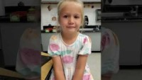
An interview with a Kindergartener

Slide 14

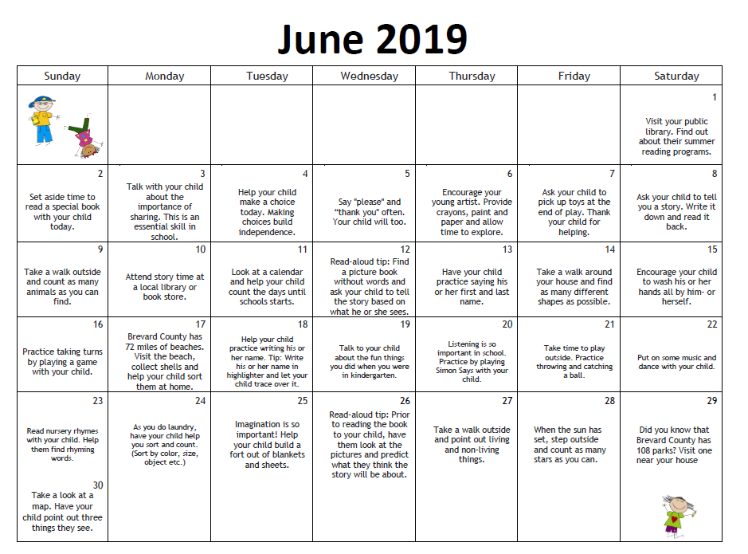
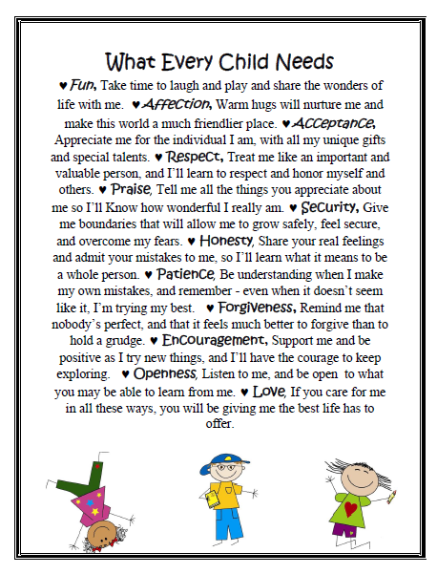



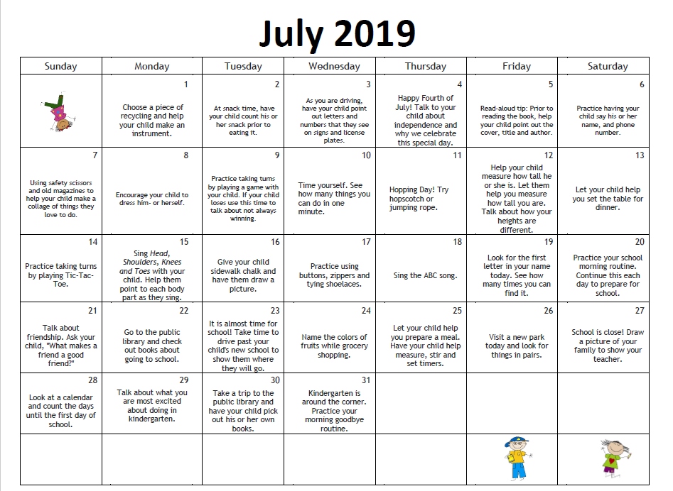
Family Engagement
Summer Learning Activities
Transition Newsletter
Public Libraries
Every Child Needs. . .
Notes:
Use the resources provided in your transition packet to spend quality moments together over the next few months!
Point out to your families all that this packet has to offer. Speak briefly about each page as it appears on the slide to make families aware of all the packet has to offer.
Family Engagement
Transition Newsletter
Every Child Needs
Summer Learning Activities
Public Libraries—share with families that locations are on the back of the purple page.

Slide 15

BPS Mobile App
Calendars
Breakfast/Lunch Menus
Peachjar
And more!

Slide 16
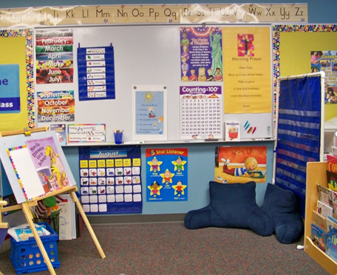
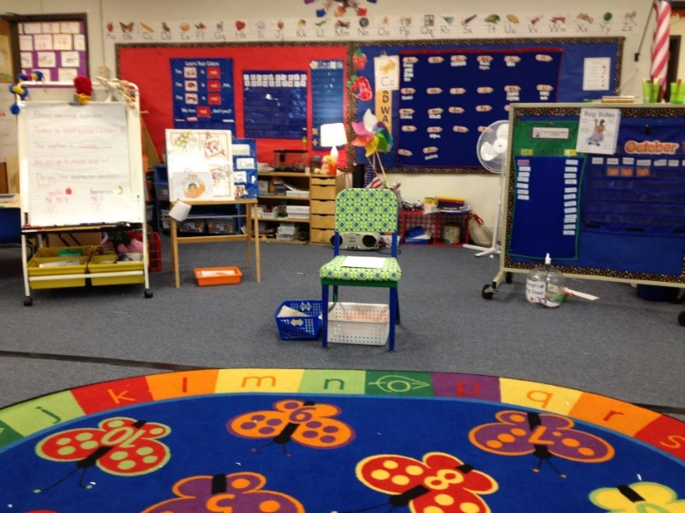
The Great K Adventure!
School Tour
Notes:
Let them know you’ll come back together for a few moments to close out their visit.

Slide 17

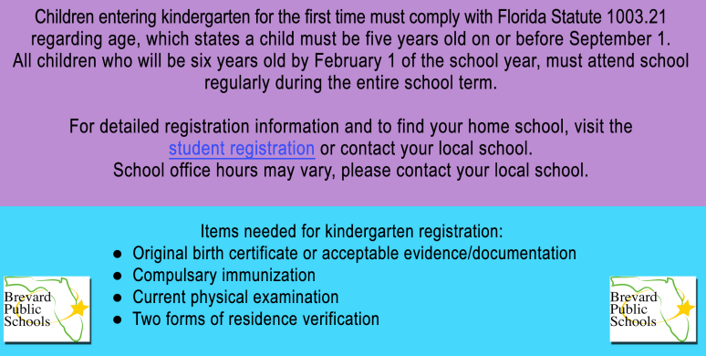
FAQ’s – Registration Process

Slide 18
FAQ’s - About Starting School
We start school at 8:00 am and dismiss at 2:30 pm.
Breakfast is served FREE everyday to all students beginning at 7:30am in the cafeteria. Gates open at this time.
Lunch can be brought from home or purchased.
You can prepay lunches via http://www.mypaymentsplus.com
Free/Reduced lunch applications can be completed online or in the school office.
Notify your teacher of how your child will be going home from school each day(car loop, bus, community childcare, district school age childcare, etc.)! Changes in dismissal will only be accepted in writing.

Slide 19


FAQ’s – Getting Involved
Volunteer – Complete online application to volunteer at our school,
support in your child’s class and to chaperone field trips
Principal’s Coffee Chat - Attend our coffee chats with administration, staff and other parents to stay on top of school happenings
Join our Parent Teacher Organization – They do great things for our children. Stop by the PTO table to find out more.

Slide 20

Question and Answer Session
School Staff and Sabal PTO are available for additional
questions after the presentation.

Slide 21
School contact information:
Sabal Elementary School
1401 N. Wickham Rd
321-254-7261
https://www.brevardschools.org/SabalES
Administrators:
Mrs. Trosset– Principal
Mrs. Hobson – Assistant Principal
Registration Questions:
Mrs. Sicilia – School Secretary
Mrs. Tellez – Office Clerk
Notes:
Share contact information, invite parents to write it down or snap a photo with their devices.
Say:
If you have further questions, please feel free to contact us here.

Slide 22

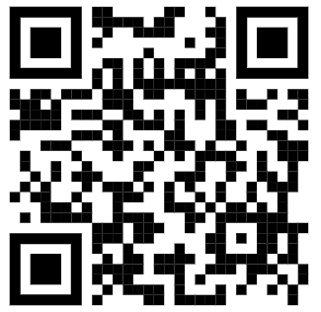

What is something new that you learned about our school or starting Kindergarten?
Please complete our exit survey
Notes:
It is so important to get to know other families of the children your child will be going to school with so… let’s take a few minutes to share your thoughts on these two questions with someone you don’t know YET.

Slide 23

Our school is looking forward to a great year with your family!

