Slide 1
Digital Design & Multimedia Foundations

Slide 2
In Digital Design 1,2, & 3 we learn
Photoshop
Illustrator
InDesign

Slide 3
Students can become
CERTIFIED
in Adobe Software!
Photoshop
Illustrator
InDesign
Dreamweaver

Slide 4
Why Certify???
Better Job Skills
Higher Education Skills
Certifications enhance your resume
They can help you get into a field of your choose
Do something you like for a living!
More certificates you gain = More potential earnings
Start a successful career
Stand out in a job search, and get a better jobs!
Stand out on Transcripts, and perform better in college or trade school!

Slide 5
We LEARN Graphic Design Software
Use CREATIVITY
DESIGN Skills and
Enjoy FUN Projects!

Slide 6
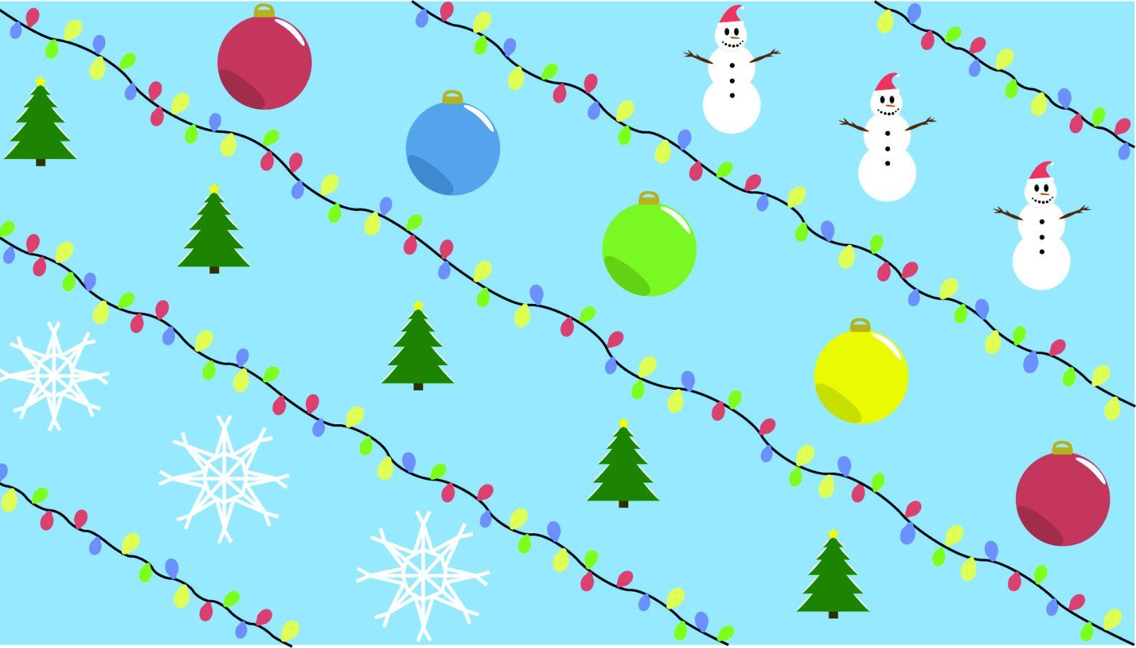
HOLIDAY FUN

Slide 7
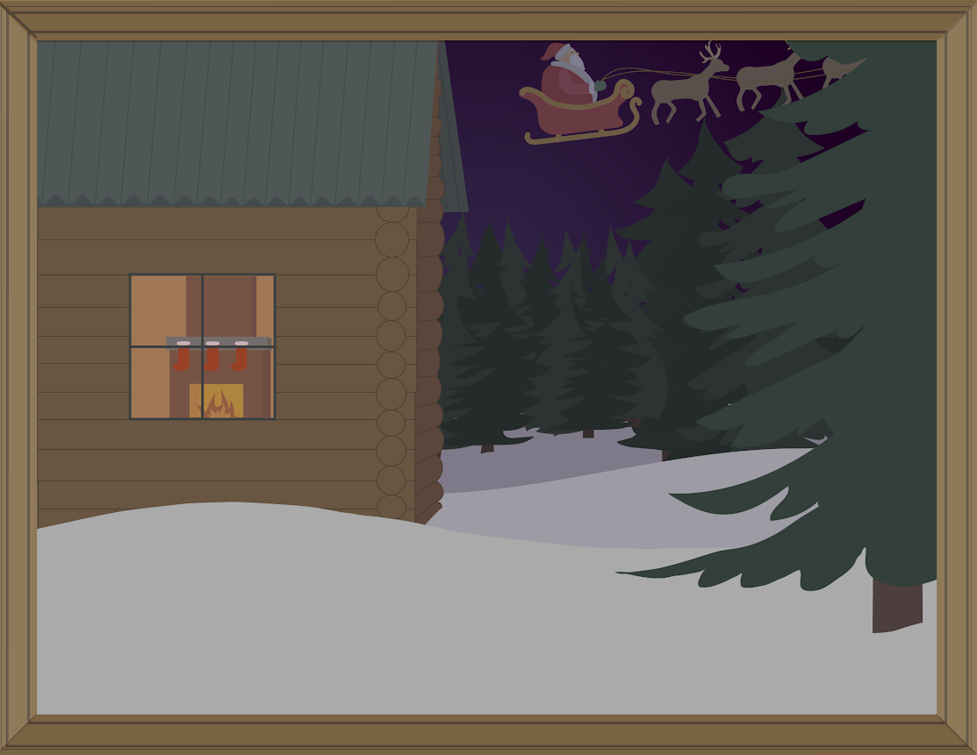
HOLIDAY FUN

Slide 8
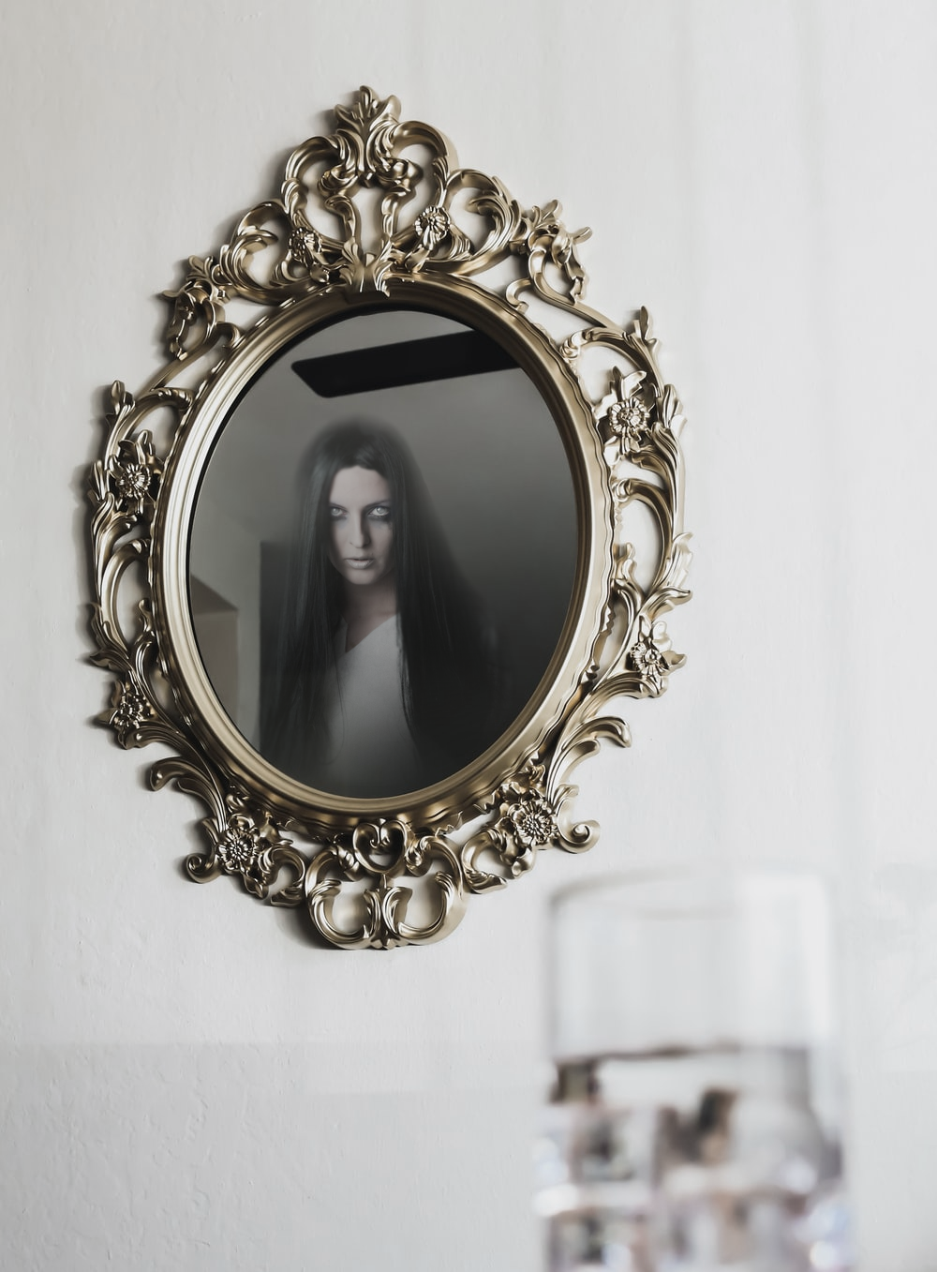
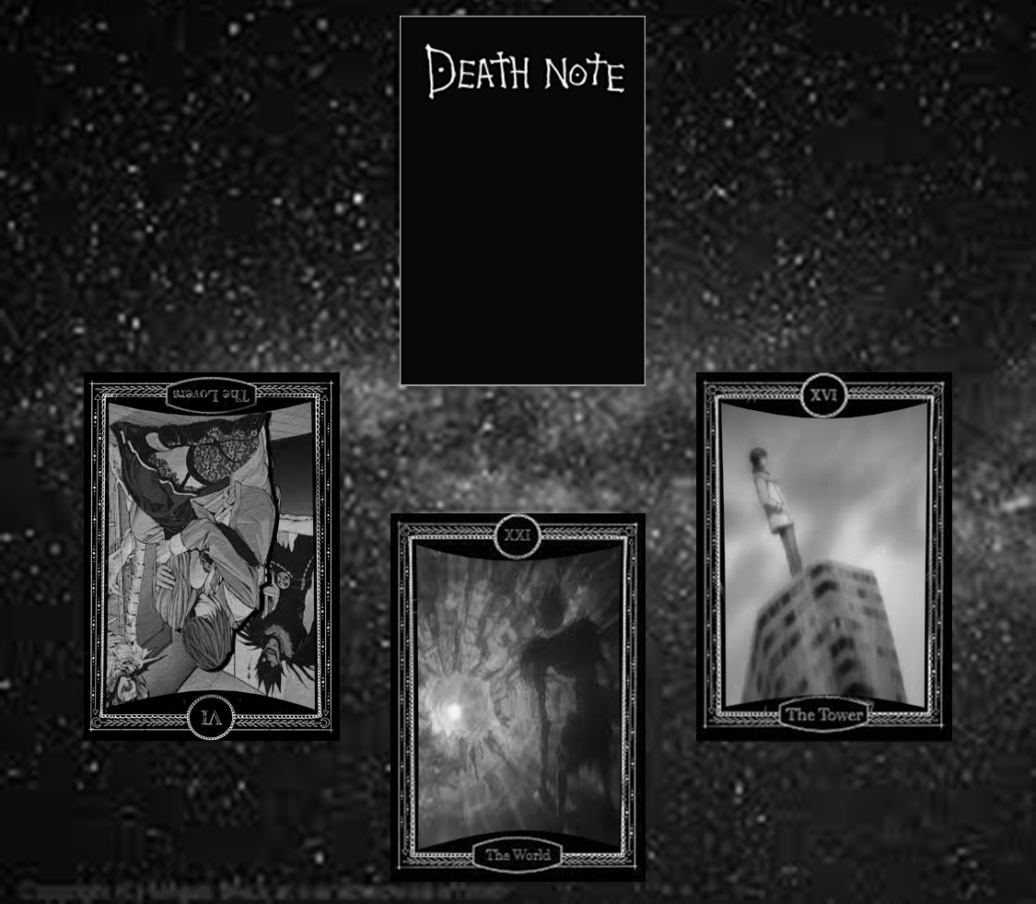
HAUNTED EXPRESSION

Slide 9
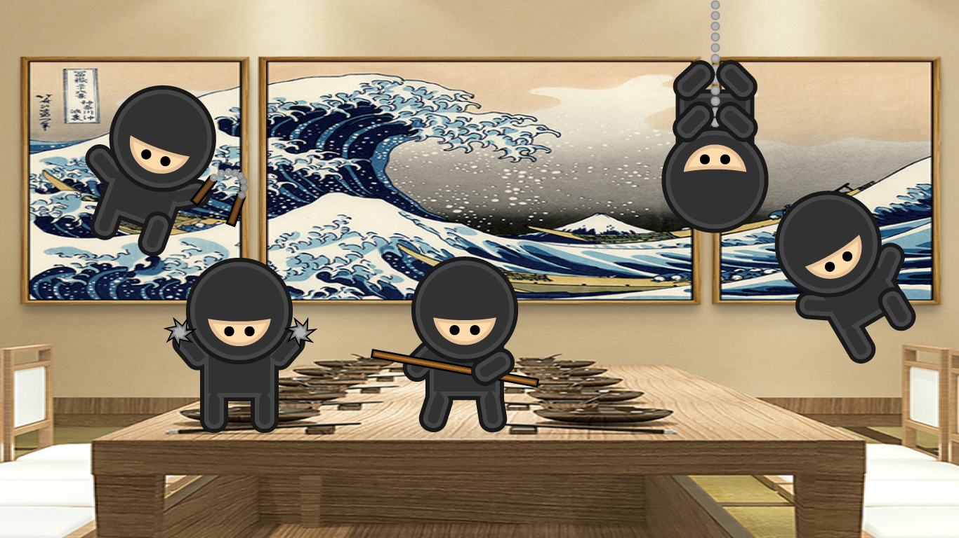
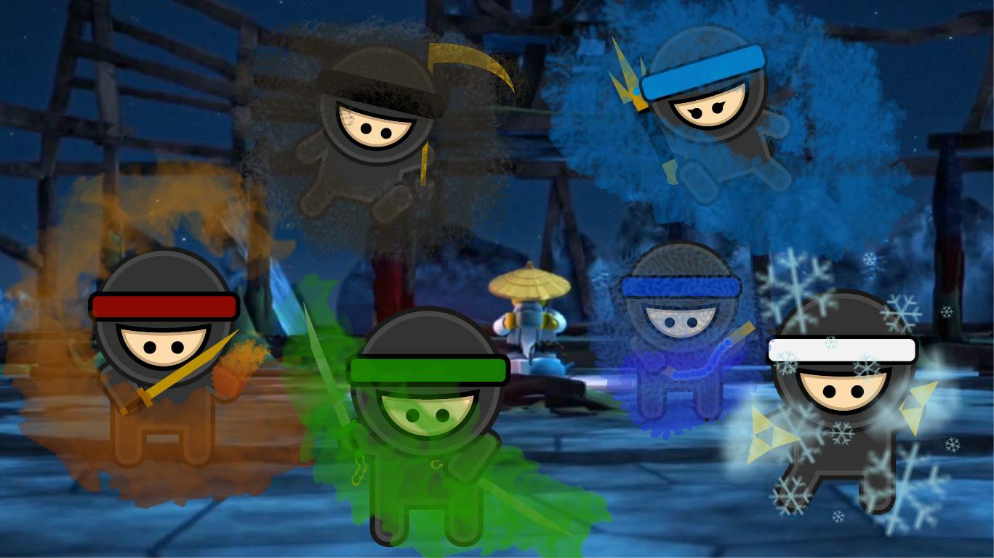
TINY
NINJAS

Slide 10
AN IMAGE INTO TEXT

Slide 12
FOUND AROUND SCHS!

Slide 13
I CAN’T WAIT TO SEE YOU NEXT YEAR!

