Slide 1


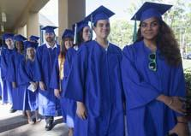
Early College Program
(formerly Collegiate High School)
A Dual Enrollment Opportunity for
Motivated High School Students!

Slide 2

What is Dual Enrollment?
High school students earn high school and college credit at the same time.

Slide 3
Dual Enrollment Options
Part-Time
Up to 3 EFSC classes per term and
1 summer class
Full-Time
Spring semester of 12th grade on EFSC campus
Early Admission
Fall and Spring semester of 12th grade on EFSC campus
Early College
Up to 3 classes per term and 2 summer classes. Bus available for 10th graders

Slide 4
Dual Enrollment Course Weight
Dual Enrollment courses are weighted the same as AP, IB, and AICE:
When your high school calculates your overall weighted high school GPA
When state universities calculate your high school GPA in the core academic classes for university admission decisions

Slide 5
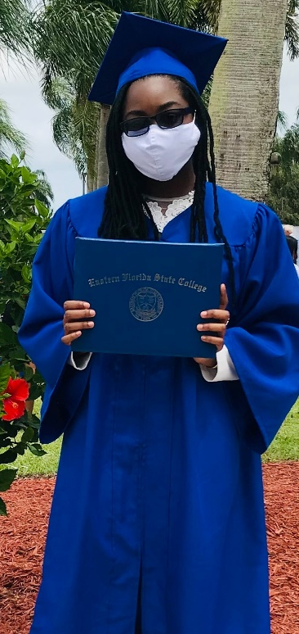
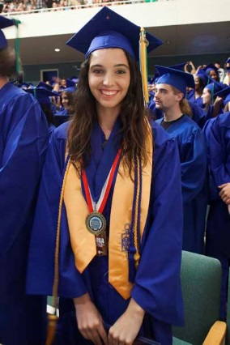
Early College Program
A partnership between Brevard Public Schools and EFSC
Developed for students whose goal is to graduate from high school with a university-transfer Associate in Arts (AA) degree

Slide 6
Early College Program Expectations
Participants are expected to:
Complete selected EFSC and high school classes each year.
Maintain program eligibility.
Successfully complete AA degree general education requirements.
Finish entry-level requirements for selected university major.
Remain on track for AA degree by high school graduation.

Slide 7
Associate in Arts Degree
Two-year degree for students whose goal is a bachelor’s degree or higher at a university
Equivalent to freshman and sophomore years at a state university
Combination of academic and elective courses chosen to meet selected university major prerequisites
Total of 20 college courses equaling at least 60 credit hours
Students graduating with an AA enjoy first-time-in-college benefits at state universities

Slide 8
Three-Year Track
10th Grade ……………………………………..12 credit hours
Fall 2 EFSC classes
Spring 2 EFSC classes
11th Grade ……………………………………..24 credit hours
Summer 2 EFSC classes
Fall 3 EFSC classes
Spring 3 EFSC classes
12th Grade ….…………………………………24 credit hours
Summer 2 EFSC classes
Fall 3 EFSC classes
Spring 3 EFSC classes
.

Slide 9

Admission Requirements
Three -Year Track
On track to successfully complete 9th grade.
State cumulative unweighted GPA of 3.0 or higher.
Completion of Algebra 1 by the end of 9th grade.
College-ready Reading and Writing scores on a college placement test. (PERT, SAT, ACT, or ACCUPLACER)
High school record of good attendance and responsible behavior.
Meet all Early College Program deadlines and requirements.

Slide 10
Two-Year Track
11th Grade…………………………………..24 credit hours
Summer 2 EFSC classes
Fall 3 EFSC classes
Spring 3 EFSC classes
12th Grade Early Admission…………….36 credit hours
Summer 2 EFSC classes
Fall 5 EFSC classes
Spring 5 EFSC classes
College credit from AP, AICE, or IB exams may be used to meet degree requirements

Slide 11

EFSC Class Times
10th grade students
  EFSC classes meet 10:50 AM – 12:05 PM
  1 EFSC class M/W; 1 EFSC class T/Th
  High school periods 3 and 4 at EFSC
  Friday: No EFSC classes – Periods 3 and 4 at the high school for study, community service, and enrichment
11th and 12th grade students
  EFSC classes meet at the beginning and/or end of school day or in the evening
  Face-to-face, online, or hybrid
  Friday: Attendance at the high school is NOT permitted during EFSC class periods

Slide 12
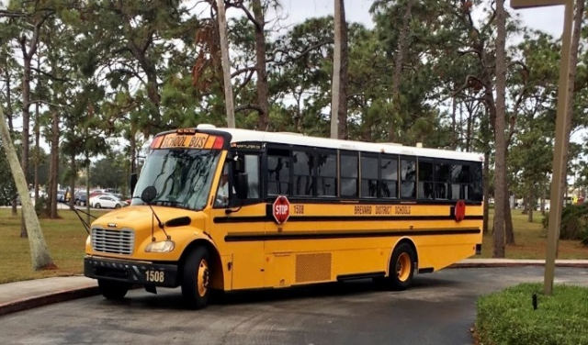
Bus Transportation
Guaranteed for 10th graders in the three-year track during designated Early College class periods
11th and 12th graders may ride bus if space is available
Not provided on BPS school holidays (i.e. President’s Day)
11th and 12th graders responsible for their own transportation to and from EFSC

Slide 13
Required Minimum Entry Scores
READING WRITING
PERT 106+ 103+
SAT 24 25 (&Lang.)
ACT 19 17 (English)
ACCUPLACER 245 245

Slide 14
College-Ready Math Score By 12th Grade
Minimum score required for MAC 1105, MGF 1106, or MGF 1107:
PERT 123
ACT 20
SAT 27.5
ACCUPLACER 258-300

Slide 15

Testing Anxiety??
Get prepared!!!
Find PERT Study Guide with PERT Practice Tests on EFSC Placement Testing webpage.
Take the PERT at your school.
Retest on PERT or ACCUPLACER 30 days after original test date.
Go to RegisterBlast on EFSC website to schedule a PERT retest.
Go to Placement Testing Services on EFSC website to schedule a remote ACCUPLACER retest.

Slide 16

Requirements to STAY in the Early College Program
“C” or higher in courses requiring writing skills and math competencies
State cumulative high school GPA of 3.0 or higher
College GPA of at least 2.0 each term
On track to receive diploma and AA degree at graduation
Qualify for MAC 1105, MGF 1106, or MGF 1107 by the fall term of 12th grade

Slide 17
Benefits of Early College Program
The Early College Program enables students to:
Adjust to college expectations while still in high school
Complete core academic requirements in a small class environment
Use college courses to explore career interests and identify their university major
Finish the first two years of college with no tuition, textbook costs, or lab fees
Earn a university-transfer Associate in Arts (AA) degree with their high school diploma

Slide 18
Estimated Cost of Attendance
2021-22 Academic Year
UF Undergraduate
Tuition/Fees $6,380
Books & Supplies 810
Computer/ Cell 1,220
Housing 5,800
Food 4,600
Transportation 1,120
Clothing Maintenance 1,070
Personal/Health Ins. 430
TOTAL BUDGET $21,430
Source: www.sfa.ufl.edu/cost/

Slide 19
Your Pathway to Success in the Early College Program
  Focus on your career goals and select a major by spring of 11th grade
  Choose your intended university
  Select courses that meet your major prerequisites and AA degree requirements
  If you change your major, college advisors will work with you to adjust your program

Slide 20

How will EFSC staff help you chart your pathway?
  College advisors help students:
    Plan their degree program
    Register for classes
    Use “myGPS” to track courses toward their degree program
    Access academic support services
  EFSC offers:
    Career Planning & Development Centers to help students identify career interests and skills
    Elective courses, such as Discover Your Major and Career
    Seminars and clubs in selected career fields

Slide 21
Factors to Consider
Additional study expectations required with college coursework
Courses designed for adults – NO modifications made to accommodate age and maturity level
EFSC grades stay on permanent college and high school transcript
Poor grades can impact scholarships and university admission

Slide 22
Factors to Consider
Summer classes may be needed to earn degree by graduation
Balancing college, high school, and extracurricular demands is necessary
Must meet high school and AA degree requirements
Transportation not provided on BPS school holidays and for classes taken outside of the Early College designated periods

Slide 23
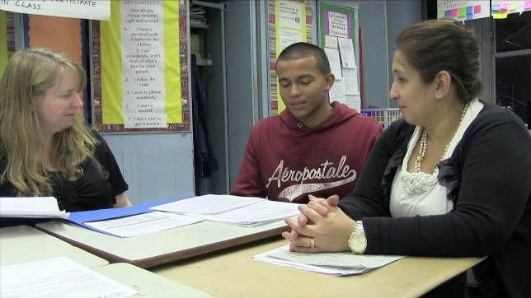
Considerations for Parents
High school counselor is point of contact for parents seeking information about student
Parents may not contact college instructors for student information (FERPA)
Families must follow both high school and EFSC calendars
Students must adhere to the high school’s procedures to obtain free college textbooks
Students are responsible for purchasing required consumables (i.e. workbooks and lab manuals)

Slide 24
Considerations for Parents
College does not have an excused absence policy; attendance requirements are specified in each course syllabus
Students who will miss class due to an unavoidable conflict should talk with their instructor for possible make-up options; the instructor’s decision is final
Students in extracurricular activities should schedule EFSC classes at times that do not conflict with practice, games, or performances

Slide 25
Getting Started!
Attend the Early College High School Information Presentation at your school.
Submit Student Interest Form to the high school counselor by February 3, 2022. (Online or paper)
Take the PERT either at your school or EFSC and meet the minimum scores in Reading and Writing.
  ***Only students that complete the Student Interest Form will test at SCHS on a first-come-first-serve basis. Retakes must test at EFSC. Sign up using RegisterBlast on EFSC website.
Submit the online EFSC Application for Admission and complete the online Dual Enrollment Orientation.
Upon qualifying for the program, student and parent/guardian must attend an in-person Early College Program Orientation at EFSC.

Slide 26

Then….
Turn in the Early College Program Student/Parent Agreement to your counselor by your school’s deadline.
Complete the Dual Enrollment Registration Form with your high school counselor by May 1st. Students can schedule appts with their school counselor during lunch at Counselor Corner.
Submit your Registration Form to the Student Document Dropbox when EFSC’s registration window opens.
Check your student Titan email for information about your registration status.
Follow your high school’s directions to obtain your college textbooks!

Slide 27
Required Steps To Get Your Free College Textbooks
1. Log into myEFSC.
2. Select EFSC Titan Web > Student Services > Registration > Student Detail Schedule or Student Schedule > Fall 2022 (or Summer 2022 for rising juniors)
3. Choose File>Print
4. Change the print destination to > Save as PDF
5. Save the PDF of your Spring schedule as your name (ie. John Smith) and B#
6. Submit this schedule to Mrs. (Allen) Hendricks in the Media Center. Email(allen.jessica@brevardschools.org) or drop it off.
Pick up books from: (1) Media Center (2) Voucher to pick up book(s) from the EFSC bookstore or (3) Online for certain classes

Slide 28
Important Dates
► PERT administered at high school: February 15, 2022
Interest Form Required by deadline to test
Report to media center at 8:45 the day of testing
► Student/Parent Agreement Form deadline: February 25, 2022
► Summer Registration Window opens: April 4, 2022
► Fall Registration Window opens: TBA

Slide 29
Important Dates (continued)
► Summer 2022 Terms
  May 16 – August 5: Summer A (12-weeks)
  May 16 – June 24: Summer B (6-weeks)
  June 13 – August 5: Summer C (8-weeks)
  June 27 – August 5: Summer D (6-weeks)
► 9th Grade Students
Limited to Summer C and D
► Fall 2022 Term: TBA

Slide 30
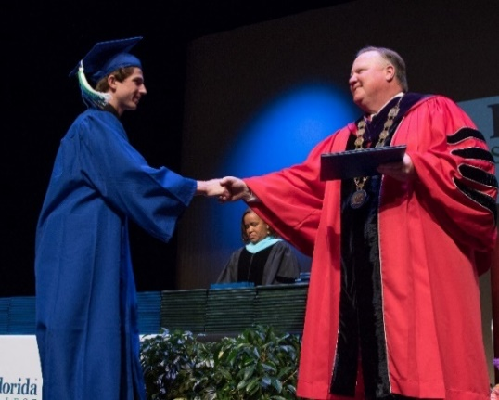
Contact Information
Guidance Counselor: (321) 638-0750
Academies: Amy Williams (Ext. 27026)
A-J & VAP: Kimberlee Leonard (Ext. 27032)
K-Z: Kayli Shear (Ext. 27024)
EFSC Advisor: Chyrell Sullivan
321-433-5409
EFSC Testing: Go to EFSC website. Type RegisterBlast in the search box to schedule your PERT testing appointment online

Slide 31

Achieve the Early College Program Goals!
1. Complete the prerequisites for your intended major.
2. Graduate with your diploma and AA degree.
3. Continue your education as a junior at a four-year university!
In 2020-2021, 431 high school students
graduated with an AA!

Slide 32


Slide 33

Student Interest Form

