Slide 1
Sherwood Science & Engineer Fair

Slide 2
Science and Engineering Fair
All students in 4th - 6th must complete an individual or team project
Projects are displayed on Science Fair Boards
All Students must have a log book. Teams must have a log book for each member
Have FUN!

Slide 3
Science and Engineering Fair
Project Due Date
January 19th
School Science Fair
January 23rd
Regional Science Fair
March 14th

Slide 4
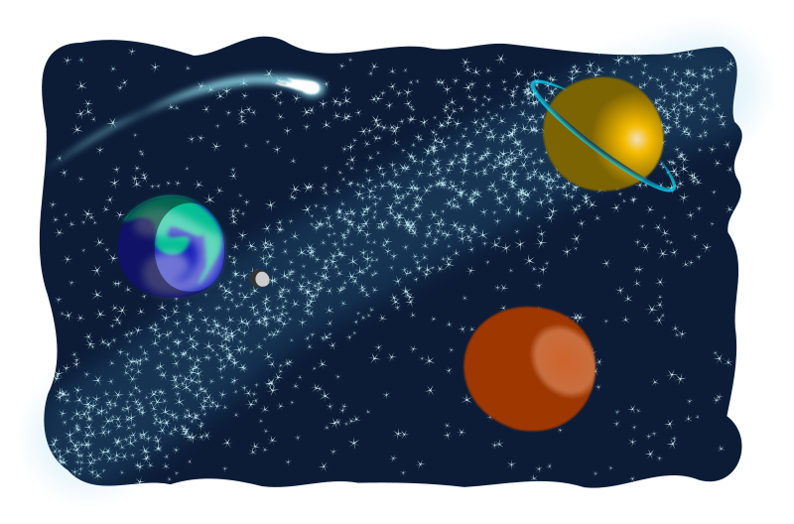
Sherwood Elementary School’s
Science and Engineering Fair Website
https://www.brevardschools.org/domain/9576
Information for the Student Science Fair handbook can be found on the Sherwood Website

Slide 5
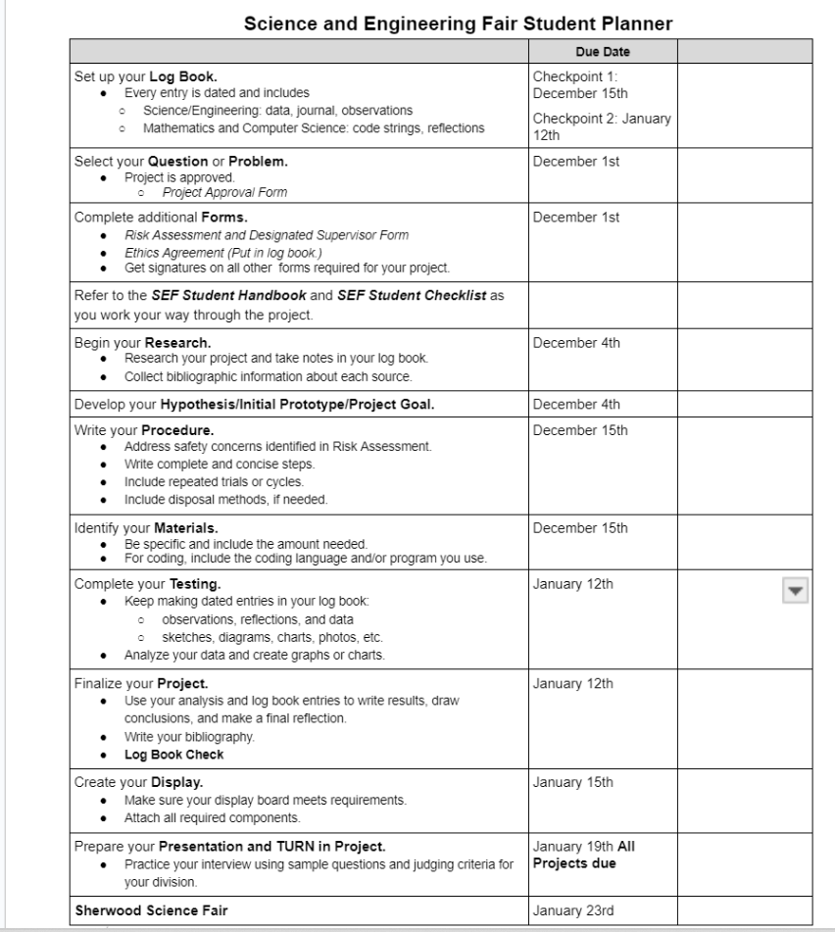
The Science and Engineering Fair Student Planner
Make sure to keep track of when different components of your Science and Engineering Fair are due.
Frequent checks are necessary to help you keep on track with your project.
You will receive a calendar and permission slips from your teacher

Slide 6
Team Projects - No More than 2 Students
Each member of the team must have his/her own logbook.
Team Projects compete against individual projects.
The students must be from 4th - 6th grades but can be from different grades
Notes:
NEW to South Fair!

Slide 7
What is the Elementary Science & Engineering Fair?
Animal Sciences Plant Sciences Microbiology Earth & Environmental Sciences Chemistry Physics & Astronomy Human Behavior | Environmental Engineering Engineering Mechanics | Robotics & Intelligent Machines Coding Mathematics
Showcase Student Projects in 12 Different Categories

Slide 8
Science Division
Categories
Animal Science (Vertebrate Care Form)
Plant Science (soil purchased from store/ no manure)
Human Behavior (MUST HAVE HUMAN CONSENT FORM)
Microbiology (NO MOLD or algae)
Earth and Environmental Science (soil purchased from store)
Chemistry (extra care with safety)
Physics and Astronomy
The Science Division is the most similar to the traditional Science Fair Project.

Slide 9
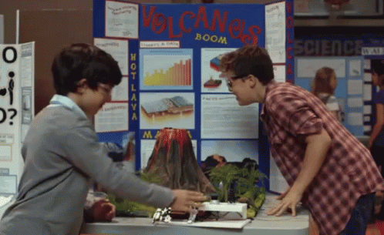
Science Division
Students design a testable question
Control group as well as dependent and independent variables
A detailed daily log
REQUIRED to complete at minimum THREE trials
ALL grades (4-6) are required to have a bibliography with AT LEAST 3 sources and notes
Building a Volcano is not an experiment!

Slide 10
Engineering Division
The Engineering Division allows students to design and then build prototypes to solve a real world problem.
Categories
Environmental Engineering
Engineering Mechanics

Slide 11
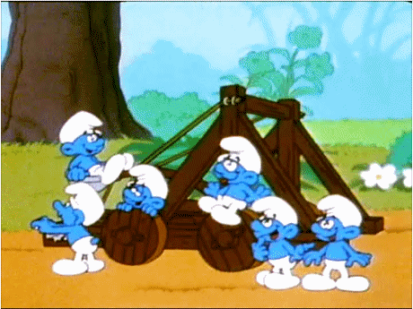
Engineering Division
Design a prototype to solve a real-world problem
Make at least three different modifications to the prototype (they do not have to build a brand new protype, they are making changes to the existing prototype)
ALL grades (4-6) are required to have a bibliography
A detailed daily log

Slide 12
Mathematics & Computer Science Division
The Mathematics and Computer Science Division allows students to design and then build robots or write code or an algorithm to solve a real world problem.
Categories
Robotics/ Intelligent Machines
Coding
Mathematics

Slide 13
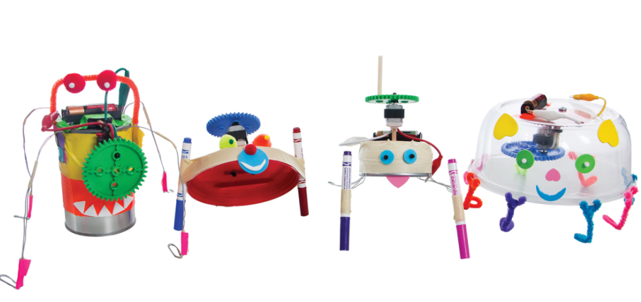
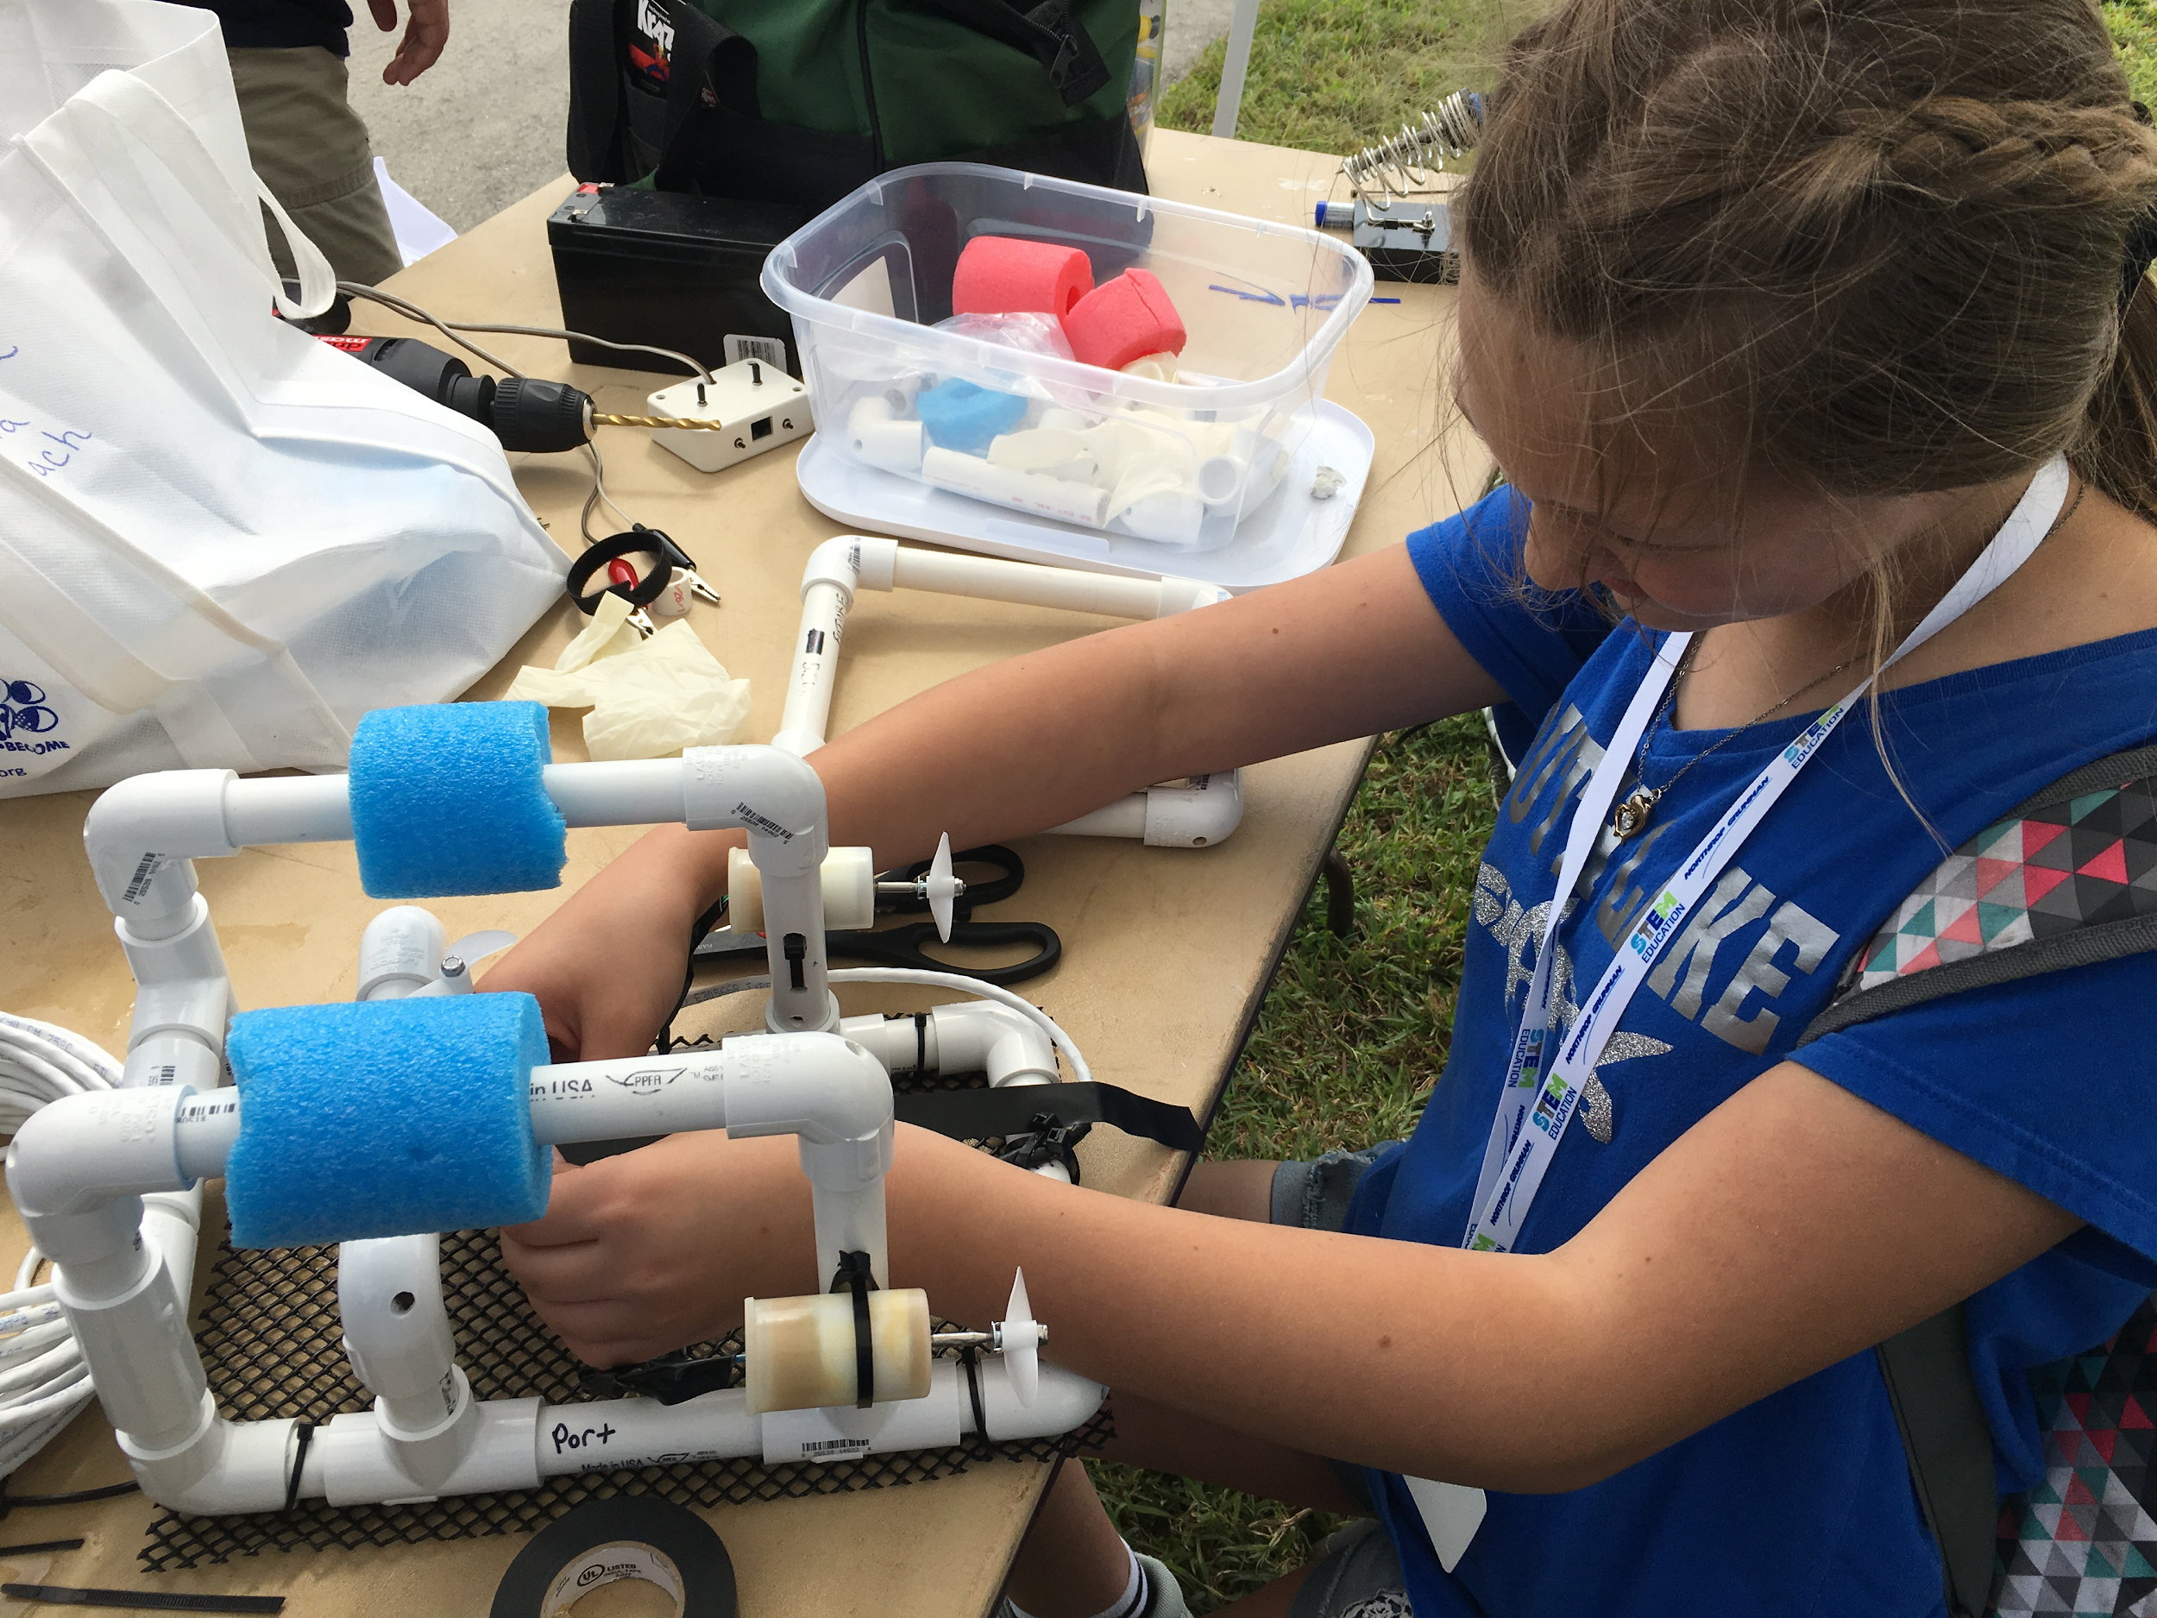
Mathematics and Computer Science Categories
Robotics and Intelligent Machines – projects will use machine intelligence to complete a task or reduce the reliance of human intervention
Coding – projects will focus on the study or development of software or information processes to demonstrate, analyze, or control a process or solution.
Mathematics- use a formula to solve a real-world problem

Slide 14
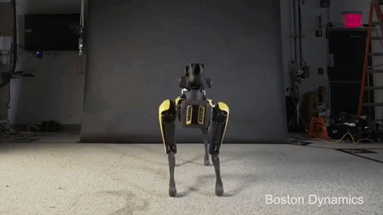
Mathematics & Computer Science
Division
Design a code, algorithm, formula, equation or robot and make at least three different modifications to the code/ robot
Bibliography with at least 3 sources
A detailed daily log

Slide 15
Projects That Are NEVER Allowed
Testing that involves any items that could be considered weapons
Testing that involves fireworks or explosives
Testing using controlled substances such as alcohol, tobacco or prescription medicine
Microbial experimentation using samples collected from the environment (NO MOLD OR ALGAE)
Projects that produce mold either intentionally or unintentionally
Any project that could cause pain, distress or death to a vertebrate

Slide 16
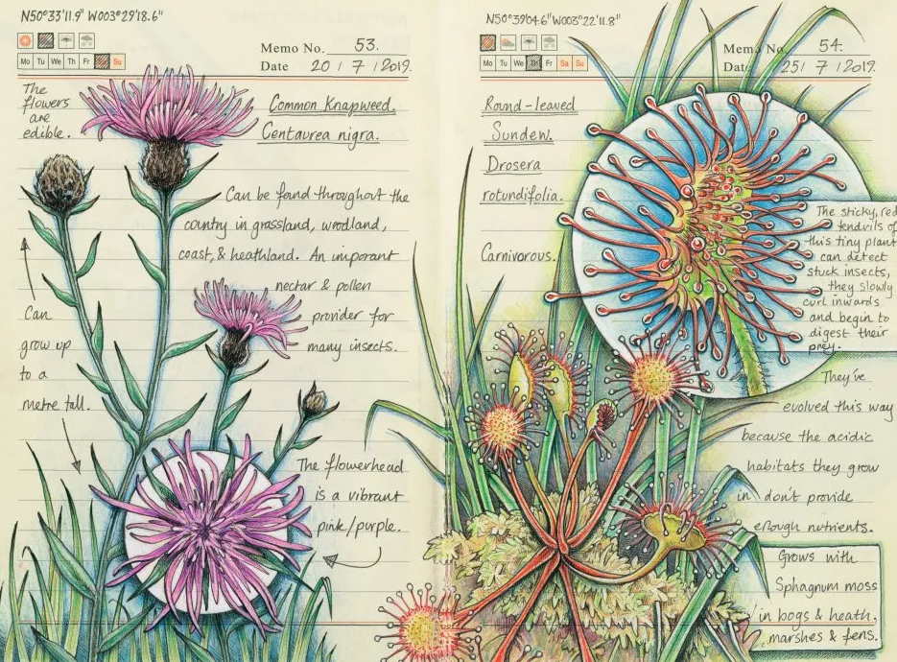
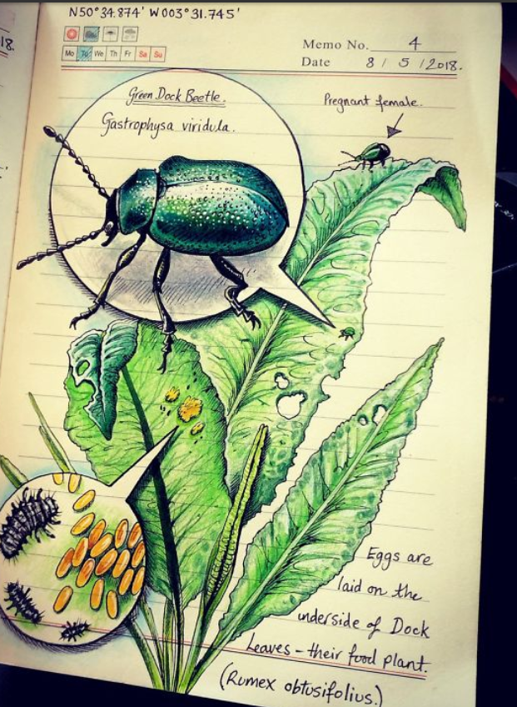
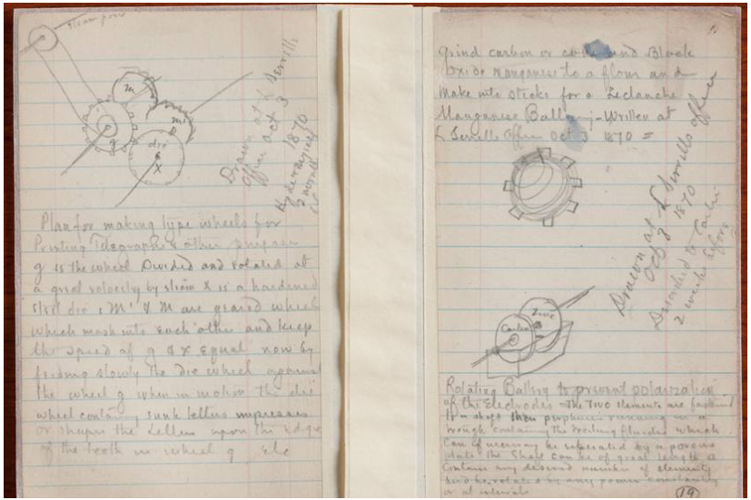
Daily Log
Dated entries
Sketches and Diagrams
Detailed entries
Minimum of 3 sources for research with notes

Slide 17
How to Come up with a Question
Consider topics that are interesting to you
What is something you are curious about or often wondered?
Ask “What If” questions
Continue your project from last year
Sciencebuddies.org
Books
It should be FUN, so pick something you are interested in

Slide 18
Science Variables
Independent Variable The variable you are “messing with”.
Dependent Variable The variable that you will record and measure. It’s changes “depend” on the independent variable.
Control Variables All aspects of these variables must remain constant.
“How Does Aspirin Affect the Growth Rate of Roses?”
“What is the Effect of Coke on the Decay of Teeth?”
Control
Independent
Dependent
Independent
Dependent
Control

Slide 19
Control Group
Control Group The group that receives no treatment or test.
(What you would normally do)
Used to compare with the experimental groups
“How Does Aspirin Affect the Growth Rate of Roses?”
The control group would be roses in water without aspirin so we can compare if aspirin has an affect on growth.
“What is the Effect of Coke on the Decay of Teeth”
The control group would be teeth not treated with coke so we can compare the decay of teeth treated with coke to those not treated.

Slide 20
Forms
There are three forms that each student will need to fill out regardless of the type of project:
Project Approval Form
Ethics Agreement
Risk Assessment and Designated Supervisor Form
Please Note: All projects involving human subjects MUST have a Qualified Scientist Form.
Notes:
Project Approval Form
Ethics Agreement
Risk Assessment and Designated Supervisor Form
There is a Science and Engineering Fair Forms Needed Key to assist teachers with determining which forms will be required for each project.
Please Note: All projects involving human subjects MUST have a Qualified Scientist Form.

Slide 21
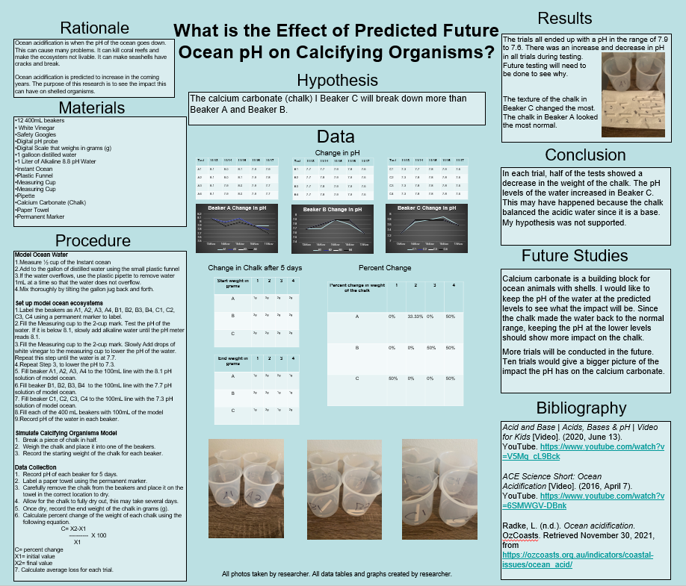
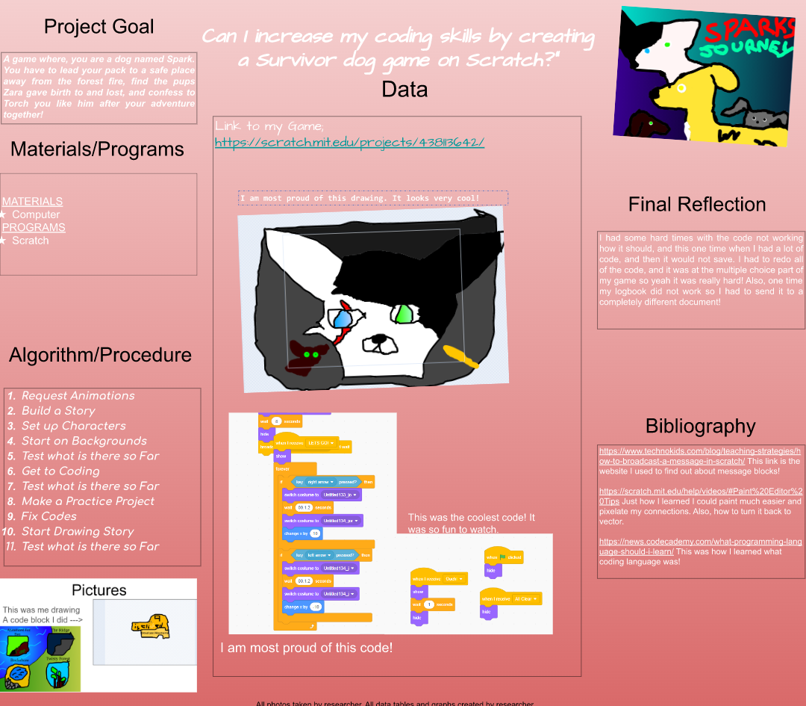
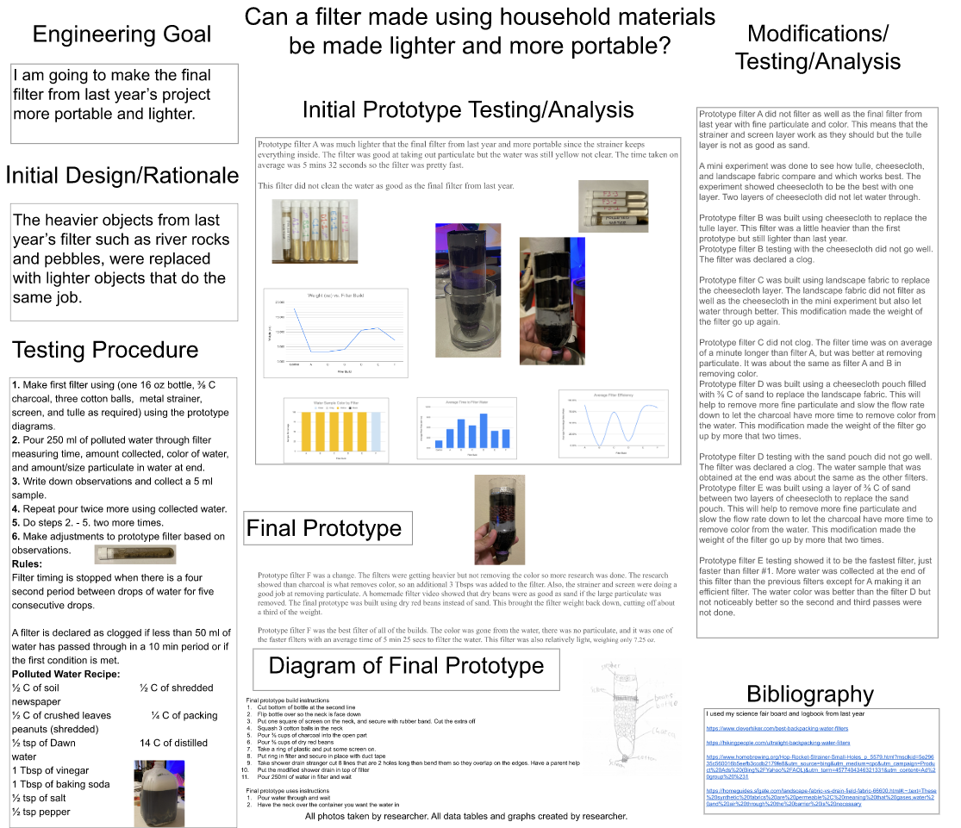
How to do a Project

Slide 22
Research
Research key terms (science words) about your project
(evaporation, electricity, insulation, chemical reaction, force, friction)
Research using a variety of sources including: library(books), videos, internet, expert in the field interview)
You need to include 3-5 credible sources in your research
In your log book, list each source, take notes on each source and write 3-5 sentences of what you learned on each source
Cite all of your sources with a Works Cited page (bibliography)

Slide 23
Hypothesis
A hypothesis is a statement about what you think will happen in the experiment. It is stated in a positive manner. Avoid statements like “I think” and “I predict.” The hypothesis should be in the form of “If ___, then___.”
If I measure the bouncing height of a new basketball with three different pressures, then the ball with the highest pressure will bounce 10% higher.
If I I test different water samples from the Indian River Lagoon after it rains, then the amount of phosphates will be greater.

Slide 24
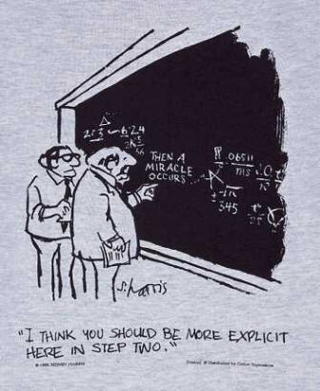
Procedure
The procedure is a listing of steps used in the experiment. It is very detailed, like a recipe. It makes it easy for someone to duplicate the experiment. It should also be written in kid friendly terms.
Example
Gather all materials.
Measure 500 milliliters of soil and pour it into the pot. Continue for each of the 5 pots being tested.
Pat the soil down and dig small hole (10 centimeters in the middle of each pot filled with soil.
Place a lima bean seed in each hole and cover the hole with the dirt.
Water each plant with 20 milliliters of water once every two days.
Record observations in daily log.

Slide 25
Materials
The materials section is a detailed list of everything used in the experiment. Include what, how much, and what kind of things used.
Non-Example
Water
Flower pots
Seeds
Dirt
Example
5 liters of rain water
Six 4 cm. clay pots
12 bush bean seeds
10 liters of potting soil

Slide 26
Testing &
Analyzing the Results
Results include both data and observations.
Record measurements and observations in the Daily Log.
Think about the data and observations and decide what those results mean.
Try to use mathematical calculations such as mean, median, mode, and range (6th grade)
Construct graphs or tables digitally that will show results clearly; Create-a-Graph, Google Sheets or Excel

Slide 27
Writing the Conclusion
Look at the data. The conclusion can be written in one or two paragraphs.
Did the data support the hypothesis? If not, why do you think it did not? What could be done differently the next time? How would people apply your findings to everyday life?
Do NOT say your hypothesis was right or wrong… It is either the data supports or does not support your hypothesis. Do not worry about negative results, or results that come out differently than expected. Just explain why you think you got those results. If the results turned out as expected, explain why your hypothesis SUPPORTS your data. This is where you apply and explain your scientific thinking. What is the SCIENCE behind your results? Justify your reasoning.

Slide 28
District Bid Requirements
Students are now judged ONLY by category and division.
If students do not have ALL COMPONENTS then they can not place first or recieve a district bid
Three Trials/ Variables Identified (Science Division)
Three Modifications (Computer Science/ Engineering Division)
Detailed Daily Log
Research/ Bibliography
Data/Graphs
Results (Data Analyzed and Discussed)
Conclusion

Slide 29
If you have any other questions, please contact your classroom teacher, science teacher, or science coach!

