Slide 1
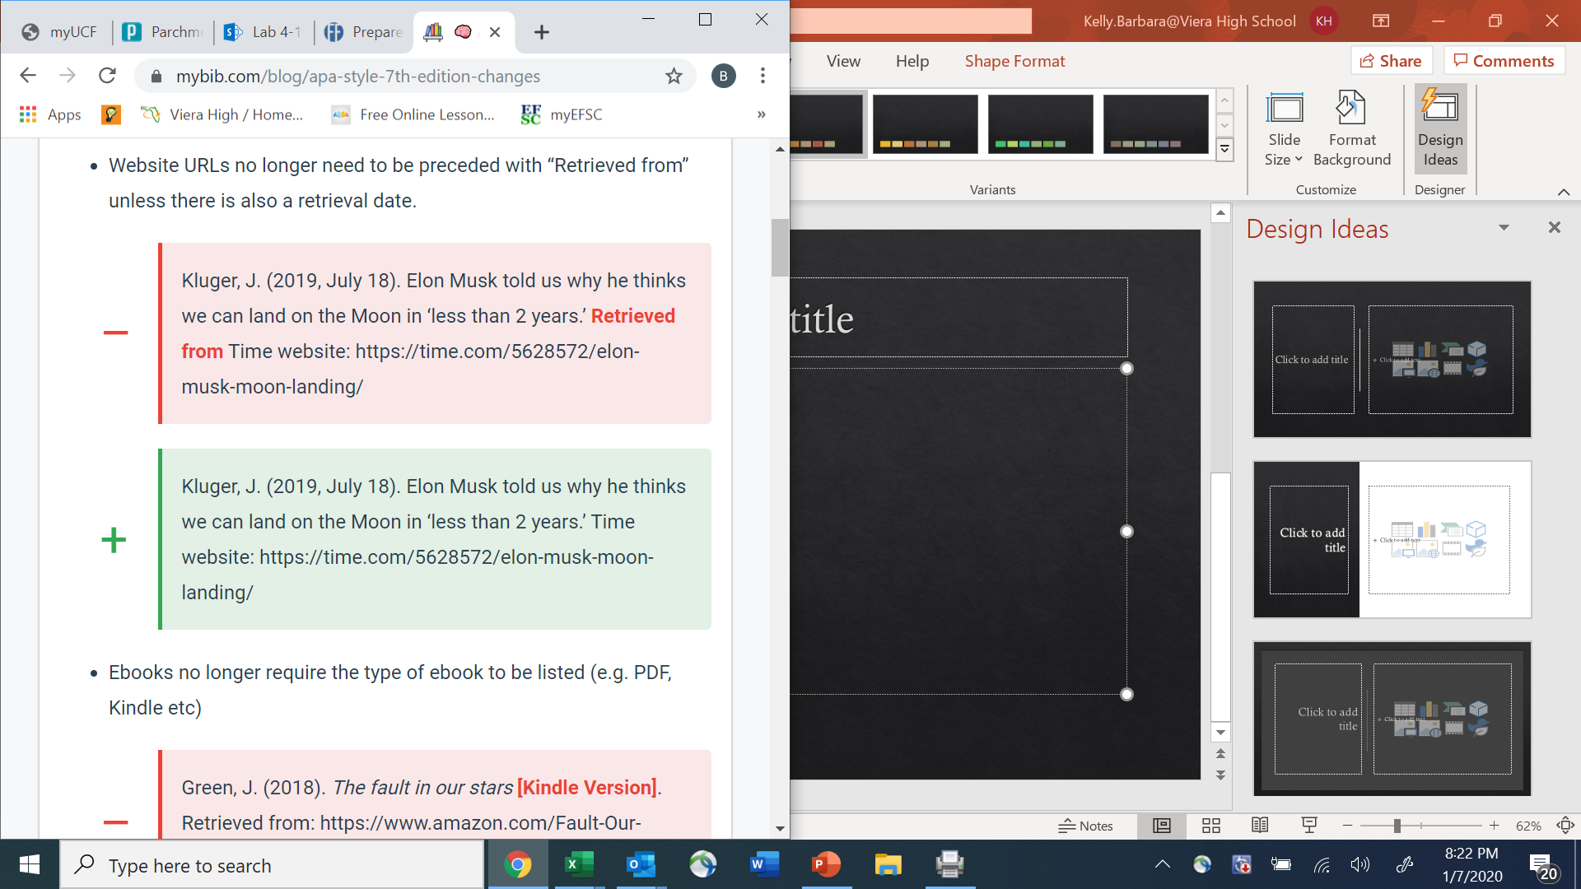

Slide 2
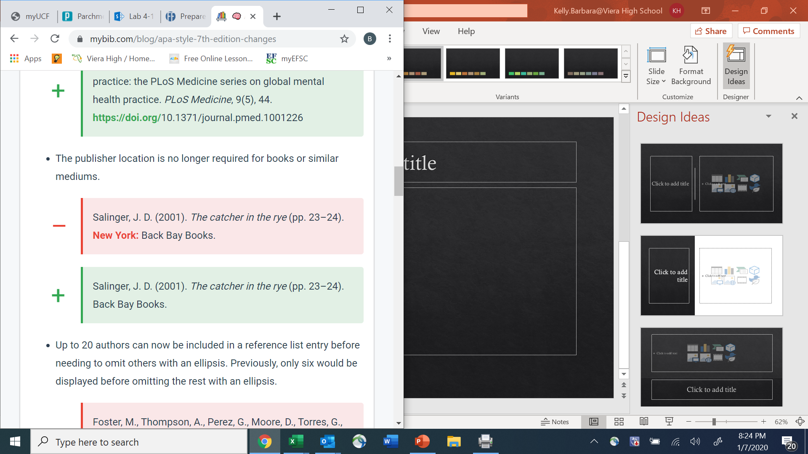

Slide 3
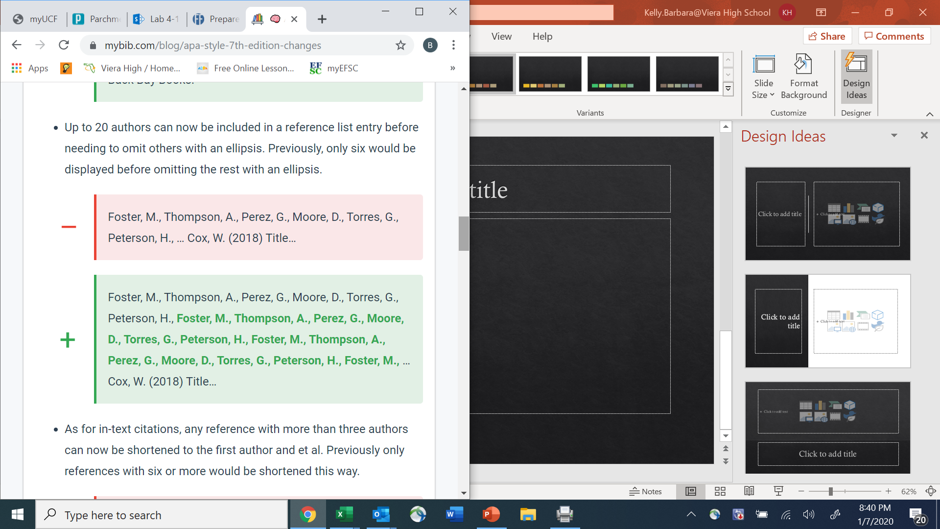

Slide 4
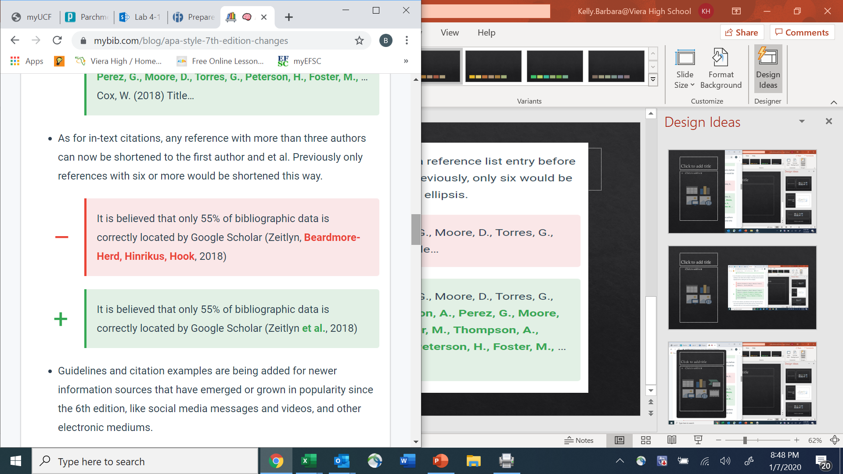

Slide 5
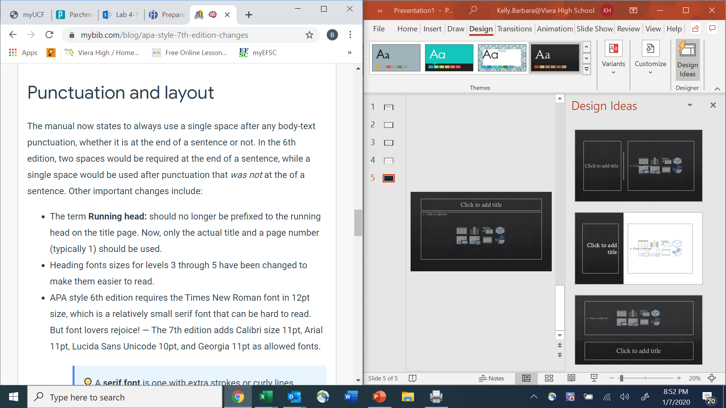




























Slide 6
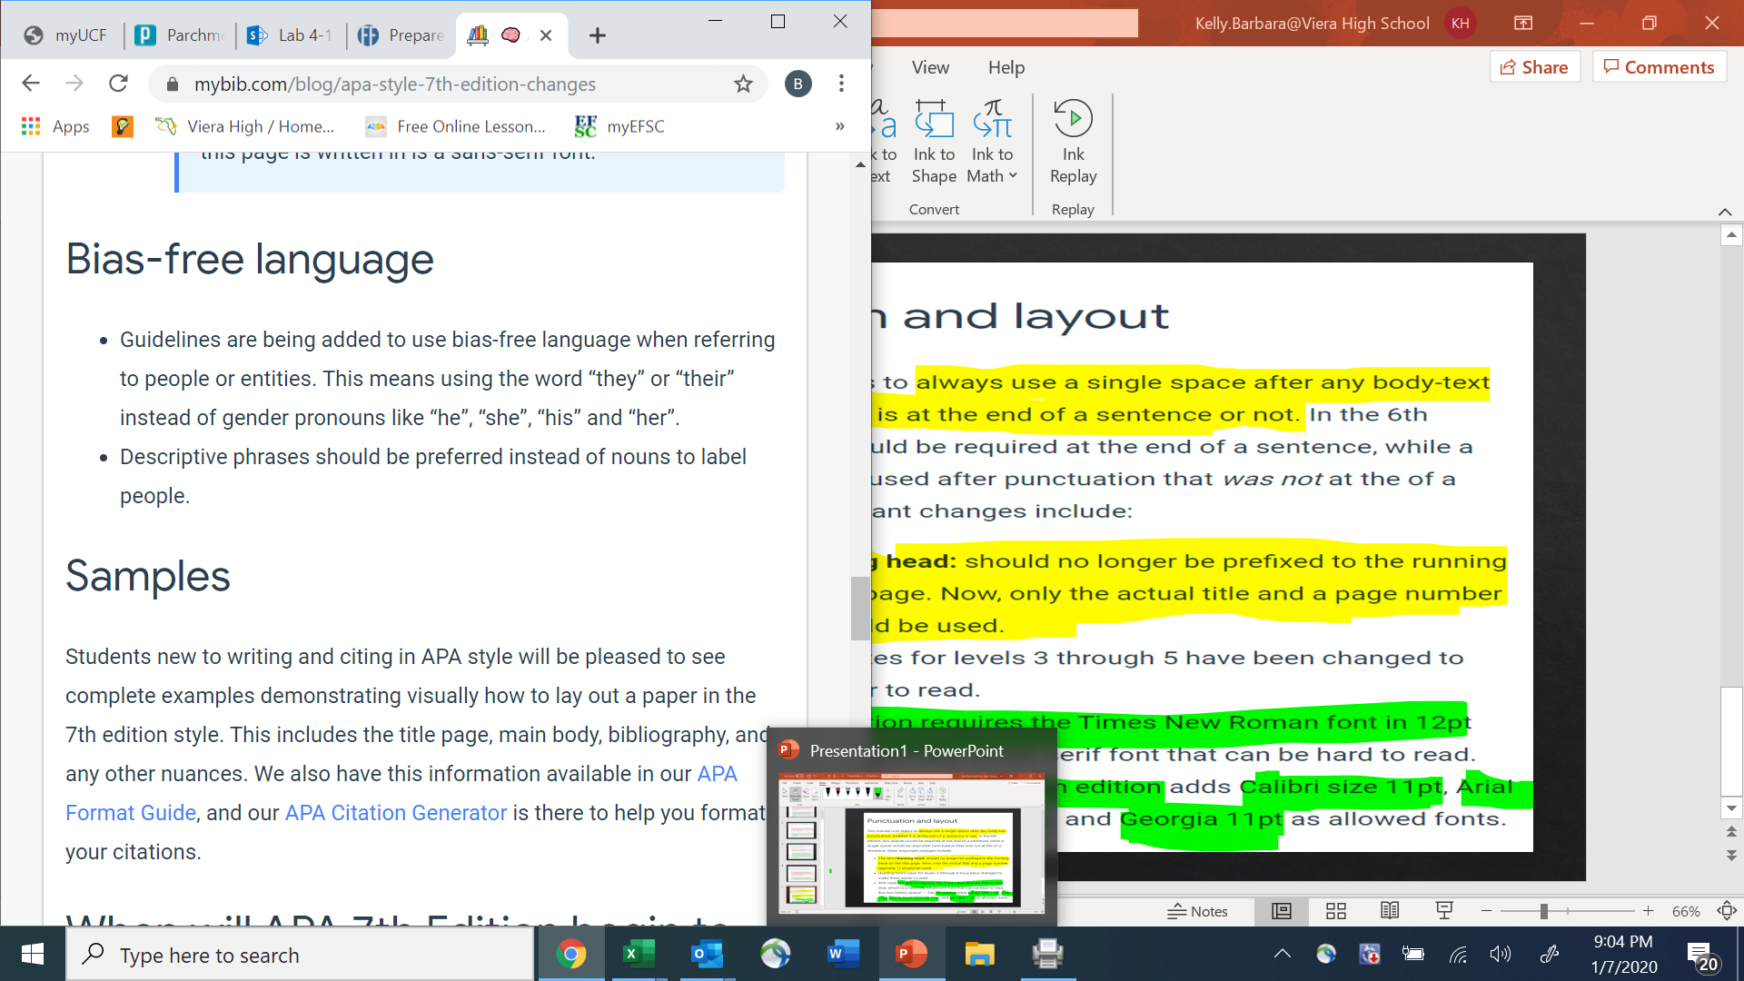
Examples of Descriptive phrases:
Instead of saying: The poor (adjective as noun), use People living in poverty (descriptive phrase)
Instead of saying: Over 65 (broad category), use 65 to 75 years old (specific)

Slide 7
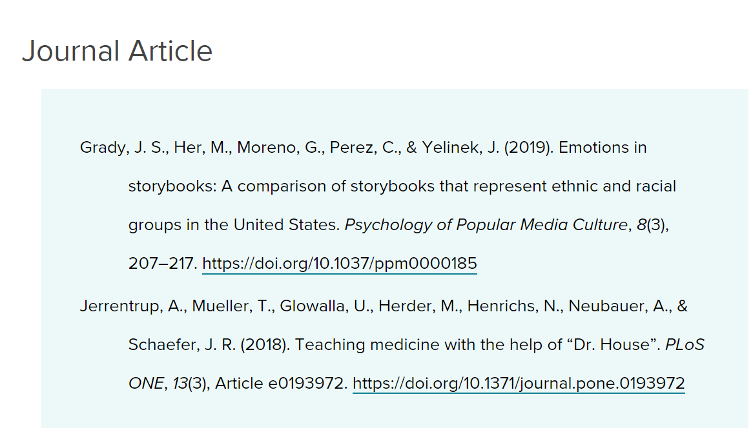

Slide 8
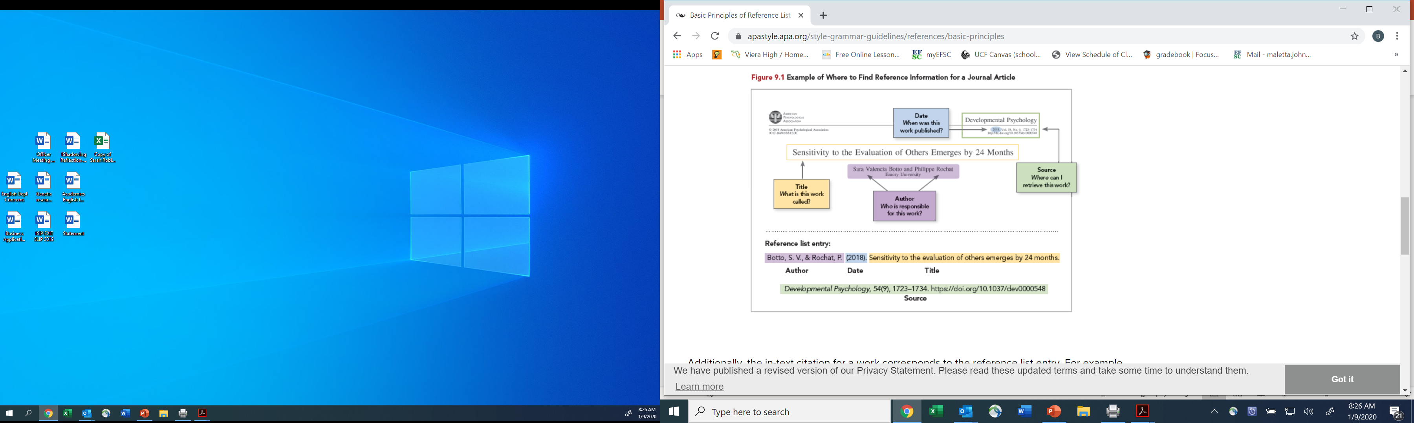

Slide 9
