Slide 1
A Guide to Senior Year ARE YOU READY?

Slide 2
Senior Year Timeline-- Fall
Narrow college list to 5 or 6 schools
Note Deadlines
Begin applications
Request Letters of Recommendation- if required
Take ACT/SAT (if needed)
Complete FAFSA
Apply to Bright Futures

Slide 3
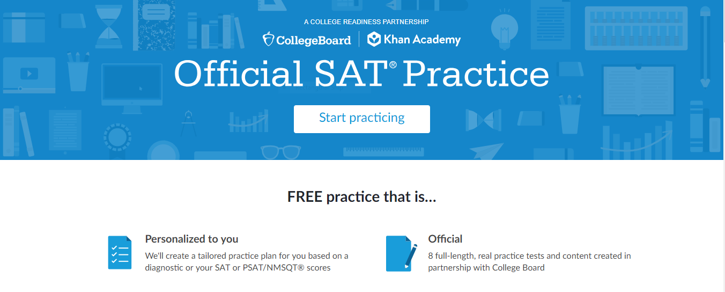
Test Scores– Apply or Wait?
Submit college applications NOW
Note test date on application
Admissions will reconsider applications once new scores arrive

Slide 4
Florida Shines www.floridashines.org
Go to College
Succeed in College
Find a Career
Explore Institutions
Discover Programs
Get Ready for College
Pay for College
Affordable Education Options
Plan You Path
Check Your Progress
Learn Online
Take a Course at Another School
Transfer Schools
Search Libraries
High School & College Graduates
Explore Career Fields
My Career Shines

Slide 5
Florida Shines www.floridashines.org
College 101
4 Nights, 4 Webinars
Explore September 20, 2021
Apply September 21, 2021
Fund September 22, 2021
Go September 23, 2021

Slide 6
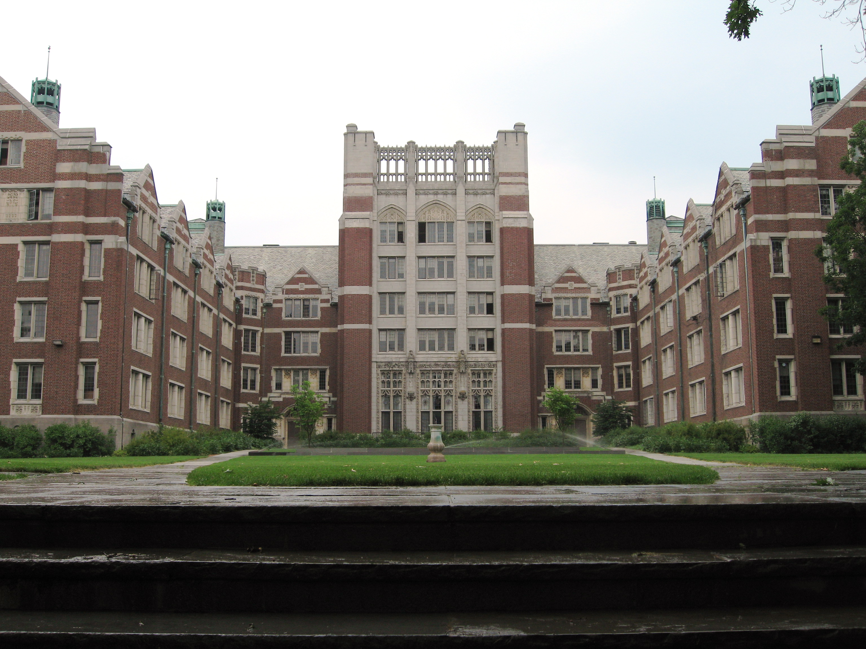
Applying for college
Consider
Research
Choose
Talents
Interests
Goals
Google
Tour potential colleges
College visits College fairs
Narrow selection to 3-5 schools
Dream to safety

Slide 7
What Matters Most to Colleges/Universities
Transcript
Student
Recommendations
Grades in College Prep Classes
Strength of Curriculum
Admissions Test Scores
Grades in ALL Subjects
Class Rank
Essay or Writing Sample
Interview
Extracurricular Involvement
Demonstrated Interest
Teachers
Counselor
Coach
Mentor
What do their words reveal about you?

Slide 8
What Selective Colleges Look For
Qualities of Mind
Qualities of Character
Capacity to Contribute to University
Potential for Life-long Leadership

Slide 9
Types of Applications
Common Application
School online application
Coalition Application
Admission requirements are like snowflakes, no two are the same!

Slide 10
Completing a college application
Résumé
Essay
Recommendation
List all accomplishments
Quantify
Work
Volunteer
Afterschool
Your story
Be honest
Don’t recount, reflect
Humor
Start early and revise
Answer the question
Use resources
Choose wisely
Allow time 2 weeks
Provide copy of résumé, research, portfolio

Slide 11
SUS Matrix 2021-2022

Slide 12
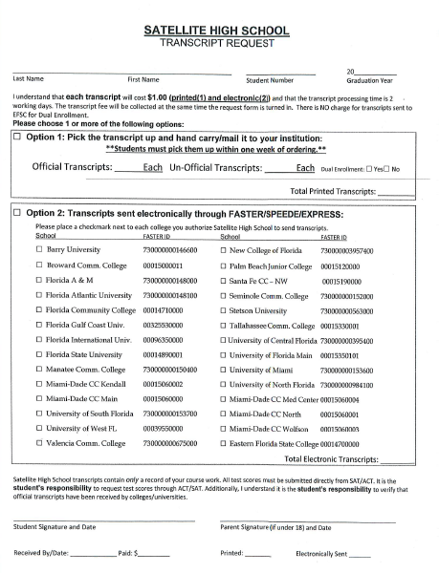
Requesting A Transcript
Complete a transcript request form
All transcripts are $1.00
Transcripts can be sent electronically through
Common App
SENDedu
Coalition
You must invite your counselor to upload transcript

Slide 13
The Common Application

Slide 14
Registration Information

Slide 15
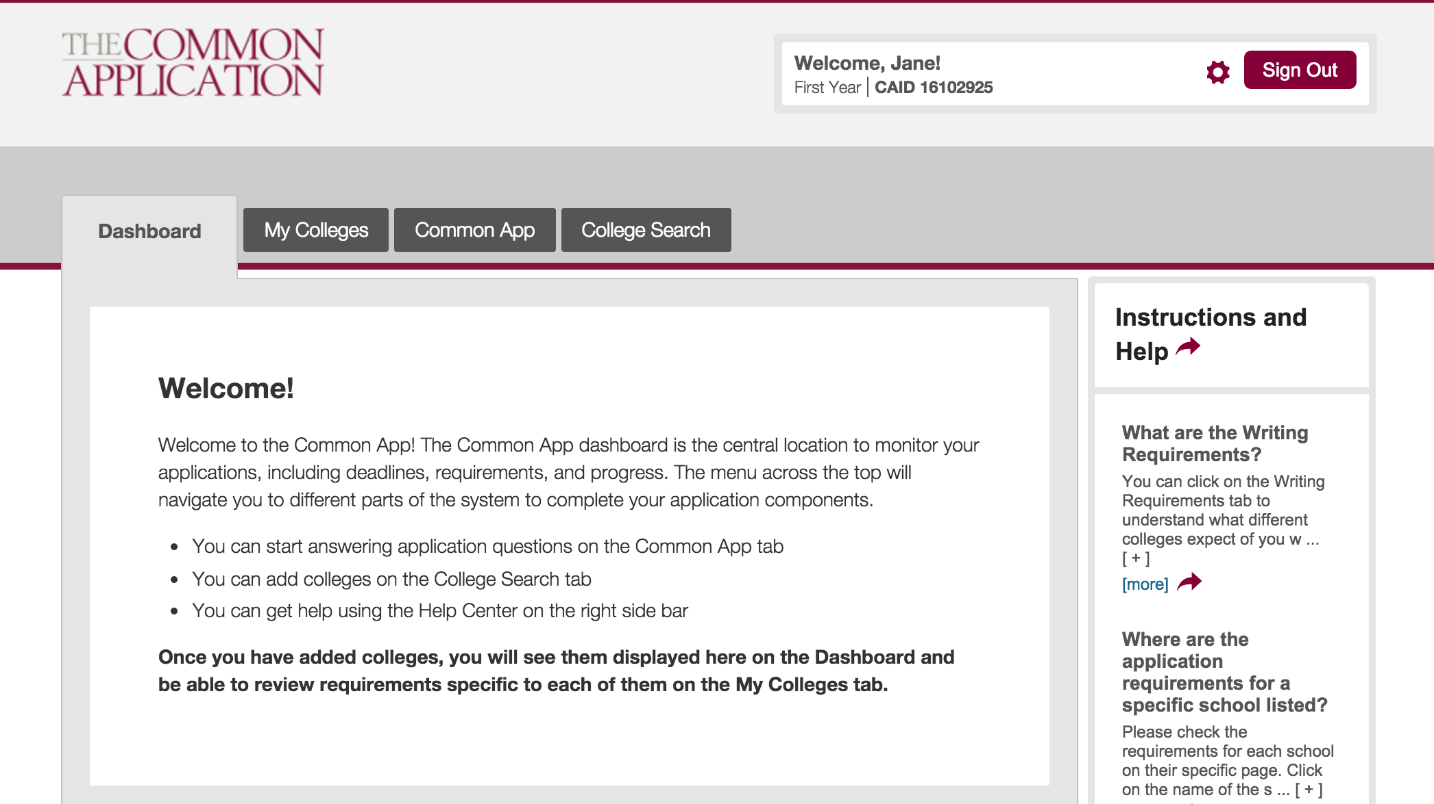
^{© 2016 The Common Application}
Notes:
Welcome to your account!
This is the welcome screen that applicants see when they first sign in to their Common App and will appear until a college or colleges are added to your My Colleges list.
The Common App ID (CAID) is the unique identifier that allows colleges to match your application with supporting documents. Write down this number with your important
college application information – it will be useful if you need to contact appsupport.commonapp.org.
Click on the gear icon to update or change your email address, password, or communication preferences.
On the right side of the screen, you will see the Instructions and Help Center link. This link appears in the same place on every page of your application. Help is available where you need it, when you need it. 24/7/365.

Slide 16
The Common App tab is where you will complete the six Common App sections. Watch these videos to learn more about them.
Search for and add colleges to your My Colleges list in the College Search tab.
In the My Colleges tab you will complete the college-specific questions for each college in your list.
The Dashboard is your home base where you can keep an eye on your requirements and upcoming deadlines.
Check out our Common App Tour video for more info!
^{© 2016 The Common Application}
Notes:
The Dashboard provides a snapshot of all of your colleges, including information on deadlines, requirements, and the submission status of your applications.
The My Colleges tab will list detailed informa8on about the colleges you have added to the list and requirements for all of your colleges.
The Common App tab is where you will go to complete the main sections of your application.
The College Search tab is used to search for colleges that you would like to add to your My Colleges list.

Slide 17
SSAR- When to Complete?
SSAR is completed AFTER primary application

Slide 18
Important Tips From Admissions
Following directions is critical!
Do not send transcripts unless requested by institution
Do not send recommendation letters unless required by institution
Deadlines are firm, not suggestions
Allow 2-3 weeks for processing
Students must write their own essays!

Slide 19
Paying for College
Scholarships
Merit Based
Athletic
Income Based
Minority Students
Students of Veterans
Students with Disabilities
Program Based
Bright Futures

Slide 20
Grants Pell Grant Academic Competiveness Grant National SMART Grant Work Study Student Loans
# 1 Mistake students make is by NOT applying!

Slide 21
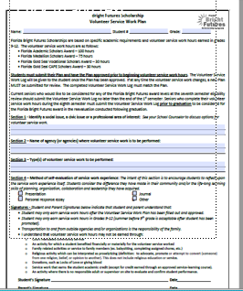
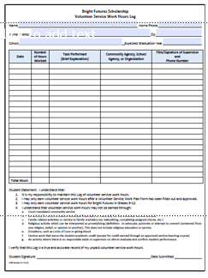
Bright Futures
Proposal
Log Sheet
Note
Proposal must be signed prior to earning hours
All hours due May 20, 2022
Students may test through June 2022

Slide 22
NCAA Eligibility
NCAA Clearing House
Admissibility
Core GPA
SAT/ACT Sliding Scale
Letter of Intent
Athletic Biography
Ensure college or university is a good fit academically

Slide 23
Career & Technical Programs @ EFSC
Emergency Medical Services
Engineering Technology
Fire Science Technology
Graphic Design
Human Resources Administrator
Law Enforcement
Pharmacy Technician
Web Development
Welding
And more….
Accounting
Applied Technology
Computer Programming
Cosmetology
Criminal Justice
Culinary Management
Dental Hygiene
Diagnostic Medical Sonography
Digital Video

Slide 24
Upcoming Events for SHS Student considering Eastern Florida State College
College For a Day
Go Higher Get Accepted
October 26 Palm Bay Engineering Tech/Computer Sciences
October 27 Melbourne
Public Safety/Health Services
October 28 Cocoa Stem Programs & Trades
February 10, 2022
EFSC Admissions Representative on Campus in Media Center
Help Students Apply to EFSC
Assistance with FAFSA

Slide 25
Reminders
Recommendation Letters
Allow 2 weeks
Do not send unless required
Bright Futures Oct. 1
FAFSA Oct. 1
Deadlines are FIRM
Early Decision Nov. 1
FSU/UF Nov. 1
Transcripts
Can take up to 2 weeks
Do not send unless required by college/university

Slide 26
