Slide 1

Accelerated Programs Agenda
Criteria for Invitation
Advanced Placement
Collegiate High School/Dual Enrollment
Testimonials
Questions

Slide 2
Criteria for Invitation
3.0 GPA or higher
Enrolled in or completed Algebra 1
AP Potential Report Data

Slide 3
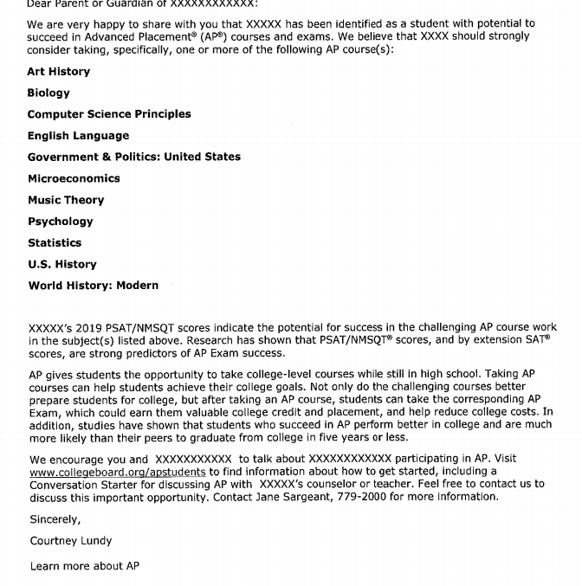
AP Potential Letter

Slide 4
Advanced Placement

Slide 5
AP Myth Vs Reality
AP Classes are too stressful
I’m and athlete and AP Courses have too much extra work
Colleges prefer dual enrollment
Classrooms are collaborative and AP teachers are supportive
You work hard, but work is purposeful and meaningful
Universities and colleges prefer rigor!

Slide 6
Why Take Advanced Placement Courses?
AP courses build skills you need throughout college years-- Bachelors to Doctorate
AP students stand out in college admissions
Earn College Credit
Skip introductory classes
Improve SAT scores

Slide 7
What is an AP score and what does it mean?
5 = extremely well qualified
4 = well qualified
3 = qualified
2 = possibly qualified
1 = no recommendation
Many colleges and universities grant credit and placement for scores 3, 4, or 5.

Slide 8

Can I do both AP and DE?
Students can earn AA degrees combining AP with DE enrollment classes
Students can use DE courses to add additional rigor to their transcript where AP courses are not available

Slide 9
AP Diplomas
AP Capstone Diploma
BPS AP Diploma
Issued from College Board
6 AP Courses
  AP Capstone Seminar
  AP Capstone Research
  4 AP courses of your choice
Issued from Brevard Public Schools
6 AP courses in 3 areas
  Ex.
    AP Lang & AP Lit
    AP World History & US History
    AP Statistics
    AP Psych

Slide 10
Why Capstone Diploma Students Stand Out
  College essays - critical thinking, communication, and research skills
  College Interviews - display confidence, passion, as well as expertise
  Research - build evidence based arguments, apply research methods, work in teams, deliver professional presentations, and complete long-term academic projects

Slide 11
  “AP Capstone helps students develop key skills that they will use over and over in college: conducting research and communicating their results.”
  —STU SCHMILL, DEAN OF ADMISSIONS AND STUDENT FINANCIAL SERVICES, MASSACHUSETTS INSTITUTE OF TECHNOLOGY

Slide 12
FAST FACTS
38 AP Courses in 7 subject categories
Each Course is comparable to introductory college course
Each course culminates in a standardized assessment
AP exams are given in May world wide
Schools must be authorized by AP Course Audit to offer approved classes
Teachers must be certified by AP to teach an AP course

Slide 13
Which AP Courses Are Offered At SHS?
Art Studio 2D & 3D
Art Studio Drawing
Biology
Calculus AB and BC
Capstone Research
Capstone Seminar
Computer Science A
Computer Science Principles
English Literature
English Language and Composition
Environmental Science
Government
Human Geography
Latin
Music Theory
Psychology
Physics 1 and 2
Spanish
US History
World History
Statistics

