Slide 1
South Lake Elementary
January 2021
A choice school focusing on STEAM – home of the South Lake Sharks!

Slide 2
Story behind South Lake?

Slide 3
STEAM
Core Components of South Lake
Focus on STEAM
Technology Integration
Exceptional Faculty
Parental Involvement
Character Education STEAM
Project Based Learning
SmartLab
Class Size 18:1 (K-3)
Class Size 22:1 (4-6)
Gifted program information

Slide 4
Curriculum
Activities | (K-6)
Media (Maker Space) | Missy Slack
Arts | Molly Andrews
Music | Mary Johnson
PE | Jake Owens
SmartLab | Rhonda Ripperger
Our focus is on state-mandated Florida Standards that include reading, science, math, social studies and writing, as well as the fine arts and technology.

Slide 5
SmartLab
What would it look like in a SmartLab? Here are just a few examples of the types of projects your child will be working on: science exploration, digital imaging, comic creation, simple machines, software engineering, 3-D printing, Ozobot Robotics, Lego Renewable Energy, and much more!

Slide 6
Other Information
Bus Transportation is currently not available
Before and afterschool care (6:30am-6:00pm)
School hours 8:00-2:30 (open at 7:30am for breakfast – free for all students) Fridays 8:00-1:15pm
Physical Education and Recess
Enrichment Clubs
Opportunities for volunteering
PTO/SAC

Slide 7
Other Information
Uniform Policy 2021-2022
Our number one job at South Lake Elementary School is to provide your child with the best positive learning experience in a safe environment. We work each day to encourage students to be successful at their job of learning. Uniforms are an important part of the school’s identity: It has a positive impact on students’ learning and behavior in and around the school, serves to unite students, increases student pride, and eliminates barriers so all students are treated equally.
South Lake’s students are expected to participate in our school’s uniform policy Monday - Thursday. We have decided to allow students to express their individual dress styles on Friday.
Monday - Thursday
Tops – solid t-shirts and/or polo shirts (if you have a logo embroidered, it needs to be on the left front chest). Shirt colors – navy or royal blue, maroon, gray, and/or white
Bottoms – Students may wear pants, skirts, shorts, skorts, or jumpers. No jeans unless it’s Friday. Bottom colors – navy, black, and khaki (no basketball shorts)
Shoes – Students may wear their choice of shoes; however, they must be safe and appropriate to the learning environment and aligned with BPS Student Dress Code Policy which states that shoes are safe and appropriate for recess and physical education.
Friday
• Students may wear uniforms or dress as they wish on Fridays, as long as it follows school board policy.
Additional Information:
Field Trip Days – students may wear class shirts and/or what is comfortable for trips, no uniforms required; however, the teacher may request students to wear class shirts.
Places that you can purchase uniforms: JCPenney, Sam’s, Walmart, Target, Old Navy, Amazon, etc.
Logo – Embroidery - $10.00 per shirt/item and ink prink $3.50 per shirt/item. (Blueberry Heirlooms by Kimberlee Towne 321-267-6555) ***Embroidery is optional
Uniform donations – we will collect gently used uniforms for donation. If you would like to drop off any donations this summer, bring those to the front office. At registration, if available, families will be able to take two uniforms per child from the donation bins, if needed.
Picture Days – students will be able to dress up and they may wear sandals, dress shoes, etc.
Mascot – Sharks School Colors – Royal Blue and Silver

Slide 8
Other Information
Join our South Lake Group Facebook page and/or click like on the PTO Facebook page to follow us
Go to www.brevardschools.org, click on schools, find South Lake. Once you are on the website you can click on the word “PeachJar” on the top right to receive our school-wide newsletters
Registration packets – link in letter
Kindergarten Orientation/Registration on campus – TBD

Slide 9
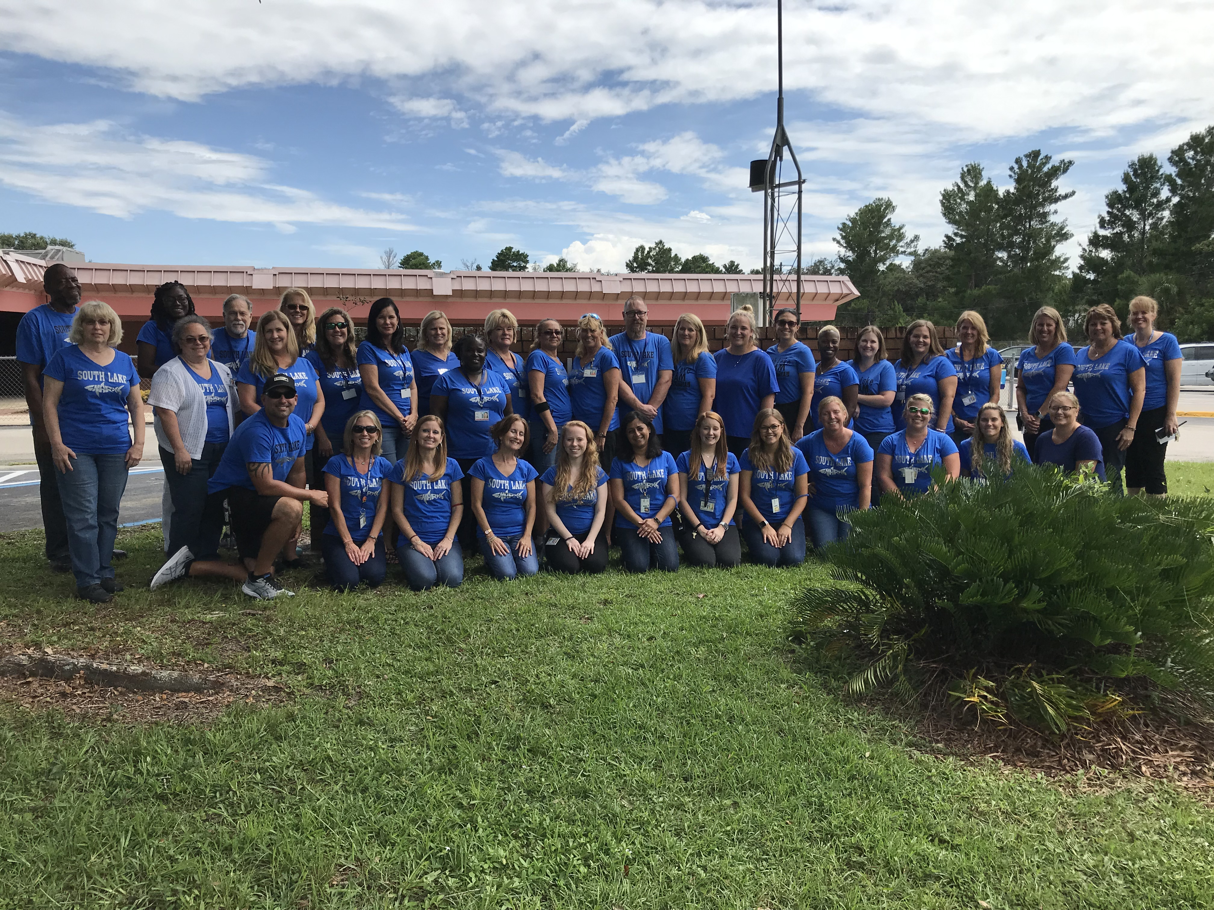
Thank You!
Questions?

