Slide 1
Welcome
To the
Best buddies
Informational meeting
Everyone needs to sign in and make sure you know who your buddy is.

Slide 2
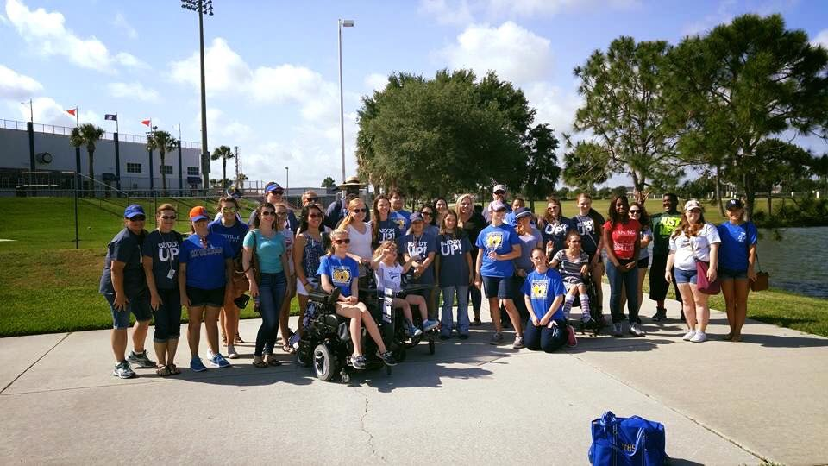
What is best buddies?
A Buddy for Life………………..

Slide 3
Mission statement & model
Best Buddies is a non-profit organization dedicated to establishing a global volunteer movement that creates opportunities for one-to-one friendships, integrated employment and leadership development for people with intellectual and developmental disabilities (IDD).
Best Buddies offers members opportunities for socialization, leadership development, and integrated employment, thereby providing the necessary tools for people with intellectual and developmental disabilities (IDD) to become more independent and more included in the community.

Slide 4
A Global movement
Clubs are in middle school, high school and college worldwide
1:1 friendship is really what Best Buddies is all about, breaking down barriers so everyone is included and has fun!

Slide 5
Events and activities
Best Buddies prom
Wonder Works Fieldtrip
In-school parties
Football games and THS Spirit activities
Community Advocacy

Slide 6
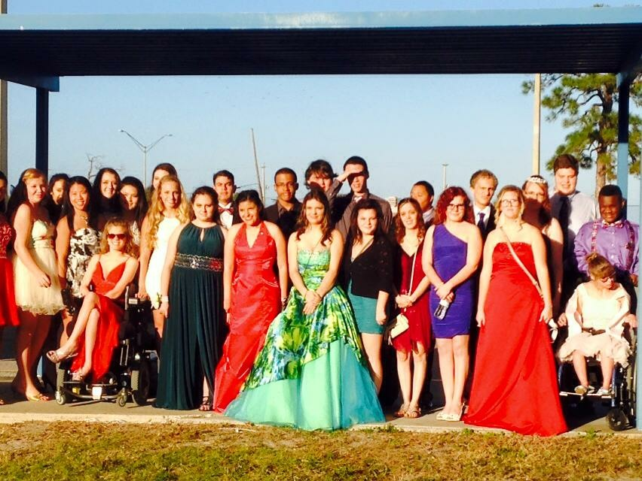
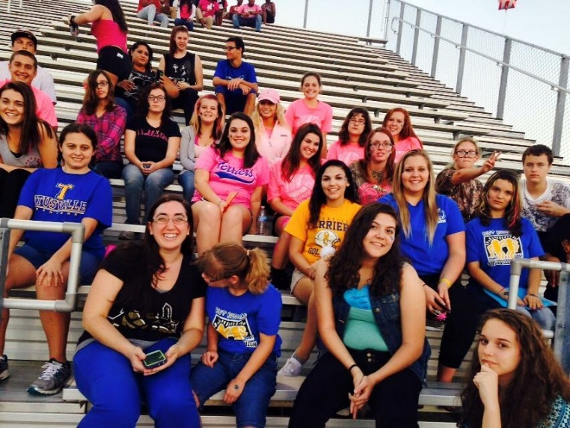
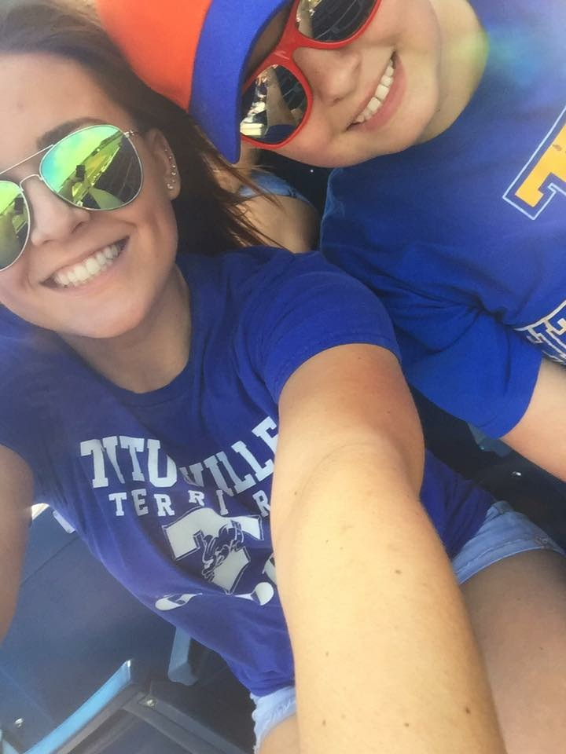
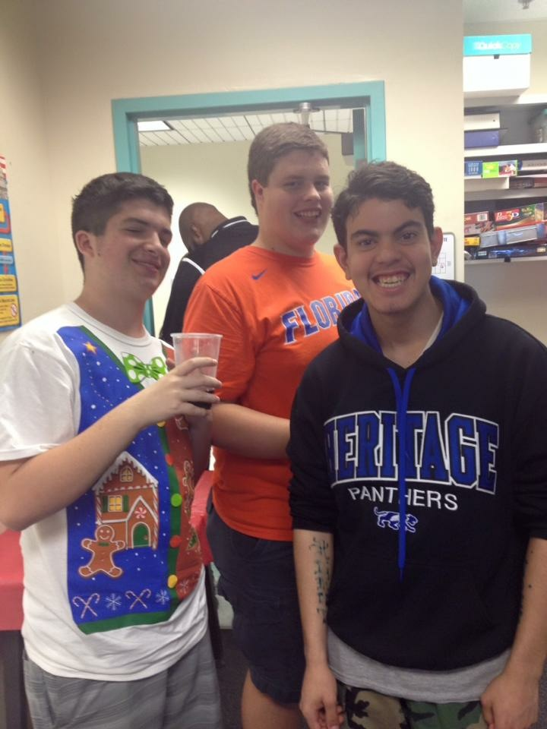
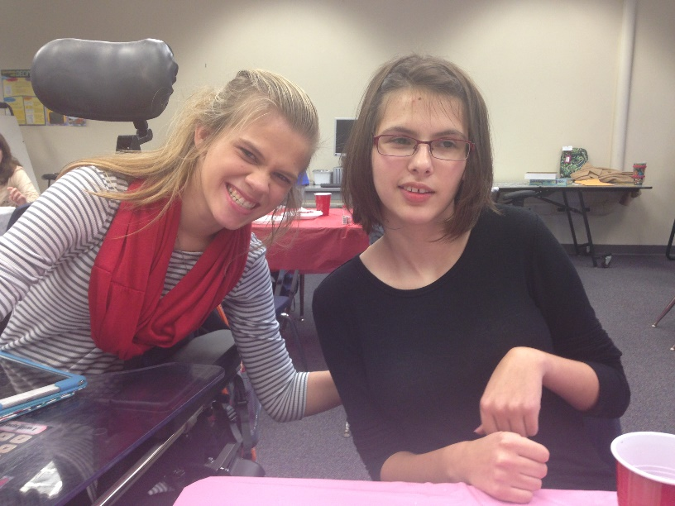
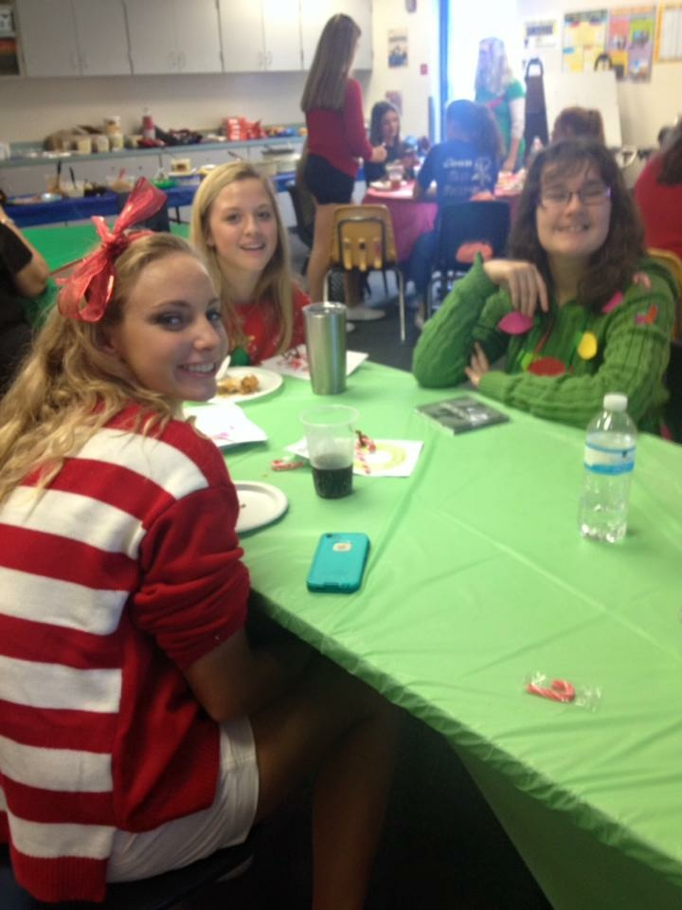
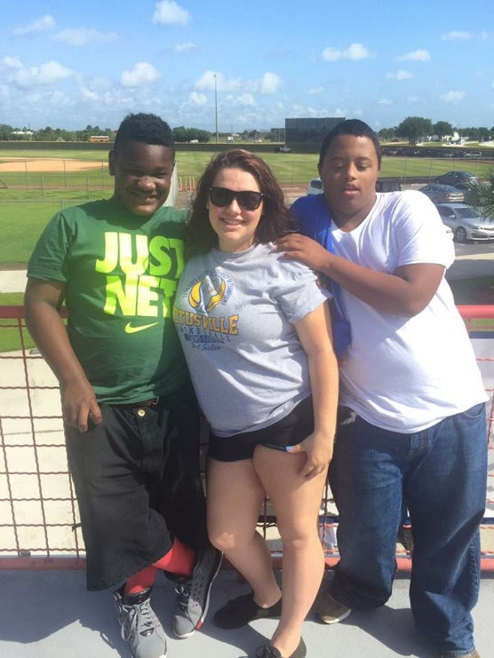
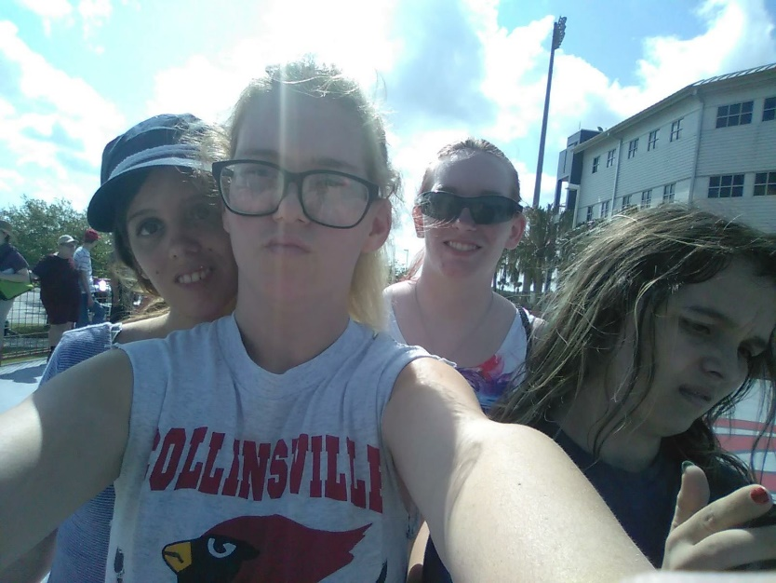
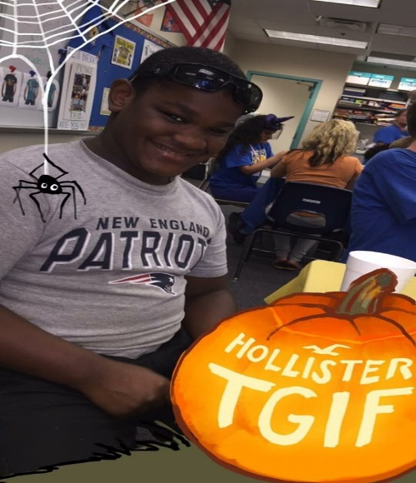

Slide 7
Peer buddy vs. associate
Both are important and need to be involved?
Peer Buddies are required to complete friendship updates by the end of each month and associate buddies will complete a survey that is required.
Every Buddy needs to have more than one friend to talk to and hang out with.

Slide 8
Expectations
Priority and commitment- Being a friend and a Buddy requires both, but it should be fun.
True friendship- You stopping by the classroom two or three times, a note, eating lunch, etc. may be the only highlight of their day and makes them happy.
Attending monthly activities and friendship updates or surveys are required. If there is a conflict, then notify Mrs. Coachman or Mrs. Register

Slide 9
Goals
One peer buddy per buddy
One or two associate buddies per buddy
Education about disabilities - ADVOCACY
Main events this year- a sporting events, holiday gatherings, field trips, Best Buddy Prom at UCF.
OUR GOAL is simple - To BE THE BEST FLORIDA CHAPTER!! With your involvement and enthusiasm, we can do it!!

Slide 10
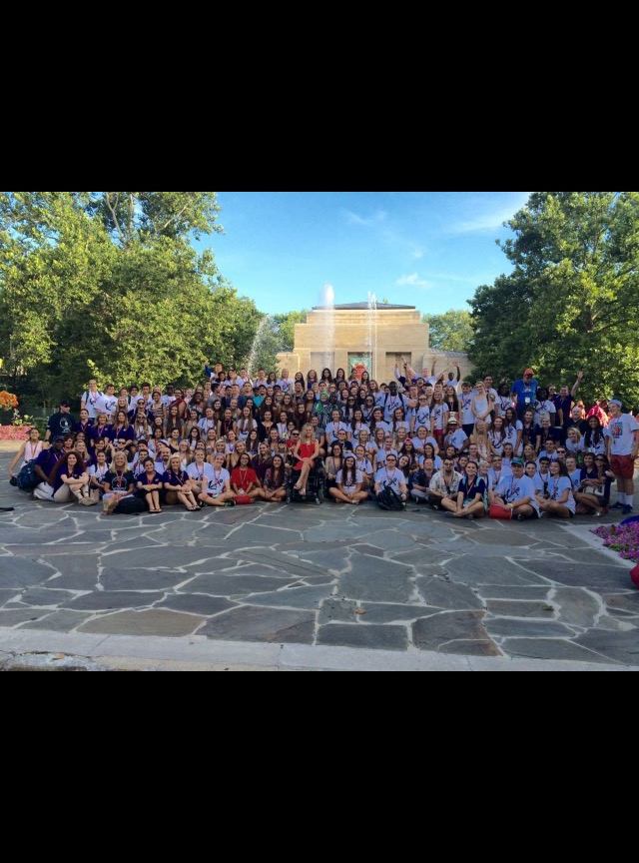
What do you get out of bb
You generally may NOT count any of the events that we do for volunteer hours, but there are exceptions for community events that promote BB
BB is More about friendship
An internationally recognized organization looks very nice on résumés
Meeting new people around Florida and possibly leadership training plus education about unique people who are fascinating

Slide 11
Meetings and social media
The first Wednesday of every month plus an officer meeting
Facebook- THS Best Buddies 2016-2017
Twitter- thsbuddies1617
THS Club Page

Slide 12
Fundraising
These 3 tumblers sale for $16 each and there is a husky, which is like a Yeti that sales for $24.
-16 oz. Stainless Steel Tumbler
-16 oz. Sports water bottle
-24 oz. Double wall plastic tumbler

Slide 13
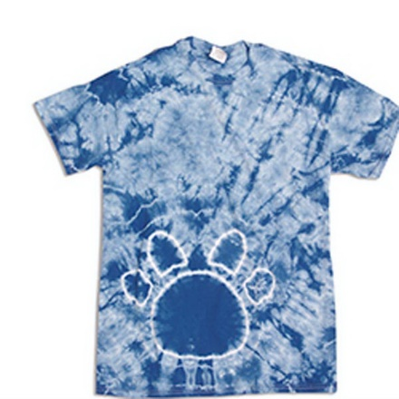
T-Shirts
The logo has to be in all black or all white.
The shirt color options are navy, teal or tie-dye

