Slide 1
New Process
Dual Enrollment Students
Last Updated 10/2023

Slide 2
A Note on Fees
There is a student fee which is usually $10 per semester.
Parking Pass Fee
Extra fees for specific classes like labs.

Slide 3
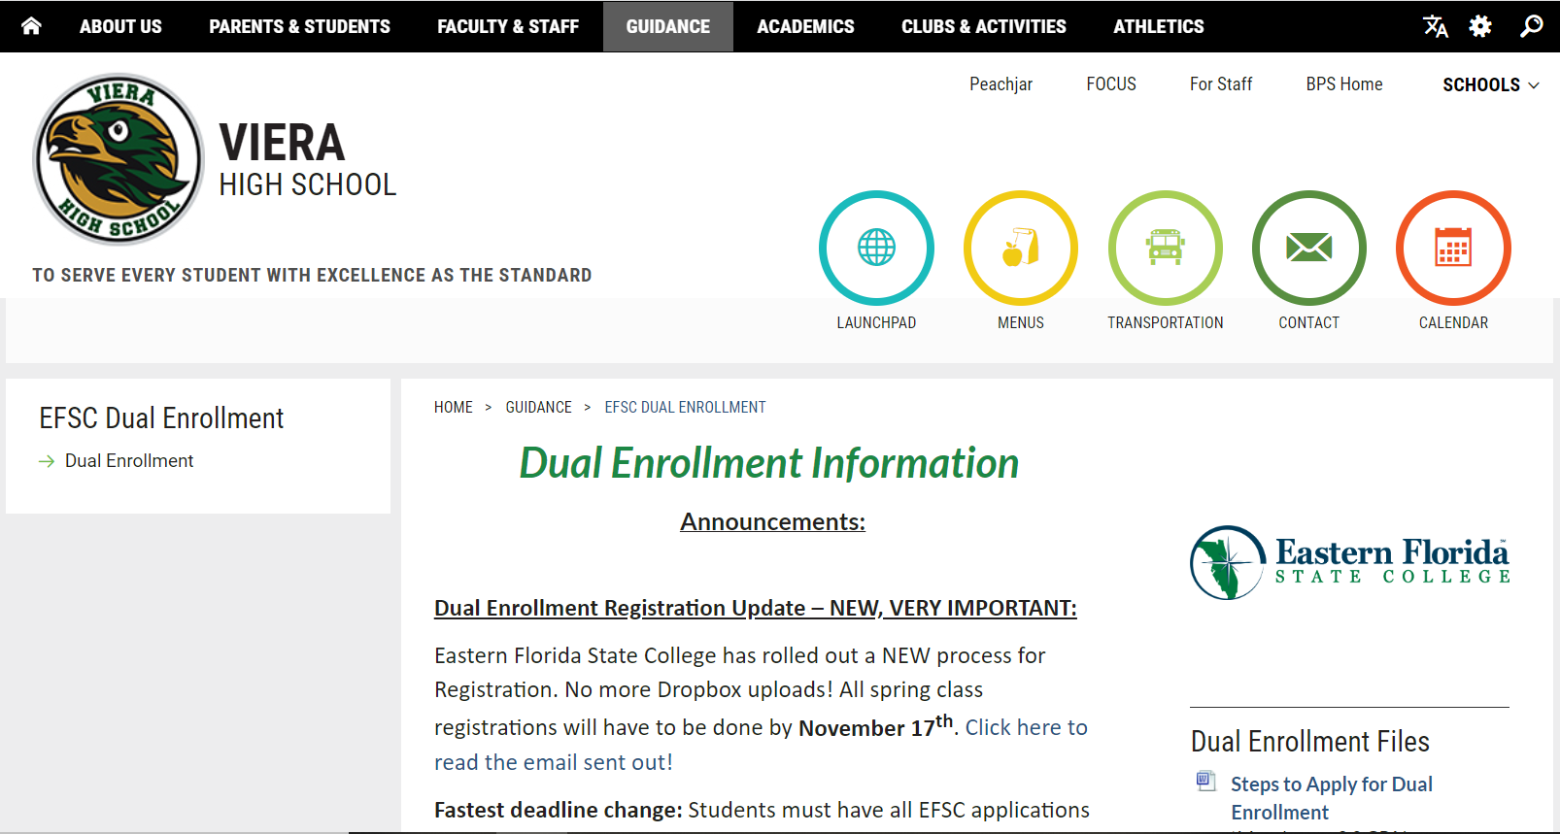
VHS Guidance – Dual Enrollment Page
If you ever want to know Dual Enrollment updates, please visit our webpage.
Choose “EFSC Dual Enrollment” drop down when you hover over the “Guidance” tab.

Slide 4
Overview of AA Requirements
The following will review the 8 areas of concentration for an AA.
Please see your EFSC advisor to go further into detail about your AA. We are just giving general information, so you can know what they look like.
We ALWAYS suggest matching your electives to your future major. Otherwise, you will be “wasting” your elective credits that won’t allow you to have 2 years of college done.

Slide 5
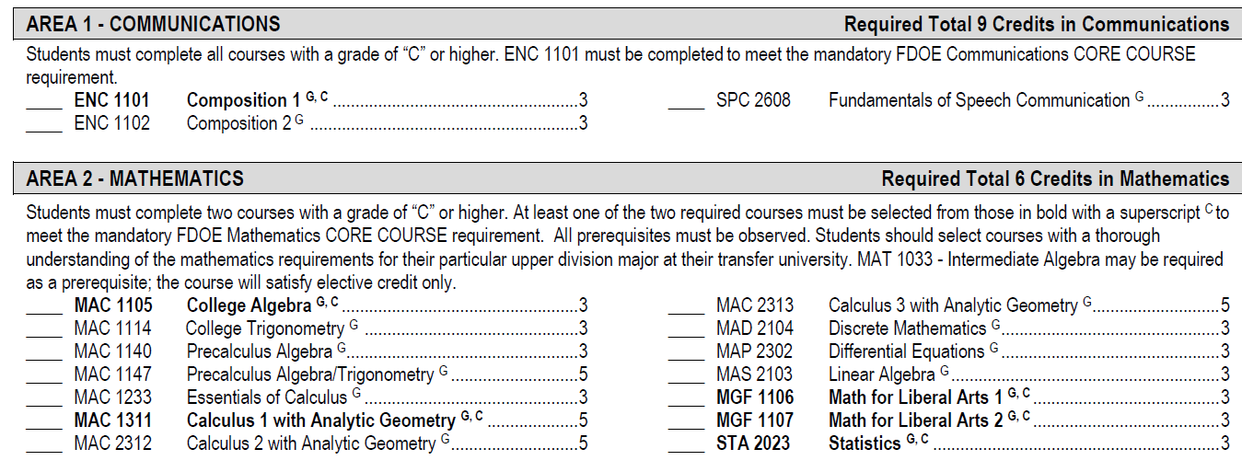
Overview of AA Requirements
Area 1 – Communications – Must take all 3 classes.
Area 2 – Mathematics – Must take 2 classes. Must have a PERT Math score high enough.
Make sure you are considering your future major when deciding what maths to take.

Slide 6
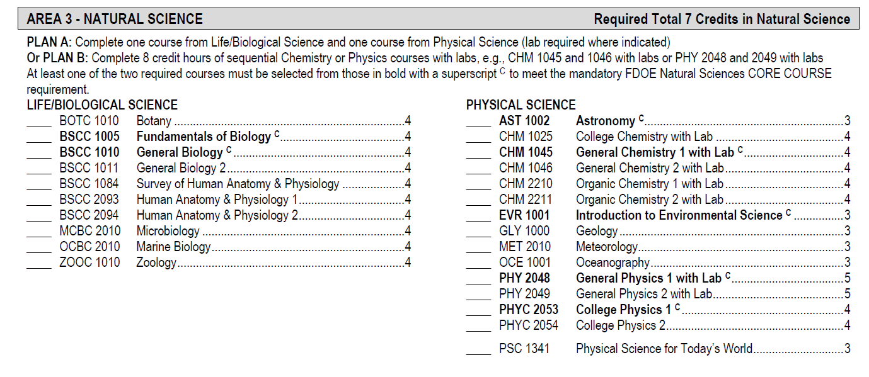
Overview of AA Requirements
Area 3 – Natural Science – Must take 1 class in Life/Biological Science and 1 class in Physical Science.
Make sure you are considering your future major when deciding what sciences to take.

Slide 7
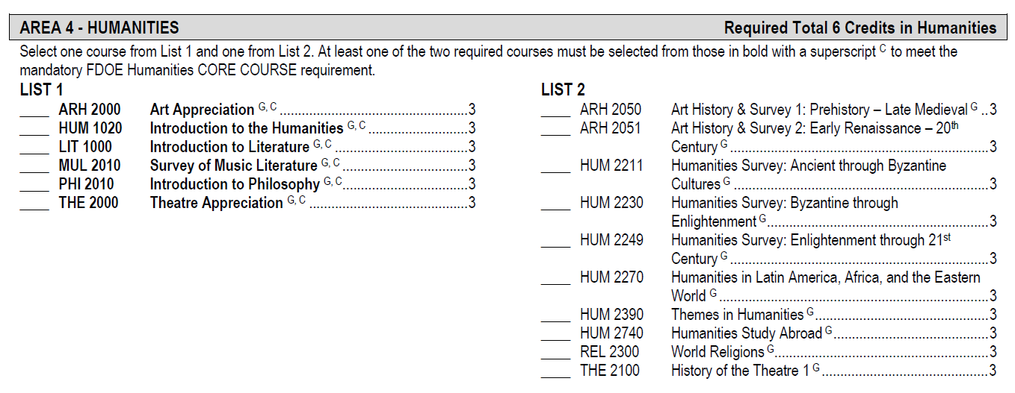
Overview of AA Requirements
Area 4 – Humanities - Must take a class from each list.
Suggestions: Intro to Humanities (HUM 1020) and World Religions (REL 2300)

Slide 8
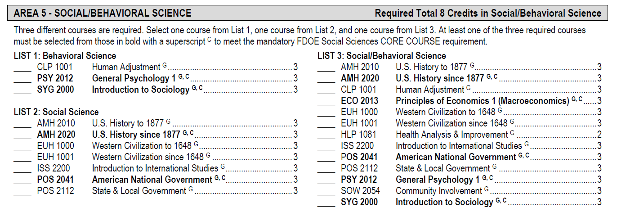
Overview of AA Requirements
Area 5 – Social/Behavioral Science - Must take a class in each list.
Area 6 – Electives – Must take 8 classes of electives.

Slide 9
EFSC Courses = High School Credit
EFSC COURSE HIGH SCHOOL CREDIT
ENC 1101 COMP. 1 1 English credit
ENC 1102 COMP. 2 1 English credit
SPC 2608 SPEECH 0.5 Performing/Fine Arts credit
All Math classes on the general requirement list 1 Math credit
MAT 1033 Inter. Alg. 0.5 Math Credit
All Life/Bio Sciences 1 Science credit
All Physical Sciences 0.5 Science credit
(Physics 1 and 2 are 1 Science credit)
All Humanities 0.5 Elective credit
(LIT 1000 are1 English credit)
AMH 2010 & AMH 2020 combined 1 US History credit
POS 2041 Amer. Nat. Govt. 0.5 US Government Credit
ECO 2013 Prin. Of Econ 0.5 Economics credit
All other social science classes will count for .5 elective Social Studies credit in H.S.

Slide 10
How to look up EFSC Courses to register for:
Go to www.easterflorida.edu
Choose “Academics & Career Options”
Choose “Cass Schedule Search”

Slide 11
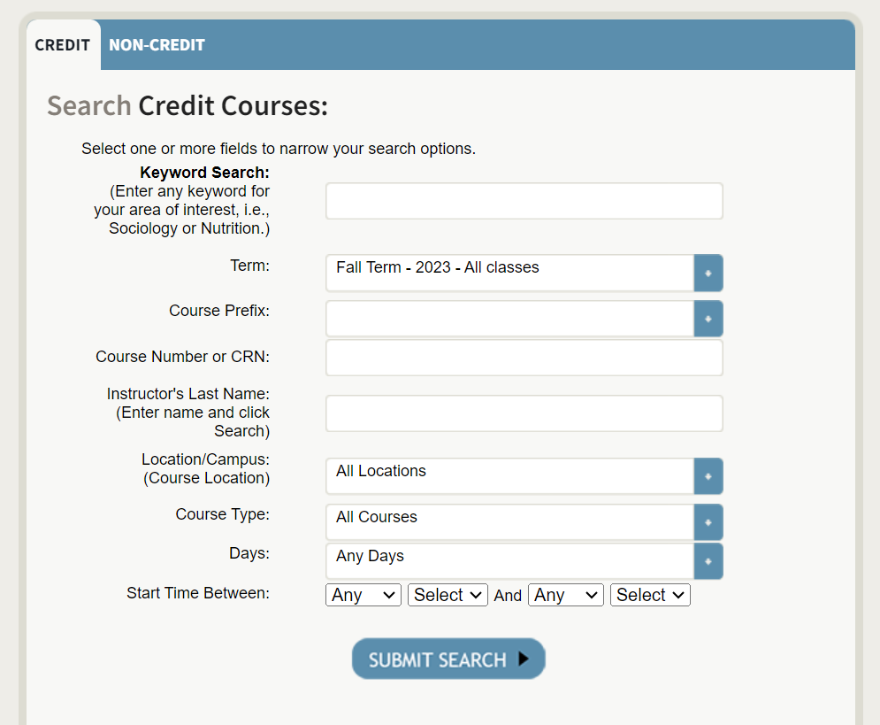
Class Schedule Search:
Fall/Spring
Dual Enrollment/Early College: Choose 16-week semester
Early Admissions: Choose any semester
Summer
Between 9th and 10th grade: Sessions C & D
Dual Enrollment: up to 1 course
Early College: up to 2 courses
Early College 10th Grade Bus Riders: 10:50am-12:05pm (one class MW and one class TR)

Slide 12
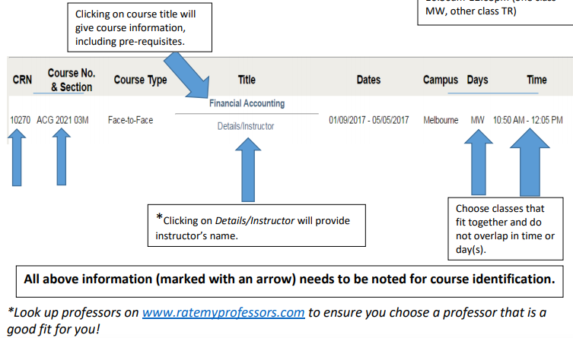
Class Schedule Search:

Slide 13
Registration Updates as of September 2023:
First - There will be NO flexibility with deadline dates. Deadlines are hard deadlines! This is an Eastern Florida State College rule.
Registration will now be online (no more Dropbox!) and MUST take place on Viera’s campus or EFSC’s campus under the guidance of School Counselors and/or EFSC advisors.
Only classes on the approved list will be allowed.
Students must have a signed DERF to register on an EFSC campus. Please see EFSC website for Lab times.
Students will not be allowed to register themselves at home.
There is no longer Add/Drop week in January for Dual Enrollment students. Therefore, it is no longer possible to wait for first semester grades to qualify for Dual Enrollment.
Please see Eastern Florida’s website for information: https://www.easternflorida.edu/admissions/dual-enrollment/registration/

Slide 14
Dates for Spring Registration 2024
Deadlines:
Monday, October 9th: Last day to submit a dual enrollment application to EFSC and to submit test scores to Viera
Thursday, October 19th: Last day to complete any outstanding admissions requirements, such as new student orientation and advising appointments.
Monday, November 6th: EFSC Spring Registration opens.
Friday, November 17th: LAST DAY for SPRING REGISTRATION!
Monday, December 4th to Thursday, December 14th: Spring Schedule Change Window for Dual Enrollment Students. Only students with EXISTING registrations can make schedule changes with the approval of a School Counselor.

Slide 15
EFSC Class Registration
There will be a 2-week window in November for Spring Class Registration and TBA for Fall & Summer Class Registration.
If you don’t register by the end of that 2-week window, you WILL NOT be in classes for the next term. We will change your schedule to bring you back on Viera’s campus.
There will be a 2-week Add/Drop window in December for Spring Class Registration and TBA for Fall & Summer Class Registration.
Only students with EXISTING registrations can make schedule changes with the approval of a School Counselor.

Slide 16
What to Bring to Registration
You need the Course Code, Course Title, CRN Number, and Section # for each class you are registering for. Bring backup classes for each class as well.
The class schedule was released on October 9th for you to see what course fits your schedule.

Slide 17
Remember the Bell Schedule when registering for classes at EFSC!
Your classes at EFSC cannot interfere with your classes here at VHS. You will be marked tardy or absent.
You will have one off period per EFSC class you take.
For example, if you are taking 2 college courses, you can have 1st and 2nd period off. A student can register for 1 class on Monday Wednesday from 8-9:15 and one class on Tuesday Thursday from 8-9:15. They will make it back in time for 3rd period.
We suggest a 30-minute commute estimate between EFSC and VHS.
Transportation to and from EFSC and VHS is the student’s/parents’ responsibility (except for the 10th grade Early College bus riders)

Slide 18
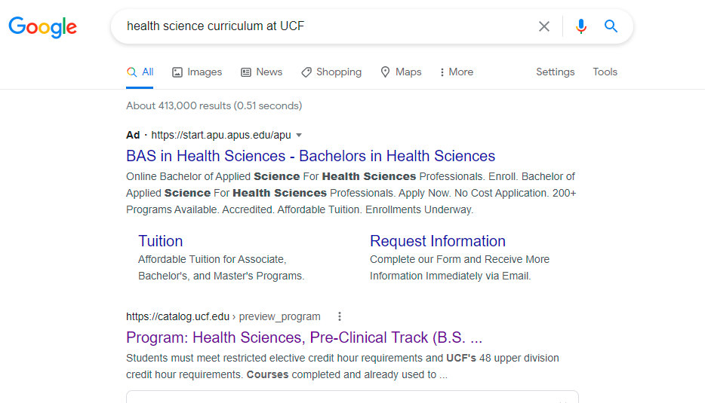
Matching EFSC Courses with state universities in FL
First, talk to your EFSC Advisor!!
Google the school(s) you’re thinking about attending and the program you want to major in.
Click on the program link.

Slide 19
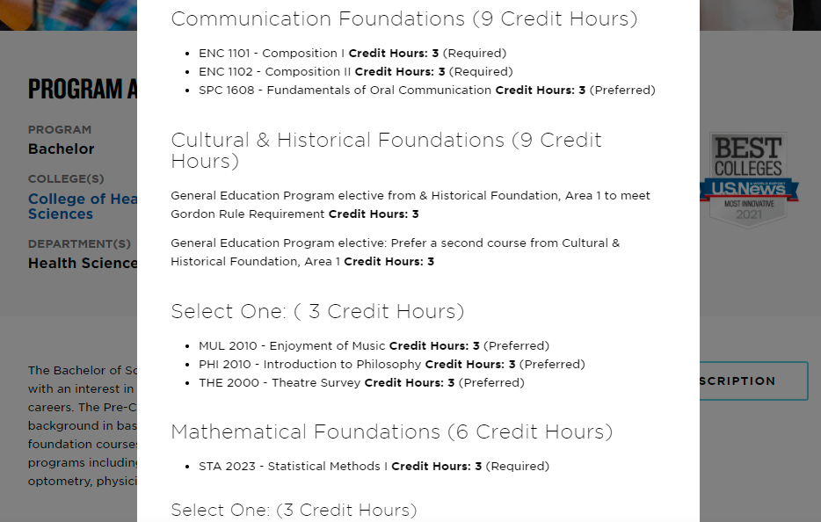
Matching EFSC Courses with state universities in FL
Here you can see exactly what courses are needed for this program.
If the course codes match your EFSC class course code, it will be a direct transfer to meet that requirement for a Bachelor’s.

Slide 20
Meet your Guidance Team
Academies Marianna Angland
A-C Kathryn Hollingsworth
D-H Madeline Contreras
I-M Angela Nellis
N-Se Christine Guanu
Sh – Z Michelle Formoso
College & Career Shawna Wells-Booth
Contact your School Counselor or the College Career Specialist for further questions or to make an appointment!

Slide 21
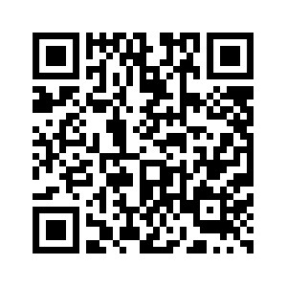
Registration Appointment Signup!

