Slide 1
Viera High School Curriculum Fair
January 25, 2024
Home of the Hawks!

Slide 2
Purpose of Evening:
Learn about the graduation requirements for successful completion of high school.
Explore exciting courses and programs that VHS has to offer.
Learn about academies and choice programs that VHS has to offer.
Familiarize yourself and your student with VHS campus and staff.
Ensure a successful transition to high school.

Slide 3
Parent Communication & Student Support
Weekly emails from Principal
Check FOCUS and review your student’s FOCUS page
Peer Tutoring Program
Tuesday, Thursday after school
Peer tutors tutor in classrooms while being supervised by teachers
Tutors earn service hours
We encourage you to speak to your child’s teacher and counselor with any concerns!

Slide 4
Guidance Department
Each counselor has 9-12th grade and is divided alphabetically by student’s last name.
Business & ACAD Marianna Angland
A-C Kathryn Hollingsworth
D-H Madeline Contreras
I-M Angela Nellis
N-Se Christine Guanu
Sh – Z Michelle Formoso
College & Career Shawna Wells-Booth
Guidance Clerks Joanna Ramsey & Kelly Dedrick
Notes:
If you have any additional questions or would like to speak with your child’s counselor one on one, we would love to accommodate you. Please feel free to copy down the name of your child’s counselor and their phone extension. We would be happy to schedule an appointment for you.

Slide 5
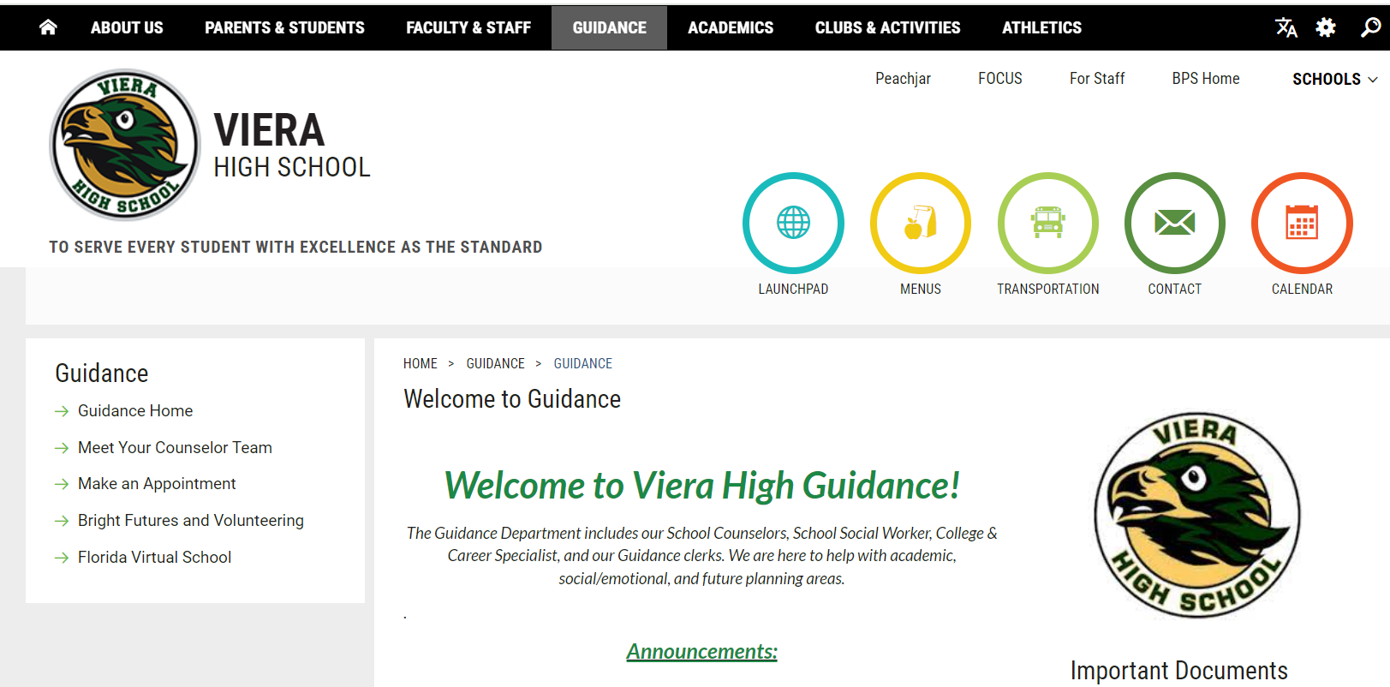
Guidance Website
We update weekly with announcements!

Slide 6
Graduation Requirements & Grade Promotion

Slide 7
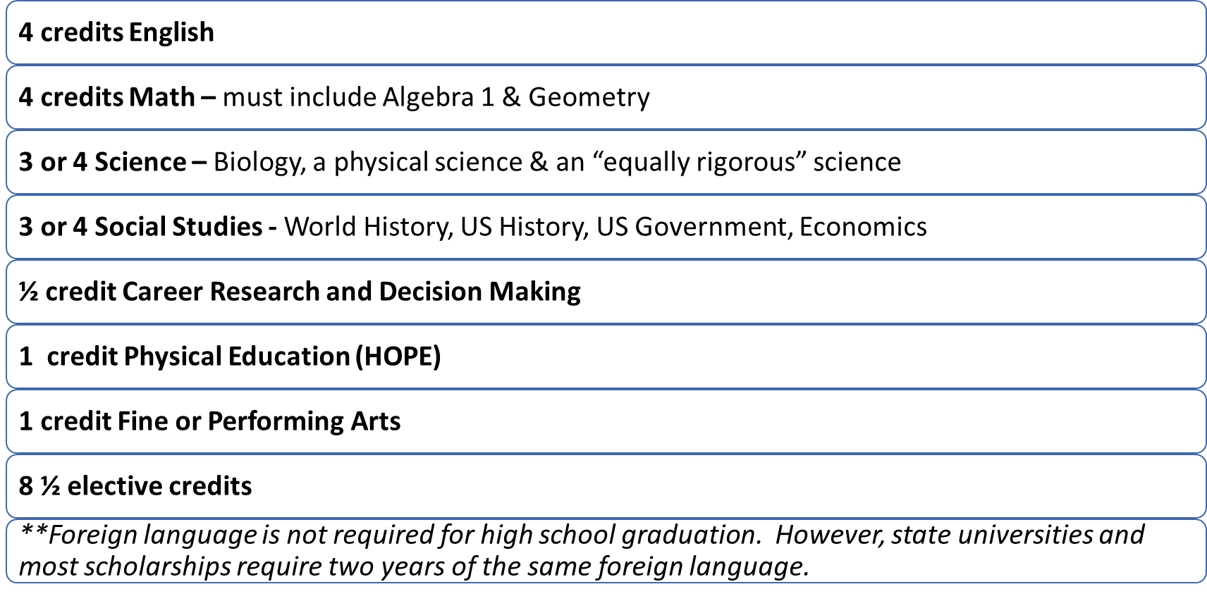
Graduation Credit Requirements

Slide 8
Additional Graduation
Requirements
Minimum Unweighted GPA
2.0
Testing
Passing score on Grade 10 FAST ELA OR SAT/ACT concordant score
Passing score on Algebra 1 EOC OR SAT/ACT/PSAT concordant score
Online course
No longer required as of July 2023.
Rigorous Coursework Requirement
3 credits in honors, AP, or Dual Enrollment courses
OR
3 credits in a sequential Career & Technical Program

Slide 9
Grade Promotion
9th grade to 10th:
Must have 5 credits
10th grade to 11th:
Must have 11 credits
2 English courses completed
2 Math courses completed
11th grade to 12th:
Must have 18 credits
3 English courses completed
3 Math Courses completed
Works differently than earlier grades where students can be retained due to credits but still continue to take their cohort year’s required classes. Credit retrieval will be necessary.

Slide 10
Earning Grades in High School
Students must pass each semester in order to earn credit for the class.
The only exceptions are the 4 year-long courses: Biology, Algebra 1, Geometry & US History. (We’ll look at next slide!)
Example:
If the student takes Art, 1st semester earns an “F” and 2nd semester earns an “A,” these two semesters are not averaged together. They are separate grades on the transcript. Therefore, the student would only have ½ of their Art requirement fulfilled.

Slide 11
How are semester grades averaged?
All high school courses are separated into semester grades.
The only exceptions are the End of Course classes: Algebra 1, Geometry, US History, and Biology.
Semester grades are averaged using:
Quarter 1 – 40%
Quarter 2 – 40%
Semester Exam – 20%
End of Course full year grades are averaged using:
Semester 1 – 35%
Semester 2 – 35%
EOC Exam – 30%

Slide 12
GPA Grade Point Average
GPA in the Freshman year is the most important year.
GPA is calculated using a 4-point scale system associated with the letter grade.
High School classes taken in middle school factor into their overall GPA.
If your student took a high school class in the middle school and received a “C ”average or lower, the student can retake the course at the high school for a better grade (grade forgiveness).

Slide 13
Required Classes by Grade

Slide 14
Freshman Required Classes
English 1
Biology
World History
Algebra 1 (Geometry can be taken if Algebra 1 is completed)

Slide 15
Sophomore Required Classes
English 2
Geometry (Higher 3rd Math can be taken if Algebra 1 or Geometry are completed)
Physical Science or Chemistry
US History

Slide 16
Junior Required Classes
English 3
Economics (1 semester) & US Government (1 semester)
3rd EQ (Equally Rigorous) Science
Math

Slide 17
Senior Required Classes
English 4
4th Math if needed
4th Science or Social Studies class

Slide 18
Elective Requirements
Career Research
Financial Literacy
HOPE (Health Opportunities through Physical Education)

Slide 19
Bright Futures

Slide 20
Bright Futures Scholarship
The biggest and BEST scholarship to aim for if your student is planning to go to a Florida public university!
Florida Academic Scholar – 100% Tuition Paid
3.5 weighted GPA in 16 credits of academic courses
4 English
4 Math
3 Science
3 Social Studies
2 Foreign Language
1340 SAT or 29 ACT Composite or 96 CLT
100 hours volunteer OR 100 hours paid work OR 100 hours combined
Florida Medallion Scholar – 75% Tuition Paid
3.0 weighted GPA in 16 credits of academic courses
4 English
4 Math
3 Science
3 Social Studies
2 Foreign Language
1210 SAT or 25 ACT Composite or 84 CLT
75 hours of volunteer OR 100 hours paid work OR 100 hours combined
Notes:
You have seen information regarding the Bright Futures Scholarships since you were in 7th grade. Some requirements have changed: test scores have gotten a bit higher and more volunteer hours are required.
However, the GPA required has not changed, nor have the courses required. It is important that you maintain your GPA and take the courses required for each of the Bright Futures scholarships.
How does your GPA compare with the required GPA’s listed?
Are you taking the necessary classes for the scholarships?

Slide 21
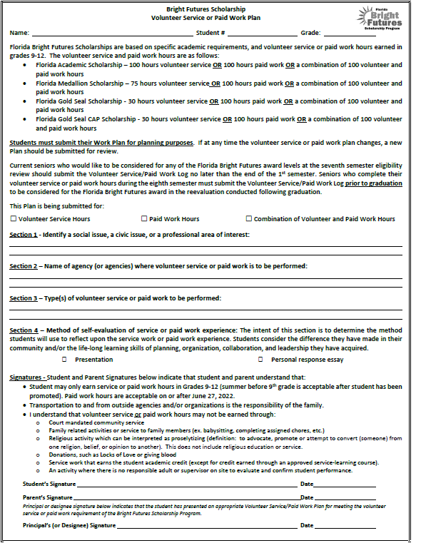
Bright Futures Scholarship Paperwork
Volunteer Service Work Form – approval before starting volunteering!
Hours can be accumulated beginning the summer before a student’s 9th grade year
Access the form through the VHS Guidance Webpage and in the Guidance lobby

Slide 22
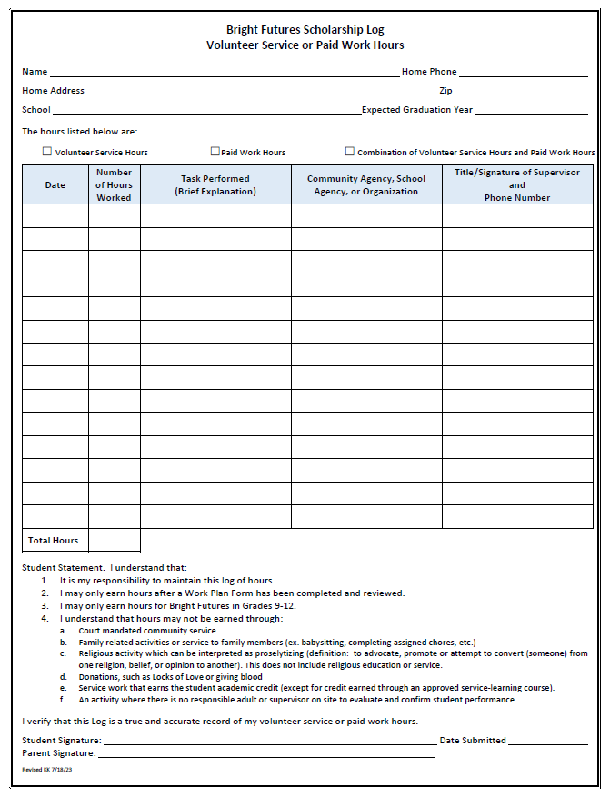
Bright Futures Scholarship Paperwork
Bright Futures Hours Log – supervisor must sign off on hours.
After the work plan has been approved then students can begin logging hours.
Student will need to write a paragraph regarding their experience on the back of the log sheet.

Slide 23
Advanced Class Options

Slide 24
What is AP? Advanced Placement Classes
College-level courses taught in high school classrooms by high school teachers
These courses require outside of the classroom work.
Courses reflect what is taught in top introductory college courses.
Students take AP exams at the end of the course to measure their mastery of college-level work and to earn college credit.
Students’ grade in the class earns the high school credit.

Slide 25
AP Courses offered at VHS
English
AP English Language (11)
AP English Literature (12)
Math
AP Calculus AB (11,12)
AP Calculus BC (11,12)
AP Statistics (11,12)
Science
AP Biology (11,12)
AP Chemistry (11,12)
AP Environmental (10-12)
AP Physics 1 (11,12)
AP Physics 2 (11,12)
Social Studies
AP Human Geography (9-12)
AP US History (10-12)
AP US Gov (11,12)
AP Psychology (11,12)
AP World History (9-12)
Electives
AP Music Theory (11,12)
AP Computer Science
AP Studio Art 2D, 3D (11,12)
AP Spanish Language (11,12)
AP Spanish Literature (11,12)
AP Capstone
AP Capstone Seminar (10,11)
AP Capstone Research (11,12)

Slide 26
Is AP for me?
Student Interest and Desire to Take an AP Course
Select AP courses in their areas of interest.
Encourage your student to take the most rigorous courses that they can be successful in.
Work Ethic
Is your student willing to put in the time outside of school to prepare for these courses and complete coursework?
Academic Ability
Students will be challenged with reading, speaking, and writing at the college level in AP courses
Student Goals Post High School
What majors are you considering? What career excites you?

Slide 27
Dual Enrollment
Students first eligibility is the summer after 9th grade.
Students must have a 3.0 GPA or higher for the previous semester and every semester enrolled in dual enrollment classes.
Students who have a 3.0 GPA or higher after their first semester of 9th grade will get an invitation to attend the Early College program for their 10th grade year.

Slide 28
What is Dual Enrollment?
These are classes taught by college professors on a college campus or online.
Your student is expected to act like a college student and take on the responsibility of that.
Your student is going above and beyond high school work – which includes reading, analyzing, and writing at a higher level. Be prepared for the extra time and effort this involves.
The grades in these college classes will affect their college GPA after high school.

Slide 29
Clubs on Campus

Slide 30
Opportunities to Get Involved
Book Club
BETA Club
Art Club
Speech/Debate
Band and Orchestra
Future Problem Solvers
Drama / Thespian Club
FCA
FCCLA
FL Scholastic Press Association
French Club
Hawk Buddies
HOSA
JROTC
Model Senate
Mu Alpha Theta
National Honors Society
Ocean Bowl
Robotics
Spanish Club
Student Government
Viera Literary Society
Yearbook

Slide 31
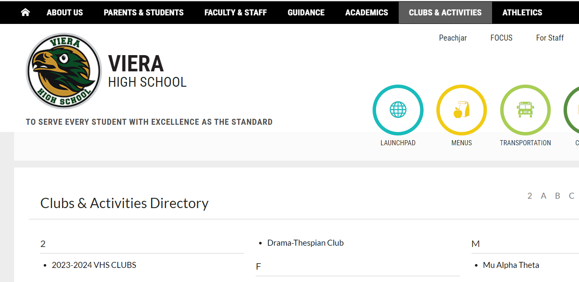

Slide 32
Choice Programs at Viera High School

Slide 33
Students who are zoned for VHS already:
Construction
Sports Medicine
Academy of Communication, Art & Design – Four Years
ALL of these programs have Industry Certification exams.

Slide 34
How do I get my student into these programs if I’m already zoned?
Some programs have applications and some can be chosen as electives without an application. Please look at VHS registration information when it comes to your student’s middle school!
The only EXCEPTION is the two academies, which you will need to speak to Mrs. Armstrong or Mrs. Angland about applying for.

Slide 35
How do I attend Viera if I am NOT Zoned for VHS? Apply for one of these:
Dental Aide
TV Production
Early Childhood
Web Application Development & Programming
Academy of Business and Finance – Four Years
ALL of these programs have Industry Certification exams.

Slide 36
Application for Choice Programs for students NOT ZONED for VHS: Dental Aide, TV Production, Early Childhood, Web Application Development and Programming and the Academy of Business and Finance
Choice application only if you are not zoned for VHS.
https://www.brevardschools.org/site/Default.aspx?PageID=2381
Follow the link and complete the application online. There is no longer a fee. You will be asked to set up a dashboard profile.
Application Window January 8th - February 23rd

Slide 37
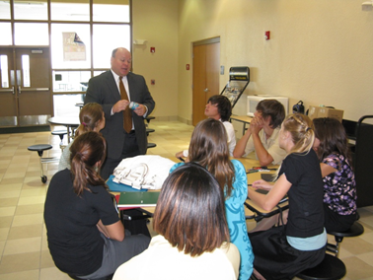
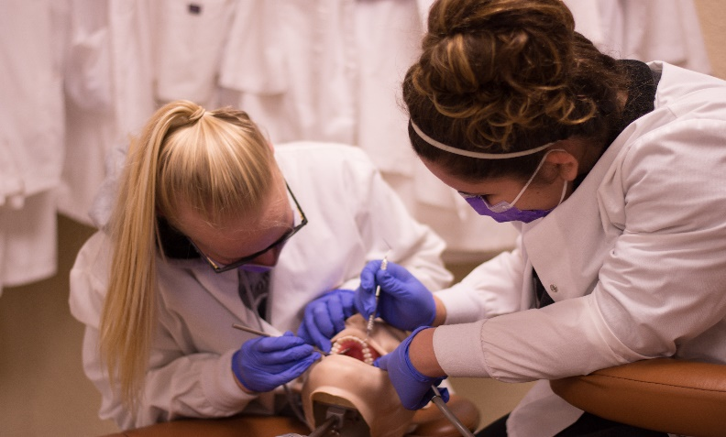
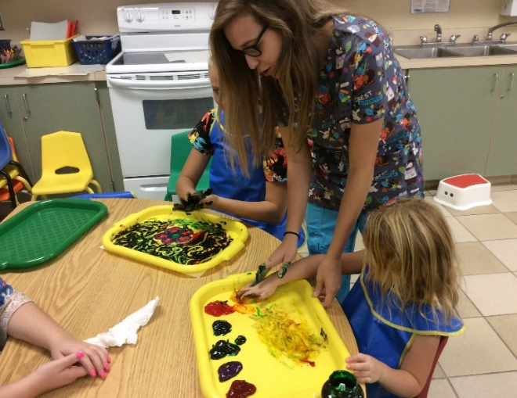
Viera High School Choice Programs
Academy of Business & Finance
TV Production
Dental Aide
Web Programming
Early Childhood

Slide 38
Academies at Viera

Slide 39
Academy of Business & Finance
Premier Academy in the district
Recognized as one of the highest industry-certified rates in the district
Microsoft Certification - Word, Power Point, Excel
Accounting Certification – Quick Books
English 1 Honors – Cohort
World History Honors - Cohort
Academy CTE Elective - Cohort
Math, Science, & 2 Electives – Non-Academy
9th Grade Schedule:

Slide 40
Academy for Communication, Art & Design
Premier Academy in the District
Recognized as the highest industry-certified rates in the district
Adobe Certifications- Photoshop, Premiere Pro, Illustrator, Dreamweaver, After Effects, etc.
9th Grade Schedule:
World History Honors - Cohort
English 1 Honors – Cohort
Academy CTE Elective - Cohort
Math, Science, & 2 Electives – Non-Academy

Slide 41
College & Career Opportunities within Academies
Real World Exposure
Project Based Learning
Life Learning Skills
Community Service
Industry Related Workshops
Industry Related Guest Speakers
Yearlong or Summer Internships
College and State University Campus Tours

Slide 42
Benefits of the Academies Program
Cover Letter and Résumé Writing Skills
Interviewing Skills
Leadership Skills
Mock Interviews
Leadership and Team Building Field Trips
Fundraising Events
Volunteer Opportunities
Competitions
Portfolio Building
Professional Dress Guidance
Cohort

Slide 43
Thank you for attending!

