Slide 1
Welcome to Junior Classroom Lesson 23-24
Viera High School
Madeline Contreras, MA, School Counselor

Slide 2
Guidance Introduction
Academies Marianna Angland
A-C Kathryn Hollingsworth
D-H Madeline Contreras
I-M Angela Nellis
N-Se Christine Guanu
Sh – Z Michelle Formoso
Social Worker Michele Becerra
College & Career Shawna Wells-Booth

Slide 3
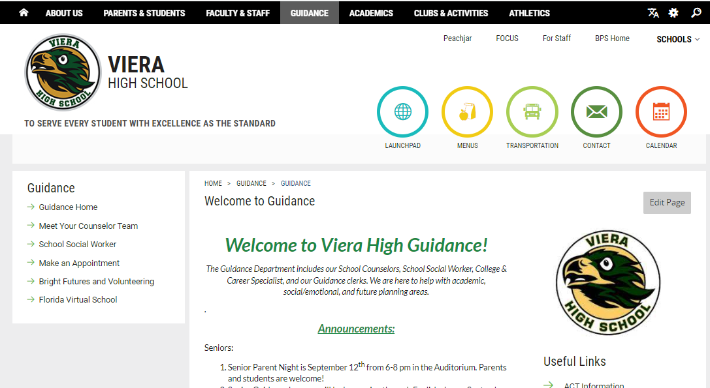
Guidance Website!

Slide 4
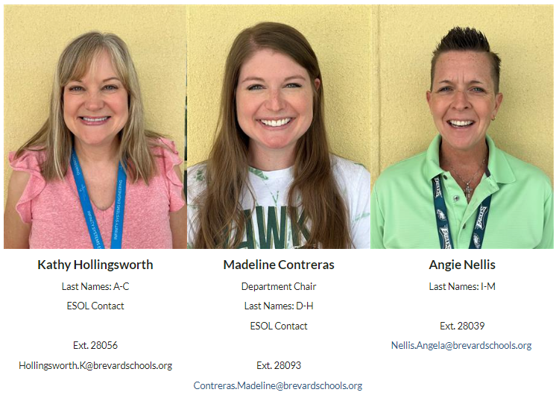

Slide 5
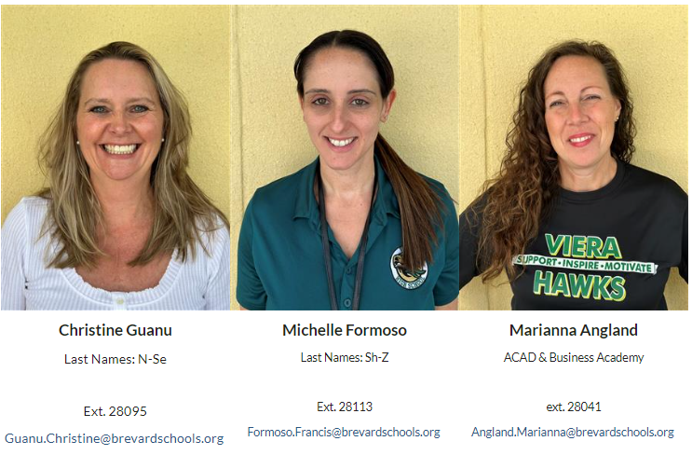

Slide 6
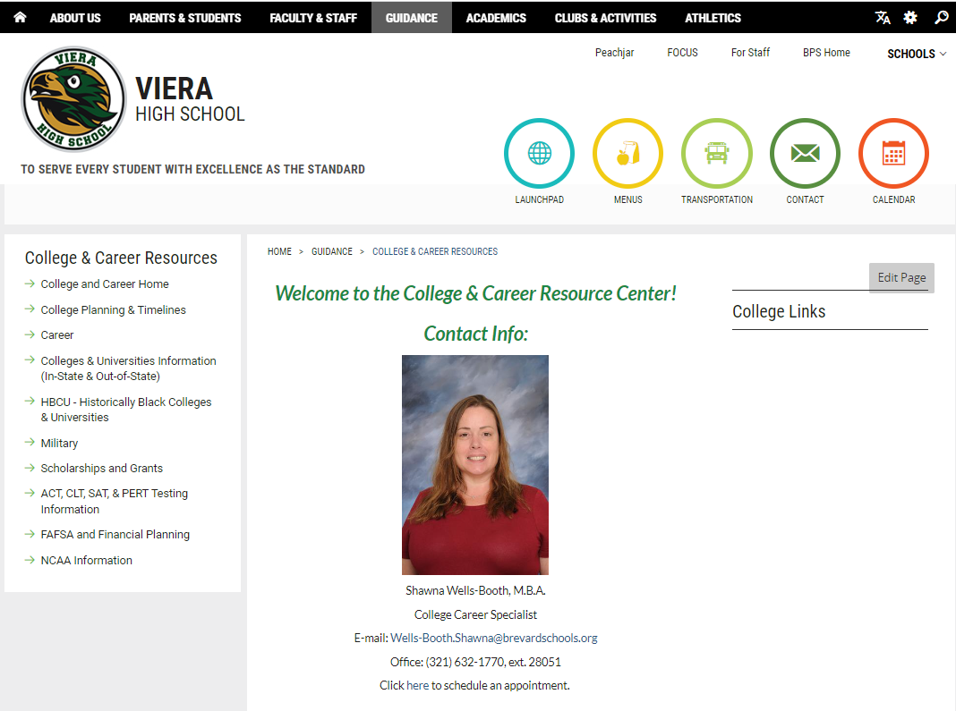
College & Career Resource Center
Drop down when you hover over the Guidance tab.

Slide 7
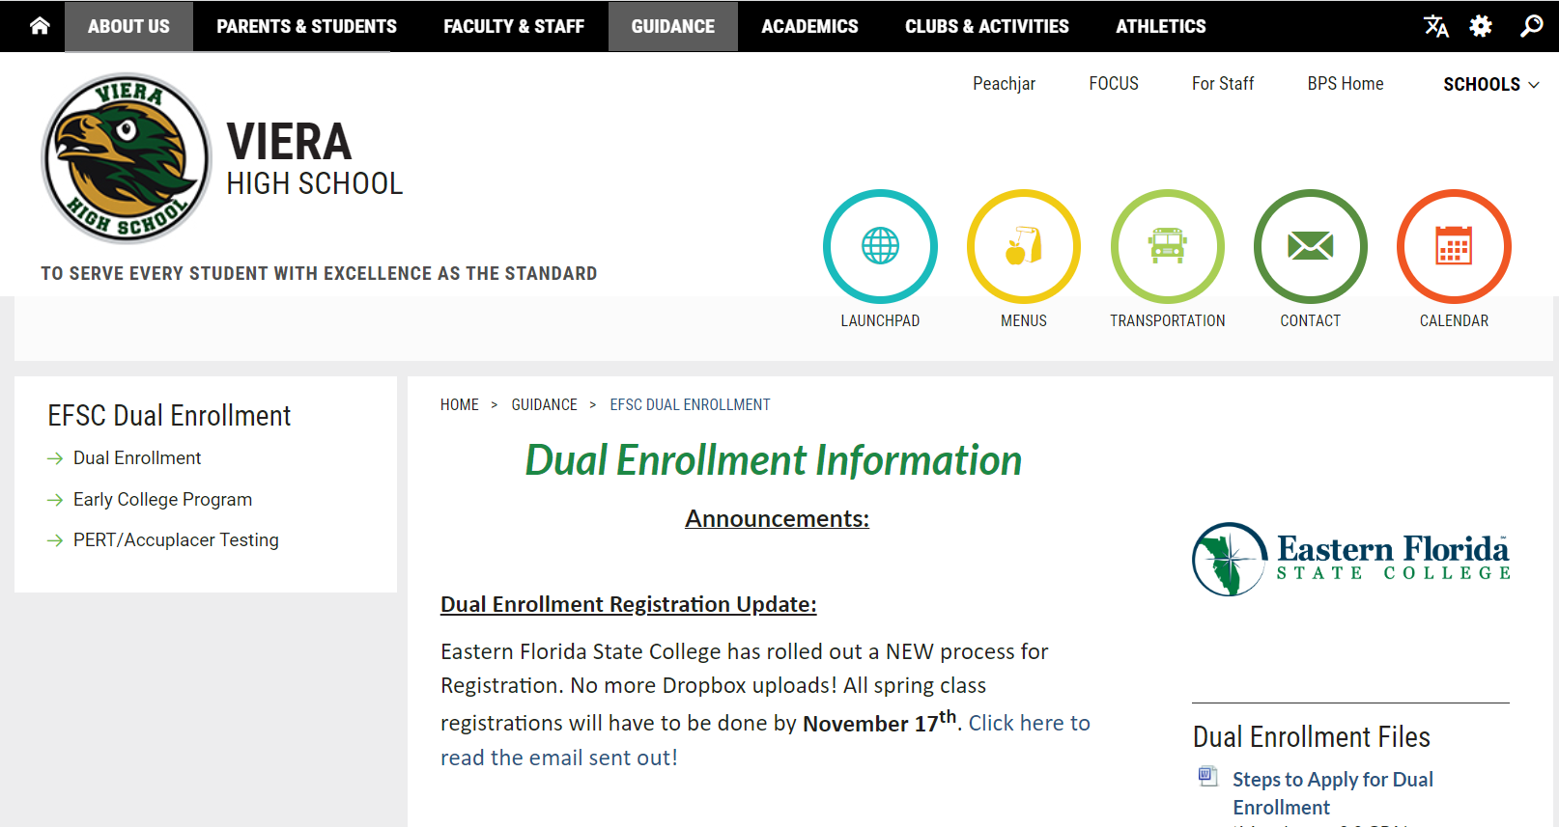
EFSC Dual Enrollment Website
Drop down when you hover over the Guidance tab.

Slide 8
Agenda
Dual Enrollment Updates
Graduation Requirements & Updates
HOPE Requirement
Bright Futures
FLVS Off Campus Note
SAT School Day
Semester Grades
Starting College Applications

Slide 9
Note about FLVS Off Campus
If students have 1-3 “off campus” periods for FLVS classes, they MUST be enrolled in the same number of classes on FLVS as they have off periods from Viera.
Students must be enrolled in 7 classes no matter how many credits they have already earned and how many requirements they have already done.
We will be pulling students back to campus if they are not signed up for the appropriate number of classes on FLVS.
**The same goes for EFSC Off Campus periods as well.**

Slide 10
Dual Enrollment Updates
Monday, October 9th: Course Schedule opens to browse classes.
Monday, November 6th: EFSC Spring Registration opens.
Friday, November 17th: LAST DAY for SPRING REGISTRATION!
Monday, December 4th to Thursday, December 14th: Spring Schedule Change Window for Dual Enrollment Students. Only students with EXISTING registrations.

Slide 11
Dual Enrollment New Registration Process
Registration will now be online (no more Dropbox!) and MUST take place on Viera’s campus or EFSC’s campus under the guidance of School Counselors and/or EFSC advisors.
Only classes on the approved list will be allowed.
Students must have a signed DERF to register on an EFSC campus. Please see EFSC website for Lab times.
Students will not be allowed to register themselves at home.
There are 10 slots available every hour for the 3 days we have an EFSC advisor on campus. You will need to have the classes you want to register for.
You need the Course Code, Course Title, CRN Number, and Section # for each class you are registering for.

Slide 12
Grades for Junior Year
Keep up on grades! You will be applying to colleges using this year’s grades and GPA.
Senior Year courses should be just as rigorous or more for college acceptance.
Colleges will ask for a final transcript!

Slide 13
Credit Requirements for High School Graduation (26 credits)
4 credits English
4 credits Math – must include Algebra 1 & Geometry
3 or 4 Science – Biology, a physical science & an “equally rigorous” science
3 or 4 Social Studies - World History, US History, US Government, Economics
½ credit Career Research and Decision Making
1 credit Physical Education (HOPE)
1 credit Fine, Performing, or Practical Arts
8 ½ elective credits
**Foreign language is not required for high school graduation. However, state universities and most scholarships require two years of the same foreign language.

Slide 14
Additional Graduation Requirements
Minimum Unweighted GPA
2.0
Testing
Passing score on Grade 10 FAST ELA OR SAT/ACT concordant score
Passing score on Algebra 1 EOC OR SAT/ACT/PSAT concordant score
Online course
No longer required as of this July 2023.
Rigorous Coursework Requirement
3 credits in honors, AP, or Dual Enrollment courses
OR
3 credits in a sequential Career & Technical Program

Slide 15
HOPE Requirement
Complete the full year course
At Viera
Online – FLVS or BVS
Completion of two years in JROTC to waive the HOPE Credit
Participate in a JV or Varsity sport for two years (these must be played at a Florida state high school) to waive the HOPE Credit

Slide 16
How are semester grades averaged?
All high school courses are separated into semester grades.
The only exceptions are the End of Course classes: Algebra 1, Geometry, US History, and Biology.
Semester grades are averaged using:
Quarter 1 – 40%
Quarter 2 – 40%
Semester Exam – 20%
End of Course full year grades are averaged using:
Semester 1 – 35%
Semester 2 – 35%
EOC Exam – 30%

Slide 17
SAT School Day
All juniors take the SAT on March 1st during the school day.
Spring SATs are going digital.
If you want the score to count for Bright Futures, you must send it to one of the 12 public state universities in Florida.
Most college applications are due by November 1st and need test scores. Make sure you are studying and taking other SATs or ACTs during your junior year!

Slide 18
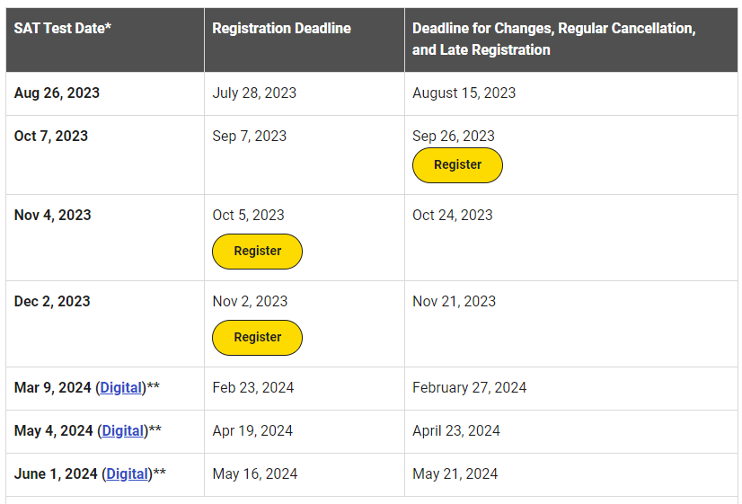
SAT Test Dates

Slide 19
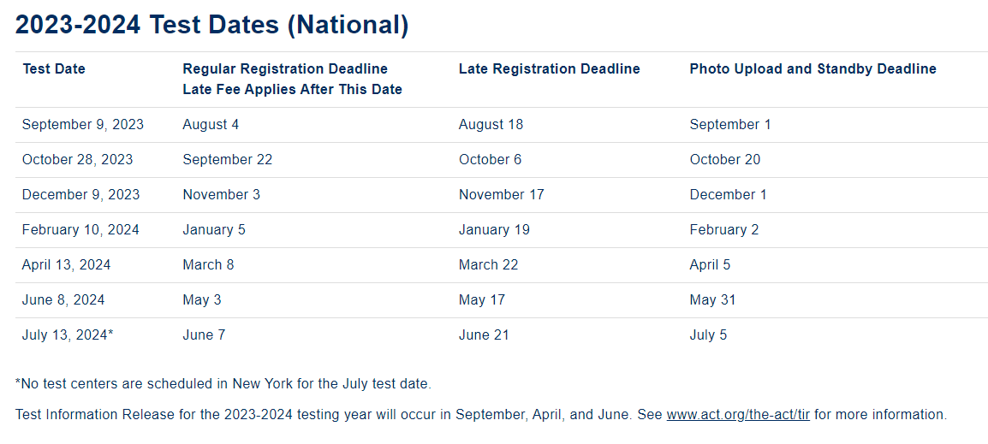
ACT Test Dates

Slide 20
What is the ACT Test Information Release?
Test Information Release for the 2023-2024 testing year will occur in September, April, and June. See www.act.org/the-act/tir for more information.
By purchasing Test Information Release (TIR), you will receive a digital copy of the multiple-choice test questions, your answers, a copy of your answer document, the answer key, and the conversion table used in determining your ACT scores. If you took the optional writing test, you will receive a copy of the writing prompt, the writing test scoring rubric, and your essay scores.
You can expect digital TIR materials to be provided within MyACT a few weeks after your score release. If you requested and were approved for alternate formats (April testing only), these materials will be prepared once your TIR report is available in MyACT and may take up to eight weeks for processing and shipping

Slide 21
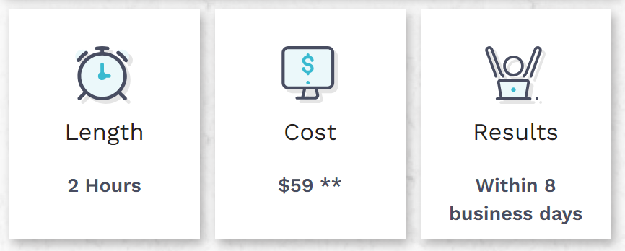
New College Entrance Test: CLT
The CLT – Online College Entrance Exam – Classic Learning Test (cltexam.com)

Slide 22
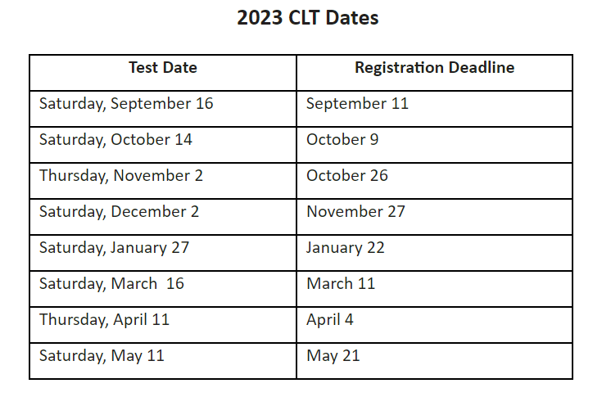
CLT Test Dates

Slide 23
Bright Futures Scholarship
Requirements
Forms
Test Scores
Volunteer Opportunities

Slide 24
Bright Futures Scholarship
The biggest and BEST scholarship to aim for!
Florida Academic Scholar – 100% Tuition Paid
3.5 weighted GPA in 16 credits of academic
courses
4 English
4 Math
3 Science
3 Social Studies
2 Foreign Language
1340 SAT or 29 ACT Composite or 96 CLT
100 hours volunteer OR 100 hours paid work OR 100 hours combined
Florida Medallion Scholar – 75% Tuition Paid
3.0 weighted GPA in 16 credits of academic courses
4 English
4 Math
3 Science
3 Social Studies
2 Foreign Language
1210 SAT or 25 ACT Composite or 84 CLT
75 hours of volunteer OR 100 hours paid work OR 100 hours combined

Slide 25
Bright Futures Scholarship
Gold Seal Scholar

Slide 26
Update on Volunteer v. Work Hours
Now there can be a combination of both volunteer and work hours.
There are NOW updated forms on our website and in our Guidance lobby.
You still NEED a “Volunteer Service or Paid Work Plan” approved before logging either kind of hours.
Once workplan is approved, then you may begin logging hours with the “Scholarship Log.”
All hours must be turned in one week prior to graduation! The last test you can take is the August 2025 SAT or ACT.

Slide 27
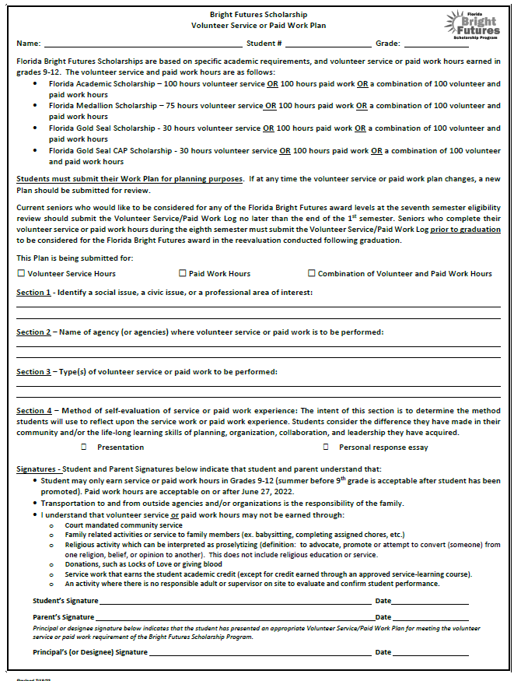
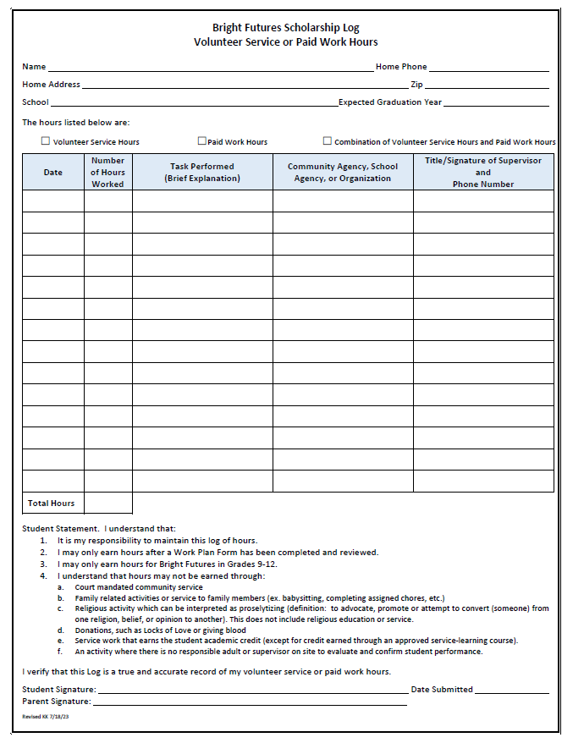

Slide 28
Bright Futures & Test Scores
You MUST send your SAT, ACT or CLT scores to one of the 12 public universities in Florida (like UCF) for Bright Futures to have access to your scores.
It enters the State Testing Bank this way. Bright Futures will not accept scores from our transcripts.

Slide 29
Out of State & Private Universities
Bright Futures is good for up to 5 years after you graduate IF you apply your senior year and are awarded it.
Private colleges and universities in Florida will use Bright Futures but it only pays what it would for a public university.
For example, if it is $300 per credit hour to attend UCF (public), that is what the student will receive towards Stetson University (private).

Slide 30
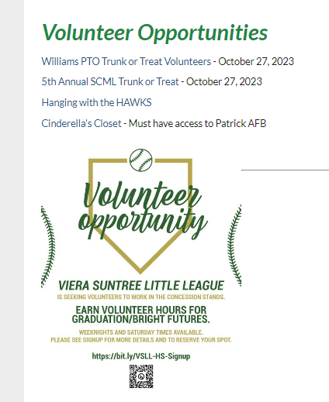
Volunteering Opportunities
Updated on our Guidance website, on the left-hand side under “Bright Futures and Volunteering”
https://www.brevardschools.org/Page/19633

Slide 31
Applying to Colleges

Slide 32
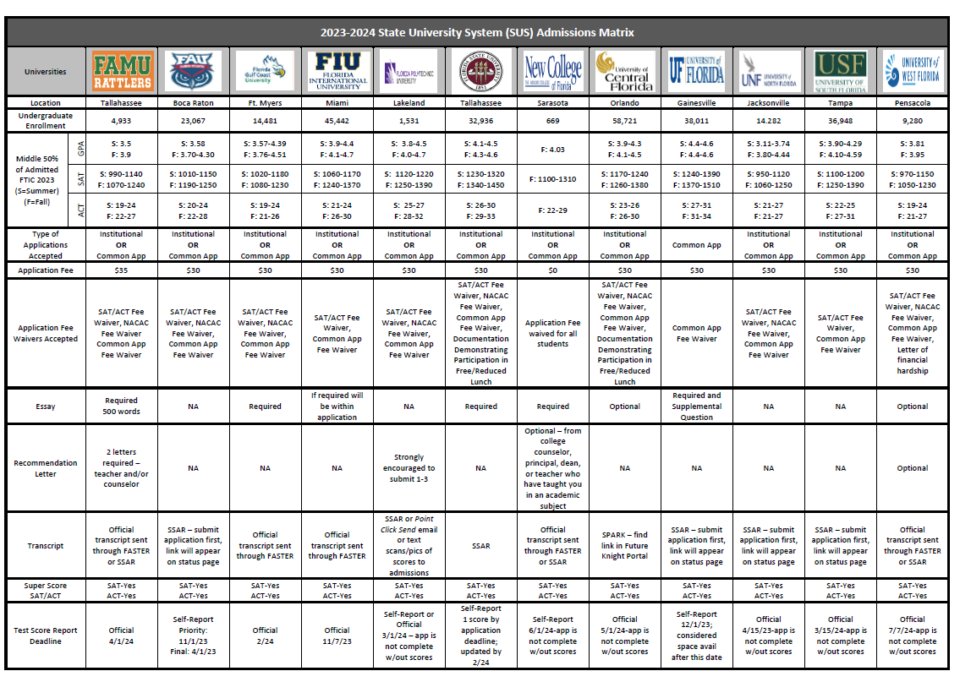
Florida State University System Matrix

Slide 34
Steps for College Application Process
Narrow college list to 5 or 6 schools and research their Undergraduate Admissions webpage.
Start Common App in August.
Turn in Transcript Request Form and Brag Sheet to Guidance for counselors to upload transcript and submit Letter of Recommendation (if needed) to Common App.
Submit official scores from CollegeBoard or ACT.
Submit Common App to each school and pay fee. Wait for emails from schools to create an account/portal with each school.
Link SSAR to each school. (SPARK is only for UCF)
Log in to school’s portal to make sure everything is submitted correctly.

Slide 35
COMMON APP
Most commonly used way to apply to colleges
One application entry and can send to multiple schools
Opens in August
Link counselors’ email directly for us to submit transcript, GPA, and Letters of Recommendation (Use ____@brevardschools.org)
***DO NOT wait for your counselor to submit their part to submit your application!***
Notes:
https://www.commonapp.org/apply/first-time-students
APPLICATION GUIDELINES AND ESSAY WRITING TIP:
https://www.commonapp.org/apply
US NEWS article The Common App: Everything you need to know
https://www.usnews.com/education/best-colleges/articles/common-app
Khan academy
https://www.khanacademy.org/college-careers-more/college-admissions/applying-to-college/college-application-process/a/filling-out-the-college-application-common-application-walkthrough
Basic tips for Common App
https://www.princetonreview.com/college-advice/are-you-ready-for-the-common-app
Tips on writing an activities list:
https://www.collegeessayguy.com/blog/guide-college-activities-list-common-app-example-application
https://blog.collegevine.com/how-to-fill-out-the-common-app-activities-section/
Tips on writing the common app essay
https://www.bestcolleges.com/blog/expert-common-app-essay-tips/

Slide 36
AA Potential Grads & Applying to University
Submit the “First-Year Student” application.
If you are SURE you are going to receive your AA, there is a box to check on your application or a form to fill out to signal you are going to be an AA grad.
New legislature came out that you can choose to apply test-optional if you are obtaining your AA by graduation.
Each school has different policies around this, so please check their website. Some may not offer scholarships because of needed test scores.
If you check “yes” and DO NOT obtain your AA, your offer can be taken back from the college or university. This is very serious!

Slide 37
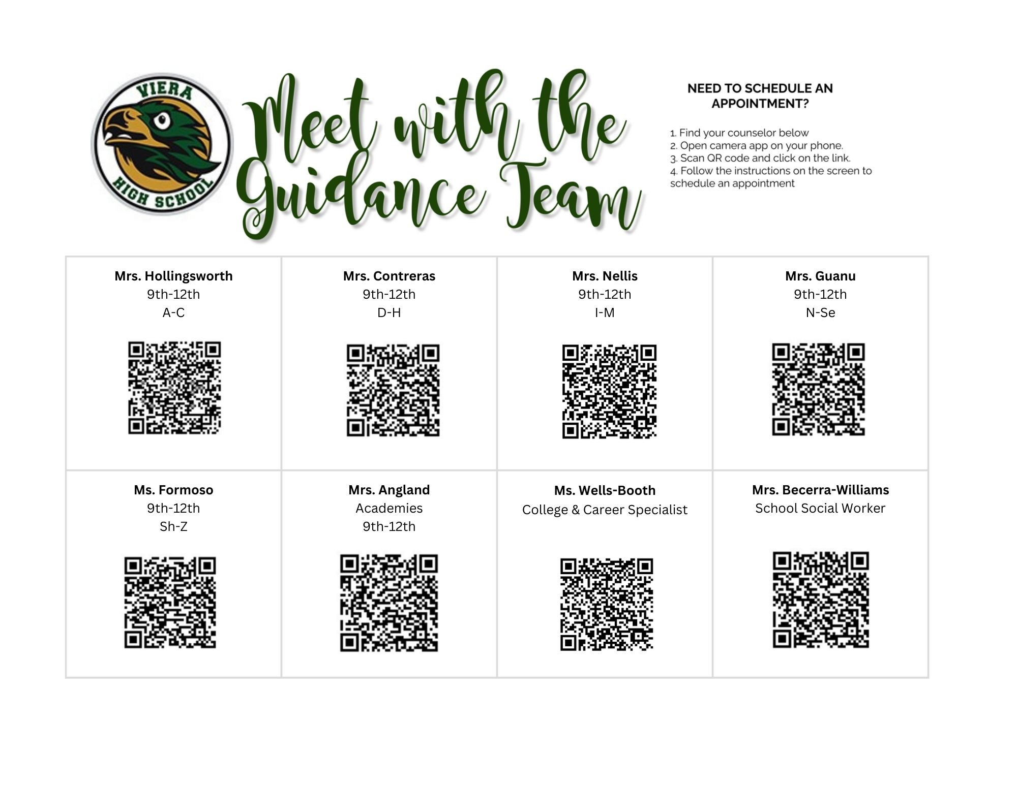

Slide 38
Questions?

Slide 39
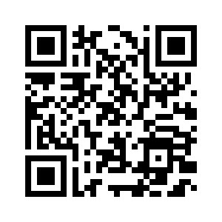
Junior Guidance Survey

