Slide 1
Welcome to Sophomore Parent Night 23-24
Viera High School
Madeline Contreras, M.A., School Counselor

Slide 2
Guidance Introduction
Academies Marianna Angland
A-C Kathryn Hollingsworth
D-H Madeline Contreras
I-M Angela Nellis
N-Se Christine Guanu
Sh – Z Michelle Formoso
College & Career Shawna Wells-Booth

Slide 3
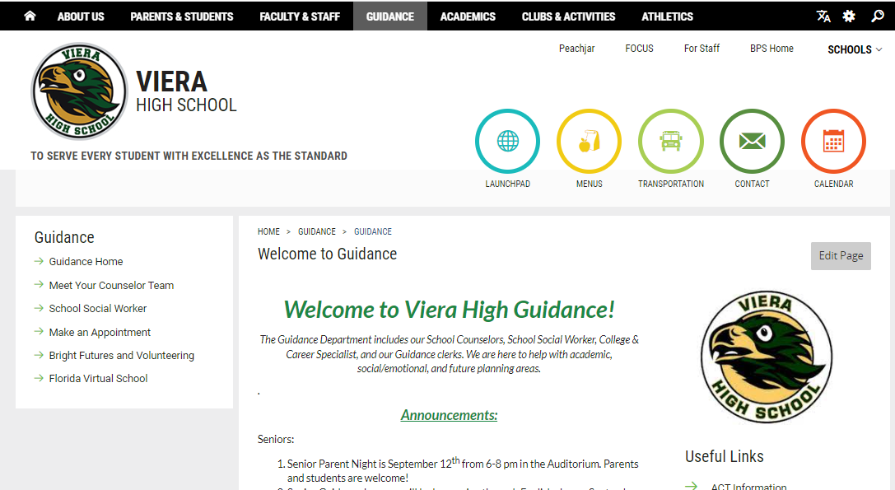
Guidance Website!

Slide 4
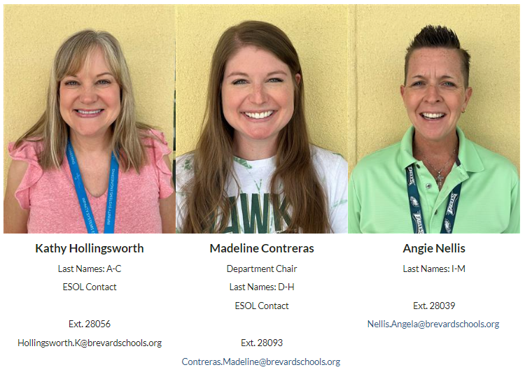

Slide 5
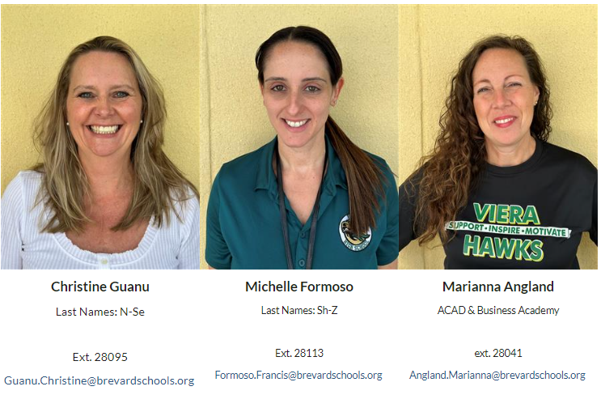

Slide 6
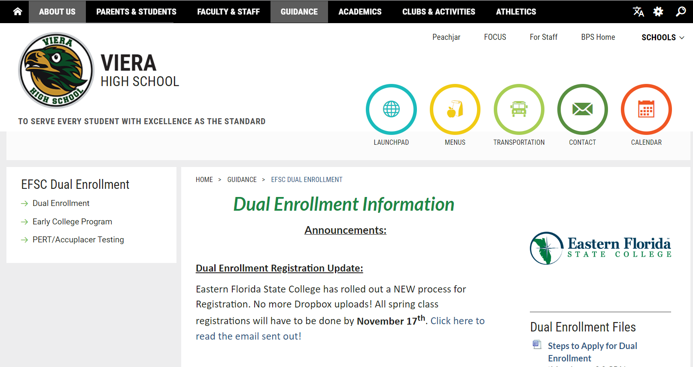
EFSC Dual Enrollment Website
Drop down when you hover over the Guidance tab.

Slide 7
Agenda
Required Classes by Grade
Graduation Requirements & Updates
Bright Futures
HOPE Requirement
AP, Dual Enrollment and FLVS
SAT School Day
Semester Grade Calculation
College & Career Presentation
School Counselor Presentation
Future Planning
Game of Life
Florida Shines
NCAA Eligibility

Slide 8
Credit Requirements for High School Graduation (26 credits)
4 credits English
4 credits Math – must include Algebra 1 & Geometry
3 or 4 Science – Biology, a physical science & an “equally rigorous” science
3 or 4 Social Studies - World History, US History, US Government, Economics
½ credit Career Research and Decision Making
1 credit Physical Education (HOPE)
1 credit Fine, Performing, or Practical Arts
8 ½ elective credits
**Foreign language is not required for high school graduation. However, state universities and most scholarships require two years of the same foreign language.

Slide 9
Additional Graduation Requirements
Minimum Unweighted GPA
2.0
Testing
Passing score on Grade 10 FAST ELA OR SAT/ACT concordant score
Passing score on Algebra 1 EOC OR SAT/ACT/PSAT concordant score
Online course
No longer required as of this July 2023.
Rigorous Coursework Requirement
3 credits in honors, AP, or Dual Enrollment courses
OR
3 credits in a sequential Career & Technical Program

Slide 10
HOPE Requirement
Complete the full year course
At Viera
Online – FLVS or BVS
Completion of two years in JROTC to waive the HOPE Credit
Participate in a JV or Varsity sport for two years (these must be played at a Florida state high school) to waive the HOPE Credit

Slide 11
Freshman Required Classes
English 1
Biology
World History
Algebra 1 (Geometry can be taken if Algebra 1 is completed)
Career Research (1 semester)

Slide 12
Sophomore Required Classes
English 2
Geometry (Higher 3rd Math can be taken if Algebra 1 or Geometry are completed)
Physical Science or Chemistry
US History
HOPE (Health Opportunities through Physical Education)

Slide 13
Junior Required Classes
English 3
Economics (1 semester) & US Government (1 semester)
3rd EQ (Equally Rigorous) Science
Math

Slide 14
Senior Required Classes
English 4
4th Math if needed
4th Science or Social Studies class

Slide 15
FOCUS How-To
New Messages
Grades & Assignments
How to get Report Cards
Grad Requirements
Test History
Communications

Slide 16
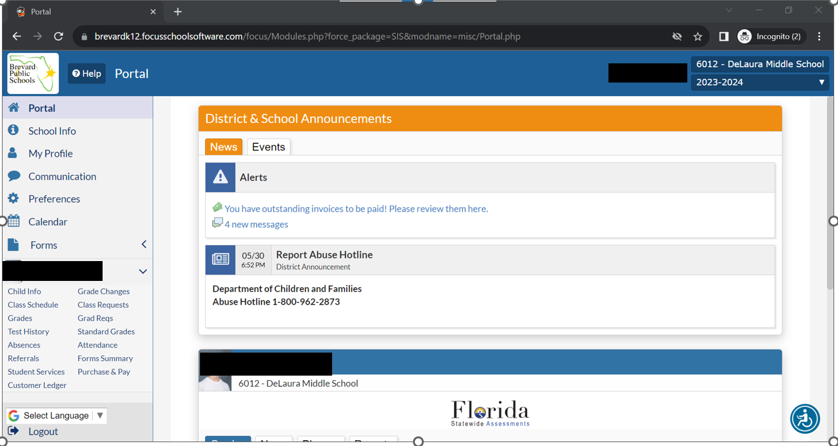
Click to change school year.
Click each to view.

Slide 17
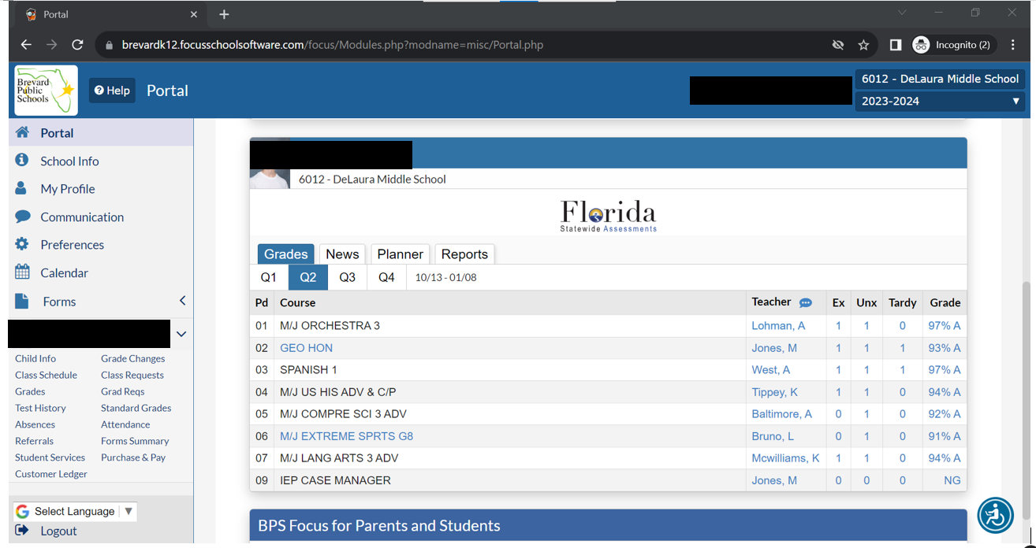
Grades
Click to see Assignments

Slide 18
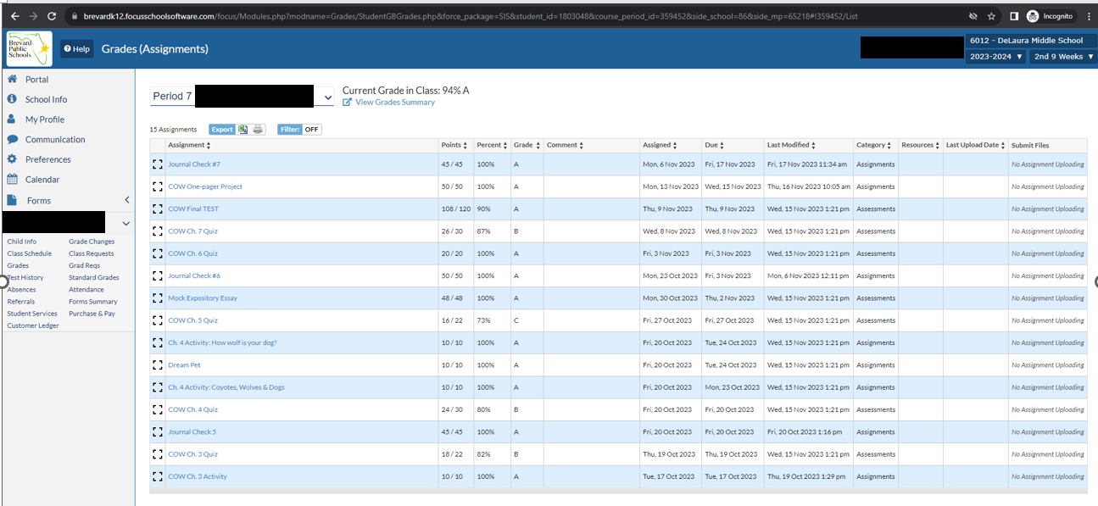
Assignments

Slide 19
How to get report cards:

Slide 20
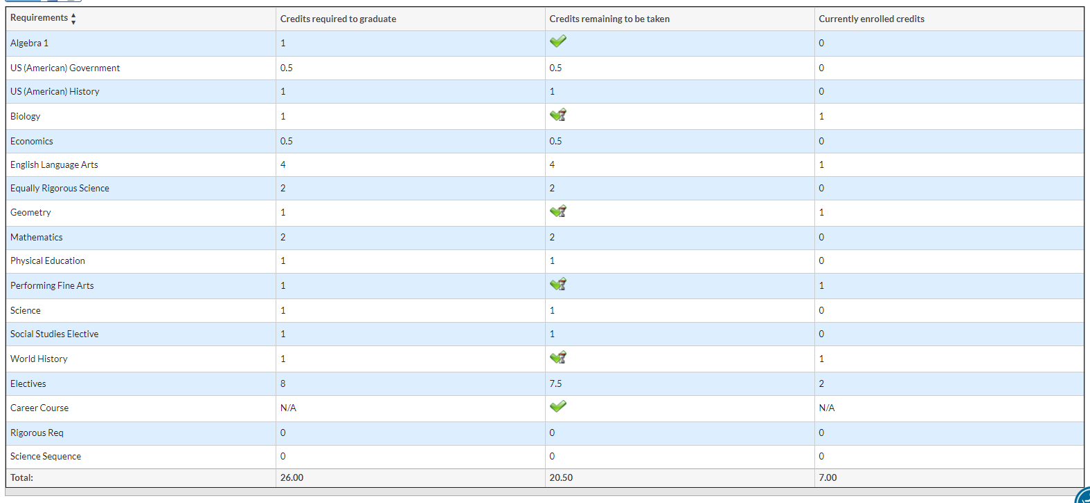
Grad Requirements Tab
HOPE
4th Science OR Social Studies.
Rigorous Coursework
Bio/Chem/Sci or Bio/Phy Sci/Sci

Slide 21
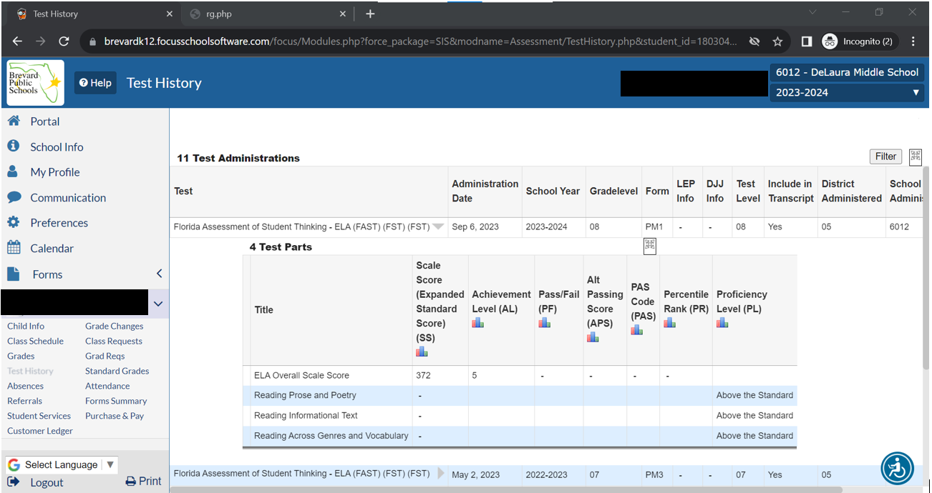
How to check test scores:

Slide 22
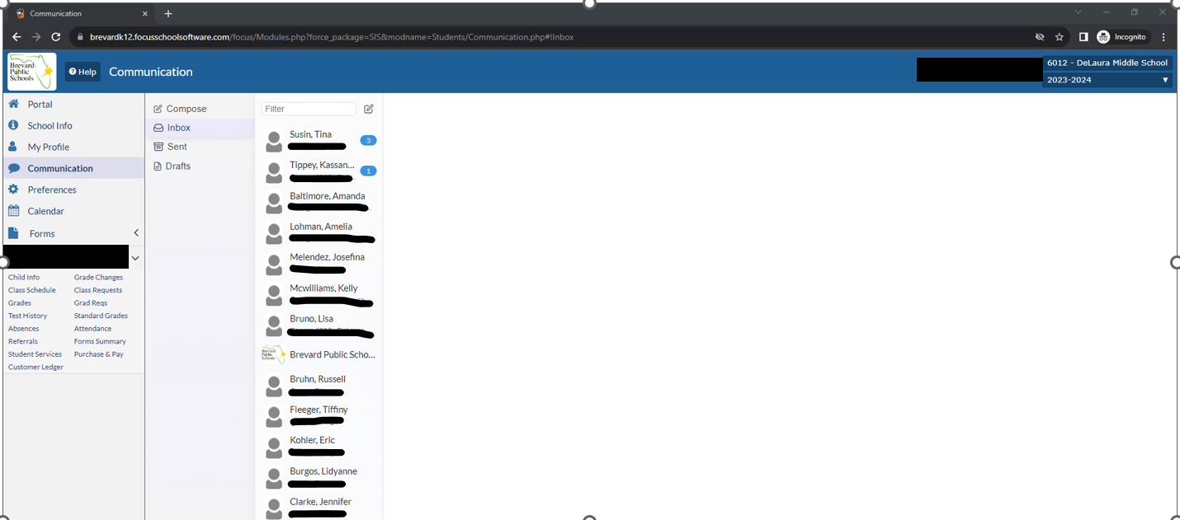
Communications Log

Slide 23
Other Class Options
AP Classes
Dual Enrollment
FLVS/BVS

Slide 24
Advanced Placement (AP) Classes
Earn high school credit from the grade in the class.
Earn college credit from the score on the AP exam (3 or higher).
Talk with your student’s current core teachers to see if an AP class is appropriate for the next school year!

Slide 25
AP Class Options
We have over 20 AP Classes offered in all major subject areas. Some examples:
AP English Composition & Literature
AP Precalculus, Calculus AB & Calculus BC
AP Physics 1 & 2, Chemistry, Biology, Environmental Science
AP World History, US History, Government and Macro/Micro-Economics
AP Capstone Seminar & Research

Slide 26
Eastern Florida State College (EFSC) Dual Enrollment
Student must have:
a 3.0 unweighted GPA to qualify
Reading & Writing PERT scores
A sheet with Steps to Dual Enrollment is available in Guidance and on our website.
Look out for Dual Enrollment Info Nights or make an appointment with your School Counselor.

Slide 27
Dual Enrollment New Registration Process
Registration will now be online (no more Dropbox uploading!) and MUST take place on Viera’s campus under the guidance of School Counselors and/or EFSC advisors.
Only classes on the approved list will be allowed.
Students will not be allowed to register themselves at home.
You will need to have the classes you want to register for and bring backups!
You need the Course Code, Course Title, CRN Number, and Section # for each class you are registering for.
Look out for emails on Summer and Fall Registration dates!
There was only a 2-week window for Spring class registration.
The first 4 steps on the Guidance sheet had to be done a month before Registration opened.

Slide 28
FLVS Off Campus Periods
They MUST be enrolled in the same number of classes on FLVS as they have off periods from Viera.
Students must be enrolled in 7 classes no matter how many credits they have already earned and how many requirements they have already done.
We will be pulling students back to campus if they are not signed up for the appropriate number of classes on FLVS.
FLVS “Off Campus” are open to 11th and 12th graders for up to 3 classes on FLVS with School Counselor and Parent discretion.
**The same goes for EFSC Off Campus periods as well.**

Slide 29
SAT School Day
All juniors take the SAT in March during the school day.
Spring SATs are going digital.

Slide 30
How are semester grades averaged?
All high school courses are separated into semester grades.
The only exceptions are the End of Course classes: Algebra 1, Geometry, US History, and Biology.
Semester grades are averaged using:
Quarter 1 – 40%
Quarter 2 – 40%
Semester Exam – 20%
End of Course full year grades are averaged using:
Semester 1 – 35%
Semester 2 – 35%
EOC Exam – 30%

Slide 31
Grades for Junior Year
You will be applying to colleges using junior year’s grades and cumulative GPA.
Senior Year courses should be just as rigorous or more for college acceptance.
Colleges will ask for a final transcript!

Slide 32
Bright Futures Scholarship
Requirements
Forms
Test Scores
Volunteer Opportunities

Slide 33
Bright Futures Scholarship
The biggest and BEST scholarship to aim for!
Florida Academic Scholar – 100% Tuition Paid
3.5 weighted GPA in 16 credits of academic
courses
4 English
4 Math
3 Science
3 Social Studies
2 Foreign Language
1340 SAT or 29 ACT Composite or 96 CLT
100 hours volunteer OR 100 hours paid work OR 100 hours combined
Florida Medallion Scholar – 75% Tuition Paid
3.0 weighted GPA in 16 credits of academic courses
4 English
4 Math
3 Science
3 Social Studies
2 Foreign Language
1210 SAT or 25 ACT Composite or 84 CLT
75 hours of volunteer OR 100 hours paid work OR 100 hours combined

Slide 34
Bright Futures Scholarship
Gold Seal Scholar

Slide 35
Update on Volunteer v. Work Hours
Now there can be a combination of both volunteer and work hours.
There are NOW updated forms on our website and in our Guidance lobby.
You still NEED a “Volunteer Service or Paid Work Plan” approved before logging either kind of hours.
Once workplan is approved, then you may begin logging hours with the “Scholarship Log.”
All hours must be turned in one week prior to graduation! The last test you can take is the August SAT or ACT after graduation.

Slide 36
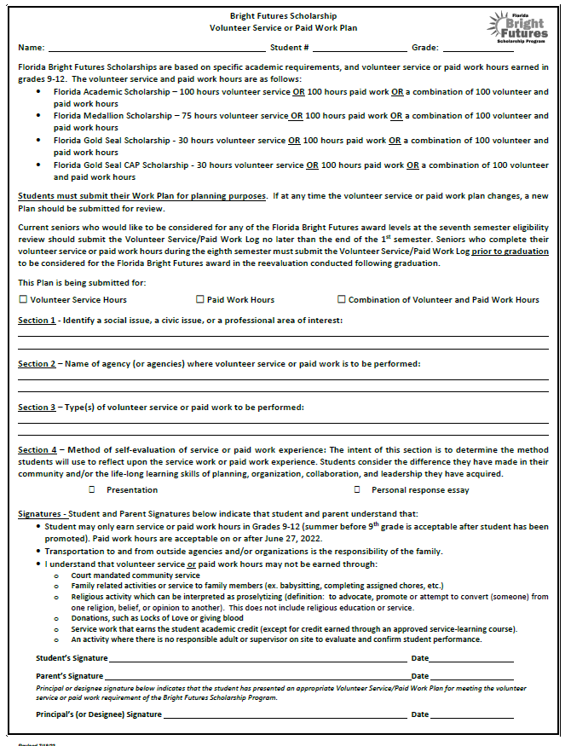
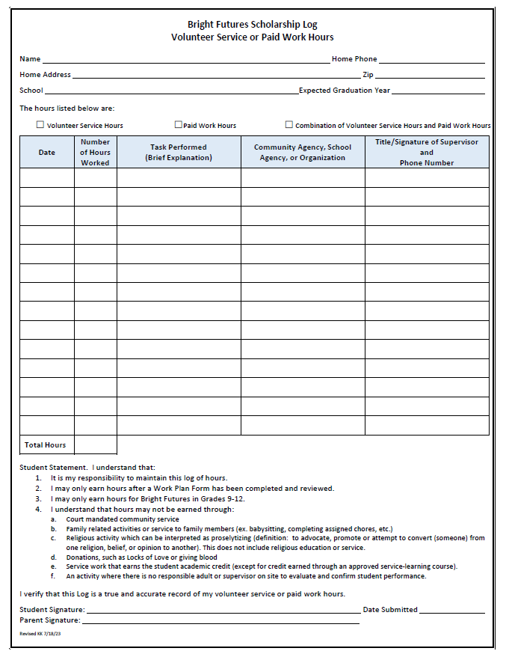

Slide 37
Bright Futures Work Plan/Proposal and Hours Log
Located in Guidance on the righthand side wall or on our website
Must be turned back into Guidance with appropriate signatures to be put in FOCUS and in Bright Futures file.
On the Work Plan/Proposal, under Section 4, the student must complete a presentation or personal response essay to be turned in with the Hours Log.
Most students write the paragraph on the back of the log or attach a sheet of paper.

Slide 38
Bright Futures & Test Scores
You MUST send your SAT, ACT or CLT scores to one of the 12 public universities in Florida (like UCF) for Bright Futures to have access to your scores.
It enters the State Testing Bank this way. Bright Futures will not accept scores from our transcripts.

Slide 39
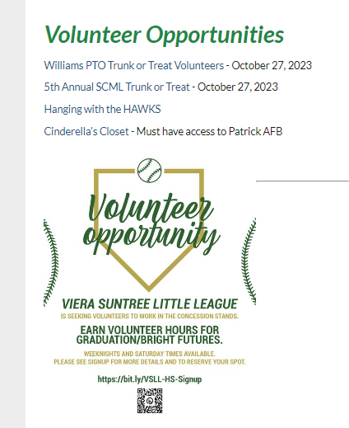
Volunteering Opportunities
Updated on our Guidance website, on the left-hand side under “Bright Futures and Volunteering”
https://www.brevardschools.org/Page/19633

Slide 40
Questions?

Slide 41
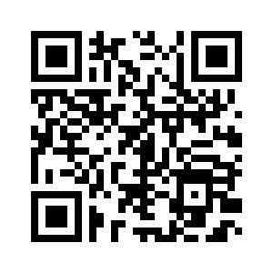
Parent Night Survey

Slide 42
College & Career
Viera High School
Ms. Wells-Booth, MBA, College Career Specialist

Slide 43
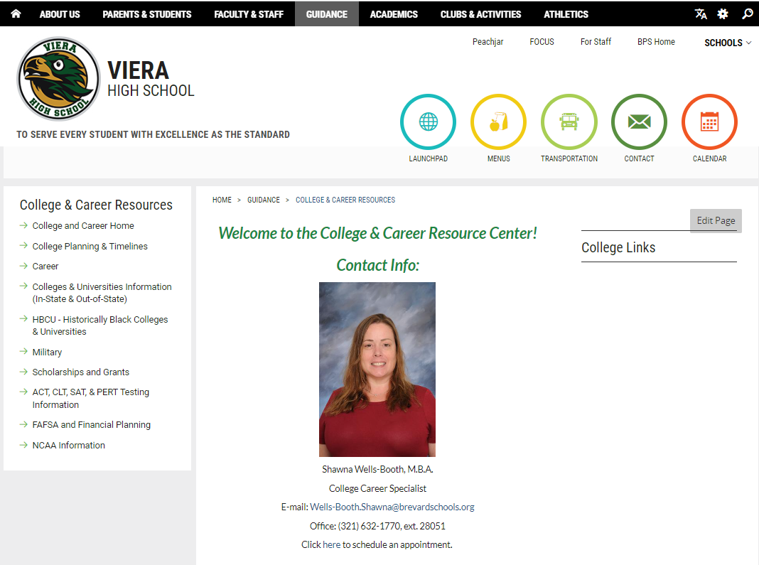
College & Career Resource Center
Drop down when you hover over the Guidance tab.

Slide 44
Purpose
College Career Specialist is to provide assistance to students and parents in making educational, occupational and life plans with a program that will enable the student to reach his/her fullest physical, emotional, psychological and behavioral potential.

Slide 45
How are you going to “Play the Game of Life?”
College
Military
Gap Year
Trade
Work

Slide 46
Florida Shines www.floridashines.org
PLAN YOUR CAREER
American Graduate, Getting to Work initiative works with community partners to create a space for students and parents to learn more about the career and college resources available to them.
Make Your Next Move an assessment tool offered by the U.S. Department of Labor. Explore careers by keyword, industry or interest.
Explore Career Fields
Environmental and Agricultural Systems
Health Sciences
Communication and Information Systems
Human Resources and Services
Business, Marketing, and Management
Industrial, Manufacturing, and Engineering Systems

Slide 48
Create A Plan

Slide 50
Florida Shines www.floridashines.org
Going to College
Explore Schools
Discover Programs
Get Ready for College
Pay for College
Affordable Education Options

Slide 51
What Matters Most?
Transcripts
Grades in Core Classes
Strength of Curriculum
ACT/SAT Scores
Grades in ALL Subjects
Class Rank
Skills/Character
Essay or Writing Sample
Interview
Extracurricular Involvement
Demonstrated Interest
Recommendations
Teachers
Counselors
Coaches
Mentors
What do their words reveal about you?

Slide 52
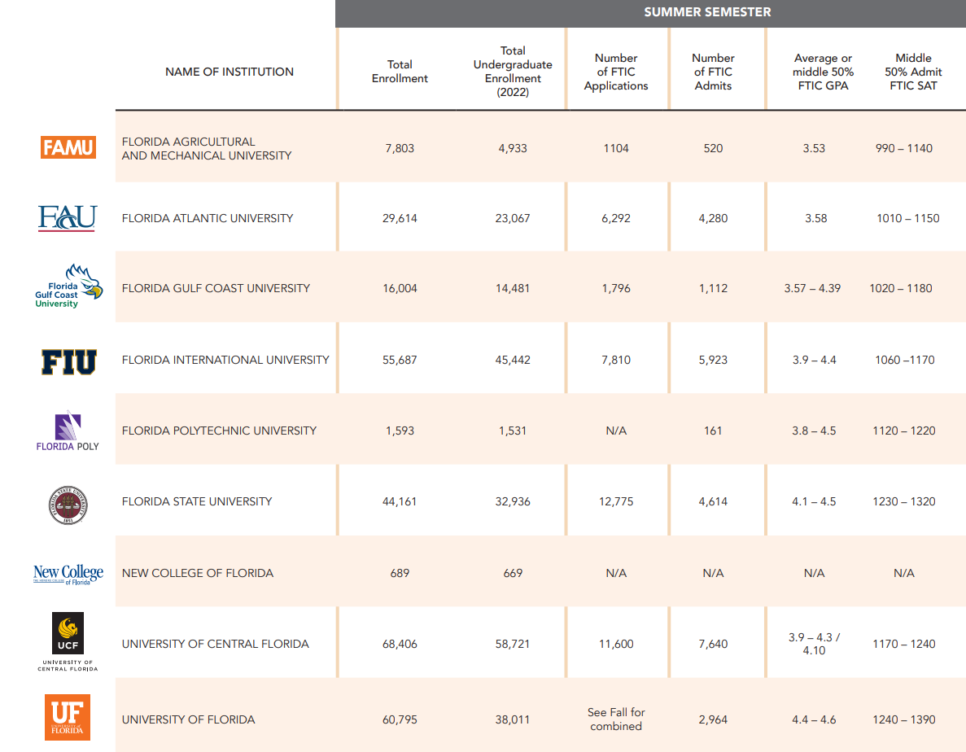

Slide 55
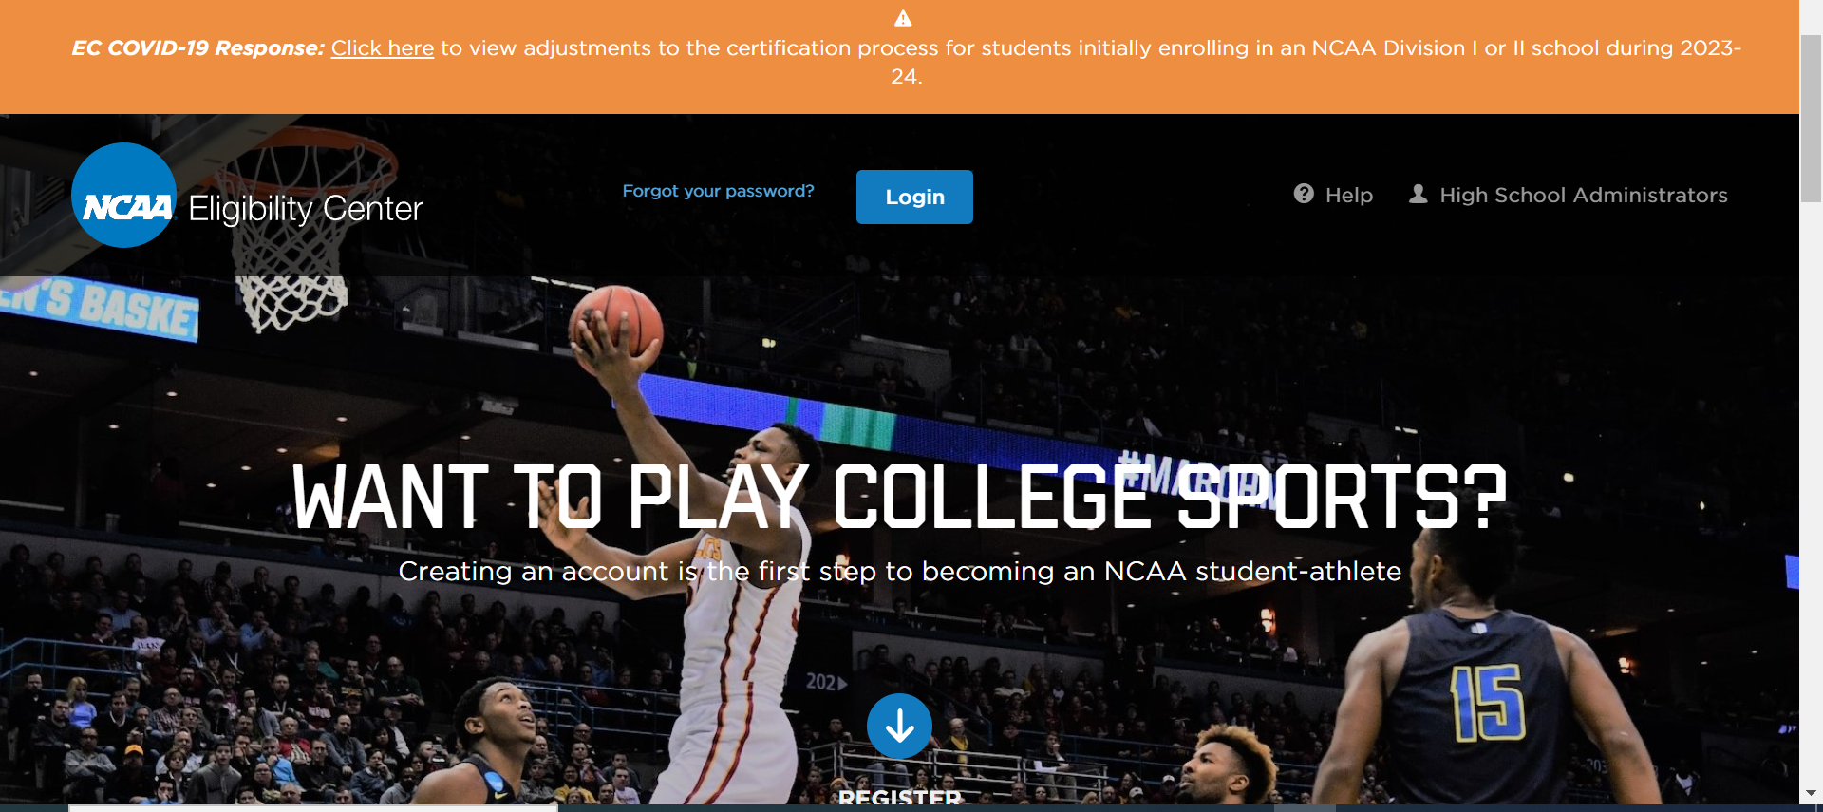
NCAA Eligibility
NCAA Eligibility Center
Admissibility
Core GPA
SAT/ACT Sliding Scale
Letter of Intent
Athletic Biography
Ensure college or university is a good fit academically

Slide 56
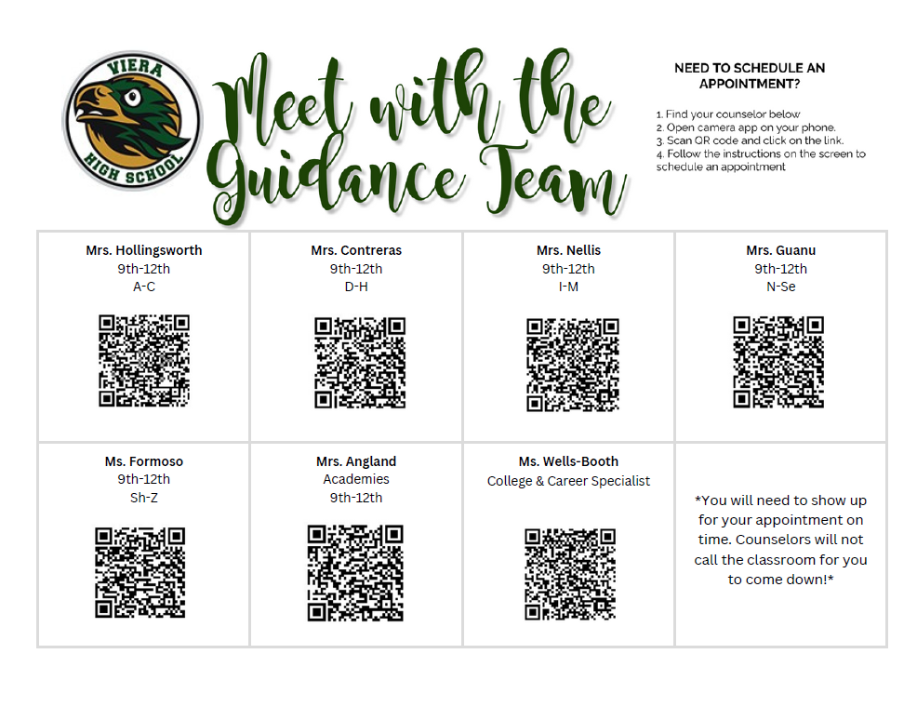

Slide 57
Questions?

Slide 58
Parent Night Survey

