Slide 1
Welcome to Senior Information Night 23-24
Viera High School
Madeline Contreras, MA, School Counselor

Slide 2
Guidance Introduction
Academies Marianna Angland
A-C Kathryn Hollingsworth
D-H Madeline Contreras
I-M Angela Nellis
N-Se Christine Guanu
Sh – Z Michelle Formoso
Social Worker Michele Becerra
College & Career Shawna Wells-Booth

Slide 3
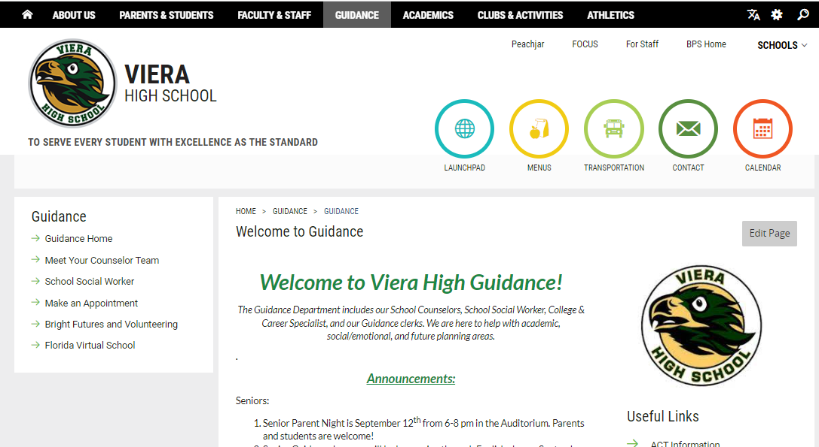
Guidance Website!

Slide 4
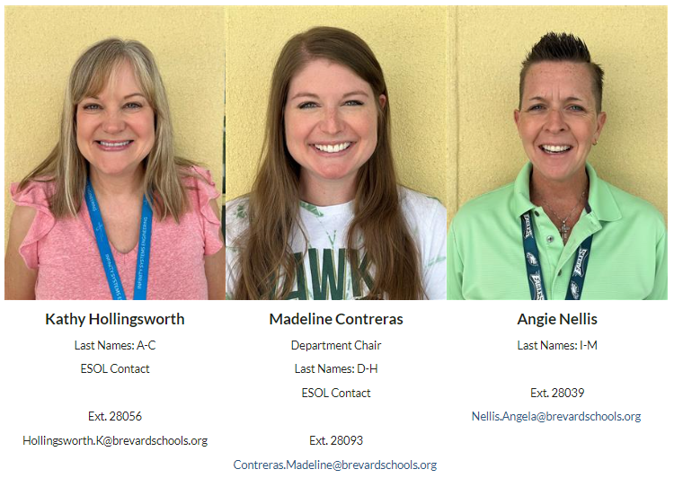

Slide 5
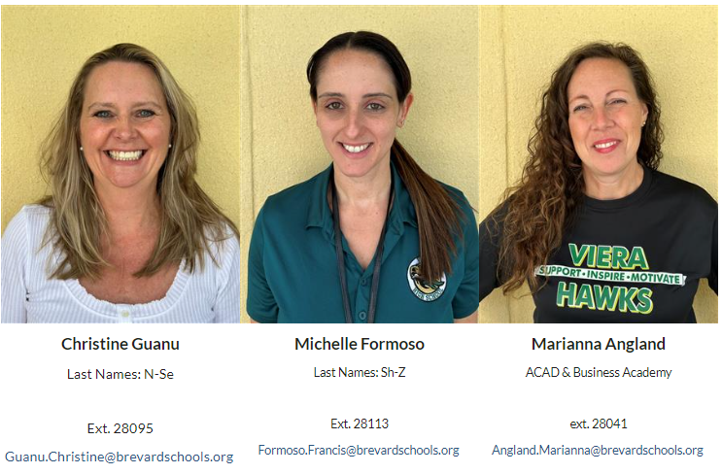

Slide 6
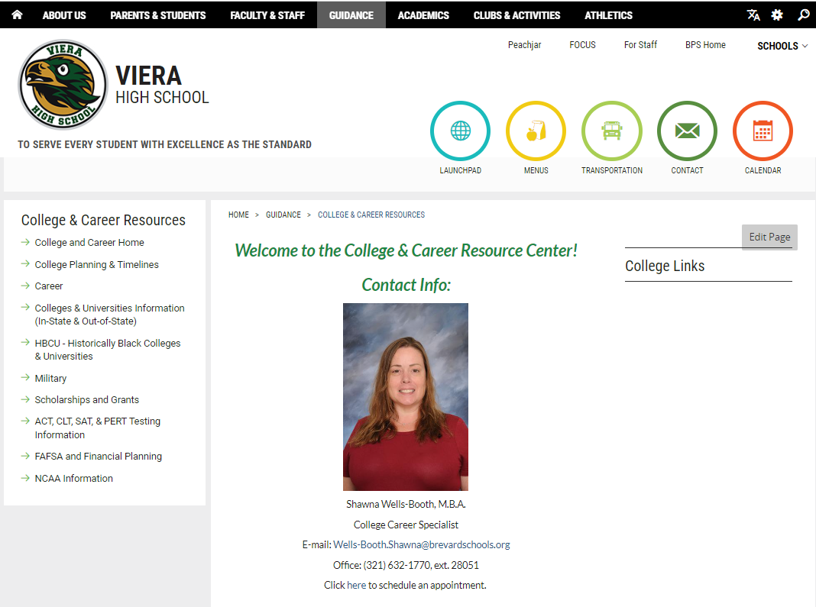
College & Career Resource Center
Drop down when you hover over the Guidance tab.

Slide 7
Agenda
Graduation Requirements
After High School Options
Applying to Colleges
Bright Futures
How to Pay for College
State College Info

Slide 8
Note about FLVS Off Campus
If students have 1-3 “off campus” periods for FLVS classes, they MUST be enrolled in the same number of classes on FLVS as they have off periods from Viera.
Students must be enrolled in 7 classes no matter how many credits they have already earned and how many requirements they have already done.
We will be pulling students back to campus if they are not signed up for the appropriate number of classes on FLVS.
**The same goes for EFSC Off Campus periods as well.**

Slide 9
Note about Dual Enrollment
Catalog Class Schedule will be available Monday, October 9th.
Early College and any Dual Enrollment student with 45+ credits please reach out to your counselor.
Dual Enrollment students can submit their Registration Forms through the dropbox starting on Monday, November 6th .
**Remember you need a Counselor signature on the Registration Form before uploading it to your EFSC dropbox.**

Slide 10
Credit Requirements for High School Graduation (26 credits)
4 credits English
4 credits Math – must include Algebra 1 & Geometry
3 or 4 Science – Biology, a physical science & an “equally rigorous” science
3 or 4 Social Studies - World History, US History, US Government, Economics
½ credit Career Research and Decision Making
1 credit Physical Education (HOPE)
1 credit Fine, Performing, or Practical Arts
8 ½ elective credits
**Foreign language is not required for high school graduation. However, state universities and most scholarships require two years of the same foreign language.

Slide 11
Additional Graduation Requirements
Minimum Unweighted GPA
2.0
Testing
Passing score on Grade 10 FAST ELA OR SAT/ACT concordant score
Passing score on Algebra 1 EOC OR SAT/ACT/PSAT concordant score
Online course
No longer required as of this July 2023.
Rigorous Coursework Requirement
3 credits in honors, AP, or Dual Enrollment courses
OR
3 credits in a sequential Career & Technical Program

Slide 12
Post High School Options
2-Year State College
Military
Technical School or Apprenticeship
Work Force
Gap Year
4-Year University

Slide 13
Unsure what you want to do?
Schedule a meeting with our College & Career Specialist, Ms. Wells-Booth!
Do Some Career Research
https://www.roadtripnation.com/edu/careerfinder
(powered by Collegeboard)
Florida Shines (www.floridashines.org)
O*NET Interest Profiler
Google has many other career interest inventories
ASVAB (Not just for the Military) will be offered at VHS in January

Slide 14
Applying to Colleges

Slide 15
Senior Year Fall Timeline
Narrow college list to 5 or 6 schools
NOTE DEADLINES – Priority is November 1st
Begin applications & request transcript to help – Common App, SSAR or SPARK
Request Letters of Recommendation (if required) & give 2 weeks notice
Take/retake SAT/ACT and send scores directly to prospective college
Complete FAFSA
Apply to Bright Futures
Include your counselor’s email on Common App! (___@brevardschools.org)

Slide 16
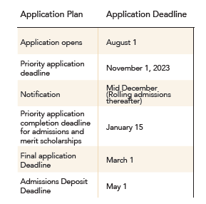
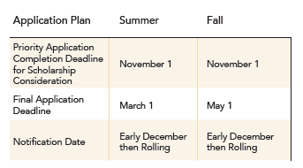
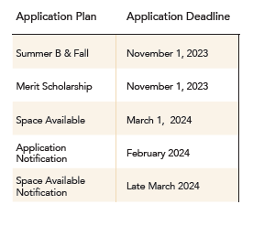
Deadlines for College Application
Make sure to note the Application Deadline, SSAR Deadline, Test Score Deadline. Are they all the same or different?
Notes:
Apply for the term you WANT to attend.

Slide 17
*BPS is now offering a college fair during the day to students only and keeping the one at night for the parents.
Transportation is limited and will be assisted as “first come, first ride.” Please direct any questions you receive to our College & Career Center tables during the student’s lunch period.

Slide 18
Grades for Senior Year
Keep up on grades!
Even after you have been accepted into colleges, you should keep up with grades and rigorous coursework.
Colleges will ask for a final transcript!
Do not change your 2nd semester schedule once you are accepted to a University. If you must change your schedule, we recommend you report it to the college before changing your schedule.

Slide 19
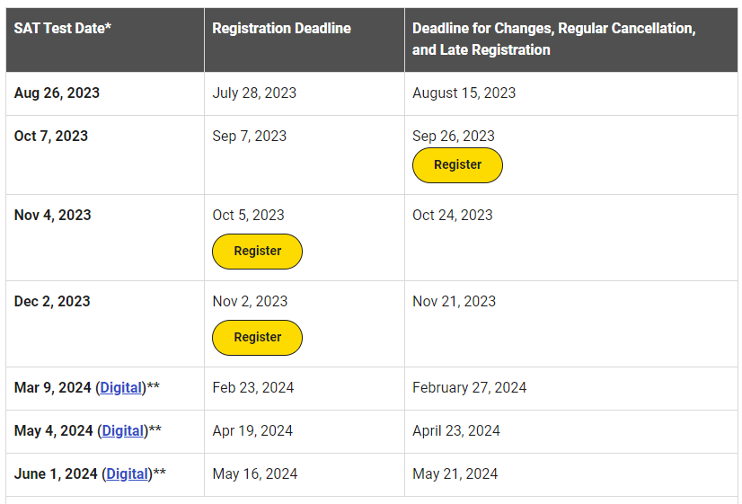
SAT Test Dates

Slide 20
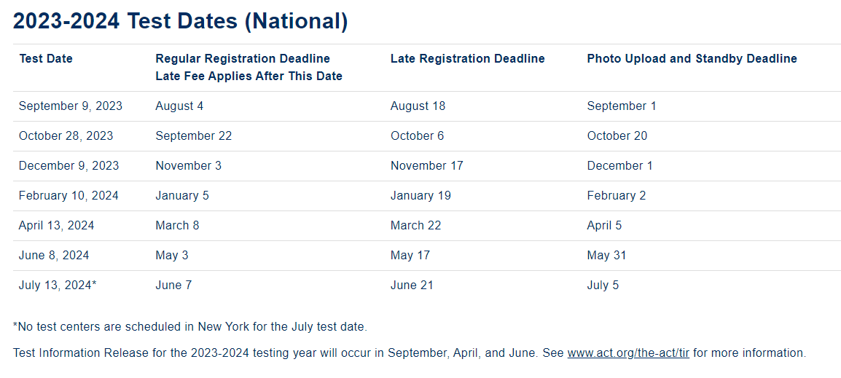
ACT Test Dates

Slide 21
What is the ACT Test Information Release?
Test Information Release for the 2023-2024 testing year will occur in September, April, and June. See www.act.org/the-act/tir for more information.
By purchasing Test Information Release (TIR), you will receive a digital copy of the multiple-choice test questions, your answers, a copy of your answer document, the answer key, and the conversion table used in determining your ACT scores. If you took the optional writing test, you will receive a copy of the writing prompt, the writing test scoring rubric, and your essay scores.
You can expect digital TIR materials to be provided within MyACT a few weeks after your score release. If you requested and were approved for alternate formats (April testing only), these materials will be prepared once your TIR report is available in MyACT and may take up to eight weeks for processing and shipping

Slide 22
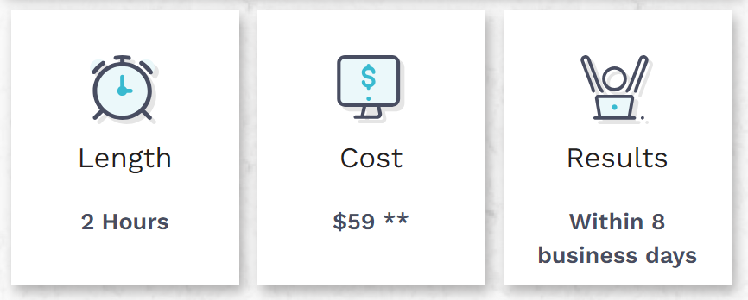
New College Entrance Test: CLT
The CLT – Online College Entrance Exam – Classic Learning Test (cltexam.com)

Slide 23
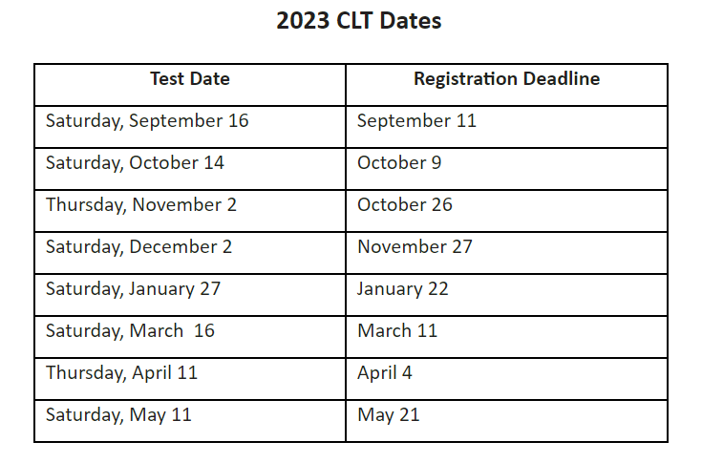
CLT Test Dates

Slide 24
Test Scores – Apply or Wait?
Submit College Applications NOW and note the Testing Deadline for each school.
Send scores directly to the college/university from your test.
Admissions will reconsider applications once new scores arrive if before their testing deadline.
**Check fairtest.org for schools that are test-optional!**
Notes:
Most schools will require one set of scores when applying. If it is before the testing deadline but after your application submission, send DIRECTLY to the school when taking your test. They will put them with your file.

Slide 25
What to look for when selecting and visiting a college?
Environment (location, size, etc)
Admission Requirements (GPA, ACT/SAT Score, Rank, extracurricular activities)
Specific programs of study?
College Expenses and Financial Aid
Housing
Facilities
Activities
Notes:
(over 50% of students go undecided and most change their minds multiple times)

Slide 26
Google your school’s site!
Google “(School) Undergraduate Admissions” and choose First Year or Freshman Applicant
https://admissions.ufl.edu/apply/freshman/
A great example of step-by-step instructions on how to apply!

Slide 27
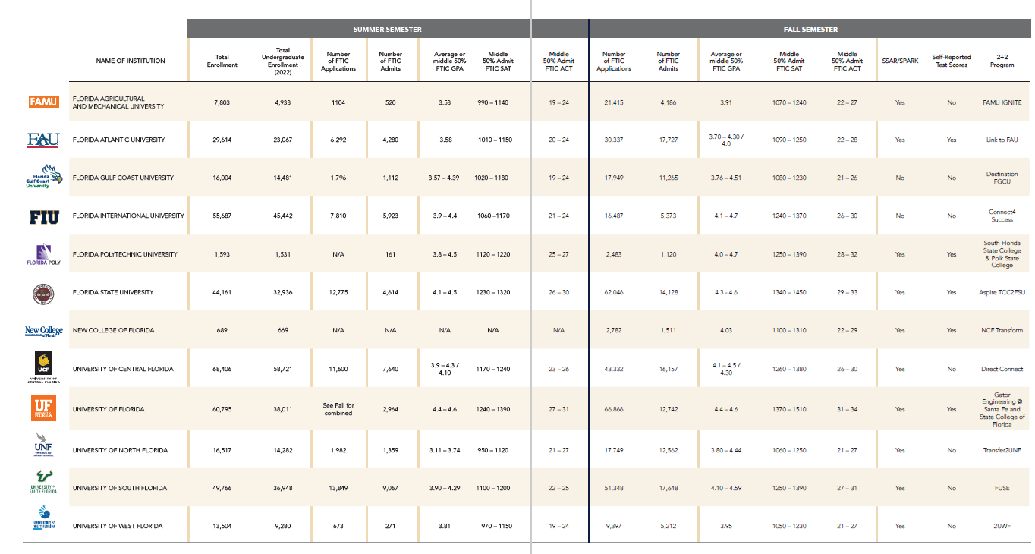
Florida State University System Matrix

Slide 29
COMMON APP
Most commonly used way to apply to colleges
One application entry and can send to multiple schools
Link counselors’ email directly for us to submit transcript, GPA, and Letters of Recommendation (Use ____@brevardschools.org)
***DO NOT wait for your counselor to submit their part to submit your application!***
Notes:
https://www.commonapp.org/apply/first-time-students
APPLICATION GUIDELINES AND ESSAY WRITING TIP:
https://www.commonapp.org/apply
US NEWS article The Common App: Everything you need to know
https://www.usnews.com/education/best-colleges/articles/common-app
Khan academy
https://www.khanacademy.org/college-careers-more/college-admissions/applying-to-college/college-application-process/a/filling-out-the-college-application-common-application-walkthrough
Basic tips for Common App
https://www.princetonreview.com/college-advice/are-you-ready-for-the-common-app
Tips on writing an activities list:
https://www.collegeessayguy.com/blog/guide-college-activities-list-common-app-example-application
https://blog.collegevine.com/how-to-fill-out-the-common-app-activities-section/
Tips on writing the common app essay
https://www.bestcolleges.com/blog/expert-common-app-essay-tips/

Slide 30
AA Potential Grads & Applying to University
Submit the “First-Year Student” application.
If you are SURE you are going to receive your AA, there is a box to check on your application or a form to fill out to signal you are going to be an AA grad.
New legislature came out that you can choose to apply test-optional if you are obtaining your AA by graduation.
Each school has different policies around this, so please check their website. Some may not offer scholarships because of needed test scores.
If you check “yes” and DO NOT obtain your AA, your offer can be taken back from the college or university. This is very serious!

Slide 31
SSAR
SSAR is the Self-reported Student Academic Record
Completed AFTER application on Common App, School’s website or Coalition App.
Fill out line by line using your unofficial transcript.
NOTES ABOUT COMPLETING:
EFSC Classes that are 1.0 credit instead of 0.5 credit (i.e., Composition 1)
Algebra 1, Geometry, Biology & US History are all full year classes. Every other class will be Semester 1 and Semester 2 grades.

Slide 32
Important Tips from Admissions
Following directions is CRITICAL!
Do not send transcripts unless requested by institution
Do not send recommendation letters unless required by institution
Deadlines are FIRM, not suggestions.
Do NOT apply on November 1st if that is the deadline! There are always glitches, shutdowns, etc.
#1 from Directors of Admissions: Read all of the correspondence from the school!
Are they offering you another term? Do you need to commit by a deadline? Are they offering you an alternate pathway to the school?

Slide 33
State College/Community College

Slide 34
Benefits of a State College
Save money
Close to home
Test scores or GPA are not high enough for a State University
To try different programs, if undecided on a major.
Later Deadline for Applications
EFSC’s deadline is in the summer after graduation.

Slide 35
Eastern Florida State College Career & Technical Programs
Accounting
Applied Technology
Computer Programming
Cosmetology
Criminal Justice
Culinary Management
Dental Hygiene
Diagnostic Medical Sonography
Digital Video
Emergency Medical Services
Engineering Technology
Fire Science Technology
Graphic Design
Human Resources Administrator
Law Enforcement
Pharmacy Technician
Web Development
Welding
And more!

Slide 36
EFSC Bachelor Programs
Nursing RN to BSN- ONLINE PROGRAM
Science Teacher/Biology-grades 6-12
Advanced Allied Health BAS track-healthcare administration
Biomedical Science BAS- Medical careers-Early Acceptance program with Lake Erie College of Osteopathic Medicine/LECOM (Pharmacy, Dental Medicine, Osteopathic Medicine) Campus Lakewood Ranch, FL
Biotechnology BAS-Lab tech, Molecular biologist
Medical Imagining-for continuing education, must have AS Degree
Veterinary Nursing BAS-For Vet. Techs to advance
Computer Information Systems Technology BAS
Organizational Management BAS

Slide 37
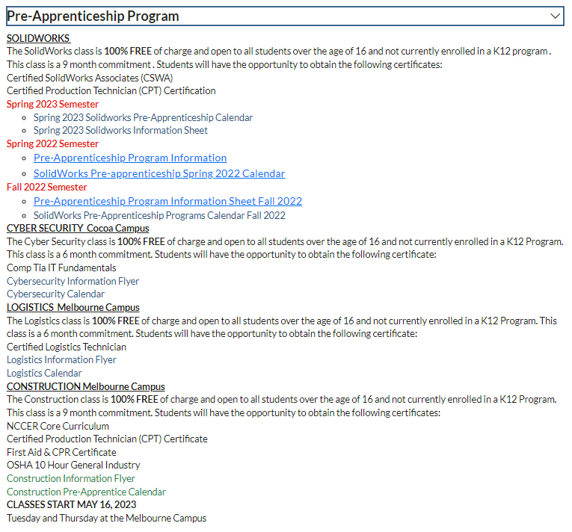
Pre-Apprenticeship Option through Brevard Adult Education
https://www.brevardschools.org/Page/18782

Slide 38
Paying for College

Slide 39
Paying for College The #1 mistake is not applying!
Scholarships
Merit Based
Athletic
Income Based
Minority Students
Students of Veterans
Students with Disabilities
Program Based
Grants
Pell Grants from FAFSA
Work Study
Student Loans

Slide 40
FAFSA Free Application for Federal Student Aid
Opens in December this year
FREE Application – Don’t pay to submit. Be aware of scam websites.
Required by all colleges
How federal grants, work study, and student loans are offered but also how colleges offer scholarships and loans
Need parents’ tax information and your own tax info if you work!
The earlier you apply, the more money there is to disperse based on need

Slide 41
Bright Futures Scholarship
The biggest and BEST scholarship to aim for!
Florida Academic Scholar – 100% Tuition Paid
3.5 weighted GPA in 16 credits of academic
courses
4 English
4 Math
3 Science
3 Social Studies
2 Foreign Language
1340 SAT or 29 ACT Composite or 96 CLT
100 hours volunteer OR 100 hours paid work OR 100 hours combined
Florida Medallion Scholar – 75% Tuition Paid
3.0 weighted GPA in 16 credits of academic courses
4 English
4 Math
3 Science
3 Social Studies
2 Foreign Language
1210 SAT or 25 ACT Composite or 84 CLT
75 hours of volunteer OR 100 hours paid work OR 100 hours combined

Slide 42
Bright Futures Scholarship
Gold Seal Scholar

Slide 43
Update on Volunteer v. Work Hours
Now there can be a combination of both volunteer and work hours.
There are NOW updated forms on our website and in our Guidance lobby.
You still NEED a “Volunteer Service or Paid Work Plan” approved before logging either kind of hours.
Once workplan is approved, then you may begin logging hours with the “Scholarship Log.”
All hours must be turned in one week prior to graduation! The last test you can take is the July 2023 SAT or ACT.

Slide 44
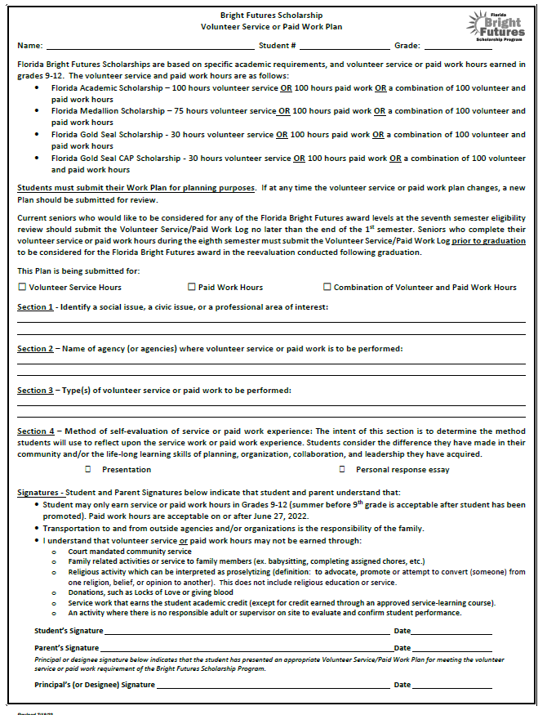
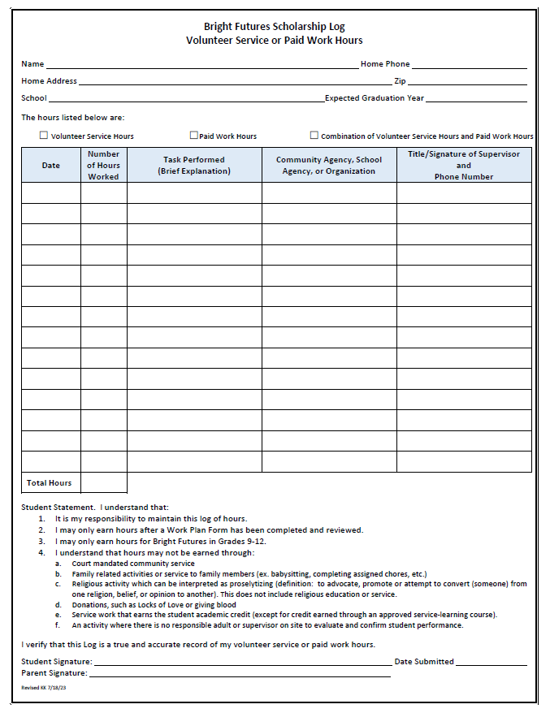

Slide 45
Bright Futures Application
Counselors will be in the computer lab in January to help seniors during their senior English class.
Application
www.FloridaStudentFinancialaidsg.org
Opens to Seniors after October 1st
Bright Futures pulls the information from our system 2-3 times per year – December, March and June

Slide 46
Bright Futures & Test Scores
You MUST send your SAT, ACT or CLT scores to one of the 12 public universities in Florida (like UCF) or one of the 28 public state colleges in Florida (like EFSC) for Bright Futures to have access to your scores.
This is very important if you are sending scores over the summer after graduation!

Slide 47
If I meet the requirements for Bright Futures, then what? How do I get the scholarship?
Once you chose the college/university you are going to attend, you will need to go back into your Bright Futures account and indicate the college you are attending.
The college and Bright Futures will link, after graduation you would talk to your college’s financial aid department for any Financial Aid/Bright Futures questions.

Slide 48
Scholarships
Current scholarships are under the “College & Career Resource” tab on our Guidance drop down on the website and printed in the Guidance office.
Brevard Schools Foundation Scholarship Packet will be released in January
www.fastweb.com
www.Scholarships.com

Slide 49
Senior Financial Aid Night November 8th from 6-8pm
Hosted by our College & Career Specialist, Ms. Shawna Wells-Booth!
We’ll be discussing Bright Futures, FAFSA, VA, Florida Aid, Brevard & Institutional Scholarships, and any questions you may have about Financial Aid

Slide 50
Senior Reminders
Recommendation Letters
Give 2 weeks notice to teacher/counselor before you want it turned in
Do not send UNLESS required
Bright Futures Application opens Oct. 1
No perk to applying earlier but make sure you do. You cannot apply after graduation.
FAFSA Application opens in December
Apply earlier to get more chance of money!
Deadlines are FIRM
Priority deadlines for major Florida universities is NOVEMBER 1st
Transcripts
Final transcripts will go out in the middle of summer to the college you submit on your Senior Survey during graduation practice.
Complete Transcript Request Form for all official copies of your Transcript (changed from last year!)

Slide 51
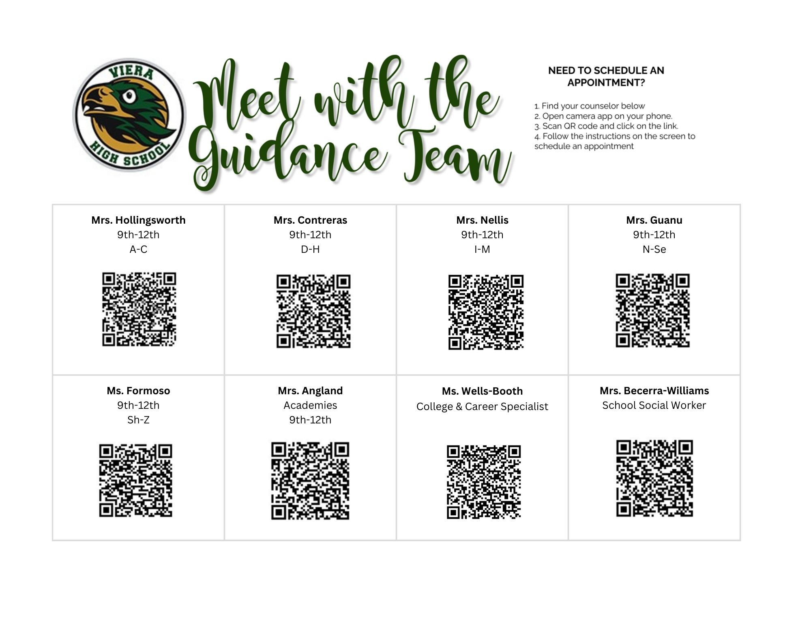

Slide 52
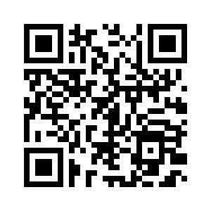
Parent Night Survey

