Slide 1
Dual Enrollment Info Night
Viera High School
Last Updated 12/7/2023

Slide 2
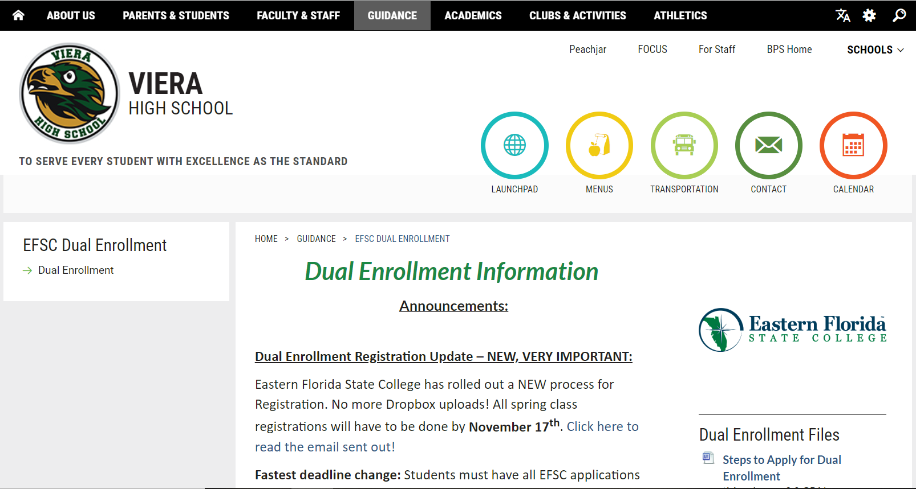
VHS Guidance – Dual Enrollment Page
If you ever want to know Dual Enrollment updates, please visit our webpage.
Choose “EFSC Dual Enrollment” drop down when you hover over the “Guidance” tab.

Slide 3
What is Dual Enrollment?
Taking college classes with Eastern Florida State College as a high school student (“dual”)
Earn college credit AND high school credit
EFSC classes will go on high school transcript and college transcript

Slide 4
Different Dual Enrollment Types
Early College
Early Admissions/
Full Time Dual Enrollment
Starts 10th Grade
Part-Time Dual Enrollment
10th-12th Grade
No classes at Viera
12th Grade ONLY
3rd & 4th Period Off Campus with bus transportation for 10th grade year only
Eligible for 2 summer classes
Up to 3 periods off at beginning and/or end of day
4-5 classes at EFSC each semester
Must have graduation requirements met
Eligible for 1 summer class

Slide 5
Advanced Coursework Warning
These are classes taught by college professors on a college campus or online.
Your student is expected to act like a college student and take on the responsibility of that.
Your student is going above and beyond high school work – which includes reading, analyzing, and writing at a higher level. Be prepared for the extra time and effort this involves.
The grades in these college classes will affect their college GPA after high school.

Slide 6
Advanced Coursework Warning
Read the syllabus.
They have hard deadlines for assignments.
Usually, they have a strict absence policy.
Exams will be at different times than class at the end of the semester. We will excuse your student here for them.
Check the Titans email account.
This is the only way professors and advisors will email your student. They will not email a personal or Brevard school account.

Slide 7
FERPA Limitations
School counselors cannot see or access anything on a student’s EFSC account. We cannot email professors.
Parents cannot talk to EFSC personnel without the student signing a FERPA waiver.
Professors will not talk to parents.

Slide 8
Roles and Responsibilities
VHS School Counselor
EFSC Advisor
Tracking high school graduation requirements
Verifying eligibility with GPA and Test Scores
Arranging student’s VHS schedule
Tracking AA requirements
Facilitating Registration process
Discussing the balance of high school classes and dual enrollment classes
VHS College & Career Specialist
Verifying eligibility with GPA and Test Scores
Facilitating Registration process with EFSC Advisors
Making changes to EFSC class schedule
Asking question about anything EFSC
Verifying eligibility with all requirements
Dual Enrollment Contact

Slide 9
How does it work for Viera classes?
Students will have a placeholder “College Course” on their schedule for how many classes they are taking at EFSC.
Students are allowed to take up to 3 dual enrollment classes, so they can have a maximum 3 periods off.
Off periods must be at the beginning and/or end of the day.
For example, if a student is taking 3 dual enrollment classes, they can have these options:
1st-3rd off
5th – 7th off
1st, 6th, 7th off
1st, 2nd, 7th off

Slide 10
EFSC Courses = High School Credit
EFSC COURSE HIGH SCHOOL CREDIT
ENC 1101 Composition 1 1 English credit
ENC 1102 Composition 2 1 English credit
SPC 2608 Fundamentals of Speech 0.5 Perf/Fine Arts credit
All Math classes on the AA list 1 Math credit
MAT 1033 Intermediate Algebra 0.5 Math Credit

Slide 11
EFSC Courses = High School Credit
EFSC COURSE HIGH SCHOOL CREDIT
All Life/Bio Sciences 1 Science credit
All Physical Sciences 0.5 Science credit
(Physics 1 and 2 are 1 Science credit)
All Humanities 0.5 Elective credit
(LIT 1000 Intro to Literature - 1 English credit)
AMH 2010 & AMH 2020 combined 1 US History credit
POS 2041 American National Gov’t 0.5 US Government Credit
ECO 2013 Principles Of Economics 0.5 Economics credit
All other social science classes will count for .5 elective Social Studies credit in H.S.

Slide 12
What happens for withdrawing?
You must talk to your School Counselor about withdrawing from a class. Your college off period will have to replaced with a Viera class or an FLVS class if you withdraw.
If you don’t tell us, you will have to sit out of dual enrollment classes for a semester.
The “W” will go on your transcripts.
Schools may look unfavorably on “W”s.

Slide 13
What happens when failing a college class?
D earns credit for high school; C earns credit for college.
Student cannot retake classes they fail in dual enrollment.
Talk to your School Counselor about the ECCO program to pay for retaking a class. It will not make up the grade on your high school transcript but can on the college transcript.

Slide 14
A Note on Fees
There is a student fee which is usually $10 per semester.
Parking Pass Fee
Extra fees for specific classes like labs.

Slide 15
Requirements & Steps to Dual Enrollment

Slide 16
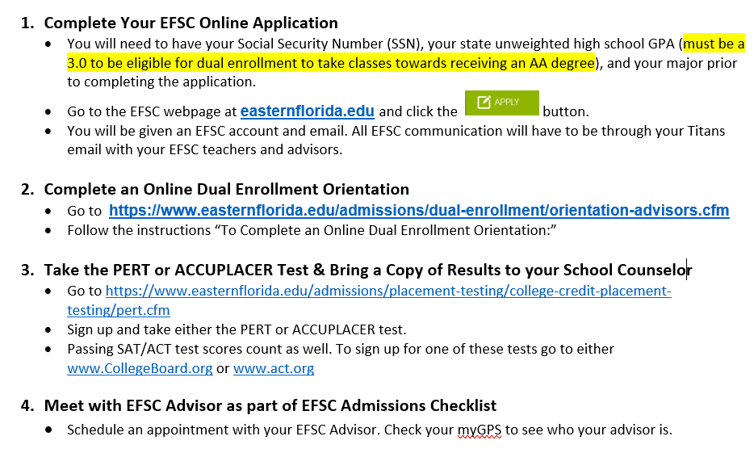
Requirements as explained by “Steps”

Slide 17
Basic Requirements to qualify for Dual Enrollment
3.0 unweighted GPA
Must have every semester enrolled in dual enrollment classes as well
PERT or Accuplacer test scores
Can use SAT or ACT scores but must be sent to EFSC from CollegeBoard or ACT account
Must all be done before a specific deadline to register!
For Spring Registration, it was by October 9th. We do not have dates yet for Summer or Fall Registration deadlines.

Slide 18
Additional Requirements by EFSC
EFSC Application
EFSC Orientation
EFSC Advising Appointment
Must all be done before a specific deadline to register!
We do not have updated deadlines for summer or fall registration yet.
Only needs to be completed once as a new dual enrollment student.

Slide 19
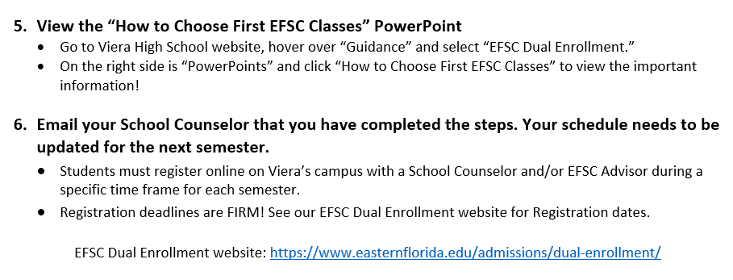
Additional Steps to Dual Enrollment

Slide 20
Transferring Credit to Other Colleges/Universities

Slide 21
Warning about Dual Enrollment Classes and Transferring Credit to Florida Universities
Always check with the Florida universities you are considering attending before taking upper-level courses as a dual enrollment student.
Some universities (i.e. FSU, UF) want students to take THEIR courses due to the curriculum.
You will not always save money and credits if you don’t talk to an Advisor/Admissions person from that university.
If a student does not complete the full AA, each college or university may have a cap of how many credits they’ll accept.
For example, 45 credit hours, which translates to 15 classes roughly.

Slide 22
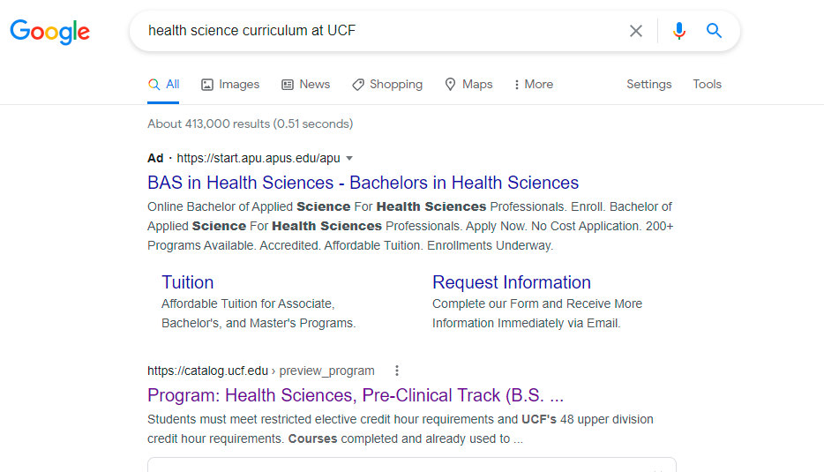
Matching EFSC Courses with State Universities in Florida
First, talk to your EFSC Advisor!!
Google the school(s) you’re thinking about attending and the program you want to major in.
Click on the program link.

Slide 23
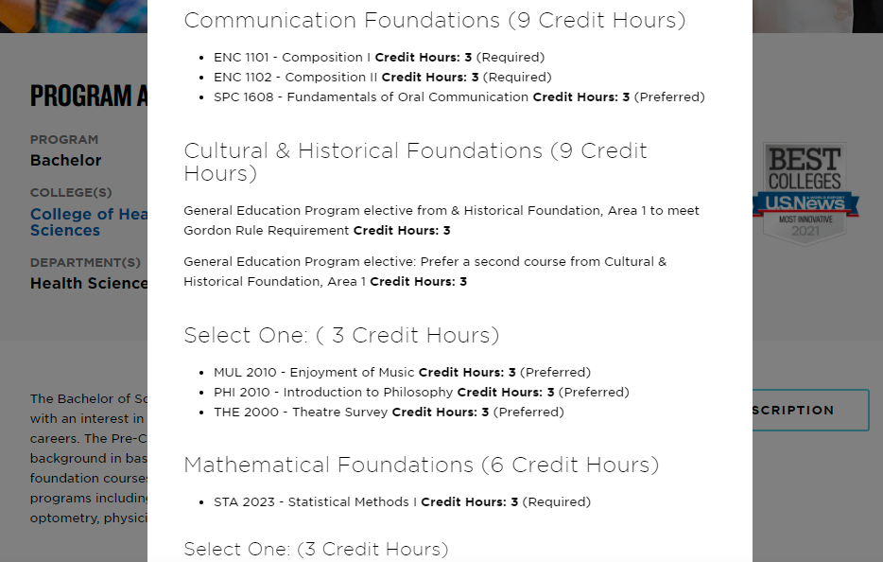
Matching EFSC Courses with State Universities in Florida
Here you can see exactly what courses are needed for this program.
If the course codes match your EFSC class course code, it could be a direct transfer to meet that requirement for a Bachelor’s degree. But ALWAYS check with an Advisor!

Slide 24
Warning about Out of State Universities
There is no guarantee that dual enrollment college credit earned through EFSC will transfer to Out-of-State universities.
Please check with the non-Florida universities your student is considering going to if they accept credit from a Florida State College.

Slide 25
Associates Degree (AA) Overview

Slide 26
What is an Associates degree?
Sometimes referred to as an AA (Associates in Arts)
A 60 credit-hour degree which includes 36 credits in general education requirements and 24 elective credits.
It is comparable to the freshman and sophomore years at a 4-year university if credits are used CORRECTLY.
4-year colleges and universities integrate these credits within their overall Bachelor’s degree plan.

Slide 27
Overview of Associates in Arts Requirements
The following will review the 8 areas of concentration.
Please see your EFSC advisor to go further into detail. We are just giving general information.
We ALWAYS suggest matching your electives to your future major. Otherwise, you will be “wasting” your elective credits that won’t allow you to have 2 years of college done.

Slide 28
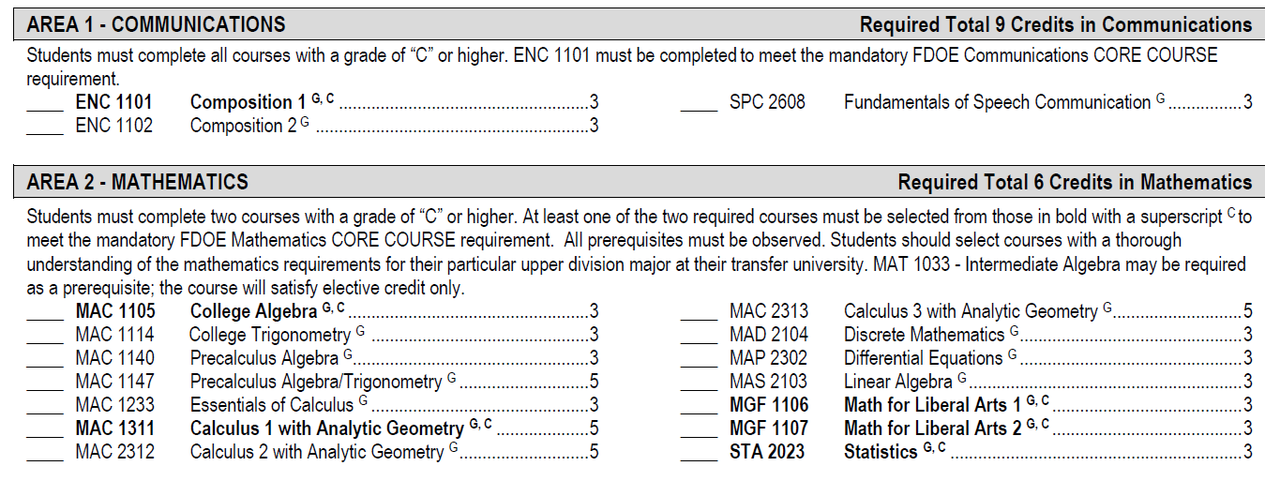
Overview of Associates Requirements
Area 1 – Communications – Must take all 3 classes.
Area 2 – Mathematics – Must take 2 classes. Must have a PERT Math score high enough.
Make sure you are considering your future major when deciding what maths to take.

Slide 29
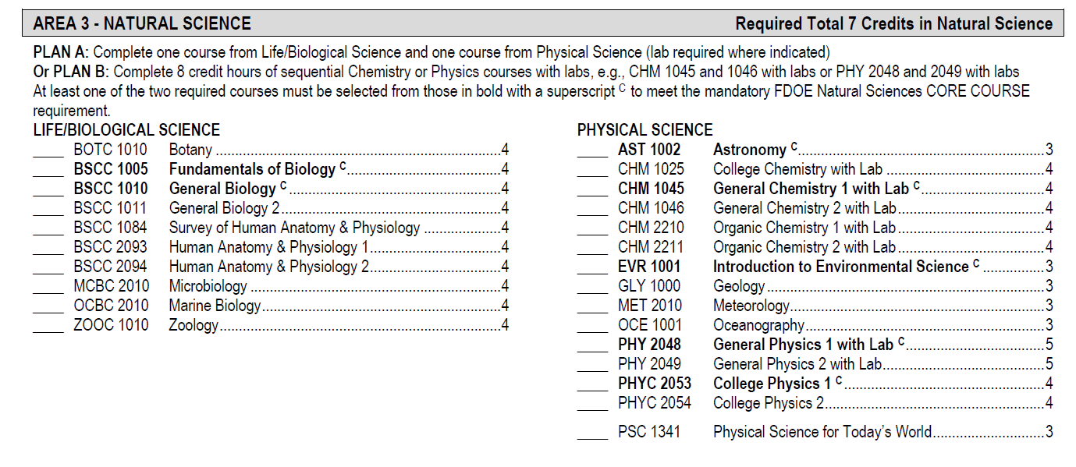
Overview of Associates Requirements
Area 3 – Natural Science – Must take 1 class in Life/Biological Science and 1 class in Physical Science.
Make sure you are considering your future major when deciding what sciences to take.

Slide 30
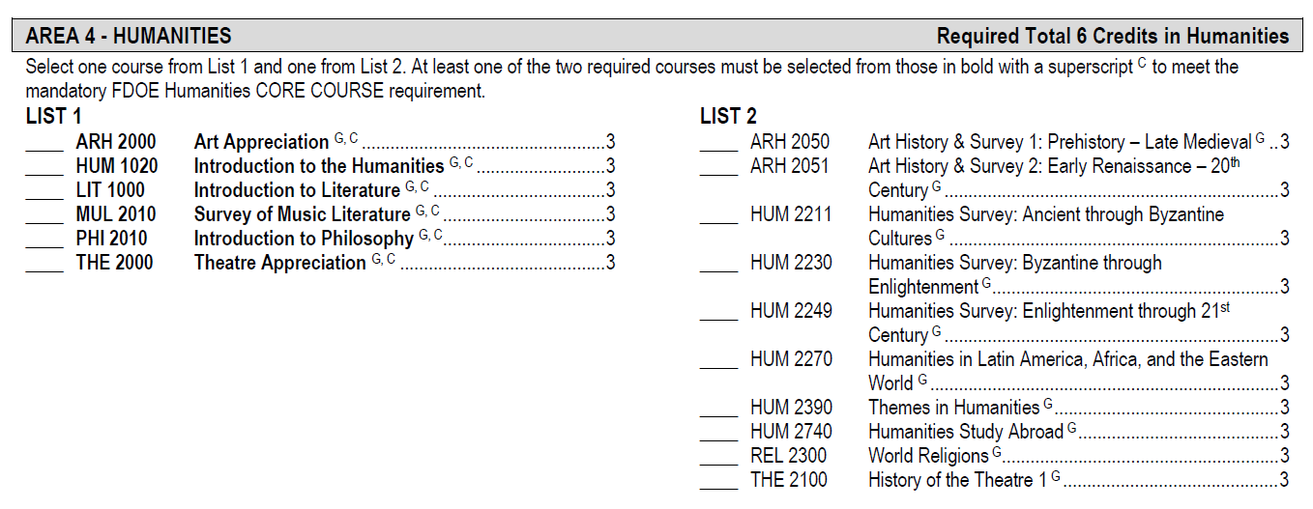
Overview of Associates Requirements
Area 4 – Humanities - Must take a class from each list.
Suggestions: Intro to Humanities (HUM 1020) and World Religions (REL 2300)

Slide 31
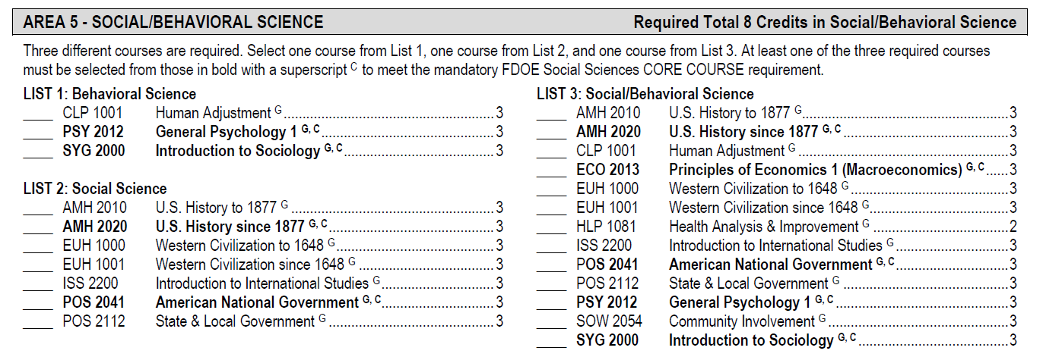
Overview of Associates Requirements
Area 5 – Social/Behavioral Science - Must take a class in each list.
Area 6 – Electives – Must take 8 classes of electives.

Slide 32
Pros v. Cons Discussion

Slide 33
Class Registration

Slide 34
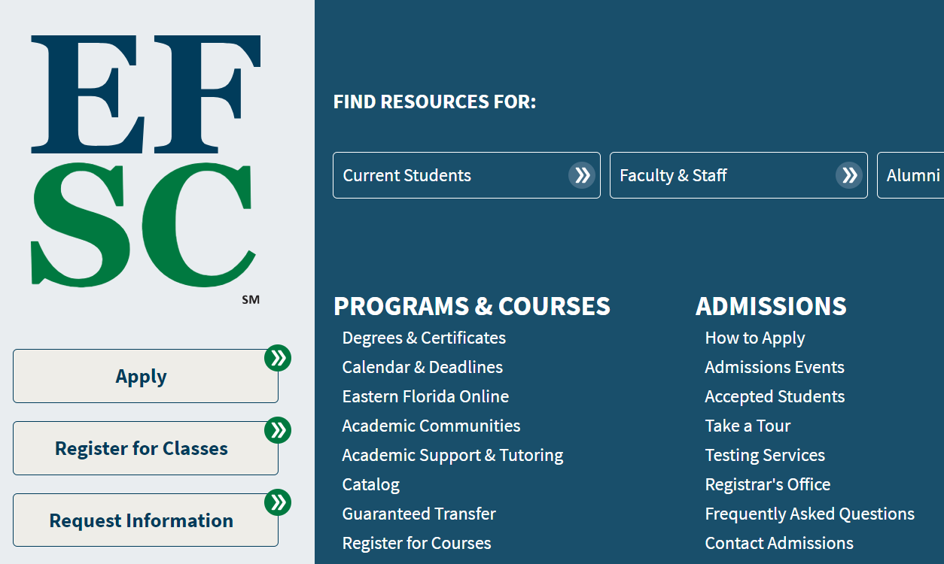
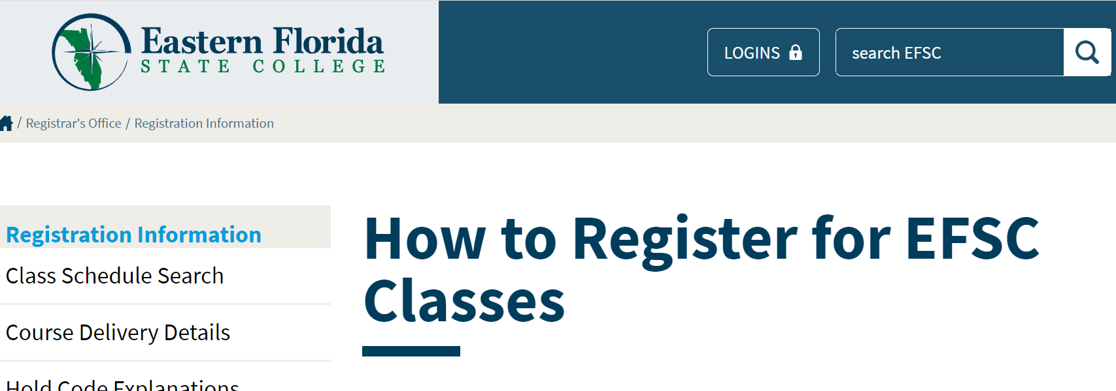
How to look up EFSC Courses to register for:
Go to www.easterflorida.edu
Click “Menu” in the top right corner.
Click “Register for Classes” as shown in first picture.
Then, click “Class Schedule Search” on the lefthand side as show in second picture.
https://www.easternflorida.edu/registrar/registration/class-schedule-search/

Slide 35
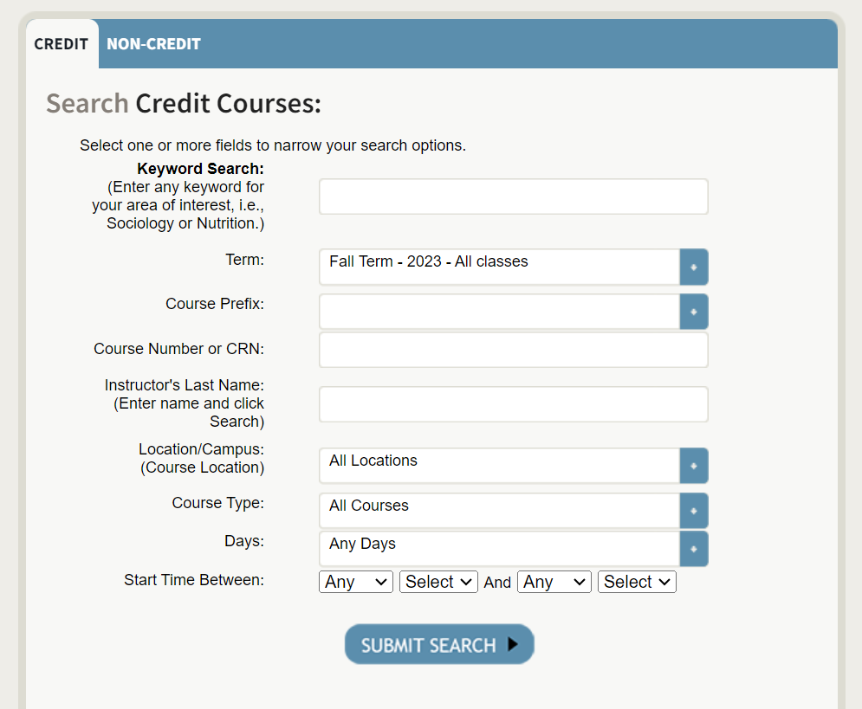
Class Schedule Search:
Fall/Spring
Dual Enrollment/Early College: Choose 16-week semester
Early Admissions: Choose any semester
Summer
Between 9th and 10th grade: Sessions C & D
Dual Enrollment: up to 1 course
Early College: up to 2 courses
Early College 10th Grade Bus Riders: 10:50am-12:05pm (one class MW and one class TR)

Slide 36
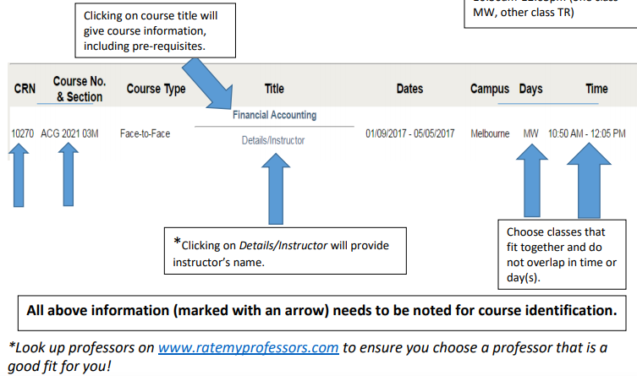
Class Schedule Search:

Slide 37
Registration Updates as of September 2023:
First - There will be NO flexibility with deadline dates. Deadlines are hard deadlines! This is an Eastern Florida State College rule.
Registration will now be online (no more Dropbox!) and MUST take place on Viera’s campus or EFSC’s campus under the guidance of School Counselors and/or EFSC advisors.
Only classes on the approved list will be allowed.
Students will not be allowed to register themselves at home.
There is no longer Add/Drop week in January for Dual Enrollment students. Therefore, it is no longer possible to wait for semester grades to qualify for Dual Enrollment.
Please see Eastern Florida’s website for information: https://www.easternflorida.edu/admissions/dual-enrollment/registration/

Slide 38
Dates for Spring 2024 Class Registration No Dates for Summer or Fall 2024 Registration Yet!
Deadlines:
Monday, October 9th: Last day to submit a dual enrollment application to EFSC and to submit test scores to Viera
Thursday, October 19th: Last day to complete any outstanding admissions requirements, such as new student orientation and advising appointments.
Monday, November 6th: EFSC Spring Registration opens.
Friday, November 17th: LAST DAY for SPRING REGISTRATION!
Monday, December 4th to Thursday, December 14th: Spring Schedule Change Window for Dual Enrollment Students. Only students with EXISTING registrations can make schedule changes with the approval of a School Counselor.

Slide 39
What to Bring to Registration
You need the Course Code, Course Title, CRN Number, and Section # for each class you are registering for. Bring backup classes for each class as well.
The class schedule will be released for you to see what course fits your schedule.

Slide 40
Remember the Bell Schedule when registering for classes at EFSC!
Your classes at EFSC cannot interfere with your classes here at VHS. You will be marked tardy or absent.
You will have one off period per EFSC class you take.
For example, if you are taking 2 college courses, you can have 1st and 2nd period off. A student can register for 1 class on Monday Wednesday from 8-9:15 and one class on Tuesday Thursday from 8-9:15. They will make it back in time for 3rd period.
We suggest a 30-minute commute estimate between EFSC and VHS.
Transportation to and from EFSC and VHS is the student’s/parents’ responsibility (except for the 10th grade Early College bus riders)

Slide 41
Meet your Guidance Team
Academies Marianna Angland
A-C Kathryn Hollingsworth
D-H Madeline Contreras
I-M Angela Nellis
N-Se Christine Guanu
Sh – Z Michelle Formoso
College & Career Shawna Wells-Booth
Contact your School Counselor or the College Career Specialist for further questions or to make an appointment!

Slide 42
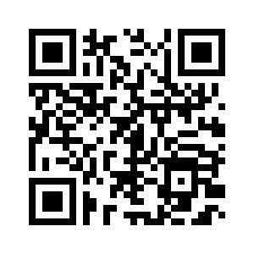
Parent Night Survey

