Slide 1
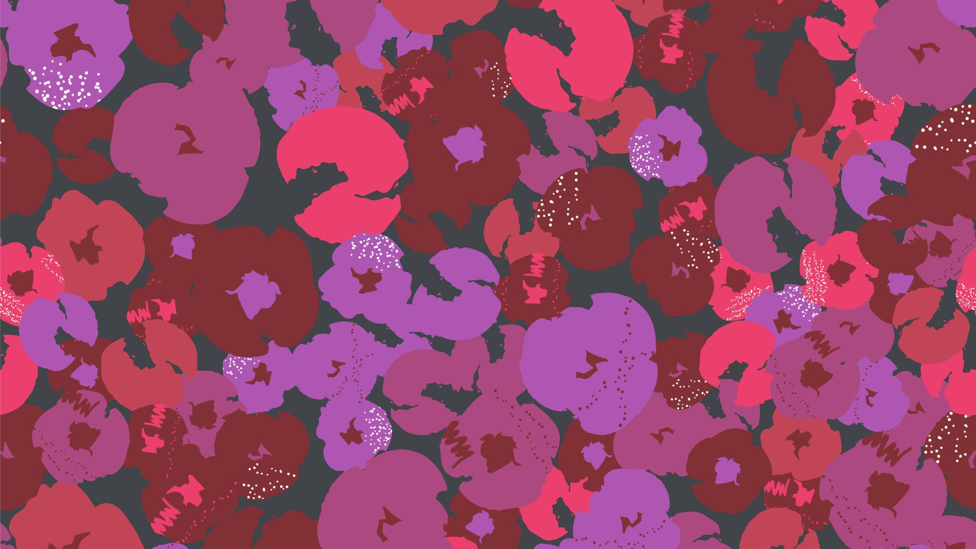
Homemade Art Supplies
Use common items from the grocery store!
Mrs. Miller, Oak Park Elementary

Slide 2
Play Dough Adult supervision required
You'll need:
1 cup flour
½ cup salt
2 tbsp cream of tartar
1 tbsp oil
1 cup boiling water
Food coloring
1. In a bowl, combine the flour, salt and cream of tartar. Mix well.
2. Add the oil.
3. Mix a few drops of food coloring into the boiling water and add to the bowl.
4. Mix everything well until it is no longer sticky.
5. Once it has fully cooled, wrap in plastic or put in a zipper bag, or airtight container. Store at room temperature for six months.

Slide 3
Taste Safe Slime
You'll need:
¼ cup chia seeds
1 + ¾ cup water
Food coloring
3-4 cups corn starch
1. Mix the chia seeds, water and food coloring together.
2. Cover and refrigerate overnight.
3. Uncover and add the corn starch a cup at a time. Mix and then continue until you achieve slime.
4. Store covered in the refrigerator. You will need to add a little water each time you take it out to use it.

Slide 4
Kid Safe Paint
You'll need:
¼ cup salt
½ cup flour
½ cup water
Food coloring
1. Mix the flour and salt in a bowl.
2. Add a few drops of food coloring to the water. Pour into the flour and salt mixture.
3. Whip well until the clumps dissolve. You can add more water if paint is too thick.
Store in the refrigerator. Will keep for months.

Slide 5
DIY Watercolor Paint
Materials:
Baking soda, white vinegar, light corn syrup, corn starch, mixing bowl, mixing spoon, half dozen egg carton, four pack food coloring, pop sicle sticks or skewers
In a mixing bowl mix 4 tbls of baking soda with 2 tbls vinegar until the fizzing stops. Add ½ tsp corn syrup and 2 tbls corn starch. Mix until smooth.
Pour mixture into egg carton cups unitl ¾ full. Add 5-10 drops of food coloring to the egg cups. Stir with stick or skewer. Allow to set overnight.
Food coloring usually comes in a 4 pack with red, blue , yellow and green.
Red+blue= purple, red+yellow=orange,
red+green=brown Experiment!

