Slide 1
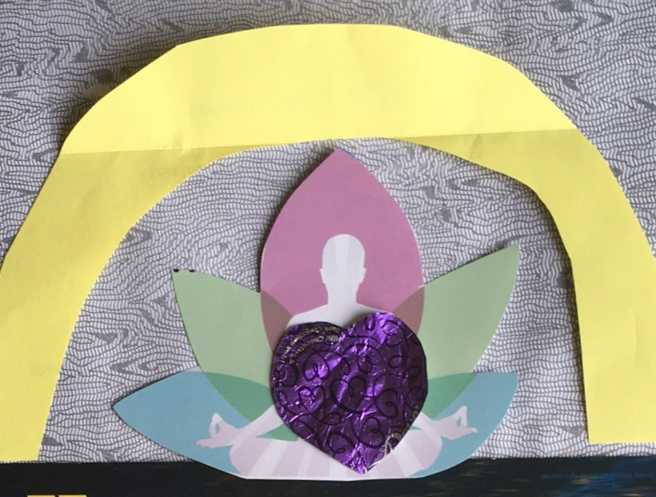
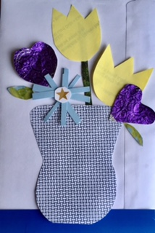
Create a Junk Mail Masterpiece

Slide 2
CREATE a JUNK MAIL MASTERPIECE
Materials:
Gather whatever scraps of junk mail you have on hand: envelopes, ads, postcards, newspaper, newsletters, etc.
(I really like the patterned insides of bill envelopes)
Add some fun extras: candy wrappers, labels, used stamps, etc.
Scissors are optional (you can tear if you want)
Glue or tape or staples or nothing at all
(make it temporary—just be sure to take a photo)

Slide 3
Use junk mail and paper scraps to create a collage.
Use the colors or patterns of your paper scraps to inspire your subject matter.
Will you make a portrait? A still life? A landscape? An abstract design?
Think of the Elements of Art that you will use:
What shapes can you cut or tear?
Do your scraps have texture?
Are you using the whole space of the paper?

Slide 4
Use junk mail and paper scraps to create a collage.
Use the Principles of Design to arrange your artwork:
What will be your point of emphasis?
(focal point)
Does your picture have balance?
Did you use patterns to create rhythm?
Does your picture show variety (of materials, textures, colors, patterns, lines, or shapes)?
Is there unity in your design?

Slide 5
Complete your JUNK MAIL MASTERPIECE
Be sure to photograph your collage when it is done!
Upload it to Artsonia:
3-6 Distance Learning Project
(Directions are on my Art webpage)
Or email it to me:
lambert.kamela@brevardschools.org
Tell me about it:
Give it a title and explain what you like the most about it, etc.

