Slide 1
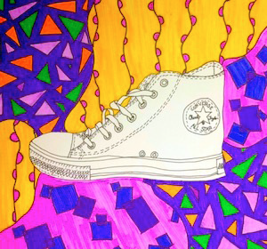
Contour Shoe Drawing
Objective: Create a contour line drawing of a shoe with a colorful background

Slide 2
You Need:
Drawing Paper
Pencil
Permanent Marker
Markers, watercolor, or another medium to add color to the background

Slide 3
Meet Artist Ian Sklarsky
Creates blind contour portraits using pen, ink, and watercolor.
Inspired by how blind contour drawing requires an artist to remain focused on the subject without distraction
Drawn with just a single line and without looking at the sketch until finished.

Slide 4
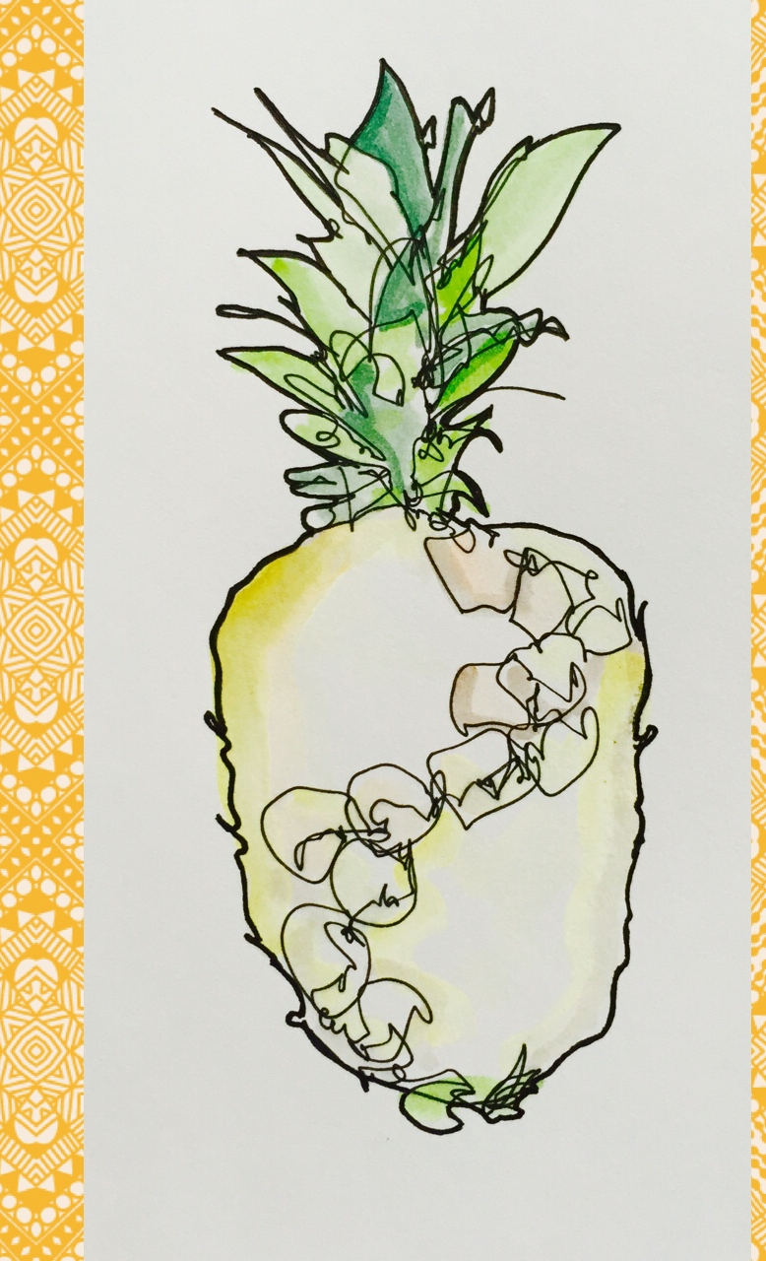
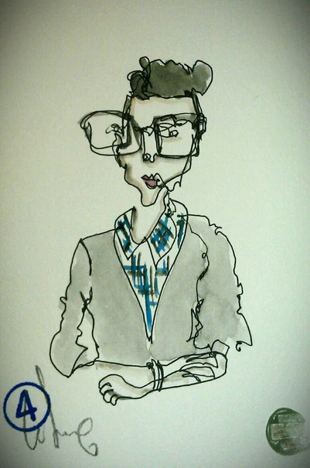
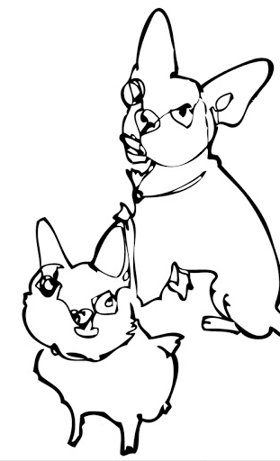

Slide 5
Your Turn:
TRACE the Drawing: Trace your pencil drawing with permanent marker. This is a nice time to add a little color; you may want to trace using a permanent marker that matches the color of your shoe . Don't color in yet, though!
CREATE the Background: Add some sort of colorful or patterned background. You may use markers or watercolors or any material you have. Think about your color choices; you might choose a certain color scheme ( all cool colors, related colors, or complementary colors, for example).
DRAW: Take off one of your shoes and set it on the table in front of you. Observe it carefully. Start drawing your shoe in pencil. You should only be drawing the contour lines (outlines—no shading)! This is NOT a blind contour drawing! You may look at both the object and your paper, but try not to lift your pencil up!
SHARE: When you are happy with your drawing, be sure to share it! You can photograph it and upload it to Artsonia or email it to Ms. Lambert.

