Slide 1

FSA Essay Writing
Parent Information Night
WMSS
Mrs. Claudia Lacy
January 29th, 2015
Notes:
Welcome Participants

Slide 2
What Has Changed In Regards To The Writing Assessment?
What it WAS… | What it IS…
FCAT – Florida Writes Assessed Florida Next Generation Sunshine State Standards 4th, 8th, and 10th Graders Prompt about a topic Given 2 pages to write on Expository (explain why or how) or Narrative (story) Prompt 60 minutes 6 Point Rubric February | FSA Writing Component Assesses NEW Florida State Standards 4th – 11th Graders Prompt about text Given 3 pages to write on Explanatory/Informational or Opinion Prompt 120 minutes 10 Point Rubric March 2 – 13th

Slide 3
While this is primarily a writing test, it is also a reading test because grade level reading is required as well to complete the task.

Slide 4
Anchor Standard:
What Students Are Expected to Do
Write informative/explanatory/ and argumentative texts to examine and convey complex ideas and information clearly and accurately through the effective selection, organization, and analysis of content.

Slide 5
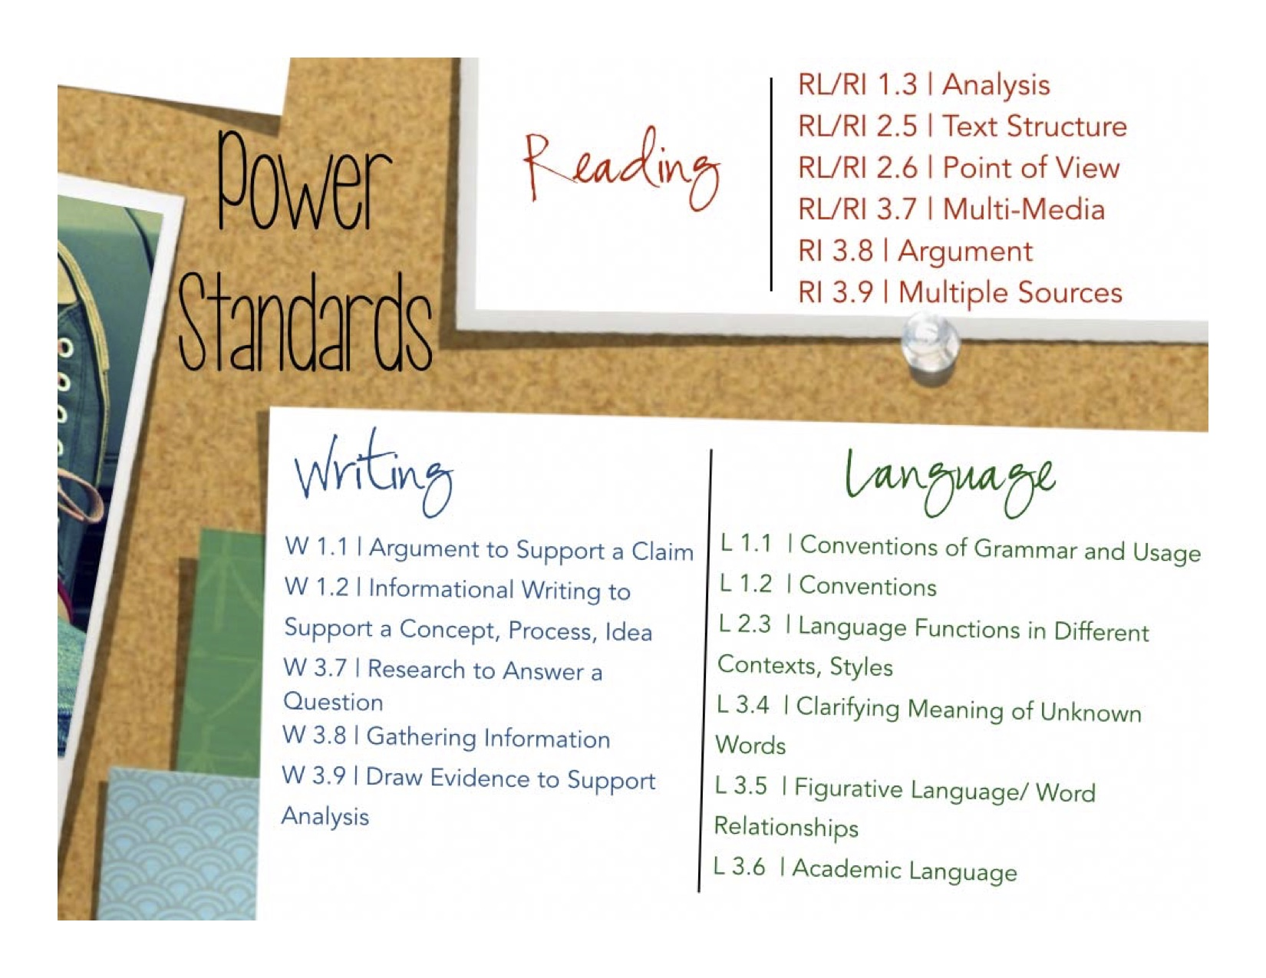
Notes:
This anchor standard includes…

Slide 6
^{The BIG SHIFT}
Writing is now…Academic Writing
Inform or explain
Explore an issue
Present an opinion
Use explicit evidence from the text
Understand text …deeply
Synthesize the information
Make connections
Support inferences and claims
Analyze the evidence
Students must:

Slide 7

What does the writing involve?

Slide 8
Overall Task Description
Students will read a stimulus about a single topic.
A stimulus consists of several texts written on a single topic.
The stimulus should consist of informational or literary or nonfiction texts and can cover a wide array of topics.
After reading the stimulus, the students will respond to a writing prompt in which they will provide information on a topic or take a stance to support an opinion or argument.

Slide 9
Students could be given two to four texts.
All of the texts combined should have the approximate word count below.
Minimum Word Count Maximum Word Count
800 1300 (4th/5th)
800 1600 (6th)
Students will be required to include and infuse information from each text and must cite specific evidence from the texts to support their ideas. The student must analyze, reflect, explain or give insight on what the evidence means, shows or how it connects to the topic. (*Analysis)
Notes:
Find table from FSA

Slide 10

To Be Successful… Students Must
Understand the task and develop a clear and precise thesis.
Critically read the text and make thoughtful decisions when selecting textual evidence to support the thesis.
Examine the effectiveness of connections between selected textual information and the thesis.
Organize the information in a structure that ensures the reader can effectively follow the writer’s development of ideas.

Slide 11
To Be Successful…Students Must
^{Be direct and to the point.}
Show an awareness of the audience
^{Set a purpose for writing}
Create voice/tone appropriate to the task
Examine a topic/idea by gathering important information
State the topic/idea in the introduction
Organize ideas and connect relevant details
Cite evidence from the text to support inferences
Provide a strong ending (conclusion)
^{Avoid unnecessary FLUFF!}

Slide 12

Let’s Look At
The Scoring Rubrics

Slide 13
Features if an Informative Essay
Introduces a clearly stated topic/controlling idea/opinion or claim
Creates an organizational structure in which information is grouped logically to support the writer’s purpose
Develops evidence with relevant facts, definitions, details, quotations and examples with references to sources
Uses precise language and content specific words that are appropriate for the audience and purpose
Uses appropriate linking ideas within and across the paragraphs to smoothly and purposefully connect the topic/idea to the evidence (transitions)
Provides a satisfying conclusion related to the topic

Slide 16
Scoring…Step 1
(Repeat for each section of the rubric.)
Level 4– Yes or No
Level 1– Yes or No
Level 2– Yes or No
Level 3– Yes or No

Slide 17
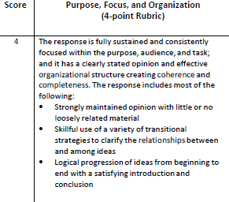

Slide 18
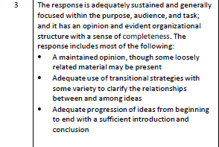
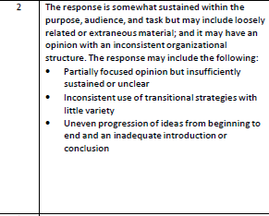

Slide 19
Step 2: Confirm with Rubric Bullets
(Repeat for each section of the rubric.)
Does the writing meet MOST of the descriptors?
Which level most accurately describes the writing?

Slide 21
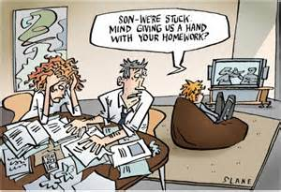
How Can You Help At Home?

Slide 22
Instructional Hierarchy
Most Important
Instruct First
Focus
Evidence
Organization
Analysis/Elaboration
Conventions
Least Important
Instruct Later
Notes:
Understand that it won’t all come at once…writing is a skill that is built upon prec

Slide 23
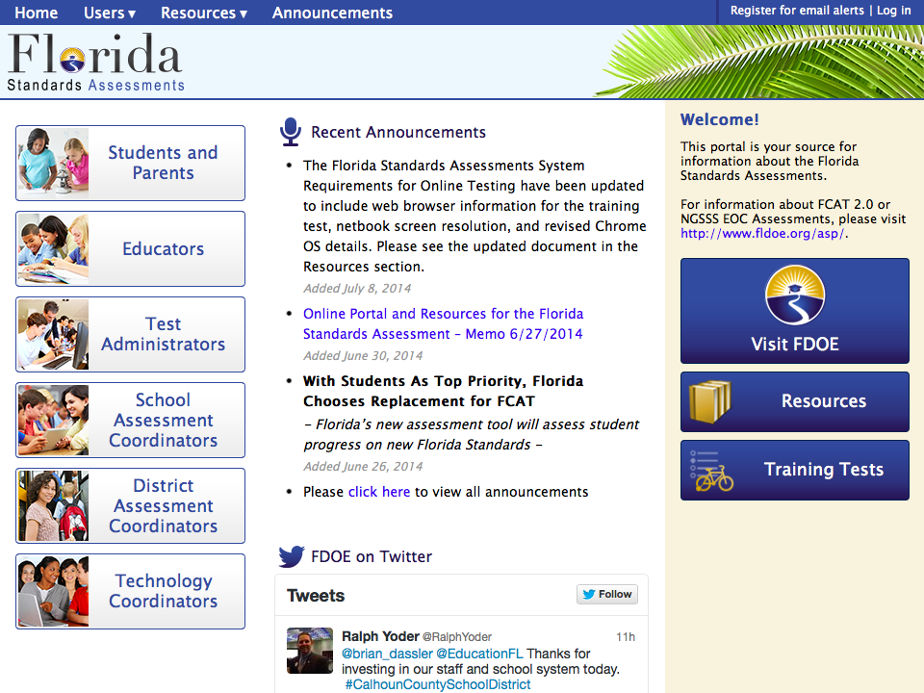
Go online and look at examples…
http://www.fsassessments.org

Slide 24
You can…
Promote consistent reading every night (20-30)
Read informational text and discuss with student
Read texts on the same topic and compare and contrast , look for connections or debate
Encourage them to express their ideas, opinions with text evidence
Promote the use of TEA paragraphs
Ask them to explain their homework
Have them use mature vocabulary and word choices
Read and discuss their writing…have them revise and edit their writing based on the rubric

Slide 25

TEA Paragraph
Topic Sentence:
1. Needs to be the very first sentence in the paragraph (only ONE sentence)
2. Opinion - Needs to make a claim; shows what paragraph will prove OR
Informational - main idea of passage
3. Will not be a detail from the text
Evidence/Examples:
1. Each piece comes directly from the text; it is a detail from the text.
2. Evidence/examples may be direct quotes or paraphrases, but both have citations.
3. Paragraph needs two to three E’s.
4. Evidence needs citation …“In the passage it states,…” (Immigration Today).
5. Evidence cannot stand on its own as a sentence and must have a lead-in.

Slide 26
TEA Paragraph Cont.
Analysis: (most difficult)
1. Consists of writer’s opinion or an explanation showing how the E supports the T
2. Often uses “if…then” statements to show critical thought
3. May have one to three A statements for each E
Concluding Sentence:
1. Paragraph must end with a concluding sentence (only ONE sentence).
2. The CS sums up the content of the paragraph and should mirror, but not repeat the topic sentence…think of the TS and CS as bookends for the paragraph.

Slide 27
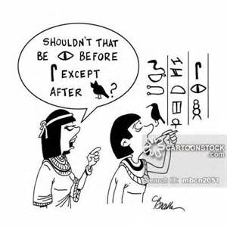
Focus on one skill at a time

Slide 28
You Can Also
Write and share your writing with them
Look at and discuss writing samples of others
Offer positive support and feedback
Encourage them to relax and do their very best
Celebrate their writing…and accomplishments

Slide 29
Other sources for help
http://writingcenter.unc.edu/handouts/
http://www.readwritethink.org/
http://faculty.muhs.edu/Downey/paragraph%20generator.html
http://teachingkidsnews.com/grades-2-8/
https://newsela.com/
http://www.time4writing.com/free-writing-resources/
http://www.writingfix.com/
https://learnzillion.com/lessons/1230-organize-ideas-for-an-argumentative-essay

Slide 30

Thank You For Coming Tonight

