Slide 1
Found Object Sculptures
Look at the following sculptures and think about these questions:
What materials did the artist use to make them?
How does the texture of the materials affect the sculpture?
What mood does each sculpture evoke?
How does the environment affect the sculptures?
How did the artist use balance in her work?
How can YOU create a found object sculpture?

Slide 2
Portland International Airport, OR, 1995

Slide 3
Styx, Whitman College, WA

Slide 4
Isbelle, Montgomery Museum of Fine Arts, AL, 2001

Slide 5
Are these two reclining horses the same? Which do you like better? Explain.

Slide 6
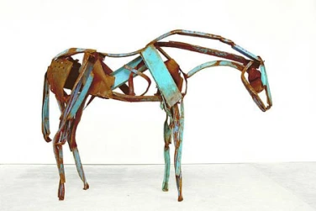
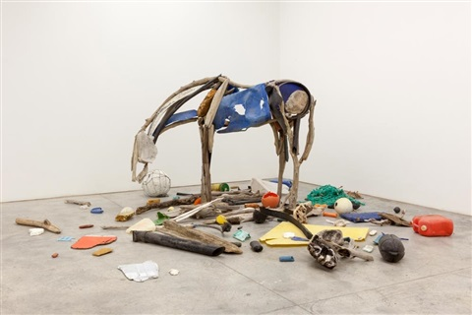

Slide 7
Some of these sculptures are made to be seen from one side, rather than from all around. This type of sculpture is called bas-relief (low-relief).

Slide 8
Which of these sculptures did you like the most?
Why? What appealed to you the most?
Use art words like texture, mood, found materials, and balance to explain your answers.

Slide 9
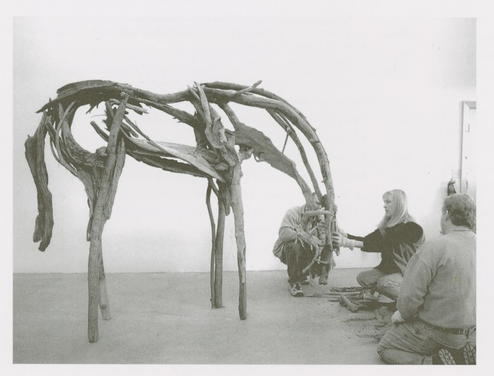
Deborah Butterfield
American Artist, born 1949
Known for her horse sculptures
Works with driftwood, scrap metal, found objects, and bronze
Sculptures can be found both indoors and outside

Slide 10
Now it's YOUR turn!
Gather
Gather natural objects that you find outside or man-made ohjects that you have around the house.​
Think
Think​ of an animal that you could make from the materials you have gathered. Be sure to consider the texture, color, patterns, and size of your objects. Decide whether to build it inside or outside.
Create
Create your sculpture. You may want to put it on a base of some sort, but you don’t have to. How will you balance your materials so they won't fall over? Will it stand on its own, or will a bas-relief sculpture work better?​
Share
Share your sculpture by taking a picture of it and emailing it to Ms. Lambert or uploading it to Artsonia. Be sure to give it a title!​

