Slide 1

Welcome EPHS Tiger Family
Conversations with Dr. Rocha
Principal
August 18, 2026

Slide 2

El Paso High Administration
Sandra Rocha-Principal→ srocha@episd.org
@ephsdr_rocha on Instragram
Daniel Vasquez- dvasque1@episd.org
Assistant Principal Guidance & Instruction
Monica Ortega-mlortega@episd.org
Assistant Principal- Students D-O
Elizabeth Ochoa- ezubiate@episd.org
Assistant Principal – Attendance
Claudia Simpson- casimpso@episd.org
Assistant Principal- Students A-C & P-Z

Slide 3

Agenda: OVERVIEW
UPDATES
STUDENT ACTIVITY UPDATES
Attendance
Closed campus
Cell Phones

Slide 4

Grade | Week of Aug. 10th
9th | 95.7
10th | 97.21
11th | 96.5
12th | 95.8
Total | 96.3
Attendance:
Student must be in attendance 90%

Slide 5
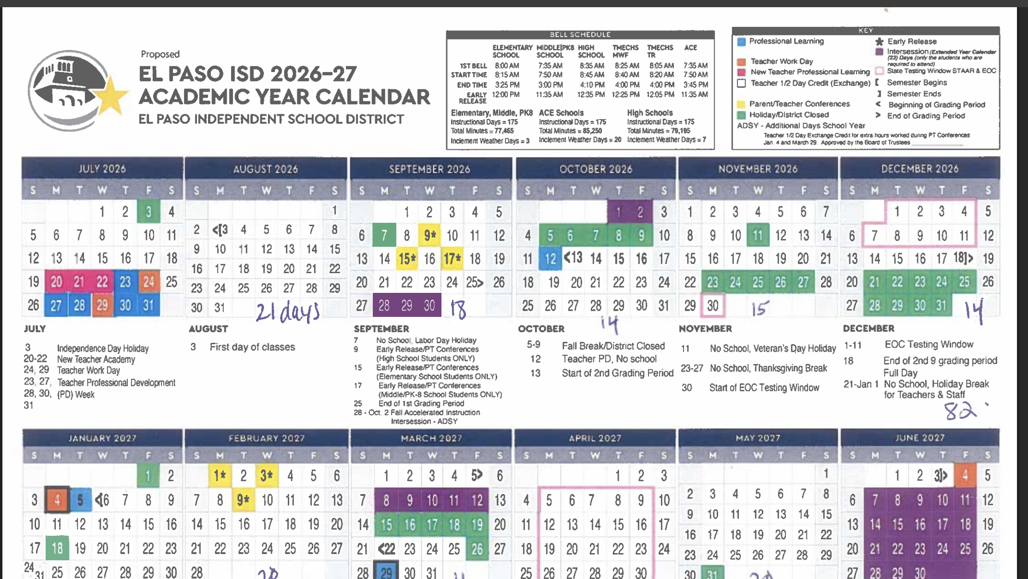

Slide 6
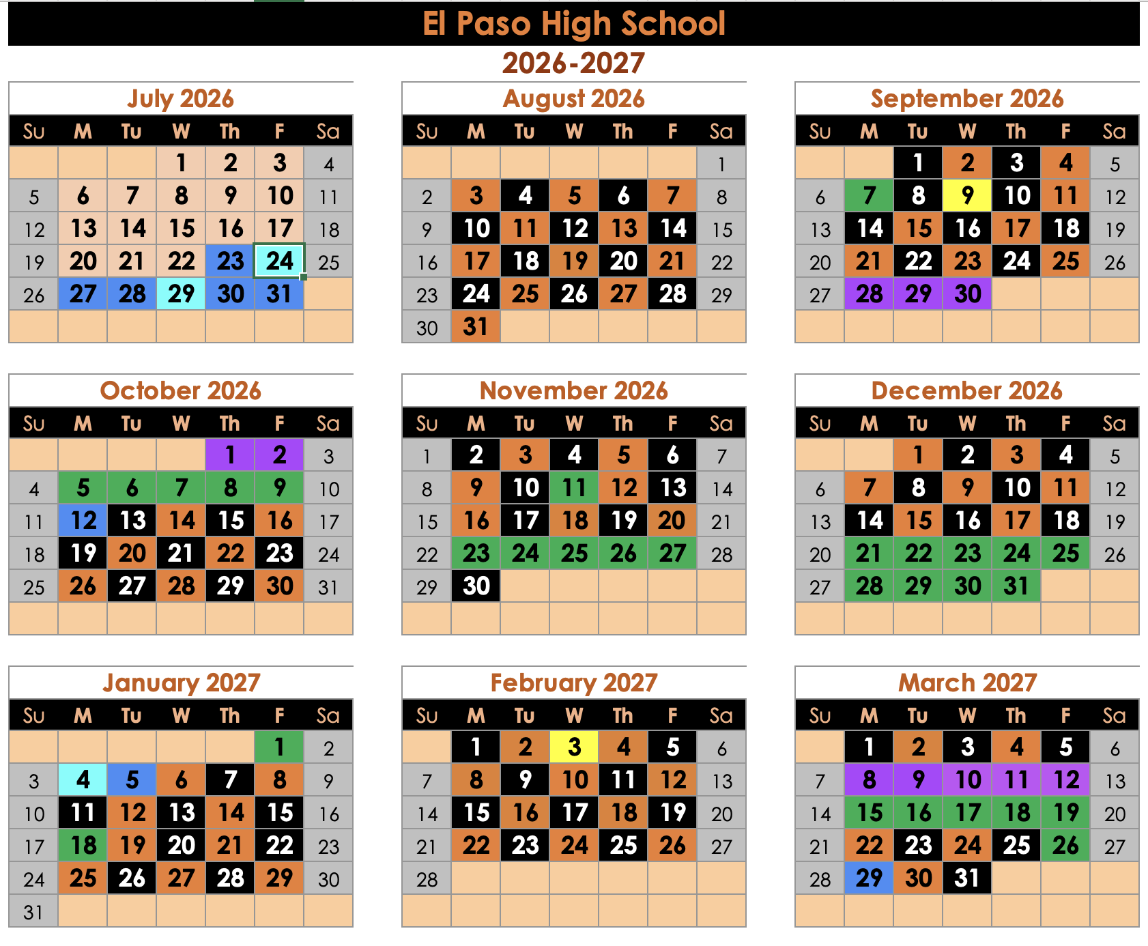

Slide 7
House Bill 1481 requires all Texas public school districts to adopt policies that prohibit students from using personal communication devices on school property during the instructional day in order to reduce distractions and support student focus.
Exceptions are made for documented medical needs or special education accommodations, and districts must outline disciplinary measures for violations in their policies.
HB 1481-Cell Phone Ban
Earbuds and headphones are not permitted for use during the school day. They must remain turned off, out of sight, and stored away at all times.
Reason: Devices capable of communication or digital connection.

Slide 8
2026-2027 School Year:
Closed Campus During Lunch
Safety Concerns with Open Lunch: Car crashed, many near-misses, fights, alleys, unknown vendors
Reduce Tardies
Academic continuity: Lunch & Advisory
District is bringing more food options: Working with vendors
Additional Lunch Activities: Esports, Crafts, Sports
Uber Eats will be allowed & Occasional Food Trucks
Drop-off & Pick up table
Senior Days: If criteria is met
Student Meetings
Our goal is not restriction, but protection and support.
EPHS Priorities:
Safety & Academics

Slide 9
Saturday School Dates:
9am-12pm
September 12th
October 17th
October 24th
November 7th
November 14th

Slide 10
Thank You!

