Slide 1
Abington Select Board
MWRA Water Supply Evaluation
10.19.2026
March 2025 Report Summary

Slide 2
Agenda
Background
MWRA Water Supply Evaluation Results
MWRA Application Process
Next Steps

Slide 3
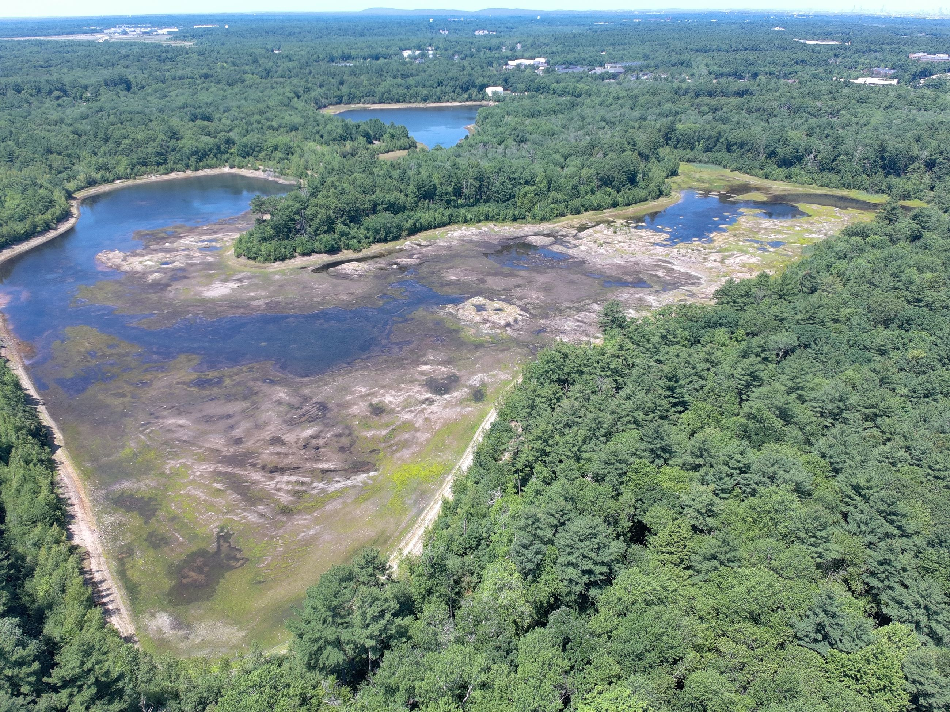
Background
Availability of surplus water supply – long-understood impediment.
MWRA opportunity – provides redundant water supply, additional available capacity & potential of accepting new connections;
Weymouth seeking access, potentially providing access.
Regional exploratory effort via joint funding:
Initial consortium of towns: Hingham, Rockland, Hanover, Abington, previously Scituate, Cohasset, Norwell, Hull
Work commenced (2023)
Met with Weymouth (2024)
Report Issued (2025)
Notes:
MWRA available margin – 51 MGD available, :
Due to demand management, rising cost of W/WWT & energy, and efficient appliances
20 MGD for communities new to system
MWRA entry fee waiver – through 12/27
MOU executed in NOV 2023 to allow Hingham to procure vendor and share costs, using ARPA funds,
EPG/Apex contracted in early 2024
Study didn’t touch on an important question – who pay for it, and how?

Slide 4
Background
Regional exploratory effort via joint funding (cont’d):
Consortium of towns reduced after report: Hingham, Rockland, Hanover, and Abington remain (2025)
Met with Sen. Keenan and Rep. Meschino (2025)
Potential Regionalization Options Explored (2025)
Met with MWRA (2026)
Select Board and Water Board Presentations 2025 - 2026
Notes:
MWRA available margin – 51 MGD available, :
Due to demand management, rising cost of W/WWT & energy, and efficient appliances
20 MGD for communities new to system
MWRA entry fee waiver – through 12/27
MOU executed in NOV 2023 to allow Hingham to procure vendor and share costs, using ARPA funds,
EPG/Apex contracted in early 2024
Study didn’t touch on an important question – who pay for it, and how?

Slide 5
Study Results
Projected Supply Deficits:
WRWS, Hanover, ARJWW, Norwell
Combined Deficit = 2.1 MGD
Redundancy Needs (Emergency Supply):
All Communities
Range of 0.40 – 2.26 MGD
Water System | Current Maximum Day Supply (MGD) | Projected MDD (MGD) | Surplus or (Deficit) (MGD)
Scituate | 4.30 | 2.82 | 1.49
Cohasset | 3.00 | 1.85 | 1.15
Hanover | 2.51 | 2.52 | (0.02)
ARJWW | 3.75 | 4.44 | (0.69)
WRWS | 6.98 | 7.44 | (0.46)
Norwell | 1.67 | 2.66 | (0.99)
Net Surplus or (Deficit) |  |  | 0.47
Total Needs [Sum of Deficits] |  |  | (2.16)
Water System | Firm Capacity (MGD) | Projected MDD (MGD) | Surplus or (Deficit) (MGD)
Scituate | 1.30 | 2.82 | (1.51)
Cohasset | 0.00 | 1.85 | (1.85)
Hanover | 2.12 | 2.52 | (0.40)
ARJWW | 3.51 | 4.44 | (0.93)
WRWS | 5.18 | 7.44 | (2.26)
Norwell | 1.27 | 2.66 | (1.39)
Notes:
Moving forward:
Submit application to MWRA Advisory Board and Board of Directors (TM decision to fund)
Obtain regulatory approvals - Mass Envi Policy Act (MEPA), Interbasin Transfer Act (ITA)
TM Vote demonstrating acceptance of admission
Approval of Legislature & Governor

Slide 6

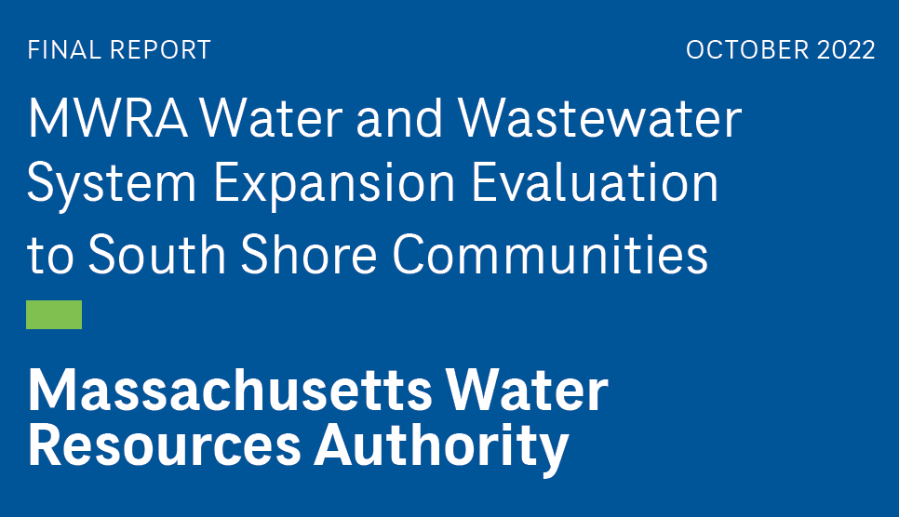
Study Results
Total of 8 conceptual MWRA supply scenarios using combined hydraulic models:
Southern vs. Northern Routes
8 – 13 miles of pipe
12” – 36” Diameter
Total Cost = $130M – $240M
ARJWW Share (by flow) = $30M – $44M

Slide 7
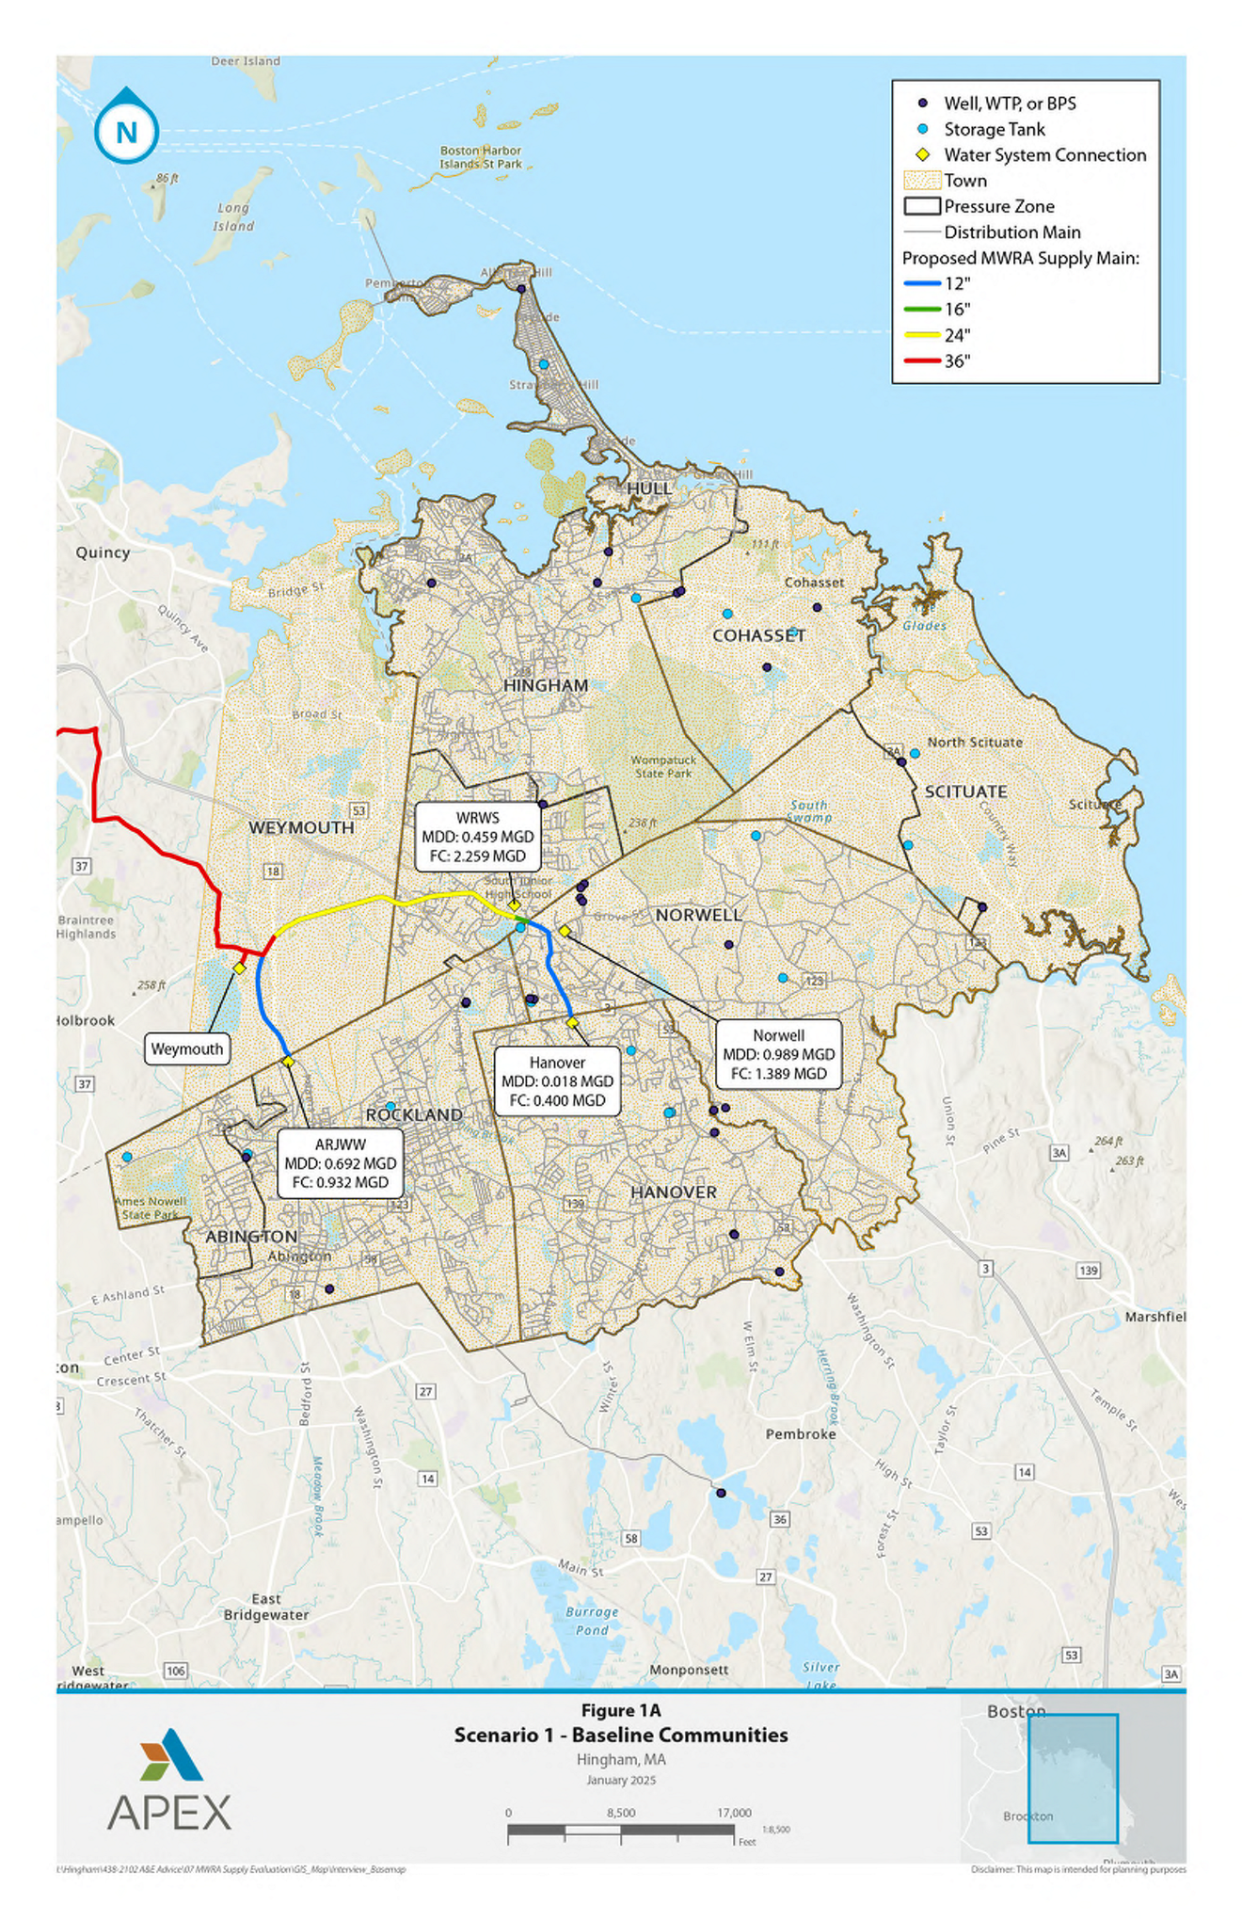
Study Results
Alternative 1A
7.6 Mile Pipeline
4 Connections
$130M
ARJWW Share (by flow) = $30M
Notes:
* = Opinion of Projected Project Cost – talk about how this is an early projection

Slide 8
Study Results
Pipe Diameter (inches) | Total Length (Miles) | ARJWW Length (Miles)
12 | 3.18 | 1.56
16 | 0.21 | -
24 | 3.68 | -
36 | 0.54 | 0.325
Total | 7.61 | 1.89
Pipe Dia. (inches) | ARJWW Length (Miles) | $ Budget / Mile
12 | 1.56 | $3.7M
36 | 0.325 | $13.1M
Connection Pump Station |  | $8.0M
Total |  | $24.8M
Notes:
* = Opinion of Projected Project Cost – talk about how this is an early projection

Slide 9
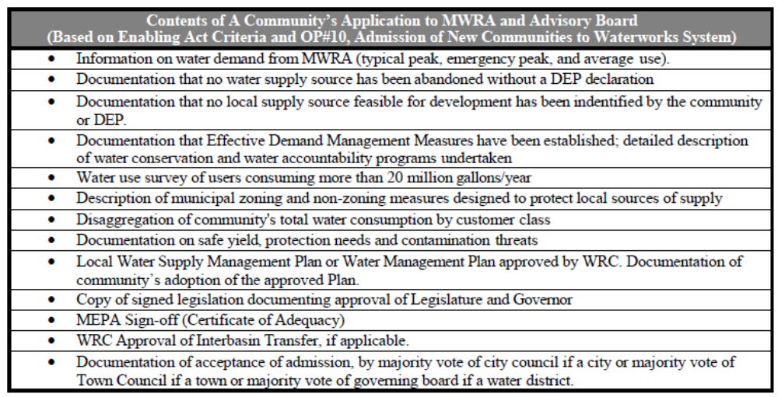
MWRA Application Requirements
Notes:
* = Opinion of Projected Project Cost – talk about how this is an early projection

Slide 10
MWRA Entrance Fee
One-time charge based on share of the total MWRA water system
Fee waived for applications approved through 12/2027
Weymouth Estimated Savings for 5.5 MGD is $36.5M
  2.0 MGD for South Shore Consortium = ~$13M
Notes:
* = Opinion of Projected Project Cost – talk about how this is an early projection

Slide 11
Next Steps
Continue Legislative & MWRA coordination:
  Share findings & gain feedback
  Infrastructure funding options
  Path to waiving entry fee after 2027
Additional Due Diligence in Support of MWRA Application
  Each Community Evaluate Local Options
  Can supply/treatment capacity be expanded?
  Are there regulatory barriers that would prevent expansion?
Track Weymouth’s Progress
Start MWRA Application Process
  MEPA Environmental Notification Form
Notes:
Weymouth – critical decisions
How much MWRA water capacity will Weymouth claim? Remainder is what’s available to South Shore
How will MWRA water get to Weymouth – North or South?
Application:
Submit application to MWRA Advisory Board and Board of Directors (TM decision to fund)
Obtain regulatory approvals - Mass Envi Policy Act (MEPA), Interbasin Transfer Act (ITA)
TM Vote demonstrating acceptance of admission
Approval of Legislature & Governor

Slide 12
Conceptual Timeline
 | 2026 |  | 2027 |  | 2028 |  | 2029 |  | 2030 |  | 2031 |  | 2032
Local Capacity Study
Design
MEPA/MWRA Approvals
Weymouth IMA
Weymouth Online
Construction
Notes:
Weymouth – critical decisions
How much MWRA water capacity will Weymouth claim? Remainder is what’s available to South Shore
How will MWRA water get to Weymouth – North or South?
Application:
Submit application to MWRA Advisory Board and Board of Directors (TM decision to fund)
Obtain regulatory approvals - Mass Envi Policy Act (MEPA), Interbasin Transfer Act (ITA)
TM Vote demonstrating acceptance of admission
Approval of Legislature & Governor

