Slide 1
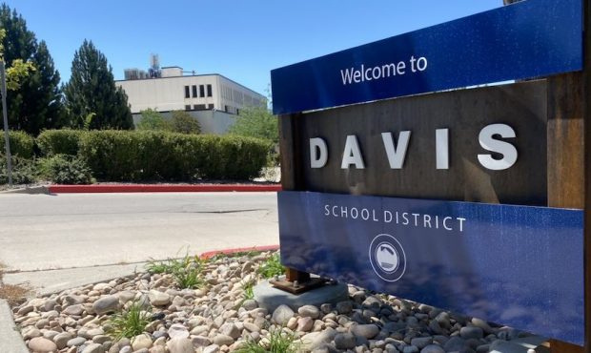


Layton Elementary
Title I Parent Presentation
2026-2027
Davis School District

Slide 2
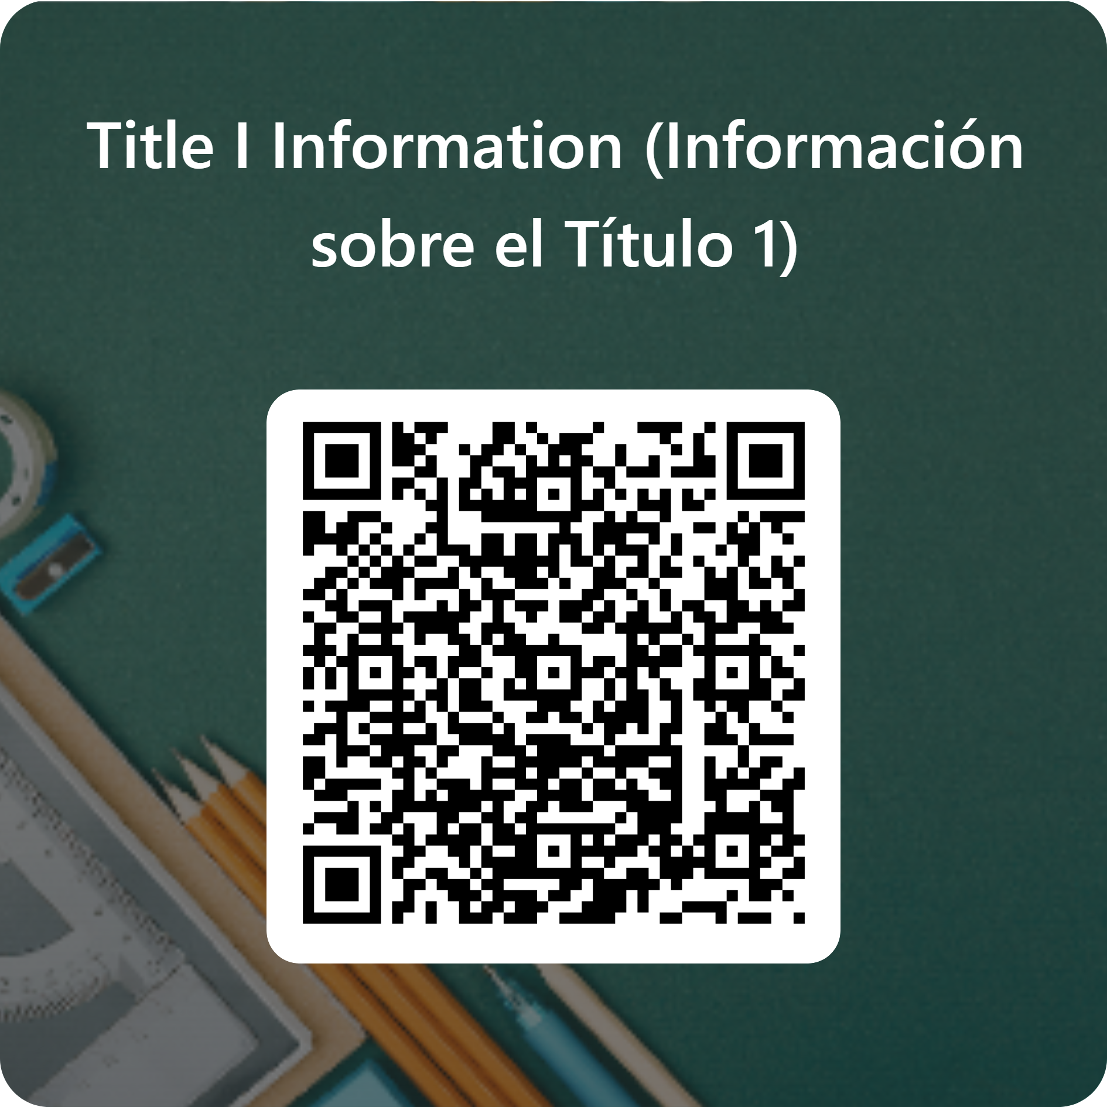
Acknowledgement
Please Confirm You Received This Information
Please scan the QR Code to acknowledge you have been provided information on Title I.
[School QR Code]
22

Slide 3

Welcome
Why This Information Matters
  Thank you for partnering with Layton Elementary to support every student's success.
  This presentation explains how Title I funding helps our school and your family.
  You have important rights and opportunities to be involved in your child's education.
2

Slide 4
What is Title I?
Federal Support for Student Success
  Title I provides federal funding to support students most at risk of falling behind.
  Funds help schools deliver high-quality instruction and close achievement gaps.
  Every Title I school uses these resources to strengthen learning for all students.
$
Federal Funding
→ Student Support
→ Stronger Schools
3

Slide 5

How Schools Qualify
Based on Student Need
  Title I status is allocated based on the percentage of students receiving free and reduced lunch.
  Schools with a free and reduced percentage of at least 40% are eligible for a schoolwide Title I program.
4

Slide 6
What is a Schoolwide Program?
Upgrading the Entire Educational Program
  The school uses Title I funds to upgrade the entire educational program.
  Resources strengthen instruction, interventions, and support across the whole school.
Reading
Math
Layton Elementary
Support
Staff Dev
5

Slide 7

Who Benefits?
Serving All Students
  Title I funds are used to serve all students in order to raise academic achievement.
  Every classroom and grade level can benefit from strengthened programs and resources.
6

Slide 8
Additional Assistance for Students
Targeted Support When Needed
  Title I funds provide extra help for students having difficulty meeting performance targets.
  Interventions are designed to help every child reach grade-level expectations.
1
2
3
4
Identify Need
Provide Support
Monitor Progress
Celebrate Growth
7

Slide 9
Requirements for a Schoolwide Program
Three Essential Elements
✓
The school must have a free and reduced lunch count of at least 40%.
✓
The school must collect and analyze data that affects student achievement.
✓
The school must develop a comprehensive site plan and annually review the effectiveness of the plan.
8

Slide 10
Key Title I Documents
Important Resources for Families
Family Engagement Policy
School-Home Compact
How families partner with the school
Shared responsibilities for learning
Guardian's Right to Know
Comprehensive Site Plan
Your rights as a parent/guardian
School improvement plan and goals
9

Slide 11

Family Engagement Policy
Updated Every Spring
  Each Title I school develops and modifies a Family Engagement Policy every spring.
  The policy outlines how the school and families work together to support student learning.
10

Slide 12
Where to Find the Family Engagement Policy
School Website
Beginning-of-Year Documents
A copy is located on Layton’s website
Provided to each family at the start of the year in your MyDSD Guardian Account or you can get a copy in the Layton Elementary School Office.
Ask your school office if you need a copy.
11

Slide 13
School-Home Compact
A Partnership for Learning
  Each Title I school develops and modifies a School-Home Compact every spring.
  The compact outlines shared responsibilities of the school, families, and students.
School
+
Family
Student Success
12

Slide 14

Guardian's Right to Know
Your Right to Teacher Qualifications
  Parents and guardians have the right to know the professional qualifications of classroom teachers.
  This right applies to all families at Title I schools in Davis School District.
14

Slide 15
Requesting Teacher Qualification Information
  Federal law requires the district to provide this information in a timely manner upon request.
  Contact your building administrator to request teacher qualification information.
1
2
3
Parent
Request
Contact
Administrator
District
Provides Info
15

Slide 16

Right to Request a Meeting
Your Voice in Education Decisions
  Guardians may request regular meetings to make suggestions and participate in decisions about their student's education.
  Schools must provide opportunities for guardians to be involved, as appropriate.
Family + School = Partnership
16

Slide 17
School Response
Timely Follow-Up on Your Suggestions
  The school must respond to any suggestions as soon as reasonably possible.
  Your input helps shape programs and supports for all students.
Suggestion Submitted
School Reviews
Response Provided
17

Slide 18
Questions or Concerns?
We're Here to Help
1
2
Talk with your student's teacher or school principal.
Set up a meeting before or after the school day.
Principal Pendergast 801-402-3500
18

Slide 19
If Concerns Continue
District-Level Support
  If concerns remain unresolved, families may contact the district Title I office.
  The district team supports schools and families in addressing ongoing concerns.
1
2
3
School
Family
District
Title I
19

Slide 20
DSD Title I Contact
Davis School District Federal Programs
District Contact
Sue Caldwell, Director of Federal Programs
Freeport West, F-2
Clearfield, UT 84025
801-402-8730
20

Slide 21
What Families Should Remember
Key Point 1
Key Point 2
Title I supports student achievement.
Families have a voice in education.
Key Point 3
Key Point 4
Important documents are available to guardians.
Schools and families work together.
21

Slide 22
Thank You
Questions?
Layton Elementary
801-402-3500| Layton Elementary Website

