Slide 1
Northridge
Career pathways Honors Recognition

Slide 2
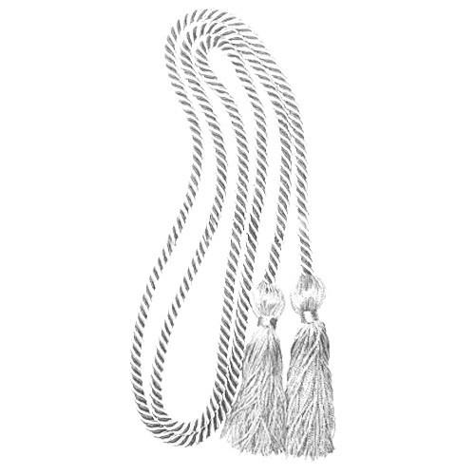
NHS Career Pathways Honors recognition
  What is this?
    Recognition for the Career and Technical Education classes you take during your time at Northridge.
  Why?
    Taking specific classes helps you follow a Career Pathway and be more prepared for a future after graduation.
    Career Pathways are State and Nationally recognized.
  How?
    Students will need to “Complete” and “Compete” in order to receive honors recognition at graduation.
      “Complete” a Career Pathway at Northridge High School
      “Compete” in a Northridge CTSO (Career and Technical Student Organization) event (local, region, state and related to your pathway) at least once during sophomore, junior, or senior year.
      Students will receive Pathway Honors Recognition Cords to wear at graduation and recognition in the graduation program.

Slide 3

Complete Classes in One of these Career Pathways
  Advanced Manufacturing and Engineering
  Agriculture
  Arts, Entertainment and Design
  Business Management and Entrepreneurship
  Construction
  Digital Technology
  Education
  Financial Services
  Healthcare and Human Services
  Hospitality, Events and Tourism
  Marketing
  Public Service and Safety
  Supply Chain and Transportation

Slide 4
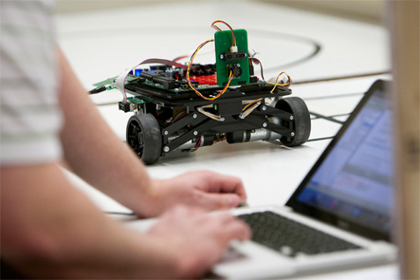


Agriculture
Advanced manufacturing and Engineering
Engineering
  Engineering Principles
  Machining 1
  Composites 1
  Robotics 1
Food Science, Dietetics, & Nutrition
  Food and Nutrition
  Dietetics and Nutrition
  Foundations of Nutrition
  Human Development
  Medical Anatomy and Physiology
Join FCCLA
Manufacturing & Production
  Machining 1
  Composites 1
  Marketing
  Welding Technician, Entry
Welding & Machining
  Welding Technician, Intermediate
  Machining 1
  Machining 2
  Metal Working
Join TSA

Slide 5


Arts, Entertainment and Design
Broadcasting and Digital Media
  2D Art and Design
  Digital Media
  Video Production
  Web Development
Business Management and Entrepreneurship
Business Information Management
  Business Office Specialist
  Accounting 1
  Digital Media 1
  Web Development 1
  Entrepreneurship
Fashion Apparel and Textiles
  Fashion Design Studio
  Digital Media
  Screen Printing
  Sewing Construction
Join FCCLA
Graphic Design and Communication
  Commercial Art
  Commercial Photography
  Interior Design 1
  Entrepreneurship
Join DECA

Slide 6


Construction
Digital Technology
Architectural and Interior Design
  Interior Design 1
  Interior Design 2
  Architectural Design 1
  Entrepreneurship
Cybersecurity
  Computer Science Principles
  Computer Programming 1
  Web Development 1
  Exploring Computer Science
Information Technology
  Computer Science Principles
  Computer Programming 1
  Exploring Computer Science
Construction and Structural Systems
  Interior Design 1
  Architectural Design 1
  Construction Technology
  Electrician
Programming Software Development
  Computer Science Principles
  Robotics 1
  Computer Programming
Join Skills USA or TSA
Web Development
  Computer Science Principles
  Computer Programming 1
  Web Development 1
  Exploring Computer Science
Join FCCLA, Skills USA, or TSA

Slide 7



Education
Pre-K: Early Childhood Education
  Child Development
  Early Childhood Education 1, 2, & 3
  Food and Nutrition
K12 Teaching as a Profession
  Teaching as a Profession
  Aspiring Educators
  Principles of Educational Instruction
  Human Development
Finance
Finance
  Accounting 1
  Accounting 2
  Customer Service
  Marketing 1
Join DECA
Join FCCLA or EDUCATORS RISING

Slide 8

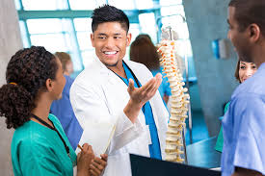

Healthcare and Human Services
Hospitality & tourism
Family & Human Services
  Human Development
  Individual & Family Relationships
  Personal and Family Finance
Culinary Arts
  Culinary 1
  Food and Nutrition
  ProStart 1
  ProStart 2
  Baking and Pastry
Hospitality & Tourism
  Marketing 1
  Hospitality & Tourism
  Accounting 1
  Entrepreneurship
Join FCCLA or DECA
Healthcare
  Medical Anatomy & Physiology
  Biotechnology
  Emergency Medical Response
  CNA
  Exercise Science and Sports Medicine
  Medical Forensics
Personal Care Services
  Customer Service
  Entrepreneurship
  Basic Esthetician and Skin Care
  Cosmetology
Join FCCLA, HOSA, or Skills USA

Slide 9


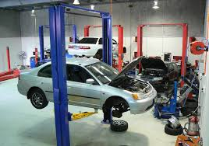
Marketing
public Service and safety
Marketing
  Marketing 1
  Digital Marketing
  Accounting 1
  Customer Service
Protective Services
  Law Enforcement
  Criminal Justice
  Medical Forensics
  Corrections
  Criminal Law
Supply Chain and Transportation
Automotive
  Intro. to Automotive
  ASE Engine
  ASE Brakes
  ASE Steering and Suspension
  Machining 1
Join DECA, HOSA or Skills USA

Slide 10

Join a Northridge CTSO to Compete
DECA - An Association of Marketing Students (Ms. Banta C203)
Educators Rising – An organization for aspiring teachers (Ms. Andersen C224)
FCCLA - Family, Career and Community Leaders of America (Ms. Lucas C231)
HOSA – Future Health Professionals (Mrs. Otis C202)
SkillsUSA - An Association of Skilled & Technical Sciences Education Students (Mr. Jensen A117 )
TSA - Technology Student Association (Mr. Harris A107)

Slide 11

What now?
Have you taken classes that go with a career pathway?
Have you been an involved member of a Northridge CTSO and participated in a competitive event (local, region, or state) that is directly related to your career pathway within the last 3 years?
Then… Apply for the Career Pathways Honors Recognition!
Applications will be available in February!
If you are not in a Northridge CTSO…JOIN NOW!!!
Look for more information during CLUB WEEK (coming soon)!

