Slide 1


WELCOME, FRESHMEN!
Notes:
Leslie

Slide 2
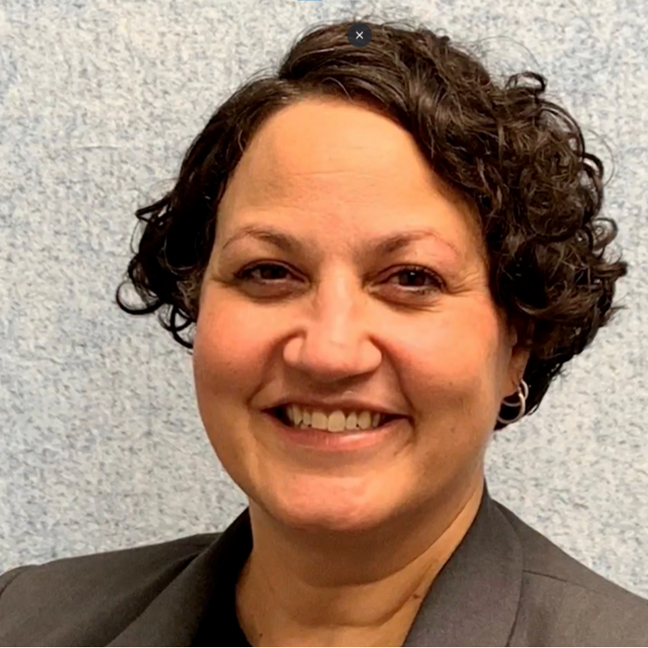
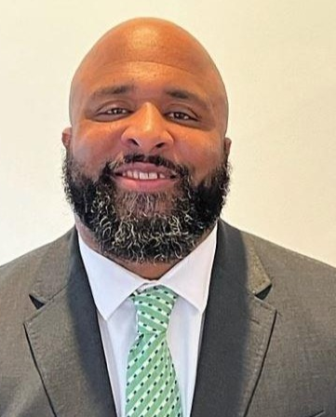
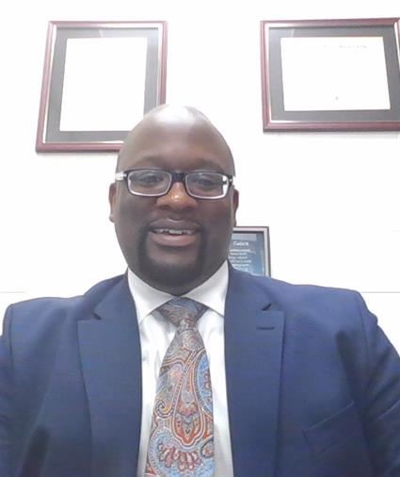
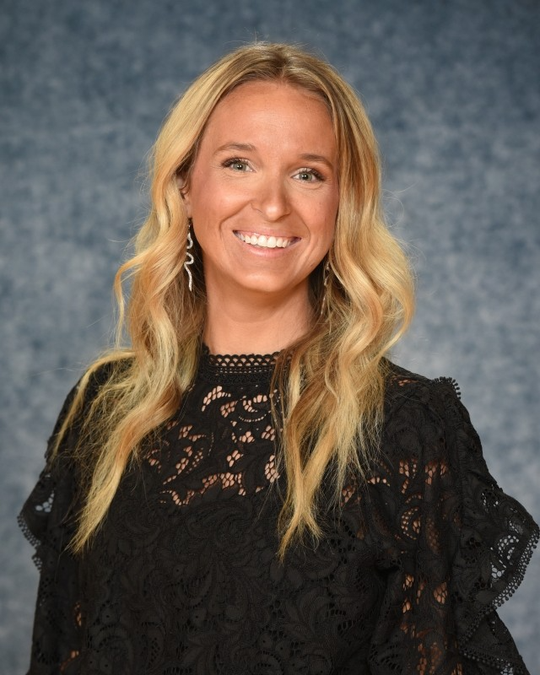
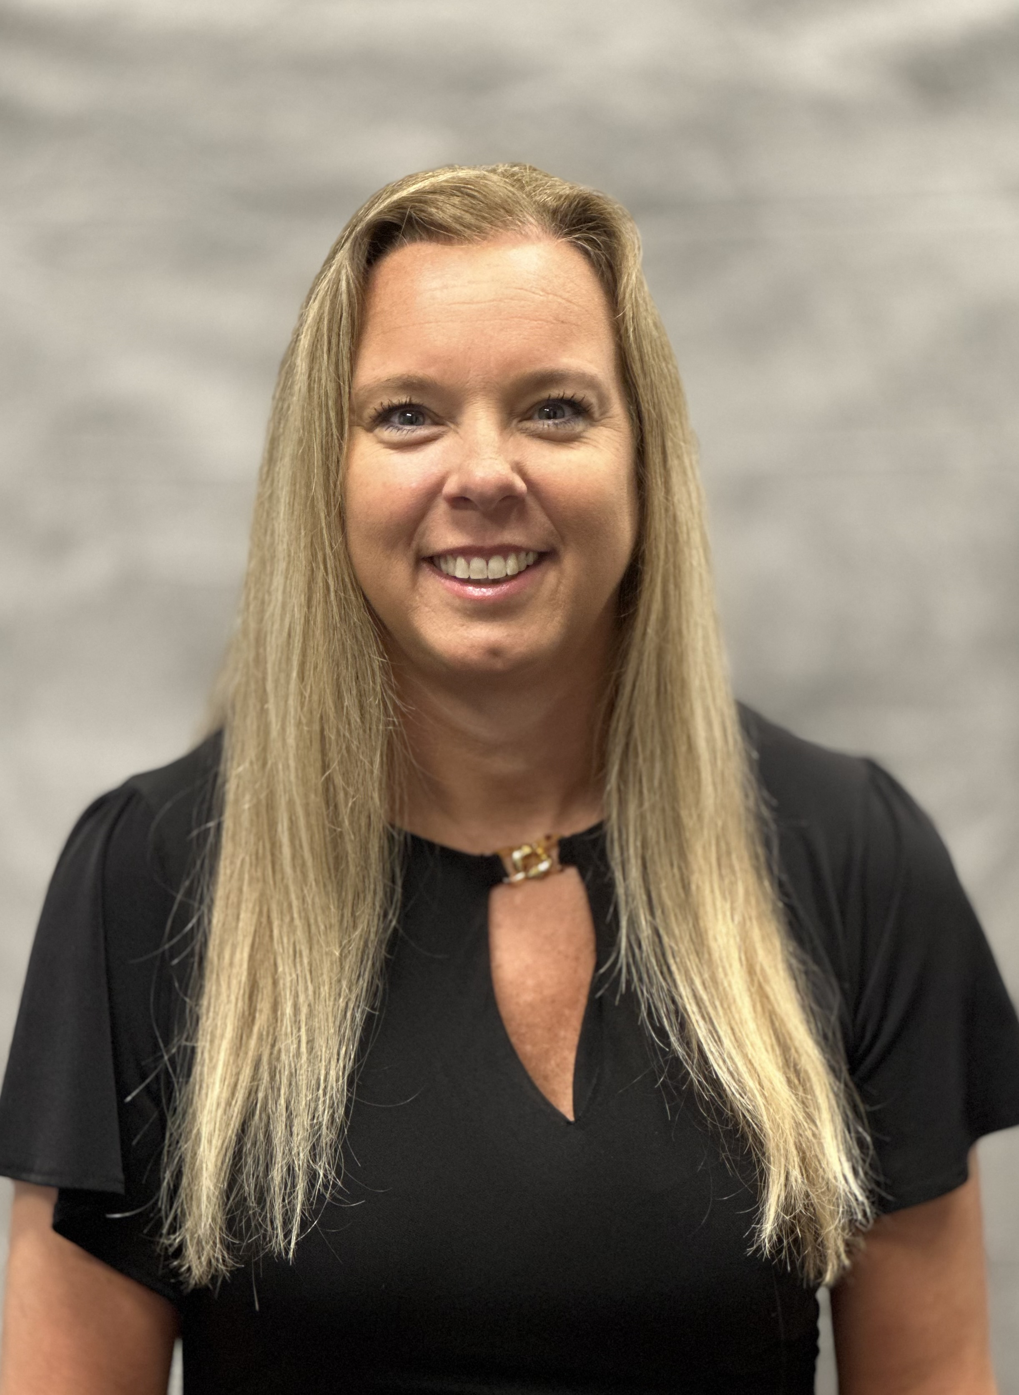
Introductions
Administrative Team
Ms. Angela Moore
Principal
Mr. Pope
Freshmen
Mr. McDaniel
Sophomores
Dr. Snyder
Juniors
Dr. Stapleton
Seniors
Notes:
Leslie

Slide 3
expectations
Successful students:
Arrive promptly and prepared to participate.
Show respect to themselves, their peers, their teachers, property and educational opportunities.
Display a positive, ethical behavior.
Follow the school code of conduct - Cell phone, badge, dress code, tardies, etc.
Believe in themselves and give their best effort daily.
Notes:
Julie

Slide 4

You are international students!
1st Cambridge International School in the state of South Carolina
ALL students will take Cambridge courses
  IGCSE (International General Certificate of Secondary Education)
  AICE (Advanced International Certificate of Education)
Notes:
Alisa

Slide 5
Cambridge learner attributes
Confident in working with information and ideas – their own and of others
Responsible for themselves, responsive to and respectful of others
Reflective as learners, developing their ability to learn
Innovative and equipped for new and future challenges
Engaged intellectually and socially, and ready to make a difference
Notes:
Alisa

Slide 6
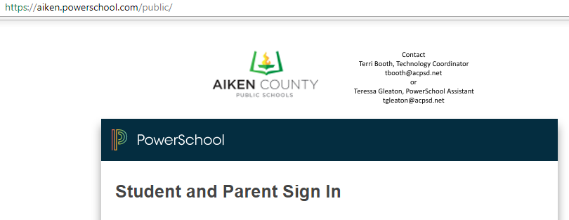

communication
Grades/Attendance
  PowerSchool Parent Portal
Notes:
Alisa

Slide 7

communication
Teacher Info/Course Syllabus/Class Resources
  Schoology (Teacher webpages)
  Go to Classlink (on your desktop) & log in
  Your classes will be listed
Notes:
Alisa

Slide 8

communication
Announcements
  Robo-calls/Robo-emails/Robo-texts
  PEACHJAR E-Flyers
    Go to www.acpsd.net/ahs
    Button is on the right hand side below the calendar
Notes:
Alisa

Slide 9



communication
Announcements
  Social Media
    Facebook (www.facebook.com/aikenhs)
    Instagram (aiken_high_school)
  ACPSD app
    Search “Aiken County Public sd” in the App Store
Notes:
Alisa

Slide 10
First day procedures
Drop Off/ Pick up
School hours
  7:45 am- You may enter the building
  8:20 am- 3:30 pm
Notes:
Alisa

Slide 11
Strategies for success
Set goals
Be organized
Be prepared for class
Do your homework!
Truly STUDY
Notes:
Julie

